Slide 1

Design of an AI based solar controller in partial shading condition
Presented by: Supervisor:
Farah Gharbi Pr Shamsodin Taheri
Deepanshu Gupta

Slide 2
1. Introduction
2. What is MPPT
3. MPPT types
4. Incremental conductance
5.Grey Wolf Optimization
Table of content

Slide 3
Introduction
Partial shading conditions often occur when photovoltaic (PV) panel does not receive a uniform irradiation due to passing clouds, presence of snow, neighboring buildings, towers, trees and telephone poles. This condition changes the convex shape of the power versus voltage (P-V) curve of the PV panel with multiple peaks. That’s why, we have to track the Global Maximum Power Point to maximize the efficiency of the (PV) panel.
1/27

Slide 4
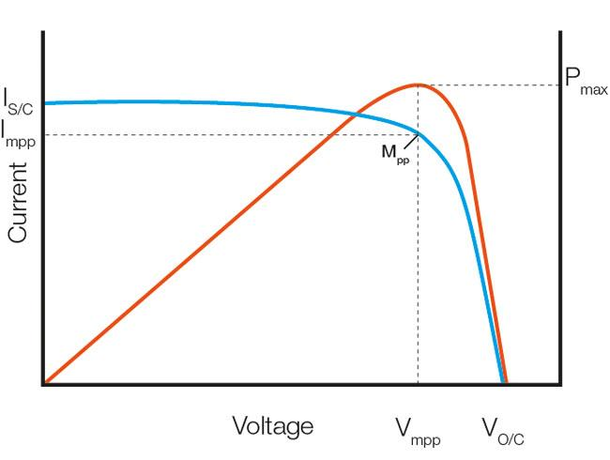
Maximum Power Point Tracking
Aims to find the maximum power for solar panels
Plays a crucial role in maximizing the energy yield from solar panels.
Ensures that solar installations operate at their highest possible efficiency.
Increased energy production, reduced costs, and a more sustainable future.
2/27

Slide 5
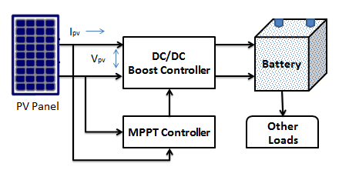
Block Diagram of MPPT
3/27

Slide 6
Different types of MPPT Techniques
Traditional MPPT techniques
Perturb and Observe (P&O)
Incremental Conductance
AI based MPPT techniques
Fuzzy logic control (FLC)
Artificial Neural network
Differential Evolution
Genetic Algorithm
4/27

Slide 7
Incremental Conductance
PV panel terminal voltage is adjusted according to MPP voltage
MPP is achieved by comparing the instantaneous conduction (I/V) to the incremental conductance (∆I/∆V).
Being able to determine when the MPP has been reached is possible because the relationship dP/dV is negative when the MPPT is to the right of the MPP and positive when it is to the left of the MPP.
5/27

Slide 8
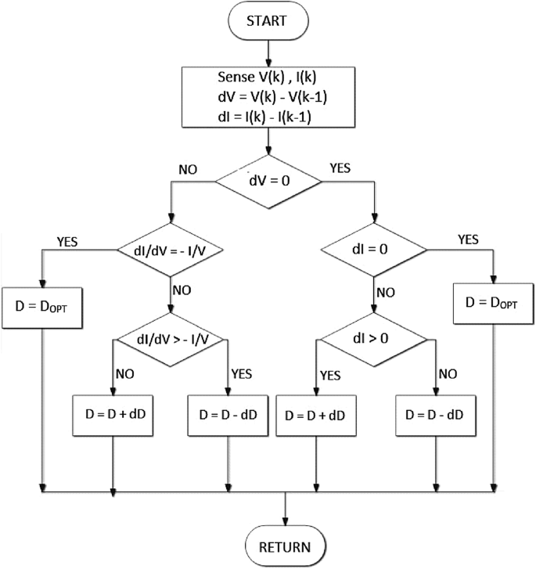
Incremental Conductance flowchart
6/27

Slide 9
Incremental Conductance Simulation
7/27

Slide 10
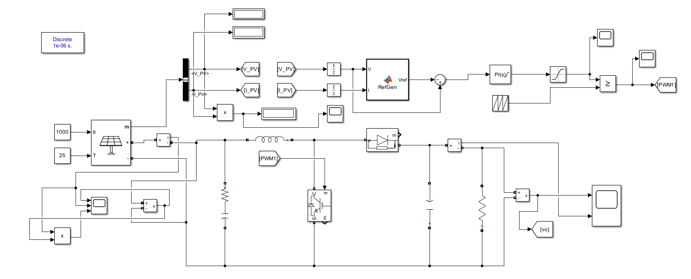
8/27

Slide 11
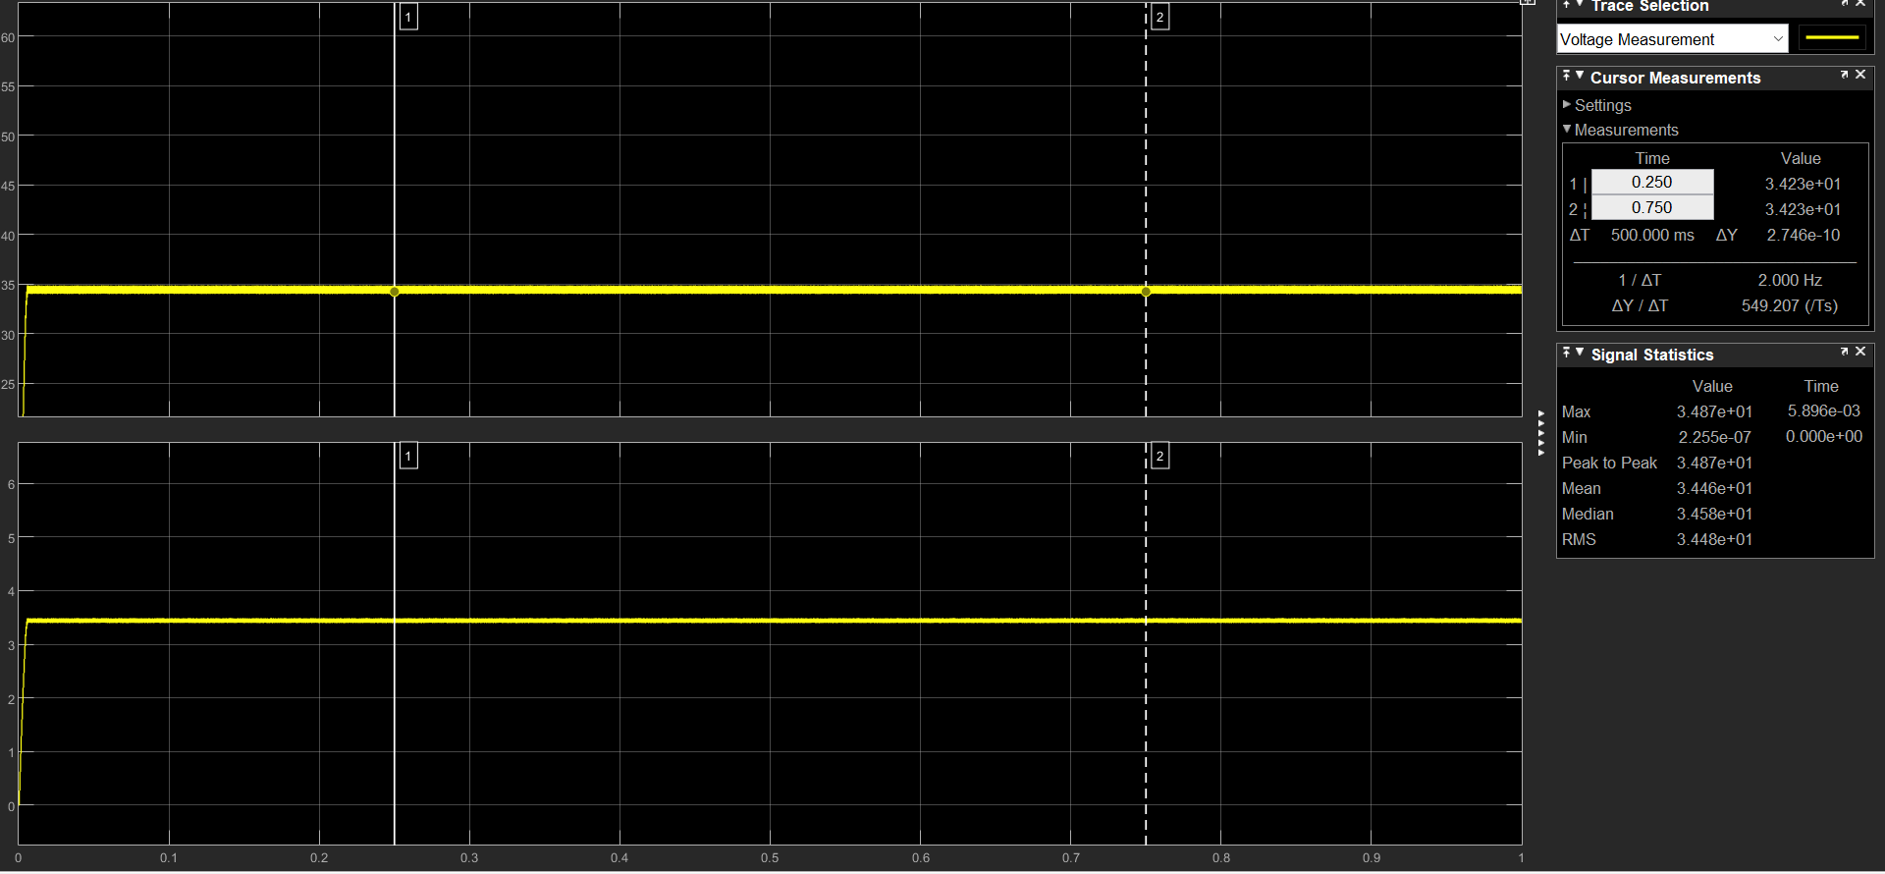
Results without partial shading
9/27

Slide 12
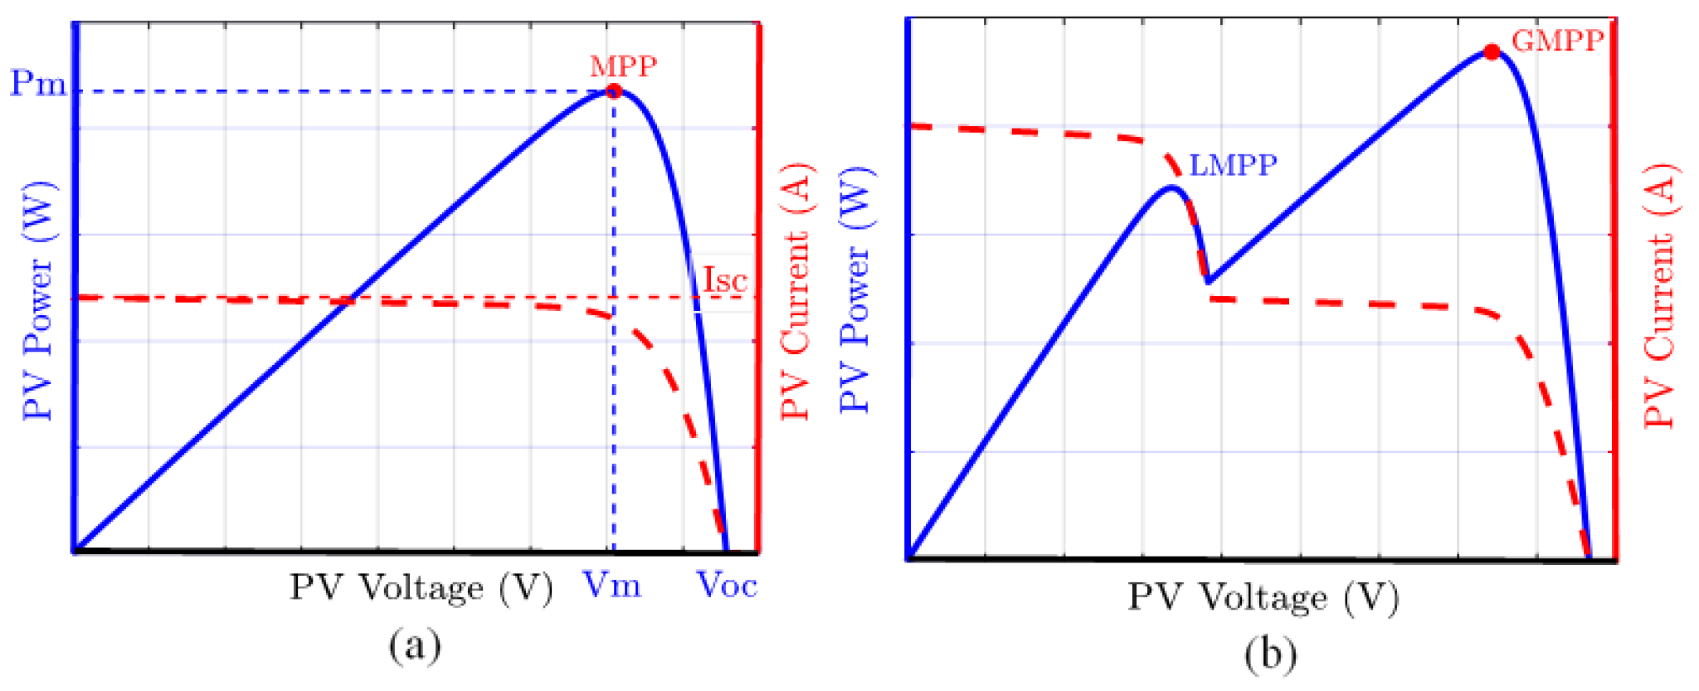
Partial shading
10/27

Slide 13
Partial shading
Situation in which certain sections of a solar photovoltaic (PV) array are shaded while others receive full sunlight.
Can be caused by various factors, such as nearby buildings, trees, clouds.
Shaded cells produce less electricity, and if they are connected in series with non-shaded cells it will decrease the current of these cells.
limit the overall power generation of the entire array
Imbalance in the energy output of the entire system.
11/27

Slide 14
MPPT Role in Partial shading
Dynamic Adjustment: It dynamically adjusts their operating voltage and current to maximize power output, even when partial shading occurs. This ensures non-shaded cells always operate at their peak performance.
Independent Control: MPPT enables individual control over each solar cell or module in the array.
Fast Response: Modern MPPT algorithms are designed to respond quickly to changing environmental conditions, including partial shading.
Efficient Power Extraction: By ensuring that each cell/module operates at its maximum power point
12/27

Slide 15
Incremental Conductance simulation in partial shading condition
13/27

Slide 16
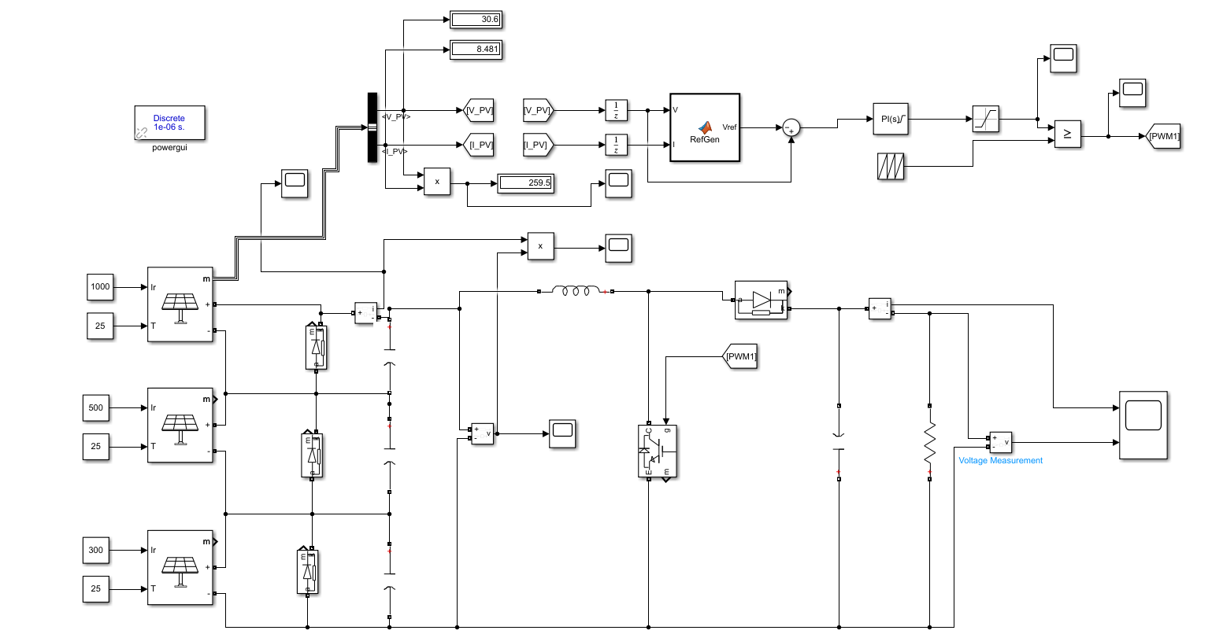
14/27

Slide 17
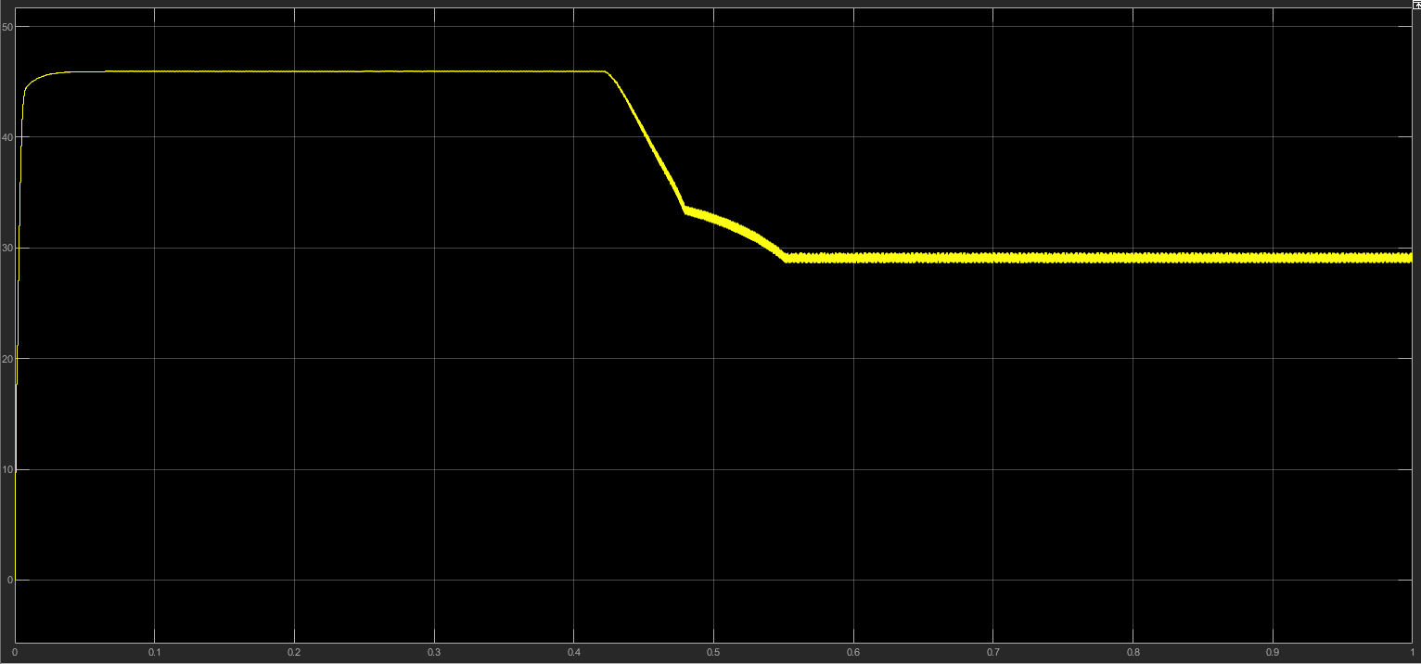
Results in partial shading condition (PV voltage)
15/27

Slide 18
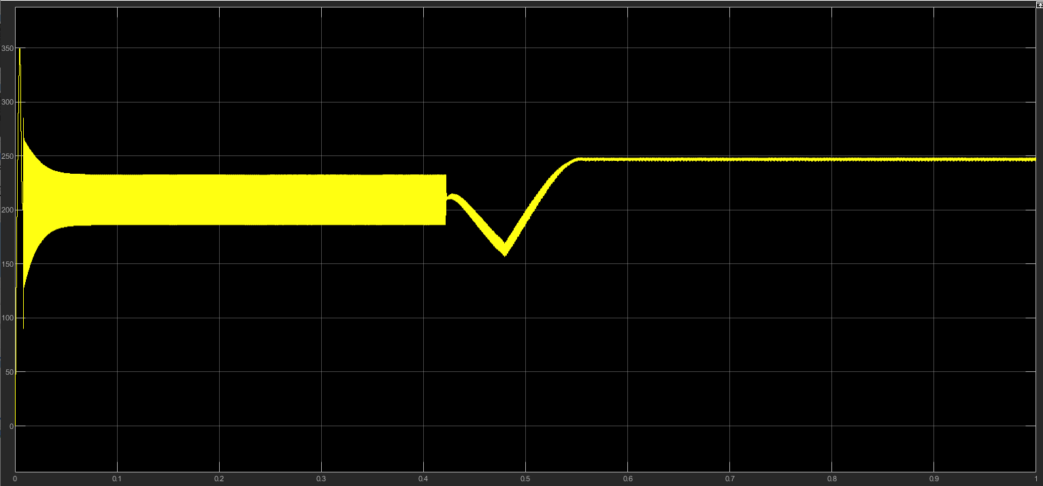
Results in partial shading condition (PV Power)
16/27

Slide 19
Traditional methods are not efficient in Partial shading condition
Global MPP Detection: Traditional techniques calculate the MPP for the entire solar array. However, in partial shading scenarios,The algorithm might detect an MPP that corresponds to only the shaded portion of the array.
Slow Response: Traditional MPPT algorithms often have slow response times, and they might not be able to adapt quickly to changing shading conditions. As shading patterns shift, the algorithm may take some time to converge to the new MPP, causing power losses during the transition period.
Oscillation: In partial shading situations, the MPPT algorithm might get stuck in oscillation between different MPPs, constantly trying to find the optimal point. This behavior can lead to power losses and instability in the system.
17/27

Slide 20
GREY WOLF OPTIMIZATION MPPT
18/27

Slide 21
Grey Wolf Optimization
Optimization algorithm inspired by the social behaviour of wolves.
Metaheuristic algorithm that is widely used for optimization problems.
Aims to find the optimal voltage and current values in MPP under varying conditions.
Can efficiently track the maximum power point even in dynamic and uncertain solar conditions.
19/27

Slide 22
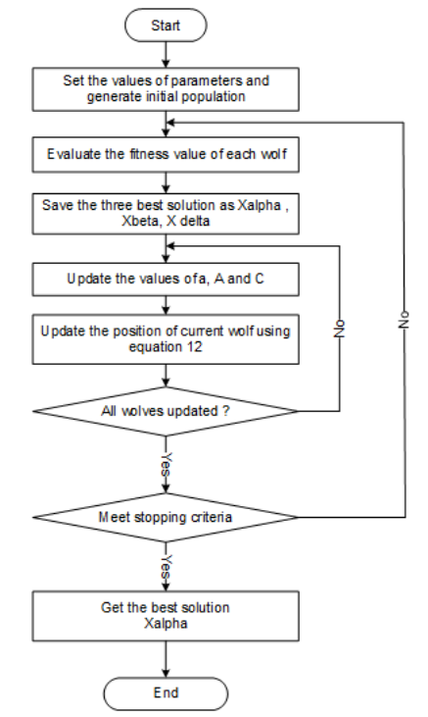
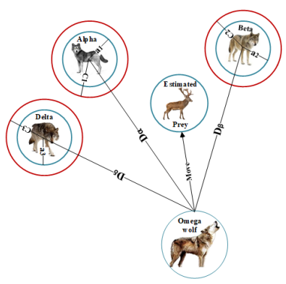
HOW GWO WORKS ?
20/27

Slide 23
GWO Simulation
21/27

Slide 24
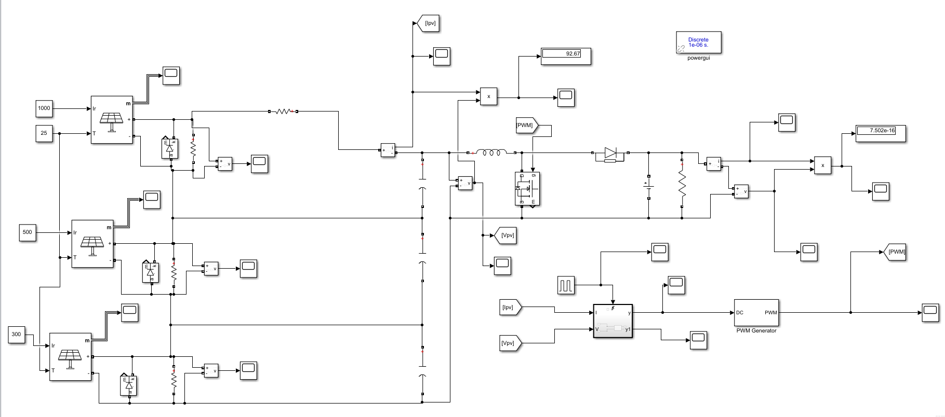
22/27

Slide 25
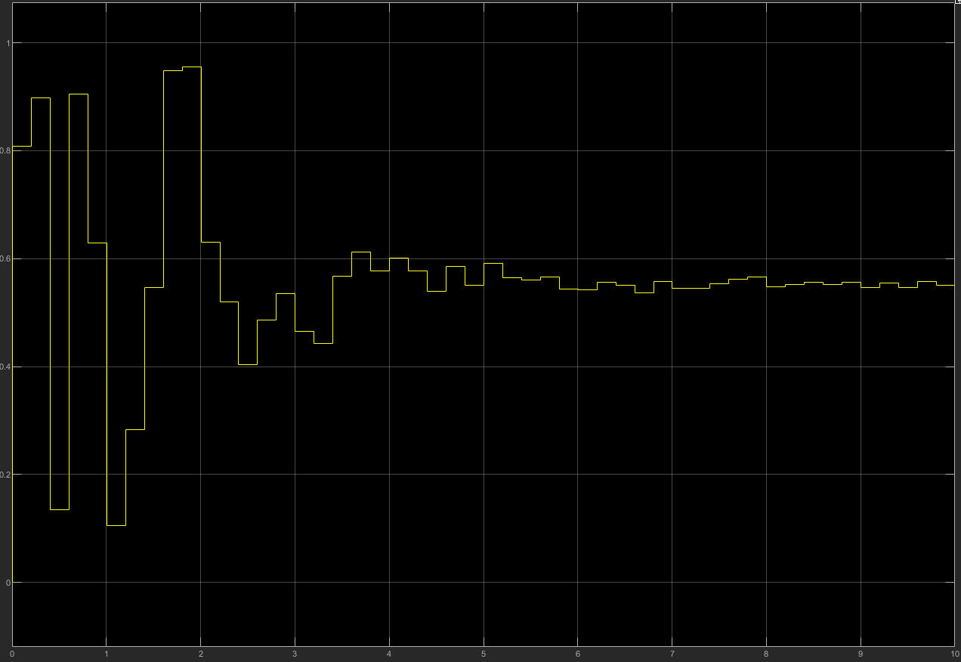
Results in partial shading condition (Duty Cycle)
23/27

Slide 26
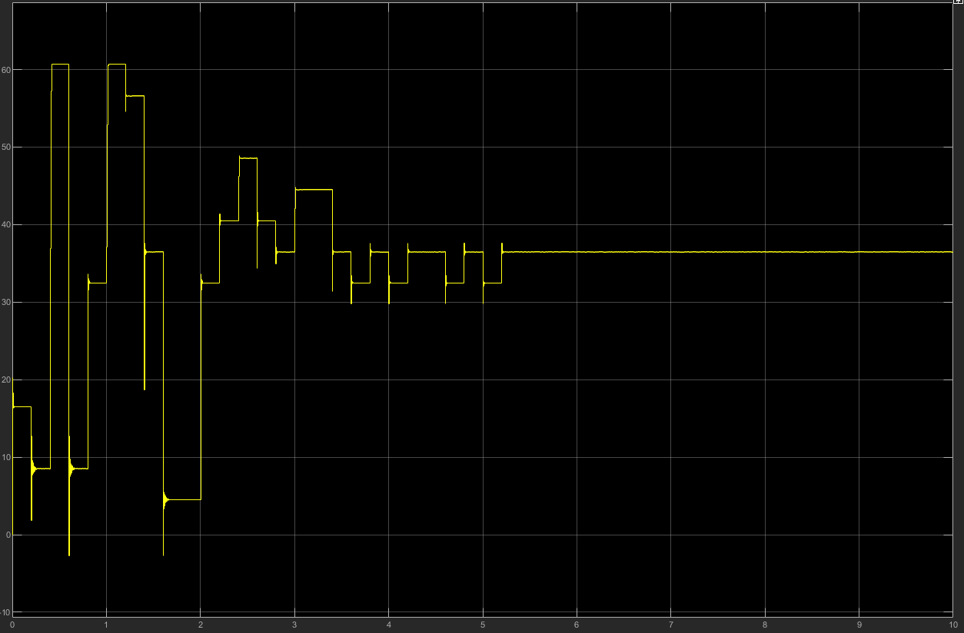
Results in partial shading condition (PV Voltage)
24/27

Slide 27
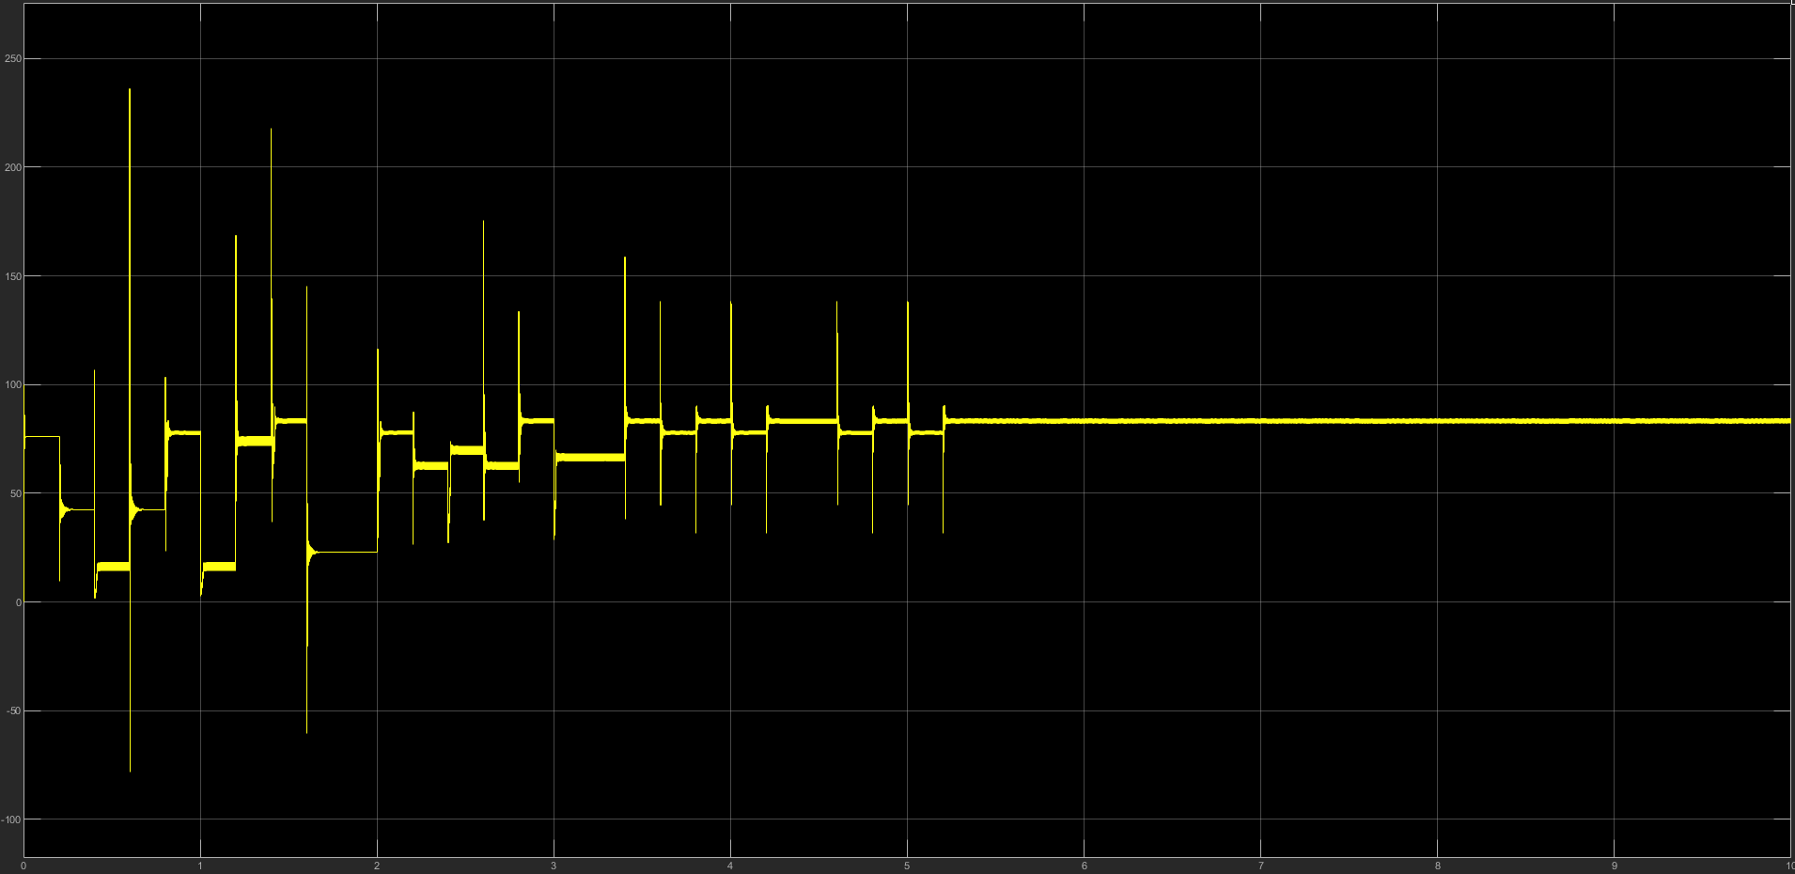
Results in partial shading condition (PV power)
25/27

Slide 28
Result analysis
Favorable results:
Best duty cycle: found after 5 seconds
Converging to the GMPP and not getting stuck in a LMPP
Small fluctuations in the PV generated power after finding the GMPP
Unfavorable results:
Power fluctuation before finding the MPP due to the randomness of generated initial duty cycle values.
Finding MPP could be faster.
26/27

Slide 29
Conclusion and perspectives
GWO can track the GMPP in partial shading condition but it’s convergence is slow due to the randomness of the initially generated duty cycles
Build an AI based algorithm to minimize the initial search area for the best duty cycle
We have to estimate the MPP area using an neural network model and search around it to minimize the time of convergence to the GMPP
27/27

Slide 30
Thanks for your attention!

