Slide 1
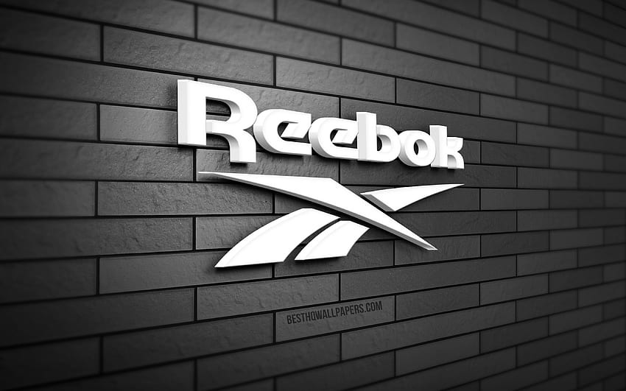

ROUND 02
BAZAAR
REVIVE AND THRIVE
Team
To: KMC, Delhi University
From: IIM Udaipur

Slide 2
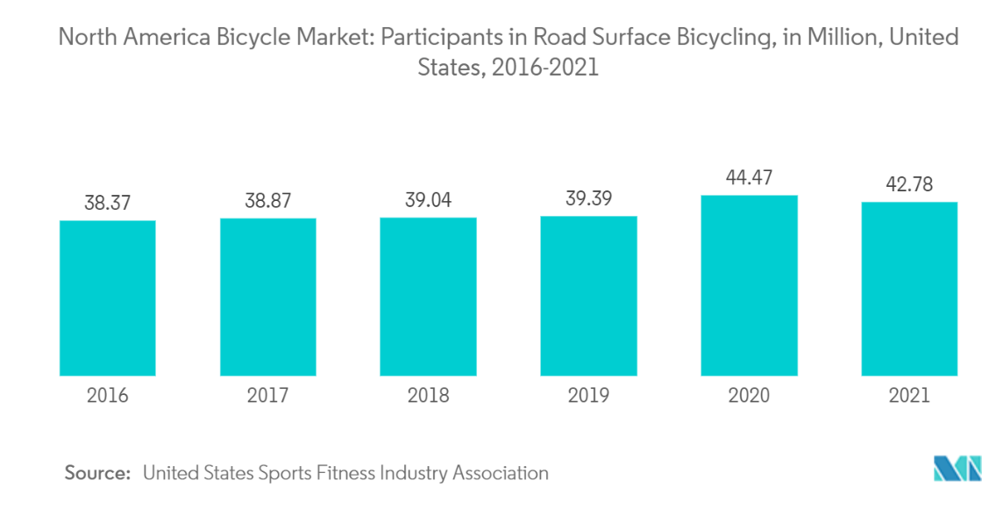
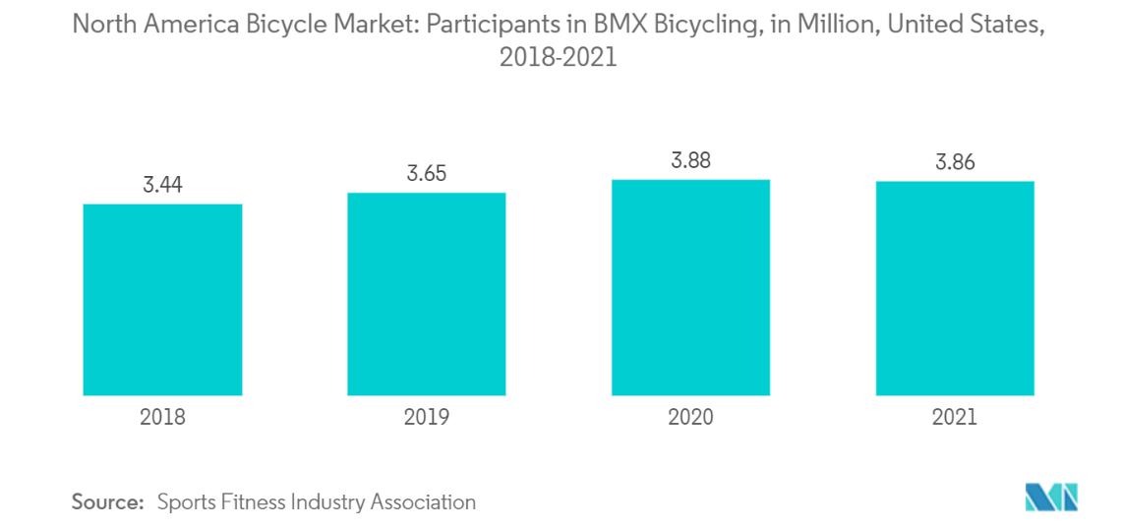
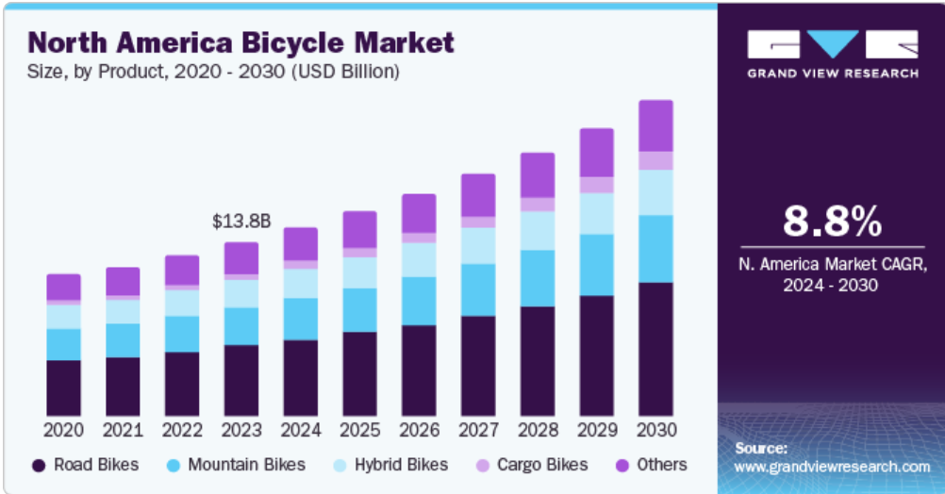
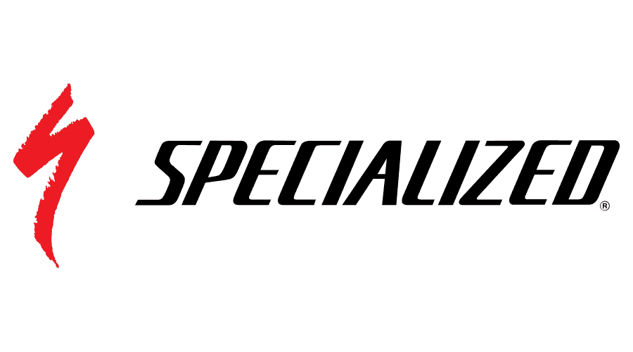
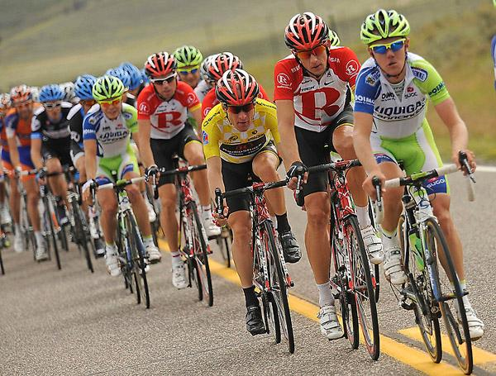
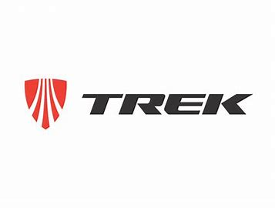
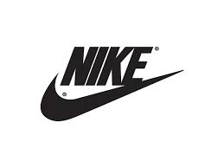
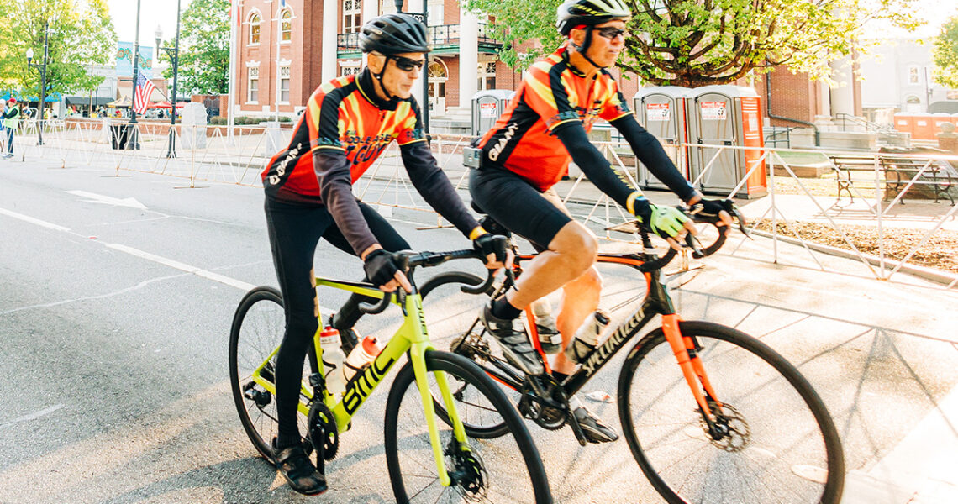
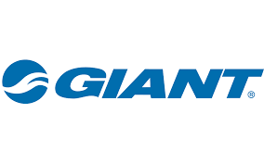
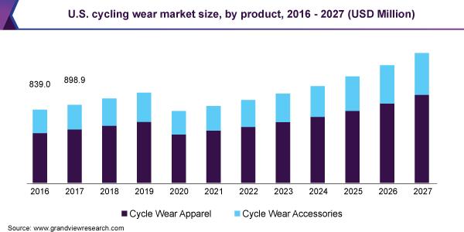
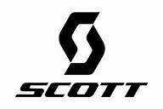

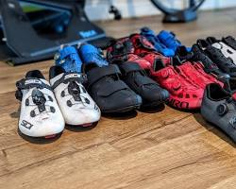
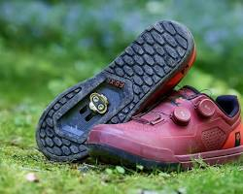


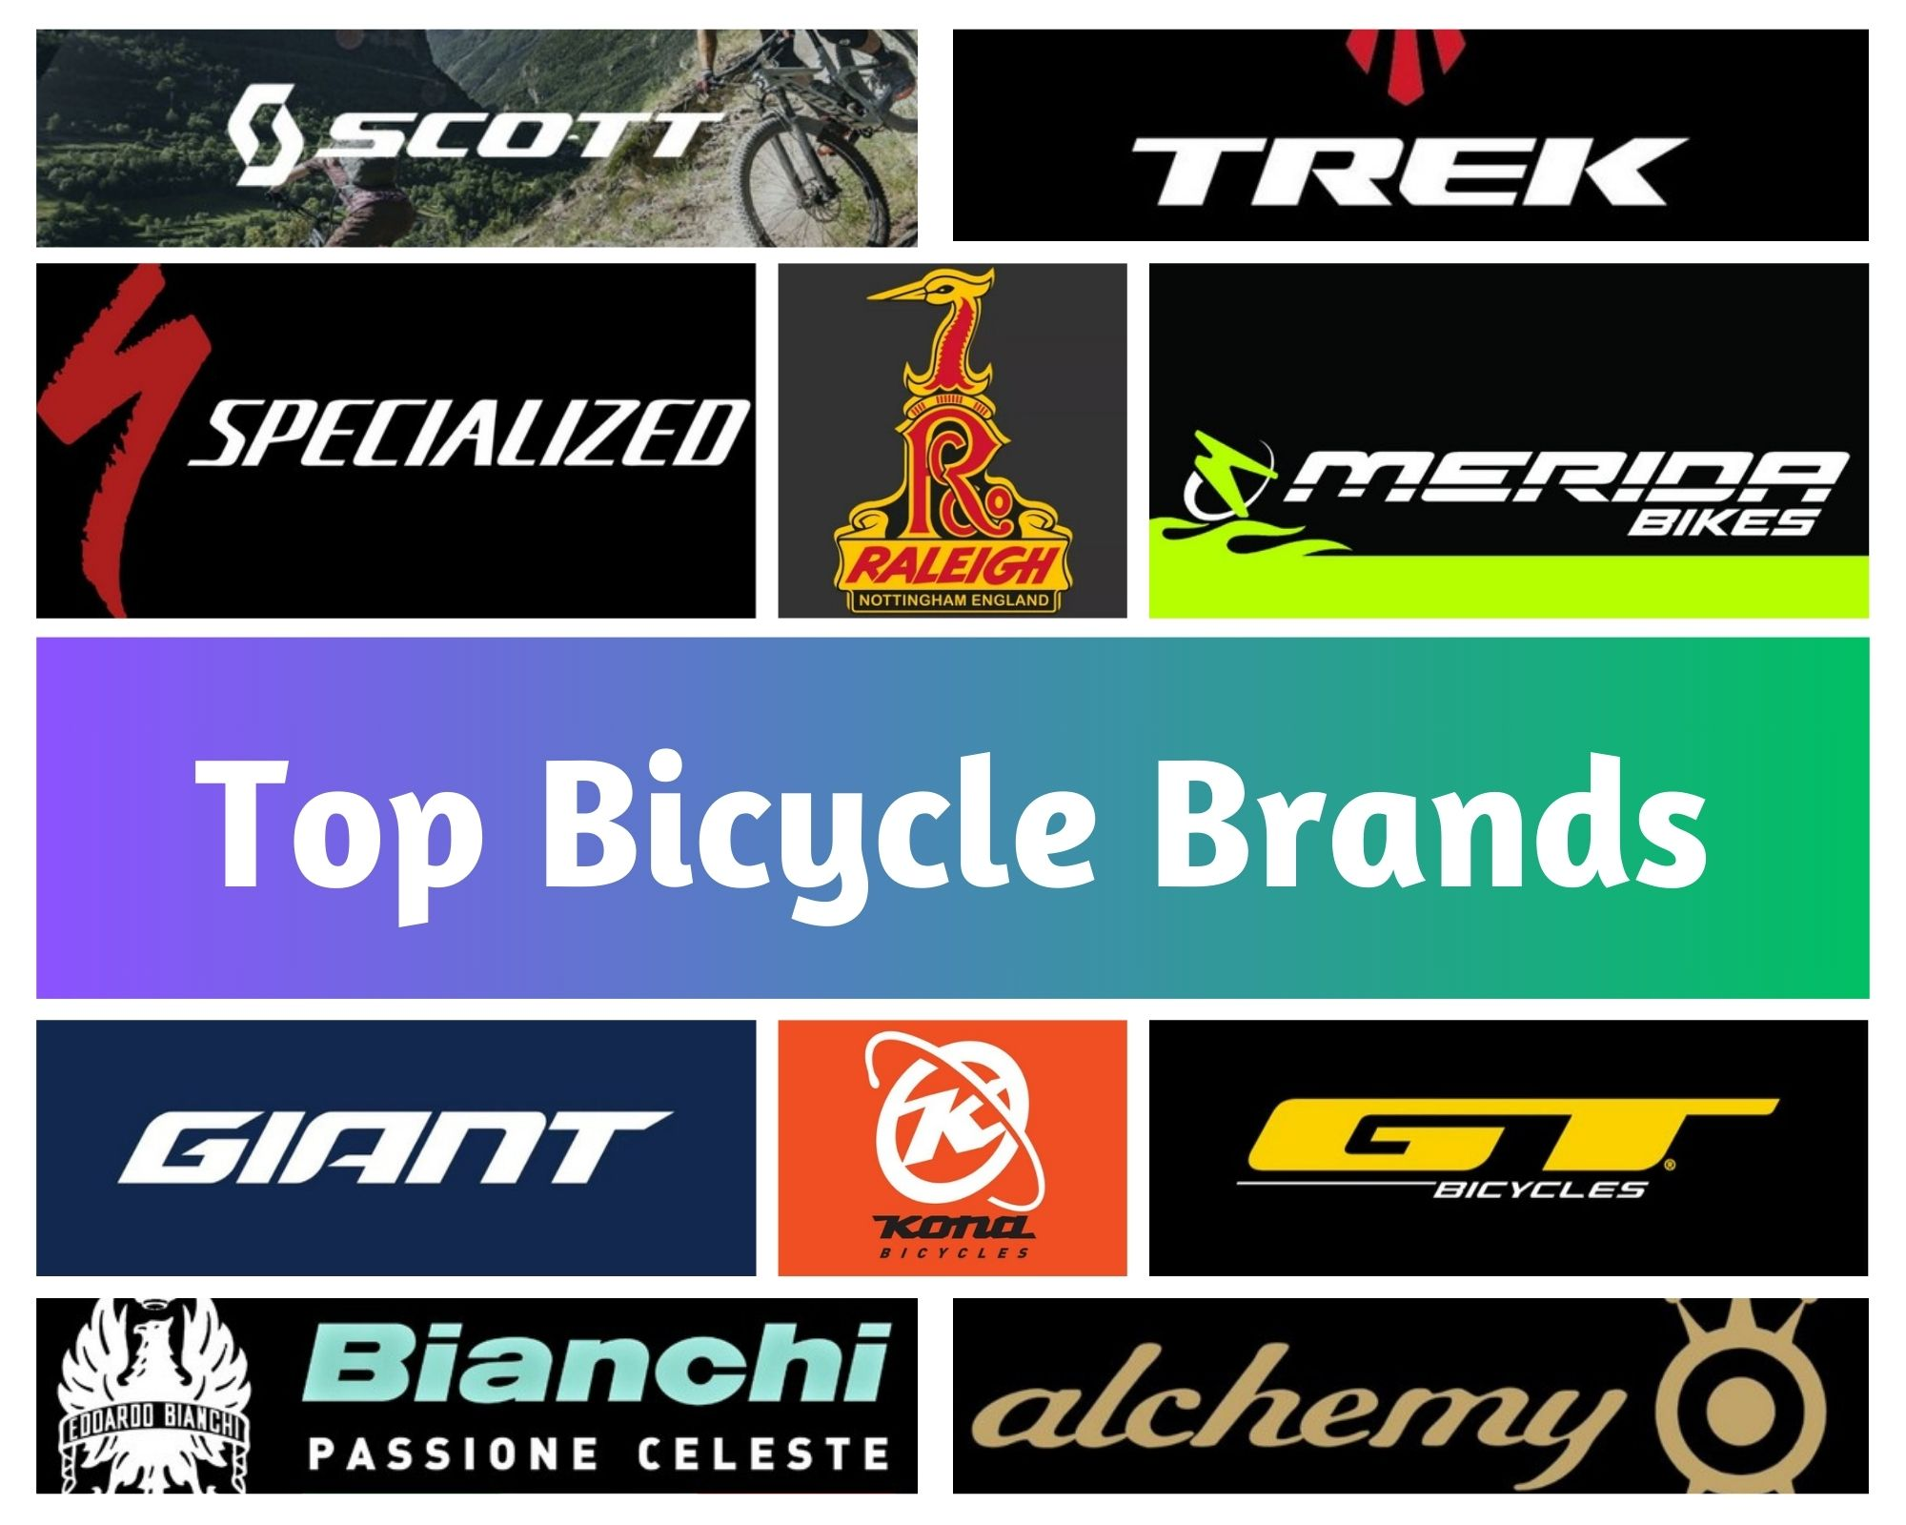
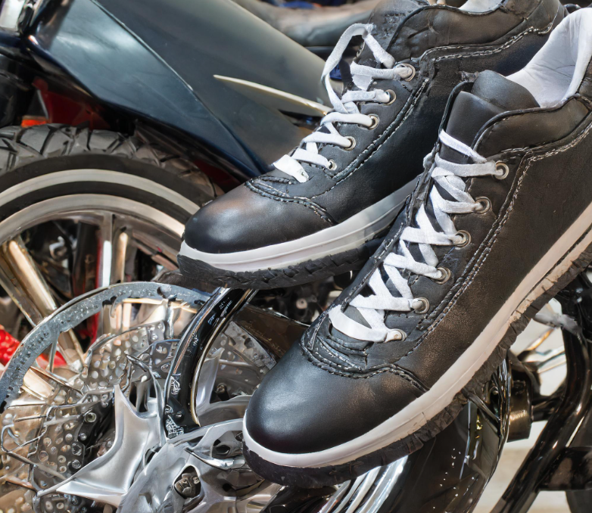
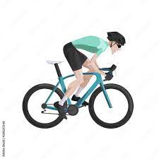

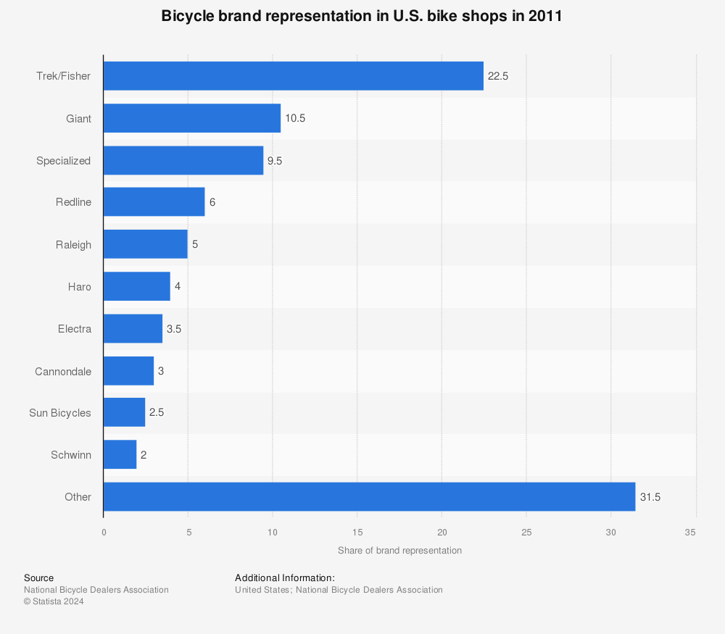
Market analysis
Trends
Professional Cycling Market
Bicycle market size in the U.S. in 2021, with a forecast from 2022 to 2027
Trends Towards Cycling
Professional Cycling Market
Major competitors in cycling industry providing cycling shoes and appraisal
The USA Professional Cycling market is projected to grow from 35467 Million in 2022 USD to 47240 USD million by 2030, at a Compound Annual Growth Rate (CAGR) of 5.3% during the forecast period
Based on TYPE, the Professional Cycling Apparel market from 2024 to 2030 is primarily split into:
Waterproof
Non-waterproof
Average expenditure on accessories by an USA customer on their cycle = $24
Increased Popularity:
Cycling became more popular during the pandemic.
Approximately one in three Americans now ride bikes.
E-Bikes:
Electric bikes (e-bikes) are gaining traction for urban commuting.
They have potent motors and extended battery life.
Safety and Infrastructure:
Bike lanes reduce accidents.
Unfortunately, 857 cyclists were killed in traffic accidents in 2023.
Industry Outlook:
The global cycling industry is worth $81 billion.
It’s expected to create over 800,000 jobs worldwide.
Guesstimate
In the professional cycling market within the USA, cycling shoes are primarily divided into two categories based on their function:
Cycling Shoes:
Market Range: Basic cycling shoes can cost anywhere from $50 to $100, while high-performance models can reach $300 or more.
Assumption: Let’s take a conservative approach and assume an average expenditure of $80 per year for cycling shoes.
Bicycle Appraisal:
Industry Norms: While direct data is scarce, let’s consider a range of $70 to $120 for bicycle appraisal services.
Assumption: We’ll take the midpoint of this range, which is $95.
Road Cycling Shoes
Mountain Bike Shoes
Source : Statista
Top Market Brands In Professional Cycling
Name: Alex Thompson
Age: 35
Occupation: Marketing Manager
Cycling Experience: Intermediate
Uses Cycling for following purposes:
Fitness and Health, Stress Relief, Exploration and Adventure, Eco Friendly Lifestyle.
Visibility & Safety is a significant concern, especially when riding in low-light conditions or busy urban areas.
Affordability is a barrier to them. Consumers are budget conscious.
Convenience & Versatility: They want outfits that can be utilized elsewhere as well
Consumer Persona
Customer Pain Points
Market share of brands in USA market
Name: Jay Watson
Age: 28
Occupation: Professional Cyclist
Cycling Experience: Advanced
Using Cycling for high level competitions.
Lifestyle: Competitive, Driven
Disciplined, Ambitious, Media-savvy
Performance and Durability: Professional cyclists demand gear that delivers top-notch performance and durability.
Customization and Personalization: They seek customized gear tailored to their unique preferences and needs.
Sponsorship and Endorsements: They prioritize partnerships with brands offering lucrative sponsorships.
Technical Innovation: They embrace lightweight materials and aerodynamic designs to excel in competition.

Slide 3
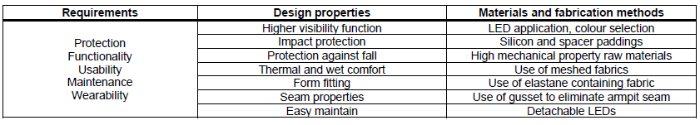
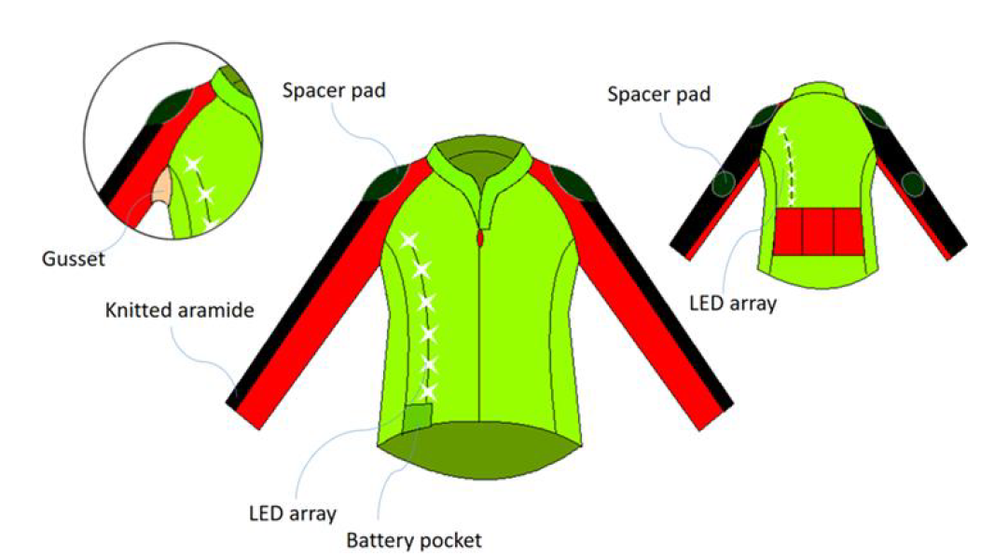
Product Designing
GUESSTIMATES_FINANCIALS
Manufacturing In-House
Cost of Manufacturing In-House:
Cycling Shoes: Reebok might aim for higher quality and brand recognition, so let's estimate the cost of manufacturing cycling shoes at $60 per pair.
Cycling Apparel: Reebok's reputation for quality and style might drive up costs compared to generic brands. Let's estimate the cost of manufacturing cycling apparel at $40 per set.
Market Size for Cycling Shoes and Apparel in 2022:
Professional Cycling Market Size in 2022: $35,467 million
Market Share for Cycling Shoes and Apparel: Assume the combined market share remains at 5%.
Market Size for Cycling Shoes and Apparel ≈ $35,467 million * 0.05 ≈ $1,773.35 million
Number of Pairs of Cycling Shoes Sold in 2022 (Same as before): ≈ 39,407,778 pairs
Revenue for Cycling Shoes in 2022: Total Revenue = Number of Pairs of Cycling Shoes Sold * Cost per Pair Total Revenue ≈ 39,407,778 pairs * $60 ≈ $2,364,466,680
Number of Sets of Cycling Apparel Sold in 2022: Number of Sets of Cycling Apparel Sold ≈ $1,773.35 million / $40 ≈ 44,333,750 sets
Revenue for Cycling Apparel in 2022: Total Revenue ≈ 44,333,750 sets * $40 ≈ $1,773,350,000
Reebok Velocity
Positioning
For cyclists who demand peak performance and durability, Reebok offers a line of cutting-edge cycling shoes and apparel, engineered with advanced technologies and customizable options to cater to individual preferences. With a commitment to innovation and athlete support, Reebok empowers cyclists at every level to ride with confidence and achieve their full potential on and off the road.
Adventurous
Health-conscious
Competitive
Performance-driven
Eco-conscious
Active
Tech-savvy
Social
Goal-oriented
Discerning
Innovative
Performance-driven
Customizable
Eco-friendly
Active lifestyle-focused
Technologically advanced
Socially responsible
Goal-oriented
Reliable
Stylish
Consumer Characteristics
Brand Attributes

Slide 4
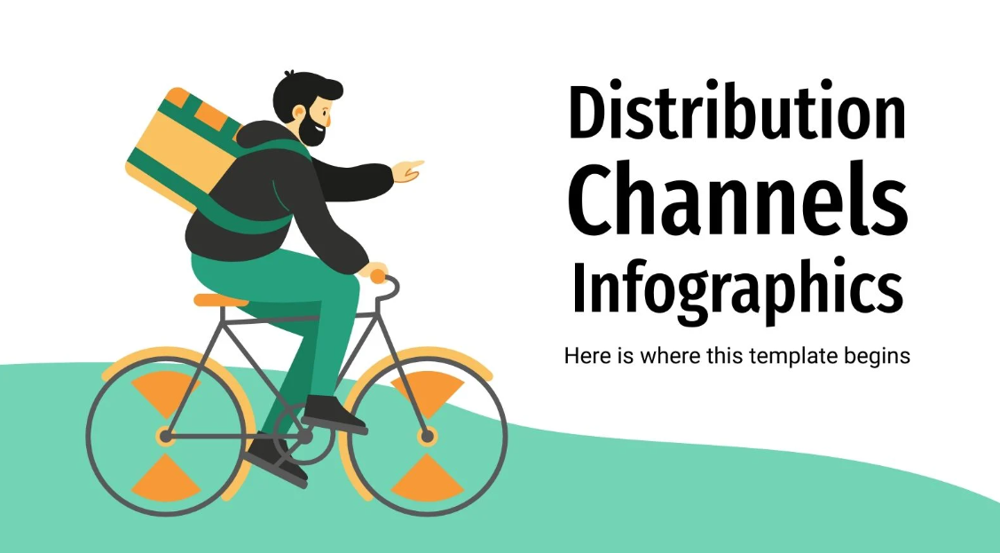







Customers:
Omni-channel Experience: Ensure availability through both online platforms and physical stores for convenience.
Product Customization: Offer customization options to cater to individual preferences and needs.
Membership Benefits: Provide exclusive benefits for loyal customers to foster brand loyalty.
Post-purchase Support: Offer responsive customer service and hassle-free return policies for customer satisfaction.
Community Engagement: Engage customers through cycling events, forums, and social media to build a loyal community.
Distributors:
Selective Partnerships: Choose distributors with expertise in cycling gear to target relevant markets.
Channel Expansion: Explore online platforms and specialty stores to broaden distribution channels.
Marketing Collaboration: Collaborate on marketing campaigns to increase brand visibility and product awareness.
Training Programs: Conduct regular training sessions for distributor staff to enhance product knowledge.
Performance Evaluation: Monitor distributor performance and provide feedback for continuous improvement.
Manufacturing:
Strategic Partnerships: Collaborate with specialized manufacturers for high-quality production.
Technology Integration: Ensure integration of advanced materials and features for performance.
Innovation Focus: Invest in R&D for unique designs and cutting-edge technology.
Sustainability Commitment: Source eco-friendly materials and promote sustainable manufacturing practices.
Cost Efficiency: Balance cost-effectiveness with product quality to maintain competitive pricing.
C&F Agents:
Exclusive Distribution: Partner with dedicated C&F agents to manage distribution channels efficiently.
Geographical Coverage: Select agents with extensive reach to ensure nationwide availability.
Training Support: Provide comprehensive training on product features and selling techniques.
Performance Incentives: Offer incentives based on sales performance to drive agent motivation.
Inventory Management: Implement systems for real-time tracking and efficient inventory management.
Retailers:
Specialized Retailers: Focus on partnerships with cycling-specific retailers for targeted reach.
Visual Merchandising: Provide branding materials and displays to ensure effective product presentation.
Staff Training: Offer training on product features and benefits to enhance customer service.
Incentive Programs: Implement sales incentives to encourage retailers to promote Reebok cycling shoes.
Customer Feedback: Establish channels for retailers to provide feedback on product performance and market demand.

