Slide 1
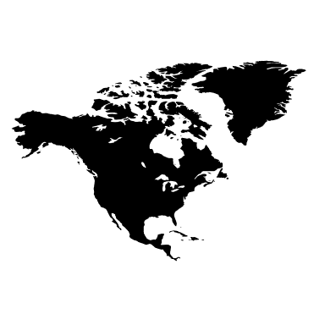
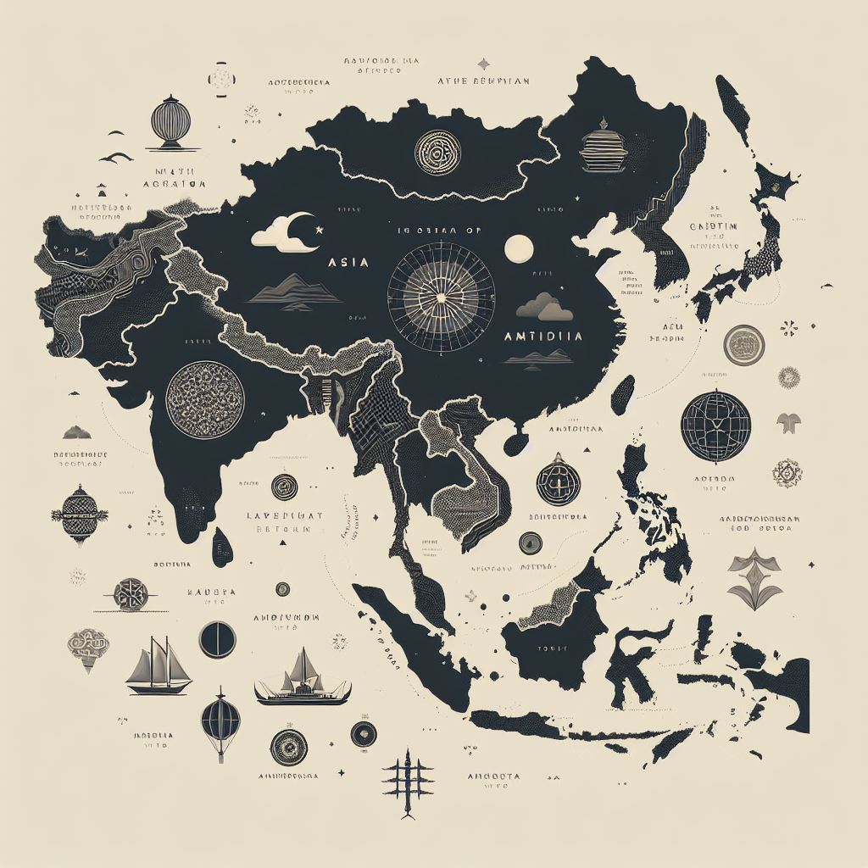
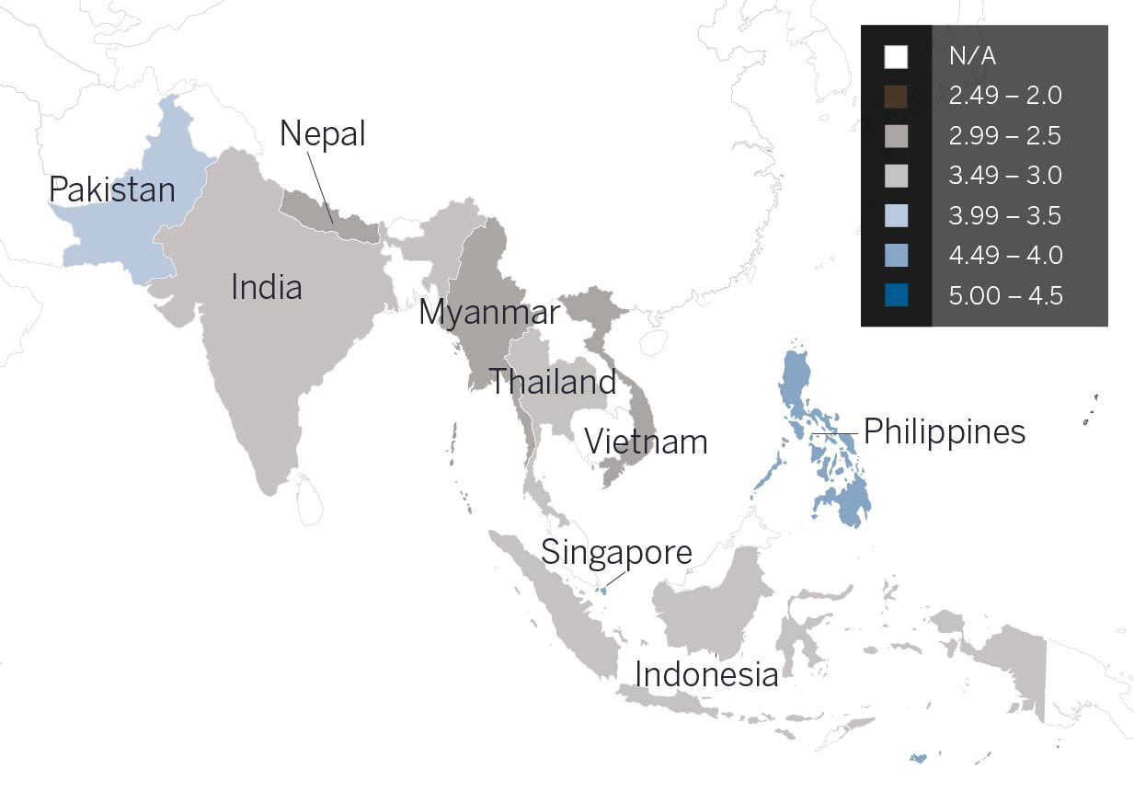
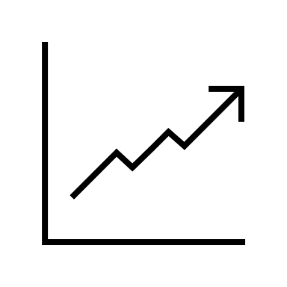

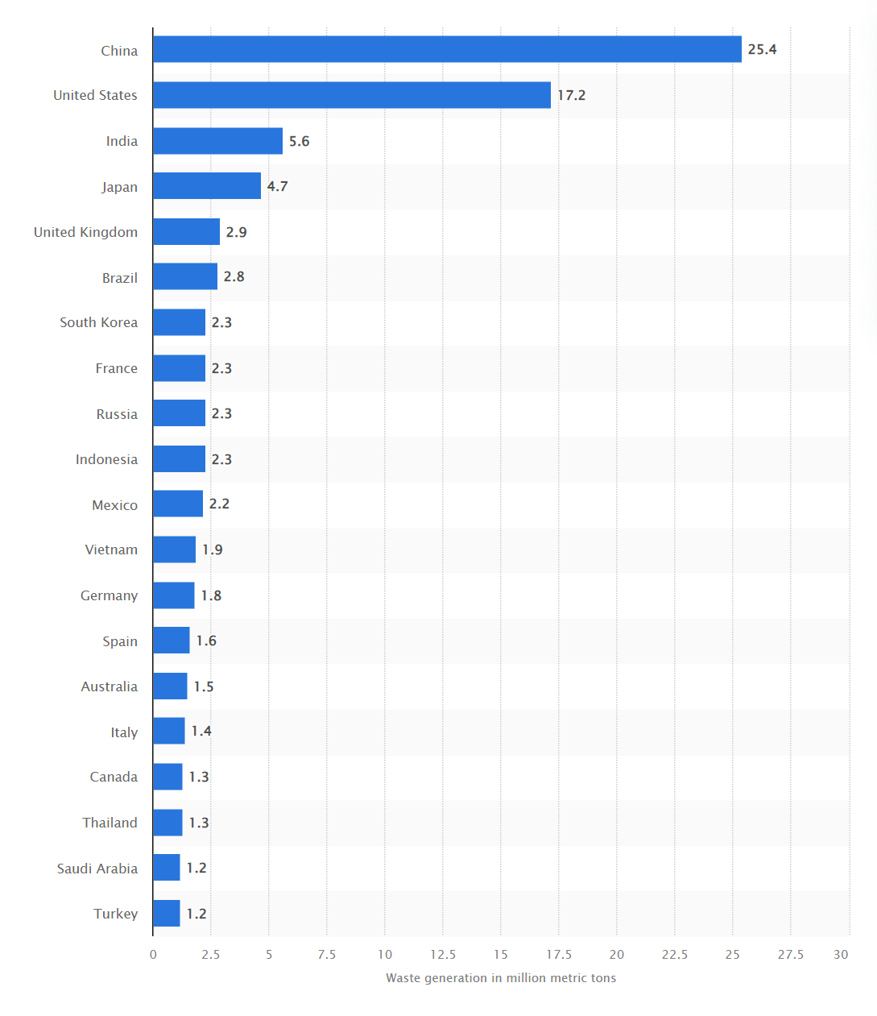



Situation Analysis
EcoWrap
Target Market
INDIA
EcoWrap is one of the leading sustainable packaging solution provider in North America.
Top 03 Markets
Market Characteristics
INDONESIA
$ 208.3 Million
12 % Market Share
Top 03 player
South & Southeast Asia
Favorable Regulations | Consumer Preferences
VIETNAM
Product Portfolio
Biodegradable
Compostable
Recycle
India, Indonesia and Vietnam are selected on basis of highest annual use of plastics among all nations in the target market.
Growth Drivers
Growing E-Commerce
Industries
Regulatory Pressure and Policy: Net Zero 2070
Food & Beverage
Pharma & Consumer Goods
Cosmetics
Increasing Environmental Awareness
Rapid Urbanization and Changing Lifestyle
This Photo by Unknown Author is licensed under CC BY-NC-ND

Slide 2
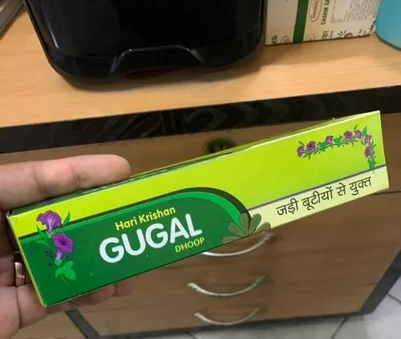
Expansion and Market Entry Strategy
Entry Mode
Marketing Strategy
EcoWrap should target these three countries to enter. Here’s the reason why?
Joint Venture with 51% share: Forming a partnership with a local company in the target market to share resources, risks, and profits. Joint ventures allow it to leverage the local partner's knowledge of the market, distribution networks, and regulatory environment.
Clients
Business
FMCG
Logistics
& E-commerce
Government
Product Strategy
Suppliers
EcoWrap
Business
Biodegradable
Distribution
Positioning
Cellulose
Compostable
Factors to consider while entering these markets:
They are developing nation hence their purchasing power would be different from western world.
We need to balance Cost Vs Benefit, as cost is a vital factor in their purchasing decision.
Language barriers and Cultural mismatch.
Diversified Supplier Base
Sourced, manufactured, transported, and recycled using renewable energy.
Is beneficial, safe & healthy for individuals and communities throughout its lifecycle.
Is manufactured using clean production technologies and best practices.
Cornstarch
EPR ( Extended Producer Responsibility )
Product Localization is important step in gaining market share. Leverage language and culture of the host country in your products.
Customized Solutions
Cost – Effective solutions

Slide 3
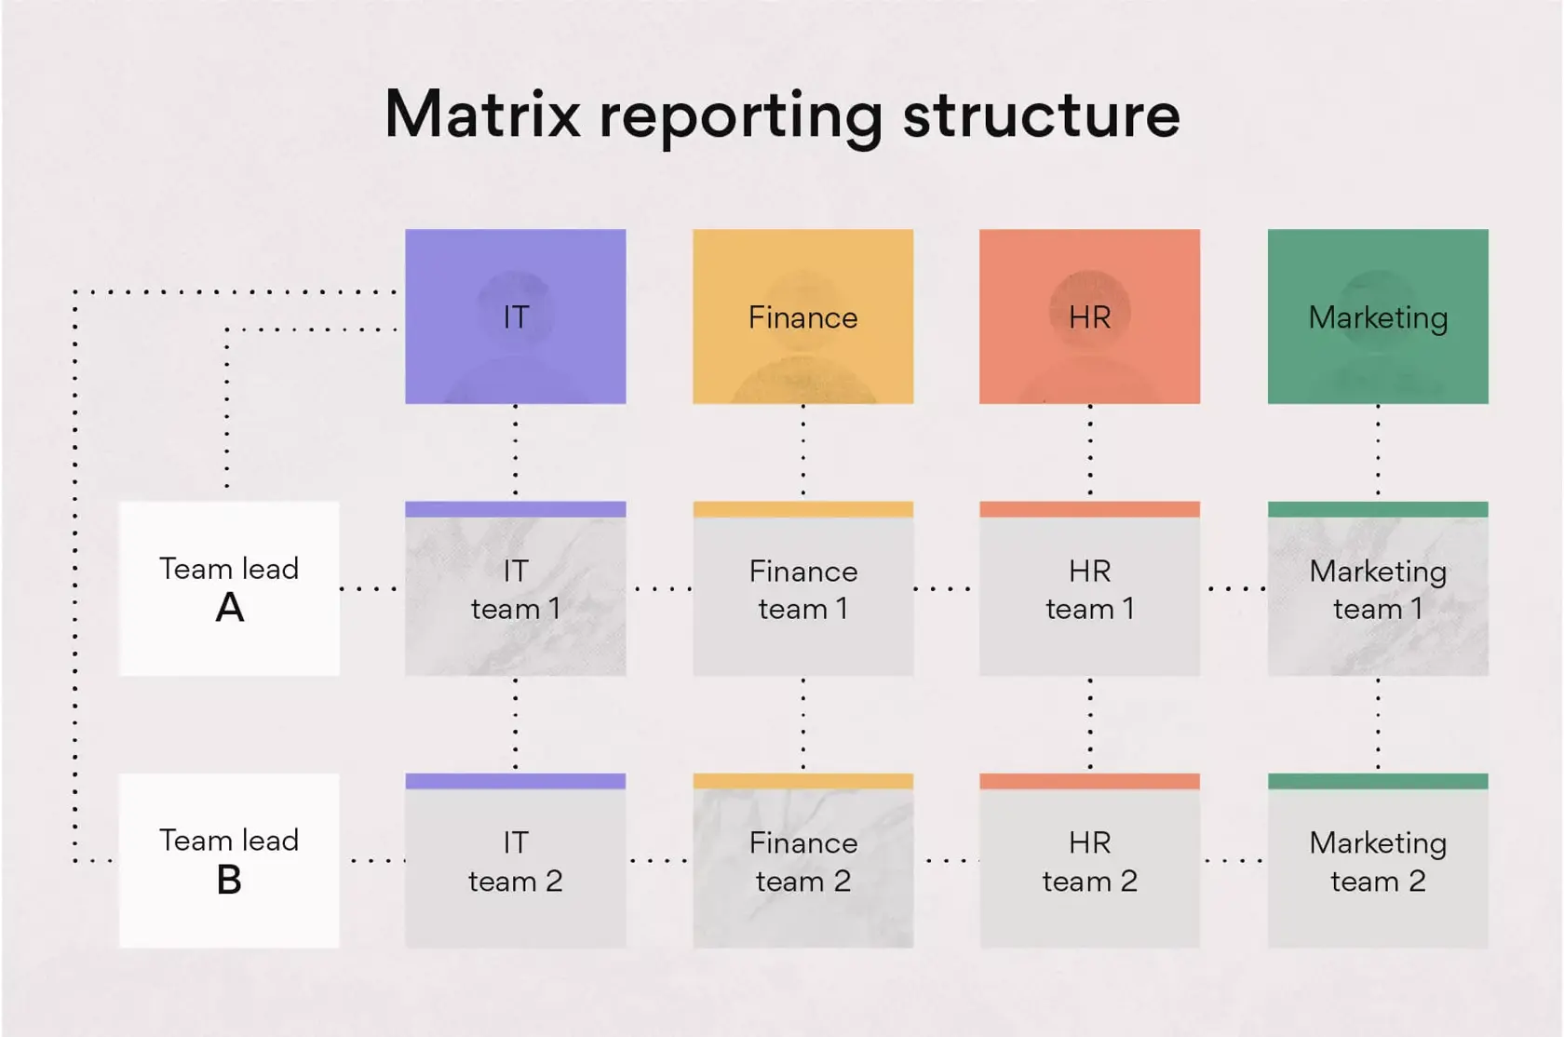






Financial Planning & Risk Mitigation
Resource Sharing
EcoWrap will invest in capital infrastructure, its years expertise in the market, network with global players, and its strong R&D capabilities.
The other partner will bring its distribution network, market knowledge and talented human resources.
Market is highly segmented in the three target countries. We will partner with a firm and form a JV with keeping at least 51% share.
Purpose and Goal
This partnership has been laid on common vision, to become the market leader in the sustainable packaging industry in the south and southeast Asia.
We want to capture 33.33% of the market in five years down the line, and during this journey we want to help 100 clients achieve their carbon emission target.
 | In $ M
Initial Investment | 1
Revenue-Year1 | 0.66
Revenue-Year2 | 0.99
Revenue-Year3 | 1.32
COGS | 50-80%
SG&A | 10-30%
$208 M
$13.2 M
Organization Structure
Currency Diversification:
Natural Hedging:
Forward Contracts:
North America
South & Southeast Asia
Please note that this is not the actual data, due to fictional nature of the problem, however we have taken the market on the same proportion as the real market.
Potential Partners

