Slide 1
AI SMART CAMPUS
MANAGEMENT SYSTEM
Complaint Management System | Digital Notice Board
Major Project Report – BCA612
Deepanshu Kumar (034) | Mayank Jain (051) | Chetan Sharma (030) | Prachi (130)
Maharishi University of Information Technology, Noida | Session: 2023-26
Guided by: Mr. Amiya Dhar Dwivedi

Slide 2
Agenda
01
Introduction & Problem Statement
08
DFD & ER Diagram
02
Objectives
09
Technology Stack
03
Proposed System & Features
10
Cost & Benefit Analysis
04
System Architecture & Modules
11
Snapshots / Screenshots
05
AI Complaint Form Generator
12
Challenges
06
Digital Notice Board
13
Future Scope
07
Database Design
14
Conclusion
AI Smart Campus Management System

Slide 3
Introduction
Traditional campus management relies on paper-based complaints, physical notice boards, and manual workflows.
The AI Smart Campus Management System replaces these inefficient processes with a smart, digital, AI-assisted platform.
The system focuses on two core modules:
1. Complaint Management System with AI Form Generation
2. Digital Notice Board for real-time announcements
It empowers students, staff, and administrators to communicate, resolve issues, and share information seamlessly.
Project Scope
✔ Web-based platform
✔ 3 User Roles
✔ AI-Powered Forms
✔ Real-Time Notices
✔ MySQL Backend
Institution
Maharishi University of Information Technology
Noida – 201304
BCA 2023-26 Batch
AI Smart Campus Management System

Slide 4
Problem Statement
Challenges in Traditional Campus Management
📋
Manual Complaints
📌
Physical Notice Boards
⏳
No Status Updates
Students visit offices physically. No tracking, no digital record of submitted issues.
Outdated, damaged or inaccessible. Announcements reach students too slowly.
Students have no way to check if their complaint is being resolved.
🤖
No AI Assistance
📊
No Central Dashboard
🔔
Poor Communication
Drafting formal complaints is time-consuming for students with no formal writing experience.
Admins lack a single view to track, assign, and resolve all campus complaints.
No centralized digital channel for broadcasting urgent campus announcements instantly.

Slide 5
Objectives
1
Provide an AI-powered complaint form that auto-generates content from user keywords.
2
Allow students and staff to submit, track and view complaint status in real time.
3
Enable admins to post, edit and manage digital notices campus-wide.
4
Implement Role-Based Access Control (Student / Staff / Admin).
5
Replace physical notice boards with a searchable, categorized digital board.
6
Maintain a complaint workflow: Pending → In Progress → Resolved.
7
Provide search & filter on both complaints and notices.
8
Deliver a fully responsive design for desktop, tablet & mobile.
AI Smart Campus Management System

Slide 6
Proposed System Overview
🔐 Login & Auth
📌 Digital Notice Board
AI Smart Campus Management System
📋 Complaint Management
👤 User Management
🤖 AI Form Generator
📊 Admin Dashboard
AI Smart Campus Management System

Slide 7
AI Complaint Form Generator
Core Innovation — Auto-fill complaint forms using AI
1
2
3
4
5
→
→
→
→
User Input
AI Processing
Form Population
Review & Edit
Submit
Student enters short keywords or brief instructions (e.g., 'Wi-Fi not working in hostel')
AI model (GPT/Hugging Face) processes input and generates a formal complaint
Subject, Category & Description fields auto-fill with structured, formal content
Student reviews, edits if needed, and approves the generated form
Complaint is saved to DB with unique ID and status set to 'Pending'
Instructions Format supported by AI: "[Issue] + [Location] + [Duration] + [Impact]" → e.g. 'Water supply issue in Boys Hostel Block-B for 2 days affecting 80 students'

Slide 8
Digital Notice Board
📢 Post Notices
🔍 Search & Filter
⏰ Schedule Notices
Admins create notices with title, content, category and expiry date instantly.
Students filter notices by category (Academic, Event, Hostel, IT, Other) or keyword.
Set future publish date – notices go live automatically on the scheduled time.
🚨 Priority Levels
📱 Responsive View
🗑️ Auto-Expiry
Mark notices as Normal, Important or Urgent with color-coded visual badges.
Notice board adapts to mobile, tablet and desktop screens seamlessly.
Expired notices are automatically removed from the board on the set expiry date.
AI Smart Campus Management System

Slide 9
Role-Based Access Control
Two distinct user roles with tailored features
🎓 STUDENT
🔑 ADMIN
✔ Register & Login
✔ Full Complaints Dashboard
✔ Submit Complaints (Manual / AI)
✔ Assign Complaints to Staff
✔ Track Complaint Status
✔ Post / Edit / Delete Notices
✔ View Digital Notice Board
✔ Manage All Users & Roles
✔ Search & Filter Notices
✔ View Analytics & Reports

Slide 10
System Architecture & Data Flow
PRESENTATION LAYER (HTML5 / CSS3 / Bootstrap / JavaScript)
⬇
APPLICATION LAYER (Python – Flask Framework / REST API Endpoints)
⬇
AI MODULE (OpenAI GPT / Hugging Face Transformers – Complaint Form Generator)
⬇
DATA LAYER (MySQL Database – Users / Complaints / Notices / AI Logs)
AI Smart Campus Management System

Slide 11
Database Design
USERS
COMPLAINTS
NOTICES
user_id (PK)
complaint_id (PK)
notice_id (PK)
username
user_id (FK)
admin_id (FK)
email
subject
title
password_hash
1 : ∞
category
1 : ∞
content
role
description
category
created_at
status
expiry_date
submitted_at
created_at
resolved_at
USER submits COMPLAINT (1:∞) | USER (Admin) posts NOTICE (1:∞)
AI Smart Campus Management System

Slide 12
Entity-Relationship (ER) Diagram
USER
COMPLAINT
NOTICE
🔑 user_id (PK)
🔑 complaint_id (PK)
🔑 notice_id (PK)
username
↳ user_id (FK)
↳ admin_id (FK)
1
∞
1
∞
email
subject
title
submits
posts
role
category
category
created_at
status
expiry_date
submitted_at
AI_LOG
🔑 log_id (PK)
generates
↳ user_id (FK)
instructions
generated_form
AI Smart Campus Management System

Slide 13
Complaint Submission Flowchart
Step-by-step process from login to resolution
START
AI Generates Form
↓
↓
⟶ AI Path
User Login
Manual Form Fill
↓
⟶ Manual
↓
Login Success?
Review & Submit
↓
↓
Select 'Submit Complaint'
Complaint ID Assigned
↓
↓
Enter Keywords / Instructions
Admin Reviews
↓
↓
Use AI Generate?
Resolved?

Slide 14
Technology Stack
🖥️ Frontend
⚙️ Backend
🗄️ Database
HTML5, CSS3, JavaScript
Bootstrap 5 / Tailwind CSS
Jinja2 Templates
Python 3.x
Flask Web Framework
REST API Design
MySQL
SQLAlchemy ORM
Relational Schema Design
🤖 AI Module
🛠️ Dev Tools
☁️ Deployment
OpenAI GPT API
Hugging Face Transformers
Instruction-to-Text NLP
VS Code IDE
Postman (API Testing)
XAMPP Local Server
AWS Free Tier / Replit
Apache Web Server
HTTPS (SSL)
AI Smart Campus Management System

Slide 15
Cost & Benefit Analysis
💰 COSTS
✅ BENEFITS
Software Tools
Rs. 0 (Open Source)
★ 80% reduction in complaint handling time
AI API
Rs. 0 – Rs. 500 / month
★ 100% paperless complaint & notice process
Cloud Hosting
Rs. 0 – Rs. 300 / month
★ Real-time transparency in resolution status
ROI POSITIVE
Maintenance
Rs. 500 – Rs. 1000 / month
★ Instant campus-wide notice dissemination
Development
Low (Academic Project)
★ Centralized admin control & reporting
Total / Year
~ Rs. 10,000 – 20,000
★ Improved student satisfaction & trust

Slide 16
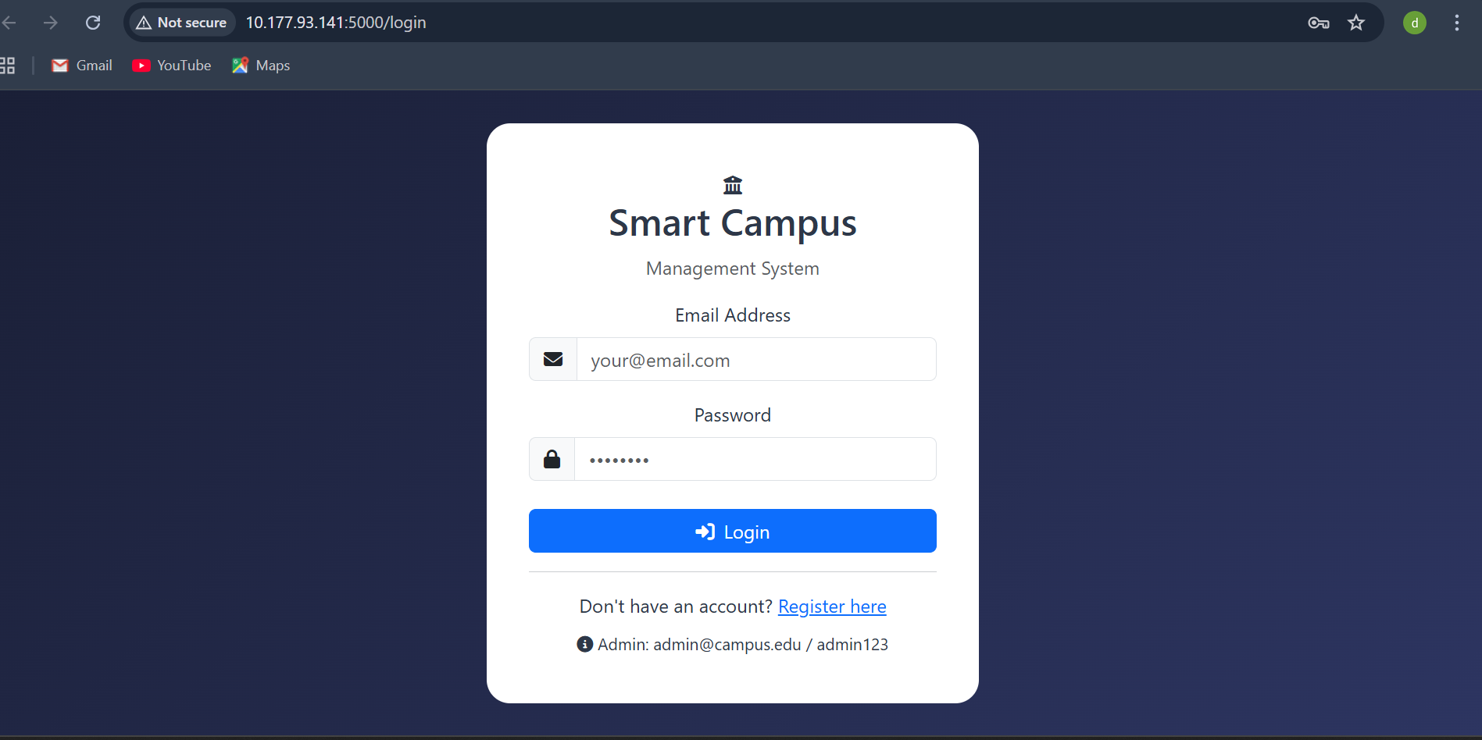
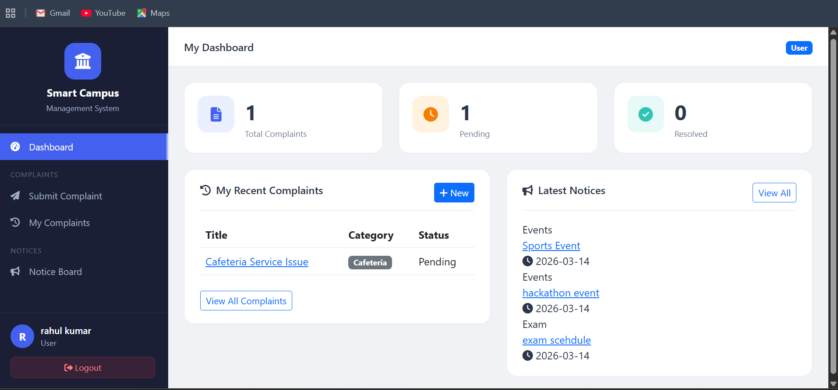
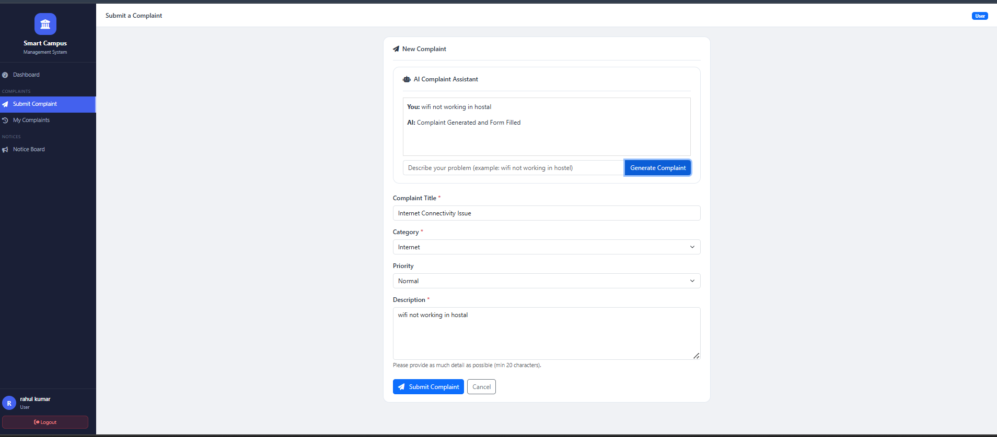
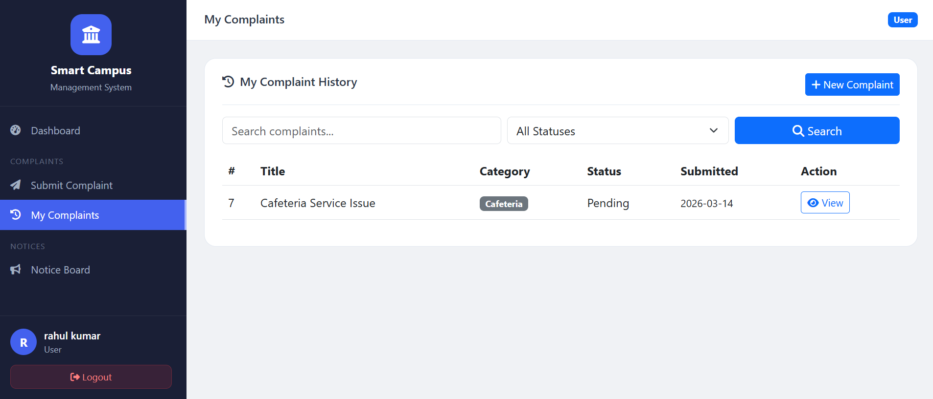
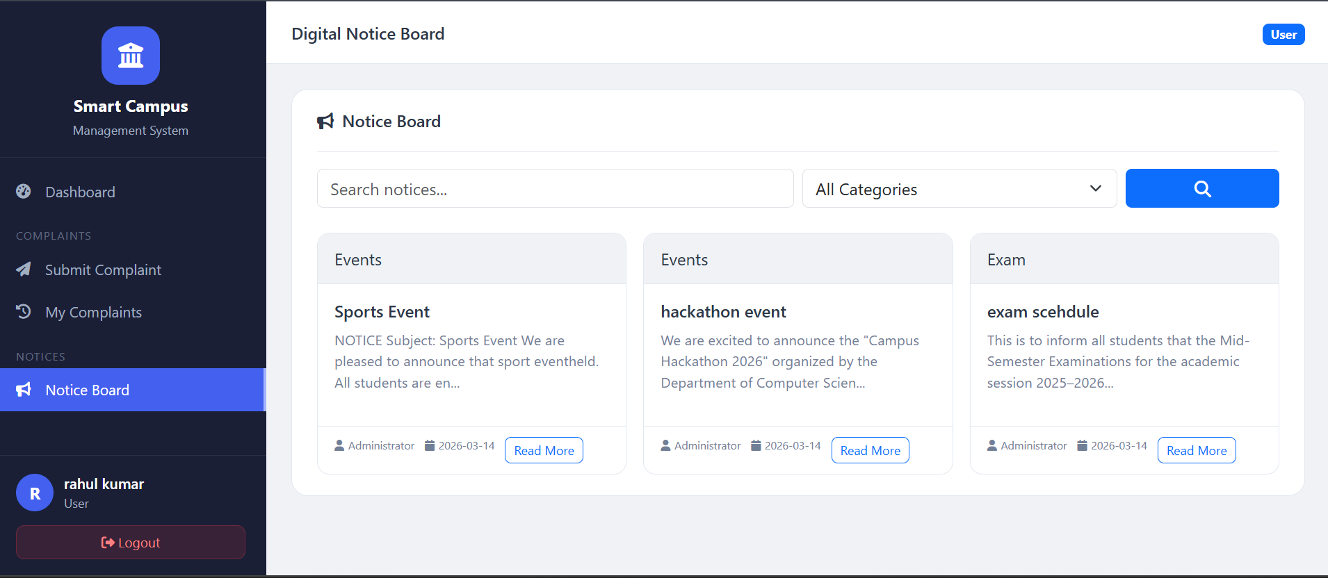
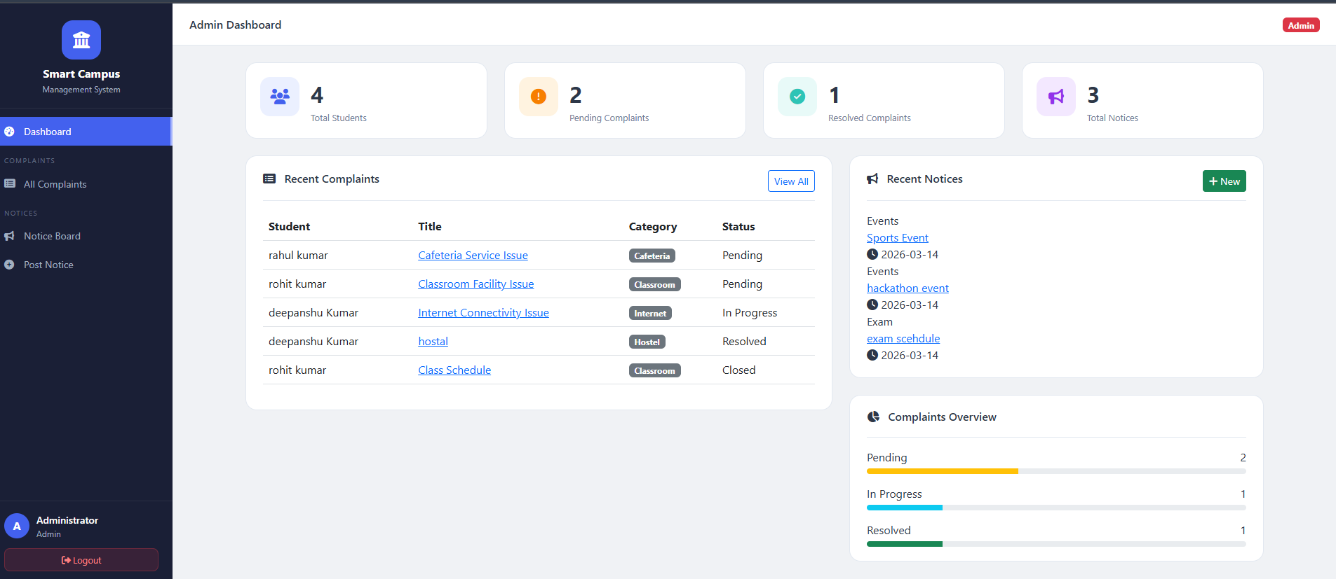
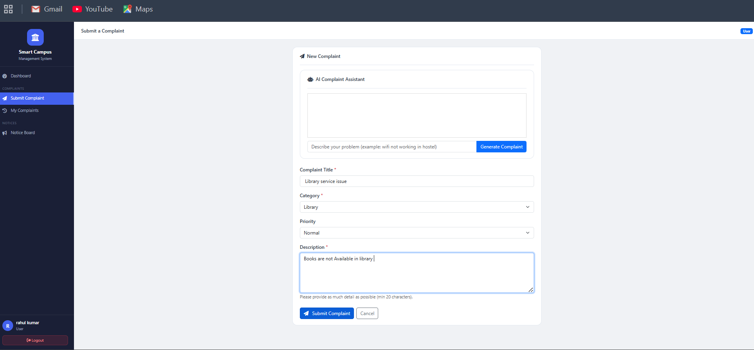
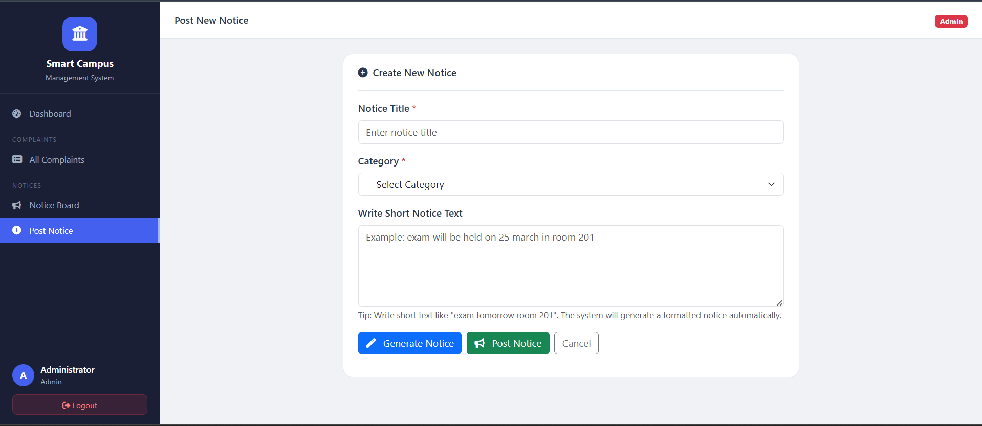
System Screens / Snapshots
🔐 Login Page
🏠 Student Dashboard
🤖 AI Form Generator
📋 My Complaints
[Screenshot]
[Screenshot]
[Screenshot]
[Screenshot]
Secure entry with role-based redirect
Complaint summary & quick actions
Keyword → formal complaint in seconds
Real-time status tracker with badges
📌 Notice Board
📊 Admin Dashboard
✏️ Manage Complaints
📢 Post Notice
[Screenshot]
[Screenshot]
[Screenshot]
[Screenshot]
Searchable, categorized digital notices
Overview of complaints, notices & users
Filter, assign & update complaint status
Rich form with priority & expiry controls
AI Smart Campus Management System

Slide 17
Challenges Faced
Technical, Operational & AI-Specific Challenges
⚙️
RBAC Implementation
🤖
AI Accuracy
💰
API Cost Control
Implementing role-based Flask session validation on every protected route without security gaps.
Ensuring AI generates formal, category-relevant complaint text without hallucinating false details.
Limiting AI API usage to control costs while maintaining quality for all student-submitted forms.
🗄️
Schema Design
📱
Responsive UI
🔄
Concurrent Users
Designing a normalized database handling users, complaints, notices & AI logs without redundancy.
Making the interface fully responsive across mobile, tablet and desktop views consistently.
Handling multiple simultaneous complaint submissions and notice views with optimized DB queries.

Slide 18
Future Scope
📅 Short-Term Enhancements
🔭 Long-Term Vision
📧 Email / SMS Notifications on status updates
🤖 AI Auto-Categorization of Complaints
🔴 Complaint Priority Levels (Low / Medium / High / Critical)
💬 Campus Chatbot for student queries
📱 Dedicated Android & iOS Mobile Application
📊 Analytics Dashboard with visual reports
⏰ Scheduled Notice Auto-Publishing
🌐 Multi-Campus / Multi-Tenant Support
🔒 Two-Factor Authentication (OTP)
🔗 Blockchain-based Complaint Integrity
🌙 Dark Mode / Light Mode Theme Toggle
🌍 Hindi & Regional Language Support
AI Smart Campus Management System

Slide 19
Advantages & Limitations
✅ Advantages
⚠️ Limitations
✔ AI saves time – complaint forms generated in seconds
✘ Requires active internet connection
✔ Fully paperless complaint & notice workflow
✘ AI quality depends on third-party API availability
✔ Real-time complaint status transparency
✘ No real-time push notifications yet
✔ Centralized admin dashboard for full control
✘ AI may generate generic text occasionally
✔ Responsive – works on all devices
✘ No dedicated mobile app in current version
✔ Scalable modular architecture
✘ Single institution – no multi-campus support
✔ Improved campus communication speed
✘ File upload size limited by server constraints
✔ Historical data for insights & analytics
AI Smart Campus Management System

Slide 20
Conclusion
The AI Smart Campus Management System successfully demonstrates how Artificial Intelligence
can transform traditional campus operations into efficient, transparent, and intelligent digital workflows.
By combining an AI-Powered Complaint Form Generator with a Digital Notice Board,
the system empowers students, staff, and administrators to work smarter and faster.
This project proves that AI integration in campus management is not just feasible —
it is highly beneficial, scalable, and a step toward a truly Smart Campus ecosystem.
THANK YOU
Deepanshu Kumar | Mayank Jain | Chetan Sharma | Prachi
BCA 2023-26 | MUIT Noida | Guided by: Mr. Amiya Dhar Dwivedi
www.muitnoida.edu.in

