Slide 1
Capstone Project
Hotel Booking Analysis Deepanshu Kanchan

Slide 2
Table of Contents
Objective
Data Summary
Data loading and exploration
Data Wrangling
Correlation matrix analysis
Scatter plot analysis
Hotel wise analysis
Some other questions
Challenges
Reference
Conclusion

Slide 3
Objective
This hotel booking dataset contains booking information about city and resort hotels. Both datasets share the same structure, with Database having 119390 Rows and 32 columns. All personally identifying information has been removed from the data. We are going to analyse hotel bookings dataset for 3 years i.e. 2015 - 2017.
We will be discussing following steps in upcoming slides.
Data loading and exploration.
Data Wrangling
Data analysis and visualization.
Conclusion.

Slide 4
Data Summary
The data table consists of 119,390 rows and 32 columns. So, Our analysis starts with understand feature description of each column mentioned below:
'hotel’: Hotel(Resort Hotel or City Hotel)
'hotel1':Copy of hotel
'is_canceled': Booking was cancelled or not.
'lead_time':Time difference between booking date and date of arrival
'arrival_date_year':Year of arrival
'arrival_date_month':Month of arrival
'arrival_date_week_number':Week of arrival
'arrival_date_day_of_month':Day of arrival
'stays_in_weekend_nights':Total Stay on weekend
'stays_in_week_nights':Total Stay on weekday
'adults':No.of adults in the room
'children':No. of children in the room
'babies':No.of babies in the room
'meal':Type of meal
'country':Country of origin
'market_segment':Market segment designation. In categories, the term “TA” means “Travel Agents” and “TO” means “Tour Operators”

Slide 5
'distribution_channel':The term “TA” means “Travel Agents” and “TO” means “Tour Operators”
'is_repeated_guest': Repeated guest or not.
'previous_cancellations':Customer previously cancelled
'previous_bookings_not_canceled':Customer previous did not cancel
'reserved_room_type':Type of room type
'assigned_room_type':Type of room assigned
'booking_changes':Any changes in booking
'deposit_type':Type of deposit for booking
'agent': Agent used for booking
'company':Company of booking
'days_in_waiting_list':Waiting list days
'customer_type':Type of customer based on stay duration
'adr':average daily rate
'required_car_parking_spaces':parking required
'total_of_special_requests':No. of special guests
'reservation_status':Status of reservation
'reservation_status_date’:Date of status of reservation
We had added two columns for our own convenient analysis.
'total_stay':'stays_in_week_nights'+'stays_in_weekend_nights'
'total_peoples'='babies'+'adults'+'children'

Slide 6
Data loading and Exploration
Data Loading:
Loading data from Google drive and reading in notebook
Data Exploration:
Checking data in different columns
Data
Operations
Columns:
Numerical columns and categorical columns
Data:
Information and data types of columns

Slide 7
Data Wrangling
Data wrangling-also called data cleaning, unifying messy and complex data sets to a meaningful format for easy access and analysis..There are various processes designed to transform raw data into more readily used formats.
*It includes following steps:
Handling missing values.
Removing duplicates data.
Converting columns to proper data type format.
Adding or removing columns for analysis.

Slide 8
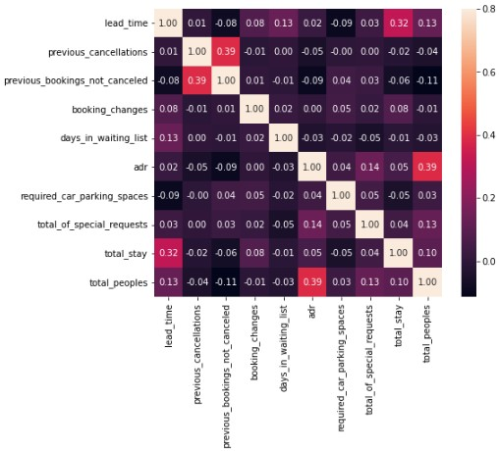
Correlation matrix analysis
*Here ‘total_stay’ and 'lead_time‘ Have slight
corelation.which means means customers are
Plan reservation before arrival
*Adr(Average Daily Rate) is corelated with
‘total_peoples’which means no of peoples
increases revenue increase.
*Also,’previous_cancellations’ and
‘previous_bookings_not_canceled’ are corelated
to one another.which means repeated guest are
those who do not cancelled there previous
Bookings
*Here ‘total_stay’ is also correlated with ‘lead_time
And so more..

Slide 9
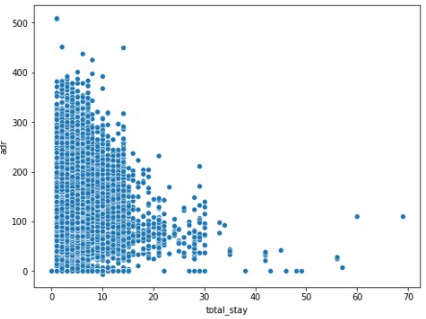
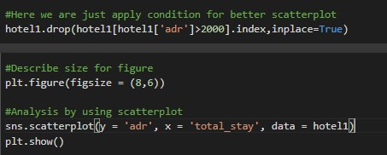
Scatter plot analysis

Slide 10
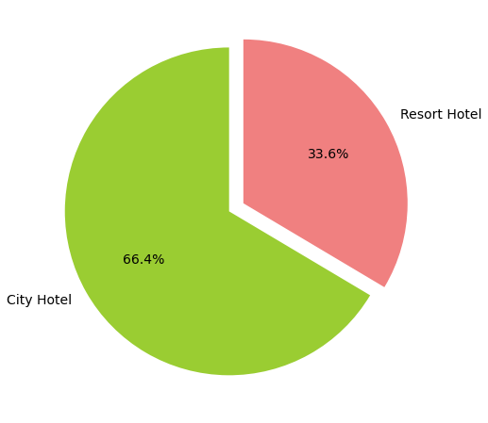
Hotel wise analysis
Type of hotel in the market and percentage in each Type?
According to Analysis city hotels are comparatively more expensive than resort hotels.
city hotel having 66.4% and Resort hotel having 33.6% percentage in hotel market
Resort hotel should me more expensive so, peoples are stick to city hotel

Slide 11
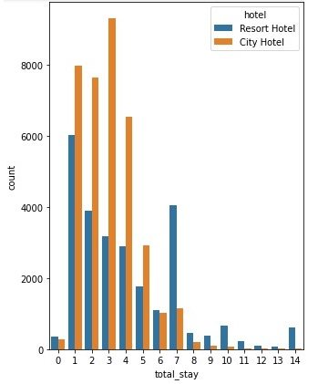
Which Hotel has higher lead time and preferred stay in each hotel?
Lead time of city hotel is more than Resort Hotel
Resort hotel having longer stay compared to city hotel.i.e.For short stay peoples are choose City Hotel

Slide 12
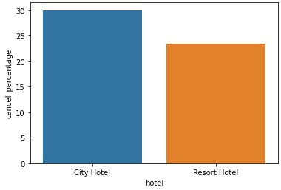
Which hotel has a higher bookings cancellation rate?
City Hotel bookings are more cancelled than Resort hotel

Slide 13
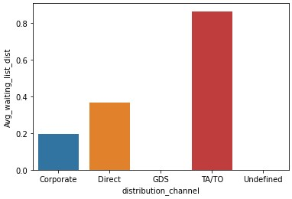
Which distribution channel has a longer average waiting time?
TA/TO distribution channel having longer waiting time compared to Corporate and Direct
The term “TA” means “Travel Agents” and “TO” means “Tour Operators”

Slide 14
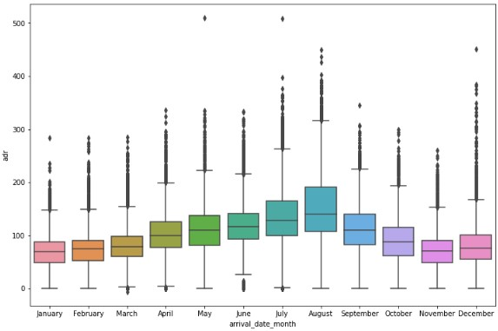
Which month hotels have high revenue?
Less peoples are visited to Hotel in January month.so,revenue having huge cut off
But, hotels have large revenue in August due to more people visiting.

Slide 15
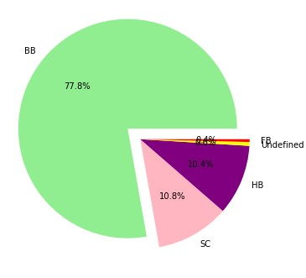
Which type of meal is booked?
BB.(i.e. Bed & Breakfast) is most preferable type of meal for 77.8% guest
Categories as per standard
hospitality meal package
Undefined/SC — no meal package
BB — Bed & Breakfast
HB —Half board (breakfast and one other meal — usually dinner)
FB — Full board (breakfast, lunch and dinner)

Slide 16
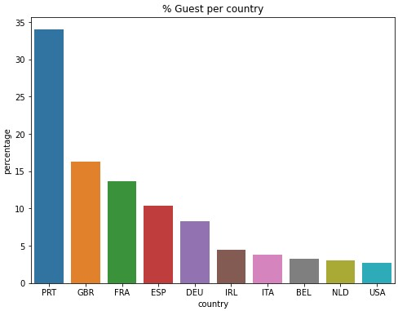
Find from which country most guests come from?
Most of the peoples are come from PRT (i.e. Portugal)

Slide 17
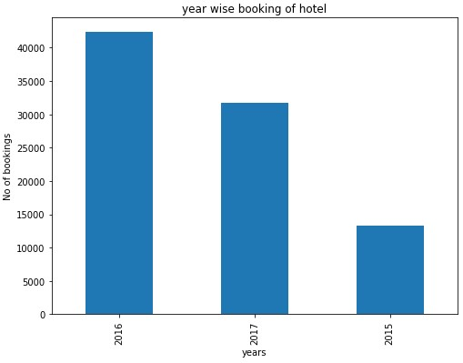
Year wise booking of hotel?
From Graph it is clear that 2016 had higher bookings compared to 2017 and 2015.
so,according to given data there is increment of booking with alternate years

Slide 18
Challenges
Data set having huge data need to segregate.Also,dataset having lots of duplicate value.
Lots of null values in the dataset.
Handling null values and replace them with Zero or ‘text'. Do with care so that it doesn’t affect analysis.
Choosing visualization for different analysis.

Slide 19
Conclusion
Average daily rate (adr) is directly proportional to totle_peoples.No peoples increases then revenue must be increased.
The percentage of city hotel is 66.45%.while the percentage of resort hotel is 33.55% is use to stay.So,City hotel connect more no of peoples and having higher lead time
For longer stay peoples are choose Resort hotel and for short stay choose city hotel
City Hotel bookings are more cancelled
Here,TA/TO distribution channel having longer waiting time
More people visit hotels in August and less people visit in January.
BB.(i.e. Bed & Breakfast) is most preferable type of meal for 77.8% guest
Most of the peoples are come from PRT (i.e. Portugal)
Year 2016 having higher bookings compared to year 2017 and 2015.

Slide 20
Reference
Almabetter
Geeksforgeeks
Stackoverflow
w3schools

Slide 21
Thank you

