Slide 1
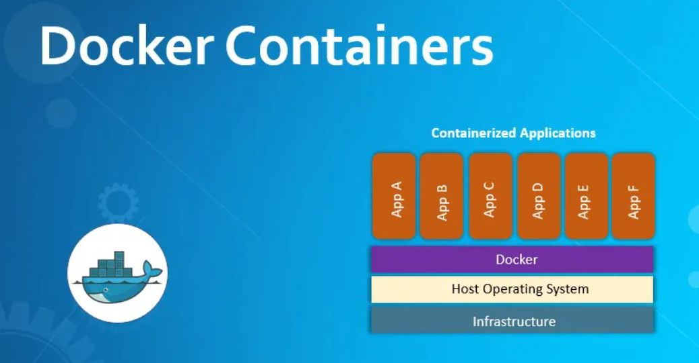
Docker

Slide 2
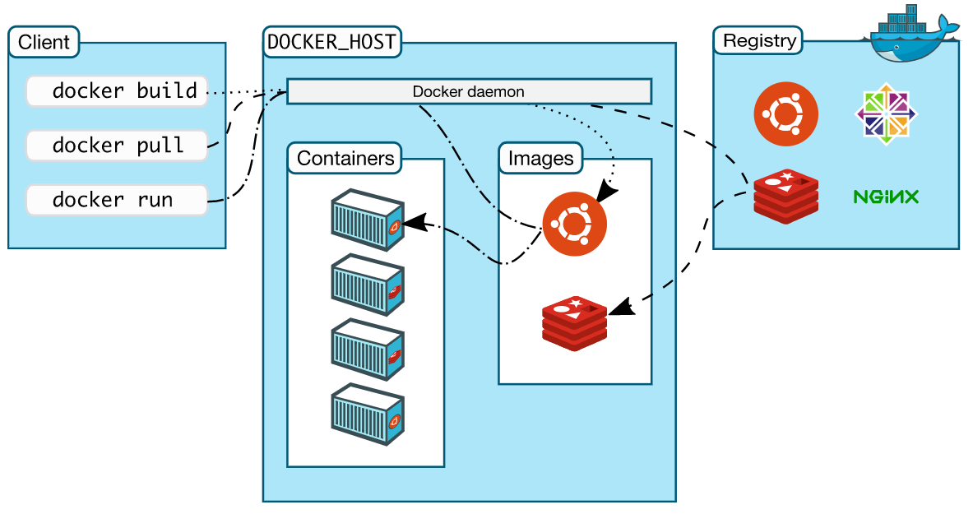
What is Docker and why it is used
DOCKER is a tool designed to make it easier to create, deploy, and run applications by using containers. containers allow a developer to package up an application with all of the parts it needs, such as libraries and other dependencies, and ship it all out as one package.

Slide 3
Install and Use Docker on CentOS 7
Prerequisites
64-bit CentOS 7 Droplet
Non-root user with sudo privileges. A CentOS 7 server set up using Initial Setup Guide for CentOS 7 explains how to set this up.
Installing Docker
# sudo yum update -y
# sudo yum install yum-utils device-mapper-persistent-data lvm2
# sudo yum-config-manager --add-repo https://download.docker.com/linux/centos/docker-ce.repo
# sudo yum install docker-ce
# sudo systemctl start docker
# sudo systemctl enable docker
# sudo systemctl status docker

Slide 4
Using the Docker Command
Command syntax
# docker [option] [command] [arguments]
To view all available subcommands
# docker
To view the switches available to a specific command
# docker docker-subcommand --help
To view system-wide information
# docker info

Slide 5
Working with Docker Images
Docker containers are run from Docker images. By default, it pulls these images from Docker Hub, a Docker registry managed by Docker. Anybody can build and host their Docker images on Docker Hub, so most applications and Linux distributions you'll need to run Docker containers have images that are hosted on Docker Hub.
To check whether you can access and download images from Docker Hub
# docker run hello-world
You can search for images available on Docker Hub by using the docker command with the search
# docker search centos
you can download images to your computer using the pull
# docker pull centos
To see the images that have been downloaded to your computer
# docker images
To delete docker images
# docker rmi <7a86f8ffcb25 >

Slide 6
Setting a trust on image download
Export trust to ENV variable temporary
export DOCKER_CONTENT_TRUST=1
To add a trust Permanente edit and add below entry in /etc/environment
DOCKER_CONTENT_TRUST=1
Exporting and importing the container from one host to other
Export from source:
docker export 4caf9bf4a32c > /tmp/alpineexport.tar
Import in designation
cat /tmp/alpineexport.tar | docker import - exportedImg:latest

Slide 7
Docker Container
Creating and running the container:
# docker container create –name mycentos –p 8050:80 <img name or ID>
# docker container start -d <container ID>
Running container directly:
# docker container run (-d or -it) –name <Name for container> -p 8050:80 <image name>
# docker container ls (or) ls –a → to list all container with is running and existed
# docker ps (or) ps –a
# docker run -it busybox /bin/bash
Stopping, killing, removing the container:
# docker <stop (or) kill> <Container ID>
# docker container prune --> To remove all stopped containers

Slide 8
Command to inspect a container
# docker container inspect dbf128e9c141
Container history and log:
# docker history <img name> <container>
# docker container logs <container ID>
To access the container
# docker container exec –it <con ID> bash
# docker attache <container ID> --> existing process have to run
# ctrl + p q to come out from container without stopping
running container with privileged access:
# docker run -d --privileged -p 8080:80 --name test centos:7 /sbin/init
# docker inspect --format='{{.HostConfig.Privileged}}' [container_id]
# docker exec -it d293571f6619 /bin/bash

Slide 9
Docker volume
Listing and creating volume
# docker volume ls
# docker volume create myvolume
Inspecting volume for detail info
# docker volume inspect myvolume
Creating container with docker volume:
# docker run -it --name=myjenkins1 -p 8080:8080 -p 50000:50000 --mount source=myvolume,destination=/var/jenkins_home jenkins/jenkins
Creating local directory and mounting the volume:
# mkdir jenkins
# chmod 777 jenkins/
# docker run -it --name=jenkins4 -p 8081:8080 -p 40000:50000 -v /home/jenkins/:/var/jenkins_home jenkins/jenkins

Slide 10
Bind Mount
Bind mount will help to mount the shared drives inside the docker container
docker run -d --mount type=bind,src="/data/ha",dst=/data centos:7 /sbin/init
Container specific tmpfs mount
docker run -it --mount type=tmpfs,dst=/logs centos:7

Slide 11
Docker Networking
Creating container under bridge network
docker network ls → To list available networks
docker run -dit --name alpine1 alpine ash
docker run -dit --name alpine2 alpine ash
docker network inspect bridge → To check detail about bridge network in docker
docker attach alpine1 → To connect running container.
Creating custom network and creating container
docker network create --driver=bridge --subnet=172.19.0.0/16 --gateway=172.19.0.1 mynet
docker network ls # docker network inspect mynet
docker run -dit --name alpine3 --network mynet alpine ash
docker run -dit --name alpine4 --network mynet alpine ash
docker network inspect mynet

Slide 12
Connecting two different network and testing
docker network connect bridge alpine3
docker network inspect bridge
docker network inspect mynet
docker attach alpine1
docker container attach alpine4
Disconnecting/connecting docker container from one network to other
docker network disconnect bridge alpine1
docker ps -a
docker container inspect <4caf9bf4a32c>
docker network connect mynet alpine1
docker container inspect <4caf9bf4a32c>

Slide 13
Docker build
Method 1
#mkdir /test
#touch /test/Dockerfile
#vim /test/index.html
#vi Dockerfile
FROM centos:latest
MAINTAINER sasi
RUN yum -y install httpd
COPY index.html /var/www/html/
CMD [“/usr/sbin/httpd”, “-D”, “FOREGROUND”]
EXPOSE 80
#docker build /test/ -t webserver:v1
#docker run –dit –p 1234:80 webserver:v1
Method 2
#docker pull centos:latest
#docker images
#docker run –it –name webserver centos:latest
#yum install httpd –y
# vi /var/www/html/index.html
# exit
#docker commit webserver webserver:v1
#docker run –p 8050:80 webserver:v1 /usr/sbin/httpd –D FOREGROUND

