Slide 1
Introduction
This case study explores the implementation of a service- oriented architecture(SOA) for an
e-commerce platform. The goal is to integrate various system such as User management service,
product catalo service, order management service, payment service, review and rating services,
search service, notification service to create a seamless and efficient e-commerce solution.
Deepanshu Malviya
deepanshumalviya428@gmail.com

Slide 2
Overview of e-commerce service
Overview: Imagine an eCommerce platform that sells various products online. The platform uses SOA to achieve modularity, scalability, and flexibility in its architecture.
Key Components:
User Management Service: Handles user authentication, registration, and profile management.
Product Catalog Service: Manages product information, categories, and inventory.
Order Management Service: Processes orders, manages cart functionality, and handles order history.
Payment Service: Integrates with payment gateways to process payments securely.
Review and Rating Service: Manages customer reviews and ratings for products.
Search Service: Provides search functionality across products and categories.
Notification Service: Sends notifications to users about order updates, promotions, etc.

Slide 3
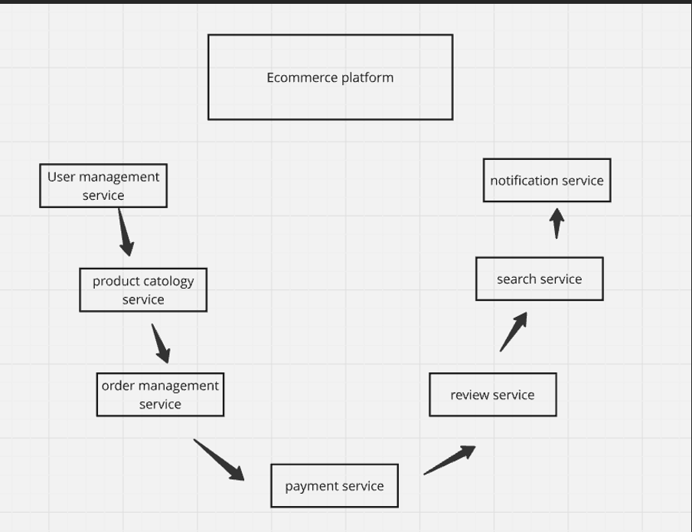

Slide 4
Advantages of SOA in eCommerce:
Modularity: Each service can be developed, deployed, and maintained independently, promoting agility and scalability.
Scalability: Services can scale independently based on demand, improving performance and user experience.
Flexibility: Enables easy integration of new features or third-party services through well-defined APIs.
Resilience: Fault isolation—failure in one service does not necessarily affect others, ensuring high availability.

Slide 5
Conclution:-
Implementing an SOA approach in e-commerce integration enhances the flexibility, scalability, and maintainability of the platform. By utilizing a service-oriented architecture, the e-commerce platform can efficiently handle various business processes and adapt to changing business needs. The provided UML diagrams offer a visual representation of the system architecture and interactions, aiding in the understanding and development of the platform

