Slide 1





Transdisciplinary project
TITLE
AI BASED GARBAGE WASTE MANAGEMENT SYSTEM
PRESENTATION BY :……
PRESENTATION SUBMITTED TO:……
            AKRATI GAUTAM (BCA)
            ADITYA SINGH DUMOLIYA (BPT)
            DEEPANSHU MANGHNANI (BTECH AI)
            VISHAL MEENA (ABM)
            KHALIFA RABIU MIKO (B.PHARMA)
Er. VISHVENDRA SINGH

Slide 2
DISCUSSION – ISSUE WITH CONVENTIONAL WASTE MANAGEMENT SYSTEM
Conventional waste management systems face challenges such as :
•over-reliance on landfills
•environmental pollution
•inefficient resource utilization
•limited public awareness
•inadequate infrastructure
•hazardous waste management issues
•rising waste generation
•economic burden
•globalization impacts
•contributions to climate change
Group 2 | Presentation

Slide 3
THE AIM OF THE PRESENTATION
1. Smart waste bins
2.Internet of things(IOT) integration
3.Data analysis and predictive modeling
4.Waste-to-energy technology
5.Community engagement and education
6.Circular economy practices

Slide 4

Concept of AI based waste management system
AI-based garbage waste management system leverages artificial intelligence technologies to optimize and enhance the efficiency of waste management processes.
This system integrates smart sensors, data analytics, and machine learning algorithms to monitor, categorize, and manage waste effectively.
By automating tasks such as waste collection, sorting, and recycling, the AI-based system minimizes human intervention, reduces operational costs, and contributes to a more sustainable and environmentally friendly waste management approach.
This technology enables real-time monitoring, predictive analysis, and the implementation of smart strategies to address waste-related challenges in a more intelligent and resource-efficient manner.

Slide 5
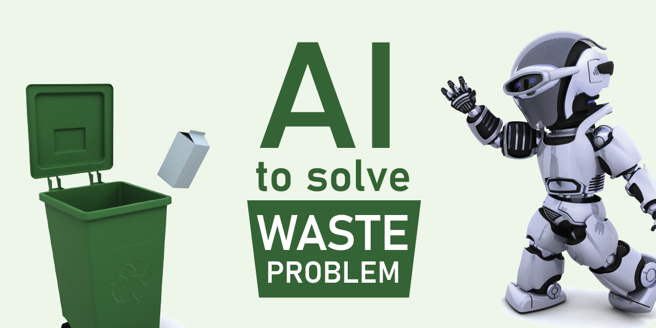
How AI works in waste management
AI plays a crucial role in sorting and categorizing waste by enhancing efficiency and accuracy in waste management processes. Here's a brief explanation:
Image Recognition: AI-powered systems use computer vision to analyze images of waste items. Cameras capture images of incoming waste, and AI algorithms identify and classify the items based on predefined categories (e.g., plastic, paper, glass).
Machine Learning: AI systems can be trained with machine learning algorithms to improve their accuracy over time. As they encounter more examples of different types of waste, the algorithms can adapt and become better at recognizing and categorizing items.
Automation: AI enables the automation of sorting processes in waste management facilities. Automated robotic arms or conveyor belt systems equipped with AI technology can quickly and accurately separate different types of materials, improving the overall efficiency of the sorting process.

Slide 6

Machine learning algorithms used for waste recognition
  Machine learning algorithms used for waste recognition employ computer vision techniques to analyze visual data and identify different types of waste. Two common types of algorithms include:
  Convolutional Neural Networks (CNNs): These are deep learning algorithms specifically designed for image recognition. CNNs excel at learning hierarchical features from visual data, making them effective in identifying and classifying objects within images, including different types of waste materials.
  Support Vector Machines (SVMs): SVMs are a type of supervised learning algorithm that can be used for classification tasks. In waste recognition, SVMs can be trained on labeled data to distinguish between various waste categories based on specific features extracted from images.
  These algorithms, along with others like decision trees or ensemble methods, contribute to the development of intelligent waste recognition systems that can automate the sorting and categorization of waste materials in an efficient and accurate manner.

Slide 7
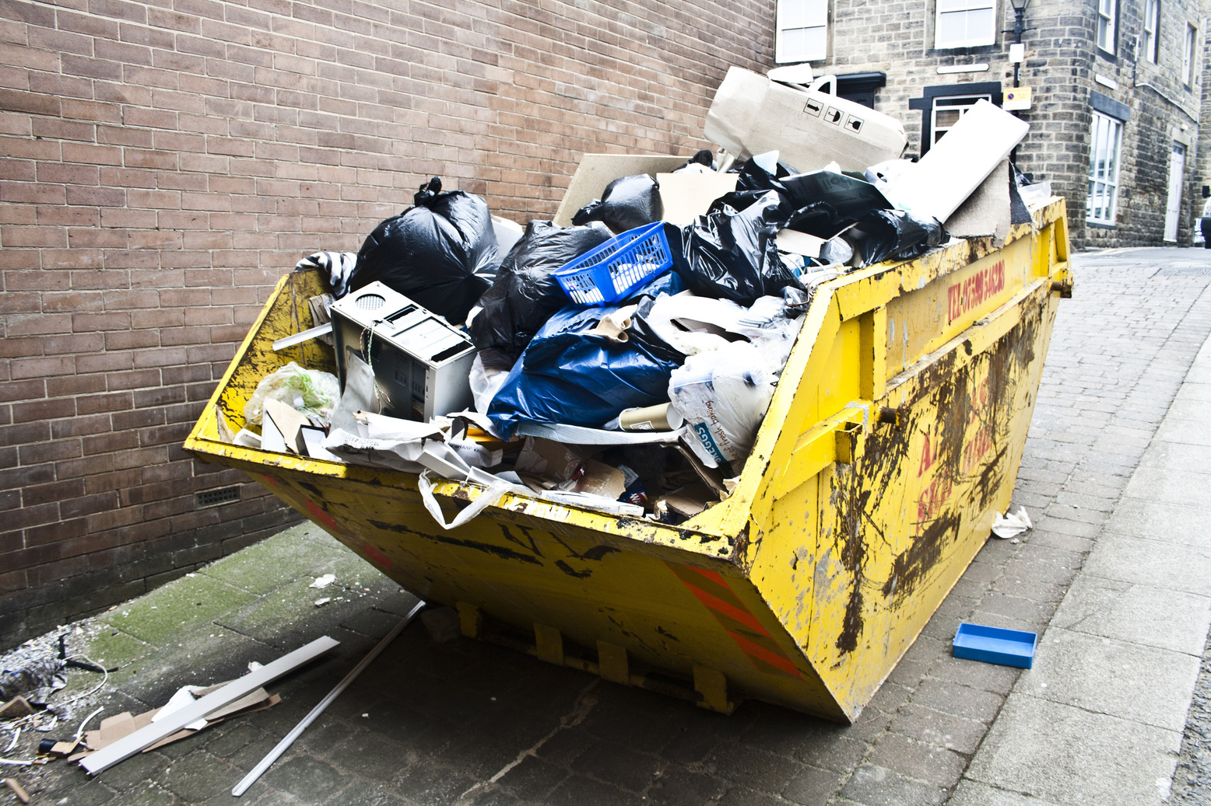

Benefits of AI in waste management
  1. **Optimized Collection Routes:** AI analyzes historical data and real-time information to optimize waste collection routes, minimizing fuel consumption and reducing carbon emissions.
  2. **Fill Level Prediction:** AI sensors monitor waste bin fill levels, predicting when they need emptying. This prevents unnecessary pickups, saving resources and reducing the environmental impact of collection vehicles.
  3. **Efficient Resource Allocation:** AI algorithms assist in allocating resources, such as personnel and vehicles, based on demand patterns and specific waste types. This ensures a more efficient use of resources over time.
  4. **Predictive Maintenance:** AI helps predict equipment failures, allowing for proactive maintenance of waste management machinery. This reduces downtime and extends the lifespan of equipment, ultimately cutting down on waste and costs.
  5. **Smart Sorting Systems:** AI-powered sorting systems in recycling facilities enhance accuracy by identifying and separating different materials. This improves the quality of recycled materials and promotes a more effective recycling process.
  6. **Data-Driven Decision Making:** AI processes vast amounts of data, enabling informed decision-making for waste management strategies. This data-driven approach contributes to long-term planning and continuous improvement.

Slide 8
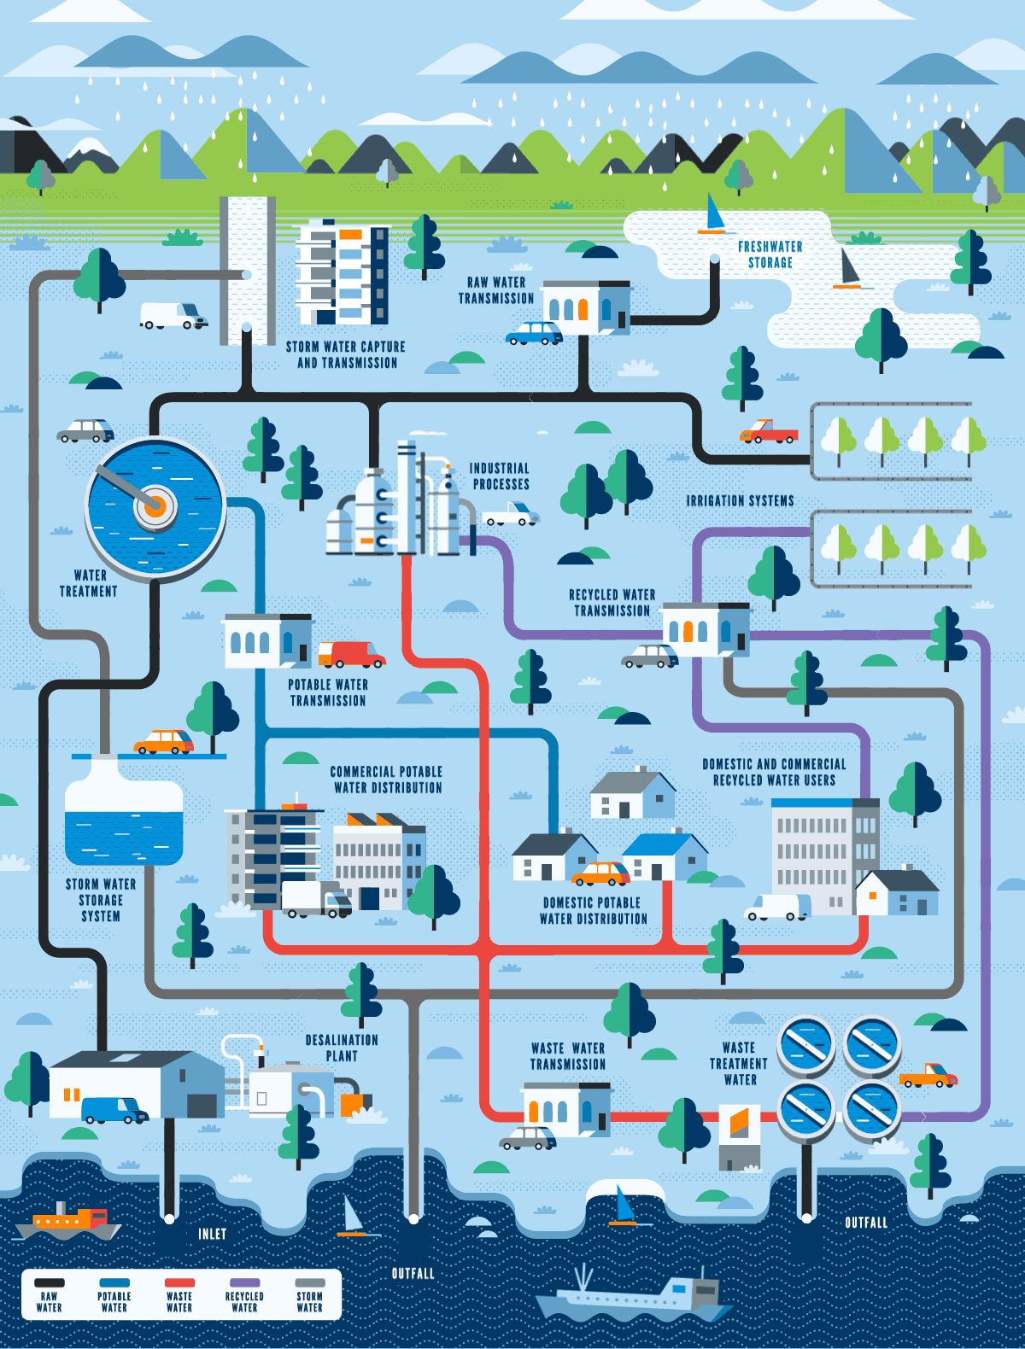
Positive outcomes of adopting AI in waste management
Efficient Collection Routes: AI optimizes waste collection routes, cutting fuel use and emissions.
Smart Bin Monitoring: Real-time monitoring reduces unnecessary collections, saving fuel and lowering emissions.
Recycling Precision: AI improves sorting accuracy, boosting recycling rates and reducing landfill waste.
Energy Savings: AI optimizes energy use in waste facilities, cutting greenhouse gas emissions.
Illegal Dumping Prevention: AI detects and prevents illegal dumping, protecting the environment.
Data-Driven Decisions: Informed decisions through AI analysis lead to more effective waste management.
Landfill Reduction: AI promotes responsible disposal, reducing the need for landfill space.

Slide 9
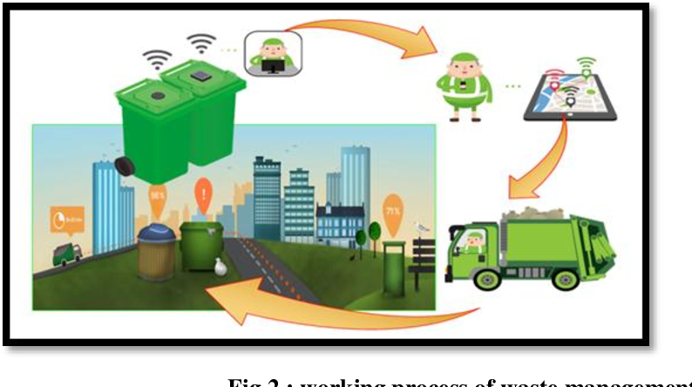
Conclusion
AI plays a crucial role in revolutionizing waste management, bringing efficiency, precision, and sustainability to the forefront. From optimizing collection routes to enhancing recycling processes, AI transforms how we handle waste, contributing to a greener and more environmentally conscious approach to managing our resources. Its ability to analyze data, predict maintenance needs, and curb illegal dumping reinforces its significance in reshaping the future of waste management for a healthier planet.

Slide 10



THANK YOU
group 2

