Slide 1

IILM UNIVERSITY, GREATER NOIDA
School of Computer Science and Engineering
Summer Internship Presentation
DATA SCIENCE MASTER
VIRTUAL INTERNSHIP
Siemens – AICTE EduSkills Virtual Internship Program | RapidMiner Platform
Deepanshu Sharma
Roll No.: 2410030927 | Section: 3CSE6
B.Tech CSE – 5th Semester
Organization: EduSkills Foundation (Supported by Siemens & Altair)

Slide 2








Agenda
Introduction & Organization Profile
Methodology – Week-wise Journey
Problem Statement & Objectives
Expected Outcomes & Learnings
Scope & Technologies Used
Certifications Achieved
System Architecture
Conclusion
Data Science Master Virtual Internship
2

Slide 3
Bridging Academia and Industry
Data science and machine learning are now core industry requirements. AICTE, EduSkills Foundation, Altair Engineering, and Siemens jointly run structured Virtual Internship Programs to build these skills in engineering students.
As part of my 5th-semester curriculum at IILM University, I completed the 8-week “Data Science Master” Virtual Internship (April–June 2026) on the RapidMiner platform.
The program covered the complete data science lifecycle — from identifying business problems to deploying and monitoring ML models.
CHAPTER 1
Introduction
Data Science Master Virtual Internship
3

Slide 4



Organization Profile
EduSkills Foundation
RapidMiner (An Altair Company)
Siemens Industry Software
Section-8, ISO 9001:2015 & ISO 20000-1:2015 certified, “Great Place to Work” certified not-for-profit. Mission: “Nation Building Through Skills.” Partners with AICTE & the National Internship Portal.
Leading enterprise data-science and machine-learning platform providing the internship's technical curriculum and certifications for data preparation, modelling, and deployment.
Global industrial software leader that supported the program, reflecting real industry backing for the skills taught.
Data Science Master Virtual Internship
4

Slide 5
Problem Statement & Objectives
Objectives
The Problem
Identify business problems suitable for AI/ML solutions
Engineering graduates often have strong theory but little hands-on exposure to industry-grade data science tools and end-to-end ML workflows. Most academic exercises stop at notebook-level modelling and skip data engineering at scale, deployment, and platform administration — skills recruiters actively seek.
Access, load, transform & calculate data at scale
Build foundational to advanced ML models
Deploy and monitor models in production-like settings
Gain enterprise platform administration skills (AI Hub, Radoop)
Earn industry-recognised RapidMiner certifications
Data Science Master Virtual Internship
5

Slide 6

Scope & Technologies Used
A curriculum-based virtual internship (not a live client engagement) covering 8 weekly modules from foundational to advanced levels, using sample datasets within the RapidMiner learning environment.
RapidMiner Studio
RapidMiner AI Hub
RapidMiner Radoop
Real-Time Scoring
RapidMiner Marketplace
Visual, code-free workflow designer for data prep, ML & validation
Centralized platform to deploy, schedule & manage models
Runs processes on Hadoop/Spark for big-data workloads
Exposes trained models as real-time scoring web services
Extension repository for additional operators & connectors
Data Science Master Virtual Internship
6

Slide 7

System Architecture
RapidMiner's modular, pipeline-based architecture supports the full data-science lifecycle
1
2
3
4
5
6
Data Access
Data Engineering
Modelling
Validation
Deployment
Admin & Monitoring
Connect to files, databases & repositories
Load, clean, transform & calculate data
Apply ML algorithms to build predictive models
Cross-validate & evaluate model performance
Publish models to AI Hub / Real-Time Scoring
Manage users, jobs & infra via AI Hub / Radoop
Data Science Master Virtual Internship
7

Slide 8
Methodology – Week-wise Journey
W1
Applications & Use Cases Professional
Identify business problems suitable for AI/ML
W2
Data Engineering Professional
Access, load, transform & calculate data
W3
Machine Learning Professional
Build foundational ML skills
W4
Data Preparation Master
Master advanced data handling & automation
W5
Machine Learning Master
Learn advanced ML techniques
W6
Applications & Use Cases Master
Deploy and monitor ML models
W7
Platform Administration Master
Configure & manage RapidMiner AI Hub
W8
Platform Administration Master
Enterprise-level platform operations
Final Credential Validation / Internship Grade Point Assessment
Data Science Master Virtual Internship
8

Slide 9
Expected Outcomes & Key Learnings
Hands-on proficiency in end-to-end RapidMiner data-science workflows
Two Master-level certifications: Applications & Use Cases, Platform Administration
Completed the 8-week internship with an overall Grade of O (Outstanding)
Practical understanding of enterprise model deployment, monitoring & administration
Data Science Master Virtual Internship
9

Slide 10
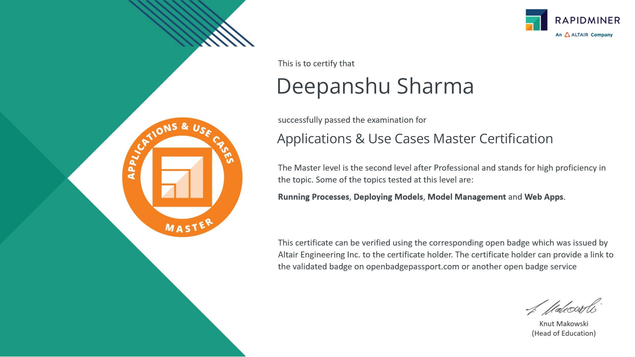
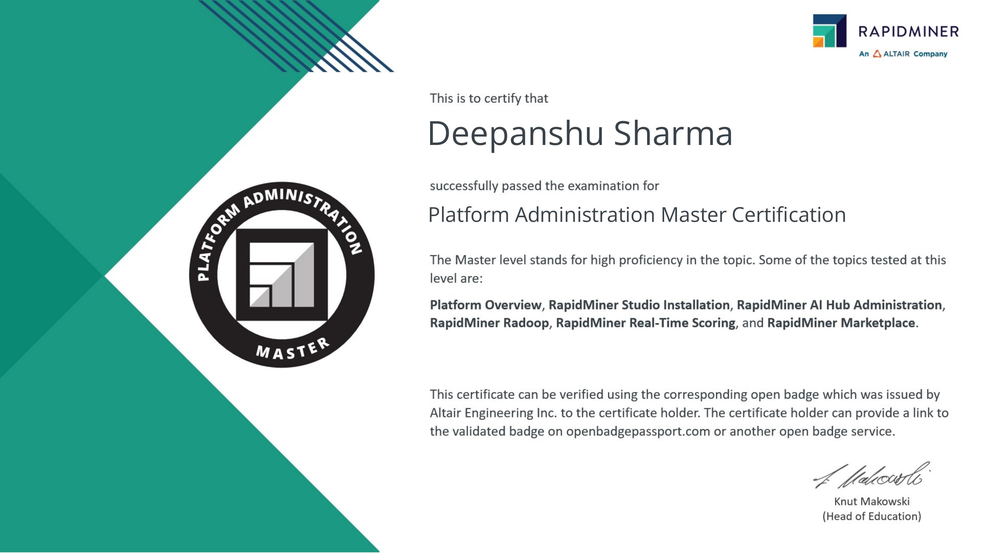
Certifications Achieved
Overall Internship Grade: O – Outstanding (90–100)
Certificate ID: 456d9d7f03e3629aac11 | Student ID: STU699effc8d7f5a1772027848
Data Science Master Virtual Internship
10

Slide 11
Conclusion
This internship strengthened my practical foundation in data science and machine learning — from data engineering to model deployment — using an industry-grade platform, directly supporting my goal of pursuing AI/ML and agentic-systems roles.
Thank You
Deepanshu Sharma | 2410030927 | 3CSE6

