Slide 1


Understanding Maven lifecycle
Goals, Advantages and usage

Slide 2
Introduction to maven
Apache Maven:
Definition: Maven is a software project management and comprehension tool. Based on the concept of a Project Object Model (POM).
Functions: Simplifies builds, manages dependencies, enforces project structure.
Key Concept: Project Object Model (POM).
Just as a project manager coordinates tasks and resources, Maven coordinates the compilation, testing, and packaging of your code. It saves time by automatically resolving dependencies from repositories, just like ordering supplies from trusted vendors.

Slide 3
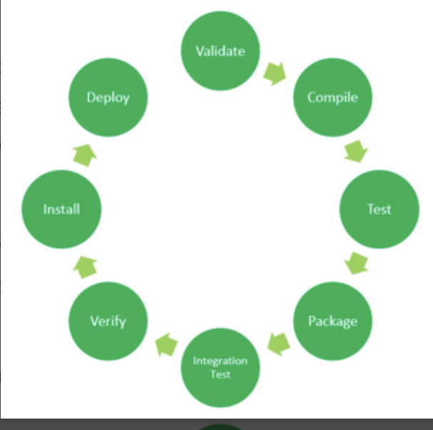
Maven lifecycle overview

Slide 4
Goals of maven
They are specific tasks that Maven can perform during the build lifecycle.
clean: It removes the previously generated artifacts, which reduces the the risk of conflicts or outdated files.
install: Installs the project into the local repository for use as a dependency in other projects.
test: The test goal is used to run the tests for the project. It executes the unit tests defined in the project.
package: Packages the application into a JAR or WAR file.
mvn command(goal name)

Slide 5
Advantages of maven
Seamless Dependency Management: Maven simplifies the management of Spring dependencies.
Consistent Build Process: Ensures a consistent and repeatable build process for Spring applications.
Integration with Spring Boot: Maven integrates well with Spring Boot for building standalone Spring applications.

