Slide 1
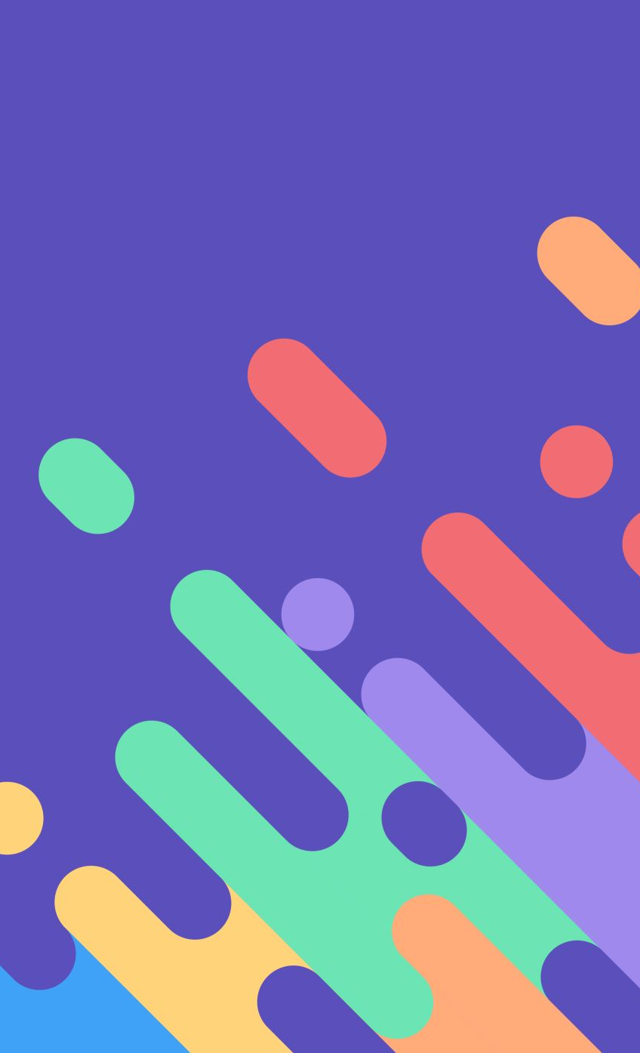
Gemini ChatBot
Deepan Krishna Tripathy
Notes:
Good [morning/afternoon/evening], everyone. Today, I'm excited to present a project I've been working on: a chatbot built using Vertex AI and Streamlit. This presentation will provide an overview of the project, the tools and technologies used, a walkthrough of the code, and a live demo of the chatbot in action. We will also discuss the potential improvements and future work. Let's dive in!"

Slide 2
Project Overview
Motivation
Features
Technical Stack
Project Goals

Slide 3
Motivation
Interactive chatbot that can respond to user queries in a natural and conversational manner.
Demonstrate capability of Gemini API and integrate it with a web interface.
Notes:
To create an interactive chatbot that can respond to user queries in a natural and conversational manner. To demonstrate the integration of Vertex AI's generative models with a web-based interface built using Streamlit.

Slide 4
Technical Stack
Vertex AI: Provides the backend for generative models, enabling natural language understanding and generation.
Streamlit: A Python library used for creating the front-end interface, making it easy to deploy and interact with the chatbot.

Slide 5
Vertex AI
Vertex AI is a managed machine learning (ML) platform provided by Google Cloud.
Key Features:
Generative models
Unified Interface
Scalability
Integrated Tools
Efficiency
Flexibility
Performance
Security
Notes:
Vertex AI is a managed machine learning (ML) platform provided by Google Cloud that enables developers and data scientists to build, deploy, and scale ML models with ease. Simplifies the end-to-end ML workflow, from data preparation to model deployment and monitoring. which include support for TensorFlow, PyTorch, and other ML frameworks.
Key features:
Generative Models: Vertex AI supports advanced generative models that can understand and generate human-like text, making it ideal for chatbot applications.
Unified Interface: Provides a single platform to manage datasets, train models, and deploy them into production.
Scalability: Designed to handle ML tasks at scale, supporting large datasets and complex model architectures.
Integrated Tools: Includes tools like AutoML for automated model training, custom model training, and hyperparameter tuning.
Efficiency: Streamlines the ML workflow, reducing the time and effort needed to develop and deploy models.
Flexibility: Supports custom model development as well as pre-built models for common use cases.
Performance: Leverages Google Cloud's infrastructure to provide high-performance computing resources for ML tasks.
Security: Ensures data and model security with built-in features for compliance and privacy.

Slide 6
StreamLit
Streamlit is an open-source Python library designed to create and share custom web applications.
Allows developers to quickly build and deploy interactive, data-driven web applications with minimal effort.
Key Features:
Simplicity
Interactivity
Real-Time Updates
Integration
Notes:
Streamlit is an open-source Python library designed to create and share custom web applications for machine learning and data science projects.
Key Features:
Simplicity: Write apps in pure Python, without needing any front-end development experience.
Interactivity: Easily add interactive widgets such as sliders, buttons, and text inputs to your apps.
Real-Time Updates: Automatically updates the app when the underlying code changes, providing a seamless development experience.
Integration: Works well with other Python libraries like Pandas, NumPy, and Plotly, enabling rich data visualization and manipulation.

Slide 7
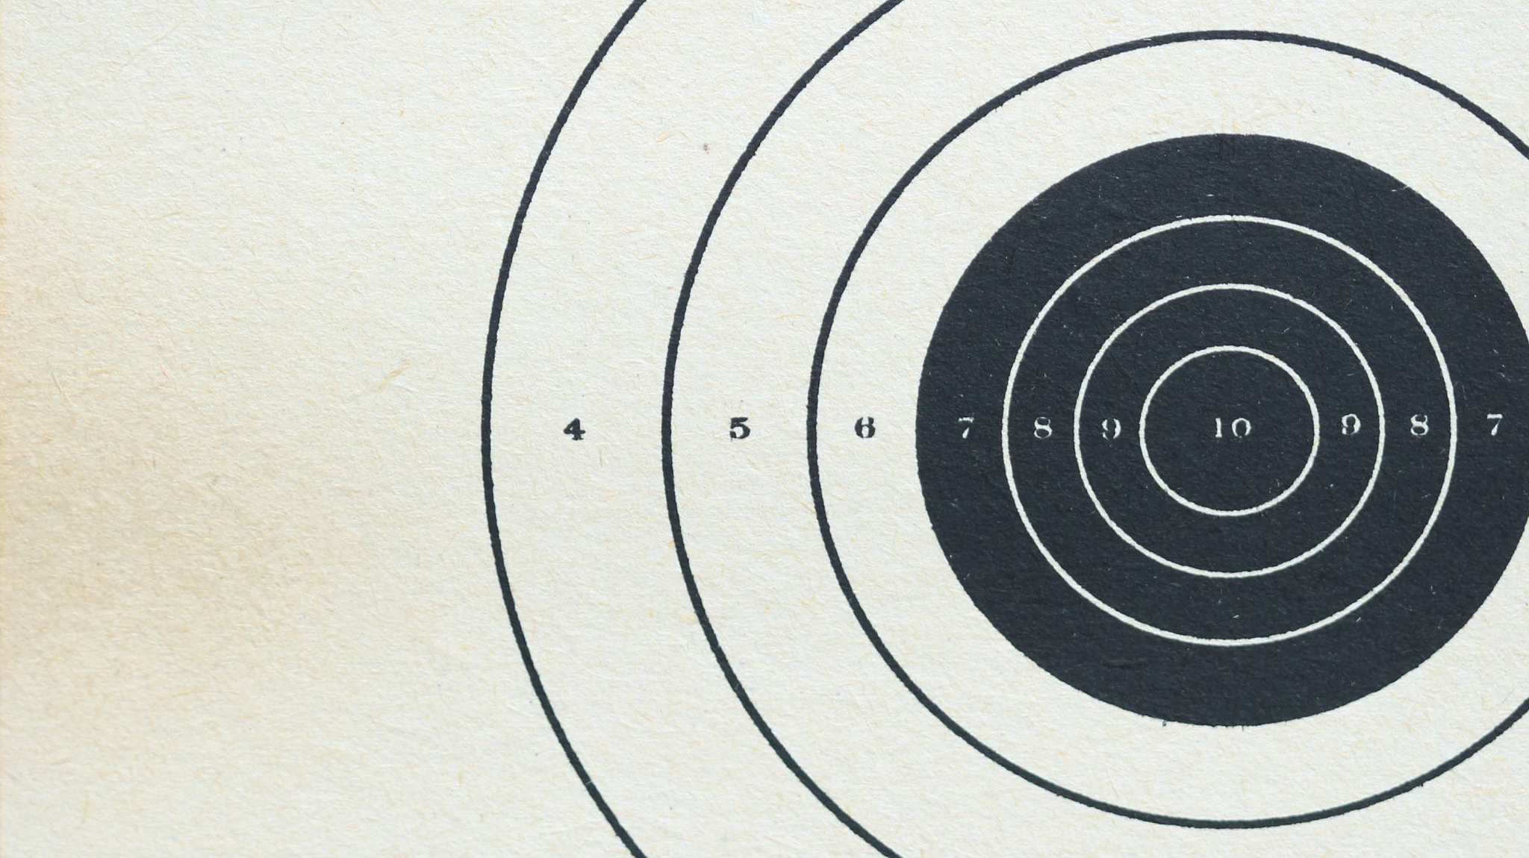
Demo

Slide 8
Project Goals
Integration
Usability
Scalability
Notes:
Integration: Seamlessly integrate Vertex AI's capabilities with Streamlit to build a cohesive chatbot application.
Usability: Ensure the chatbot is easy to use, with clear prompts and responses.
Scalability: Design the chatbot framework to be easily extendable for future enhancements.

Slide 9

Thank You

