Slide 1

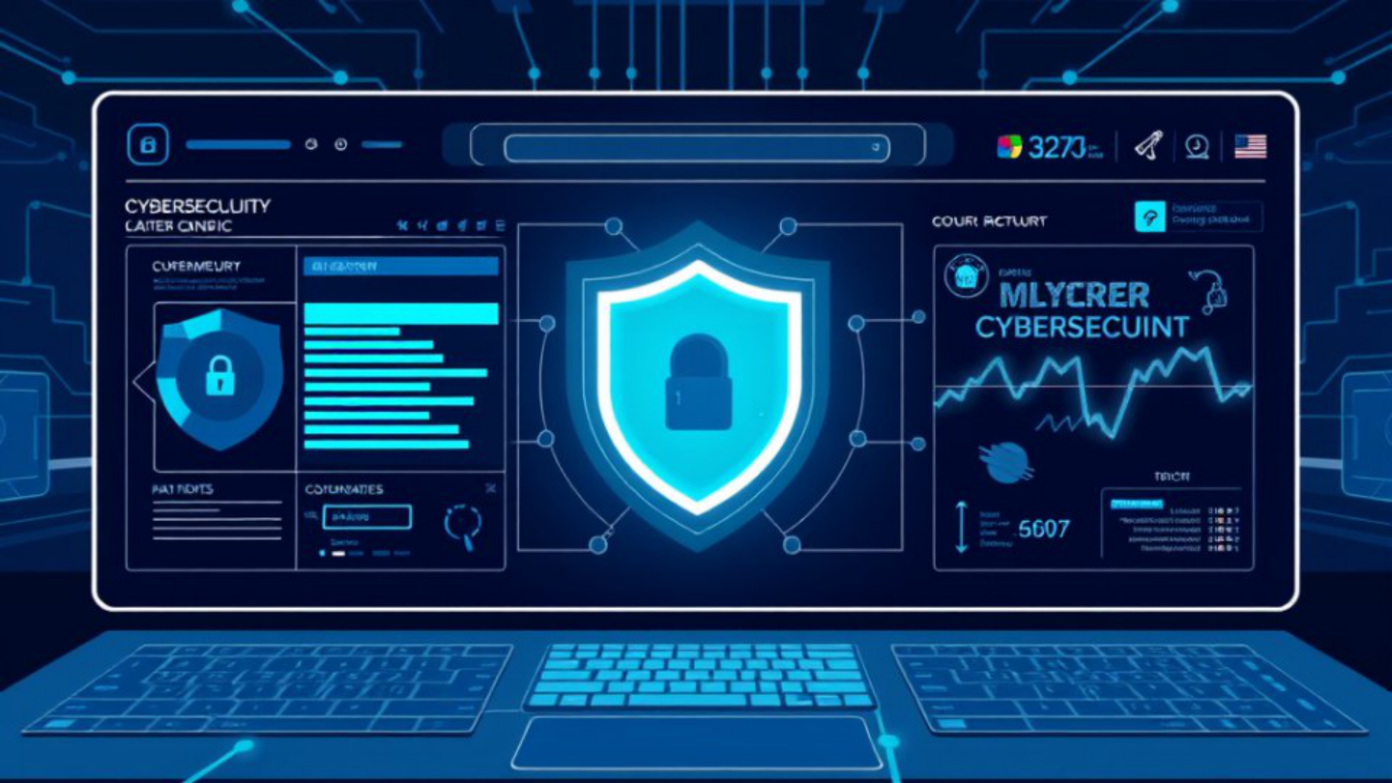




SECURE DIGITAL ACCESS
Integrated Age- and Content-Appropriateness
Firewall with Email Verification
Under the Guidance of: Mrs. Shanti Kumari
PROJECT PRESENTATION
Cyber-Safety Framework
Protecting young users through controlled access
Verification · Filtering · Trust

Slide 2



PROJECT OVERVIEW
Abstract
SAFE ACCESS AT THE NETWORK BOUNDARY
This project proposes a practical firewall that combines age-based access control,
real-time content appropriateness checks, and email-domain verification. It
evaluates URLs and page content before access, applies rules for student or staff
profiles, and validates MX records to block suspicious, disposable, or fake domains—
helping institutions reduce unsafe browsing and risky registrations while creating a
scalable, safer digital environment.

Slide 3






RESEARCH SUMMARY
Literature Survey
Prior work establishes strong building blocks for safer access—but keeps browsing and
email protection largely separate.
WHAT THE RESEARCH SHOWS
01
Layered web enforcement works best
Filtering, age-based policy rules, proxies, and real-time classification improve controlled
IDENTIFIED LIMITATION
access.
Most solutions protect
browsing or email—not
02
Email trust depends on verification
both.
SPF, DKIM, DMARC, and MX checks help validate sender domains and reduce spoofing
risk.
Research direction
An integrated policy engine can
03
Key gaps remain at the policy boundary
connect access control, traffic
Disposable-email detection and student-safe access policies remain underdeveloped.
inspection, and domain trust.

Slide 4




CURRENT STATE · CONTENT SAFETY
Existing System
Today’s controls are fragmented: they block known signals, not harmful context.
What exists
Where it breaks
Basic controls target familiar signals
Known-signal defenses miss evolving risk
URL blacklists and keyword matching
Alternate accounts and proxies bypass age restrictions
Firewalls enforce ports, protocols, and rules
No real-time understanding of page or media context
Age gates and email checks add basic friction
Separate tools create gaps and miss new harmful sites
Core gap: fragmented checks cannot consistently prevent inappropriate access.

Slide 5







PROPOSED SOLUTION
Safer access, verified at every layer
A unified system combines real-time content intelligence, firewall enforcement, and trusted
email verification.
Content Control
Firewall Enforcement
Email Verification
URLs and page content are analyzed in
Policy-violating pages are blocked
Domain validity and MX records are
real time against each user group’s
automatically before they reach the
checked to reject disposable,
age profile.
network user.
suspicious, and fake accounts.
•Institutional policy enforced centrally
•Trusted domains verified automatically
•Categories allowed by age profile
•Unauthorized pages rejected in real time
•Safer browsing for institutional users
•Suspicious registrations rejected early
One protective layer for safer browsing and more trustworthy registration.

Slide 6




PROJECT OBJECTIVES
Build a safer digital perimeter.
Three technical goals connect intelligent filtering, controlled access, and
trusted identity checks.
01
02
03
Content intelligence
Policy enforcement
Email trust checks
REAL-TIME
CONTROL
VERIFY
Use firewall-based access control
Validate MX records and block
Classify web content as age-
to enforce institutional policy.
disposable or suspicious domains.
appropriate or inappropriate.
Outcome: stronger online safety for schools and institutions.

Slide 7







SECURE ACCESS CONTROL
Methodology
A policy-driven pipeline turns requests and email signals into auditable access
decisions.
Content Enforcement
DECISION
Collect requests from browser and email-entry points, classify them by URL, category, and page text, then compare
Auditable
them with age-based access policies.
Firewall outcome: allow, block, or warn — with every decision logged.
Email Verification
Validate domains through DNS and MX records, then flag disposable domains and suspicious registration patterns
SIGNAL
before access is trusted.
Verified
Risk signals are retained for administrative review.

Slide 8




EXPECTED OUTCOMES
Safer access. Stronger control.
A practical foundation for trusted, age-appropriate digital access.
THE RESULT
What institutions gain
Age-appropriate access
Safer
Safer pathways to trusted online resources.
by design.
Stronger threat protection
Better defense against harmful content and fake email domains.
Protection becomes visible, enforceable,
and easier to trust.
Clearer institutional control
More visibility and consistent policy enforcement.

