Slide 1
IBM University Engagement Project Submission
“Exploring the Power of Agentic AI with IBM Granite and IBM Bob”

Slide 2

Project Tile – InterviewTwin – RAG-Powered Personalized Interview Trainer Agent (PS-22)
Domain of Project – Education / Career Development
Student Name | Recent Passport Photo | Email ID | Mobile number [WhatsApp]
Deepanvitha Katari |  | deepanvithakatari19@gmail.com | +91 9542967904

Slide 3
Problem Statement -
Problem Statement : Interview Trainer Agent (PS-22)
The Challenge
Job seekers preparing for interviews often struggle with structuring answers, anticipating role-specific questions, and identifying their own skill gaps. Interview questions, industry expectations, and behavioral guidelines are scattered across recruitment portals and professional networks. Without personalized, real-time coaching, many candidates underperform in interviews despite being genuinely qualified.
The Objective
Build an AI-powered Interview Trainer Agent (InterviewTwin) that delivers personalized interview questions and preparation strategies based on a candidate’s resume, experience level, and target job role. The solution should:
Personalized Question Sets – Generate tailored interview questions based on resume, job role, and experience level.
RAG-Based Retrieval – Retrieve role-specific questions and behavioral scenarios from a real interview knowledge base.
Resume & Job Match Analysis – Compare a resume against a job description to identify strengths and skill gaps.
Adaptive Mock Interviews – Adjust question difficulty and focus area in real time based on answers.
Technical & Soft Skill Coverage –
Technical Questions (role-specific, difficulty-adjusted)
Behavioral Questions (STAR-style scenarios)
HR Questions (motivation, career goals, fit)
Model Answers & Tips (score, feedback, improvement tips)
Preparation Report – Show a readiness score, strong/weak areas, and a personalized study plan.

Slide 4
Proposed Solution -
Proposed Solution: InterviewTwin – AI-Powered Interview Trainer Agent
The proposed solution is a RAG-grounded, personalized interview coaching agent built using IBM Bob, IBM watsonx.ai, and Granite Models to provide personalized, real-time interview coaching. The system addresses challenges in generic interview prep, lack of resume-specific guidance, and static question banks through an intelligent, adaptive architecture.
At its core, the solution uses a Retrieval-Augmented Generation (RAG) pipeline to fetch real interview questions from a curated knowledge base of 1,400+ technical, behavioral, and HR questions. This data is embedded using IBM Granite’s embedding model and stored as a vector store, enabling semantic retrieval of the most relevant questions using Granite models.
The system works through four key stages:
Resume & JD Analysis extracts a structured candidate profile from an uploaded resume and structured requirements from a pasted job description using Granite.
Gap Analysis compares the candidate’s profile against the job description, producing a match score, strong matches, and missing skills.
Personalized RAG Retrieval & Question Generation retrieves relevant questions and tailors them using the candidate’s resume details and the job’s specific requirements, so questions sound like a real interviewer for that role.
Adaptive Evaluation & Coaching scores each answer, gives structured feedback and a model answer, and adapts the next question’s difficulty and focus area accordingly.
The solution includes a user-friendly interview dashboard (built with Streamlit) that shows the candidate’s job match score, live interview progress, and a final performance report.
IBM Bob is used to orchestrate agent workflows, while watsonx.ai ensures scalable model deployment, embeddings, and AI governance. Granite models power reasoning, summarization, and personalization.
Overall, this solution delivers an end-to-end personalized interview coach that helps candidates walk into interviews more prepared, confident, and aware of their own strengths and gaps.

Slide 5
Technology Used
IBM Bob platform - Used as the AI-assisted development environment to build, debug, and iterate the entire application
IBM Granite model - specifically – granite-4-h-small (chat/generation) and granite-embedding-278m-multilingual (retrieval) – for resume/JD analysis, question personalization, answer evaluation, and semantic search
IBM Cloud – Specifically IBM Cloud Lite’s watsonx.ai and Watson Machine Learning services provide the infrastructure to run Granite models. IBM Cloud enables a reliable, secure, and scalable environment for deploying InterviewTwin.
RAG– RAG to fetch real data first, then generate intelligent answers, grounding every interview question in a real dataset rather than free-form LLM generation.
IBM Watsonx.ai - For model deployment, embeddings, and AI governance
Vector Database (JSON-based local vector store) – Stores Granite embeddings for 1,400+ interview questions, enabling semantic retrieval

Slide 6
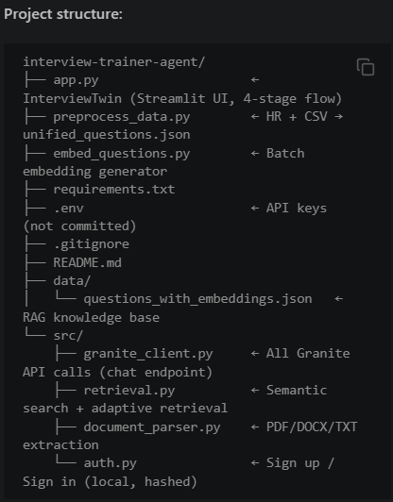
Required Files created using IBM bob -
app.py
requirements.txt
src/granite_client.py
src/retrieval.py, src/auth.py
.env, src/document_parser.py

Slide 7
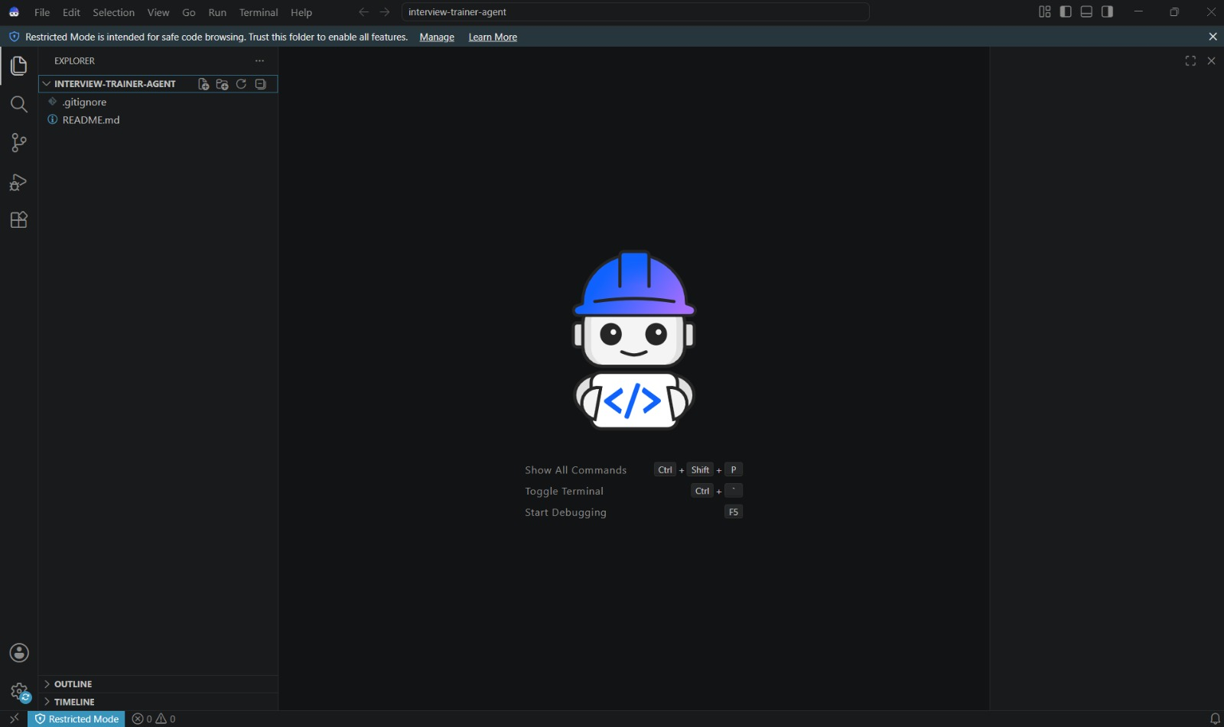
IBM Bob Screenshots:

Slide 8
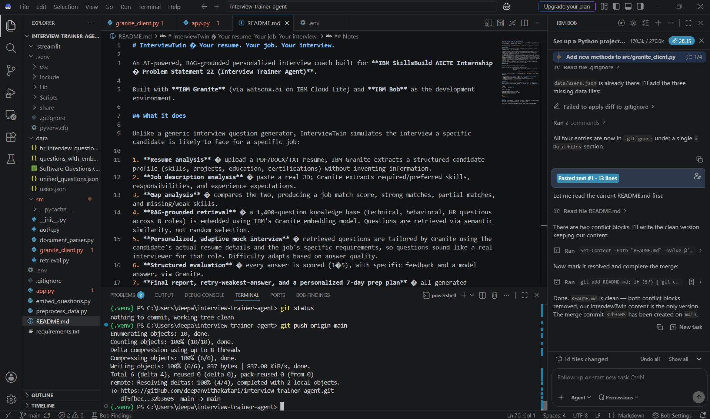

Slide 9
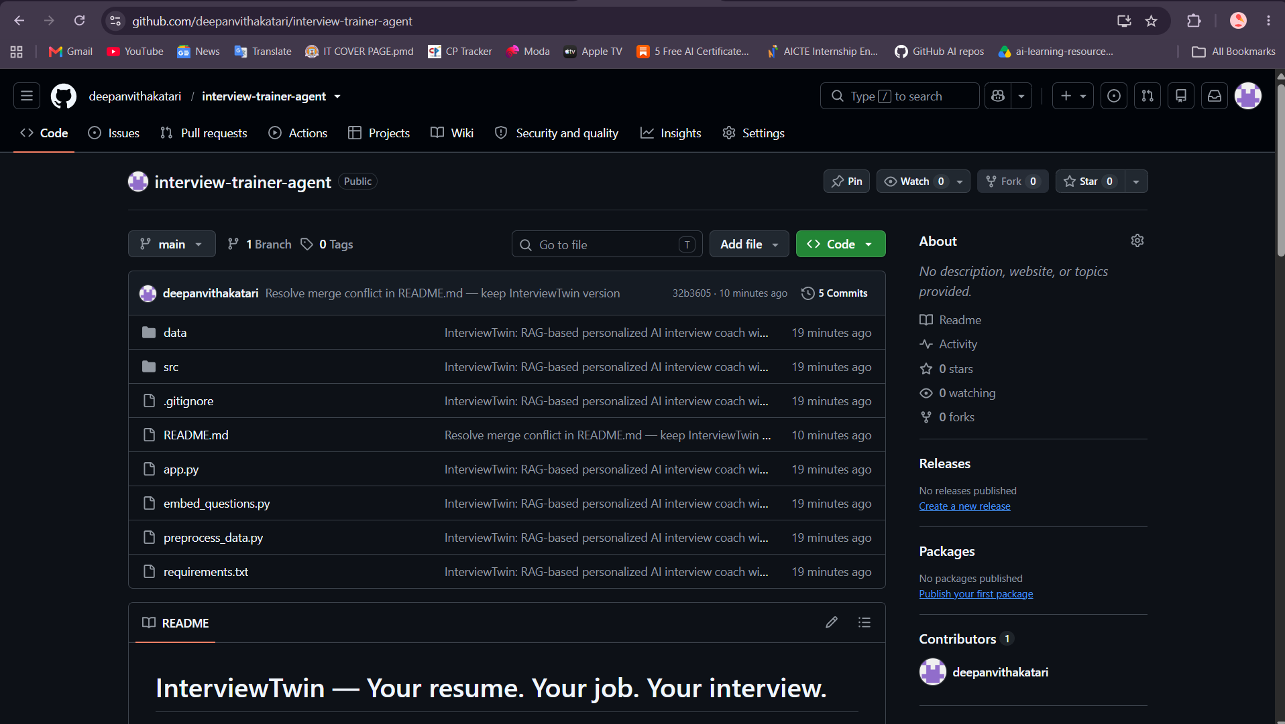
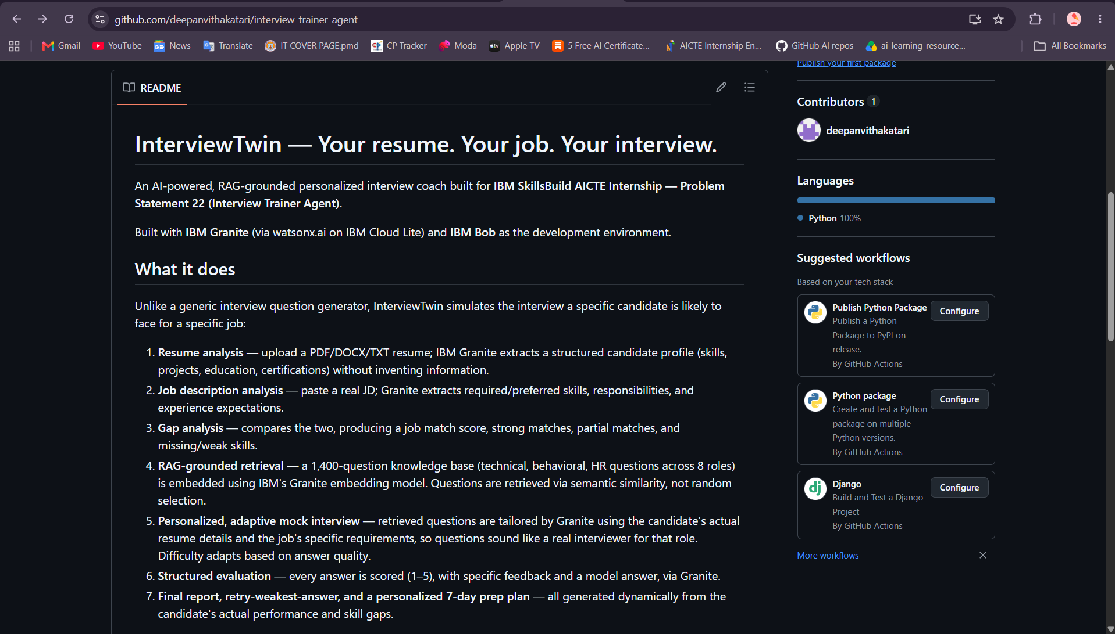

Slide 10
InterviewTwin Architecture Blueprint
1. Resume + Job Description – Candidate uploads a resume (PDF/DOCX/TXT) and pastes a real job description.
2. IBM Granite – Structured Extraction – Granite extracts a structured candidate profile and structured job requirements, without inventing information.
3. Gap Analysis – Granite compares the two, producing a job match score, strong/partial matches, and missing skills.
4. RAG Knowledge Base (1,400+ Questions) – Technical, behavioral, and HR questions across 8 roles, embedded using IBM Granite's embedding model and stored as a vector store.
5. Semantic Retrieval – The candidate's profile is embedded and compared against the question bank using cosine similarity to retrieve the most relevant questions.
6. Personalized, Adaptive Interview – Retrieved questions are tailored by Granite using the candidate's resume + JD context. Difficulty adapts in real time based on answer quality.
7. Evaluation, Report & Prep Plan – Each answer is scored and given feedback + a model answer via Granite. A final report, retry-weakest-answer, and personalized 7-day prep plan are generated.

Slide 11

Role of Agentic AI in the solution
Role of Agentic AI in InterviewTwin
Agentic AI enables InterviewTwin to function as an intelligent, adaptive interviewer rather than a static question generator. Using IBM watsonx.ai and IBM Granite models, it coordinates resume analysis, job description analysis, gap analysis, RAG retrieval, and answer evaluation to deliver a genuinely personalized interview experience.
Each stage performs a specific role — extracting resume data, analyzing job requirements, retrieving relevant questions, personalizing them, and evaluating answers — while working together. This multi-agent approach ensures every question and evaluation is grounded in the candidate’s real profile, not generic output.
Agentic AI also brings context awareness, understanding the candidate’s actual skills, projects, and job target to generate tailored questions. It supports real-time adaptation, reinforcing weak areas and advancing to new question types based on how the candidate answers each question.
Additionally, the gap analysis directly informs which questions get asked, creating a closed feedback loop between resume, job description, and interview content.
Overall, Agentic AI makes the system proactive, personalized, and goal-driven, acting like a real interview coach that helps candidates walk in genuinely prepared.

Slide 12
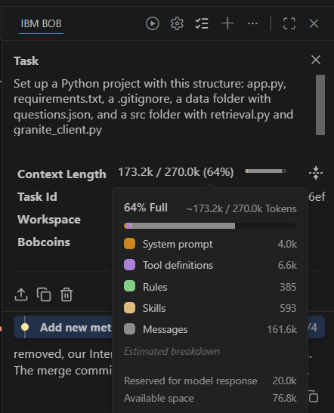
Token Usage
After the Prompt
·
·

Slide 13
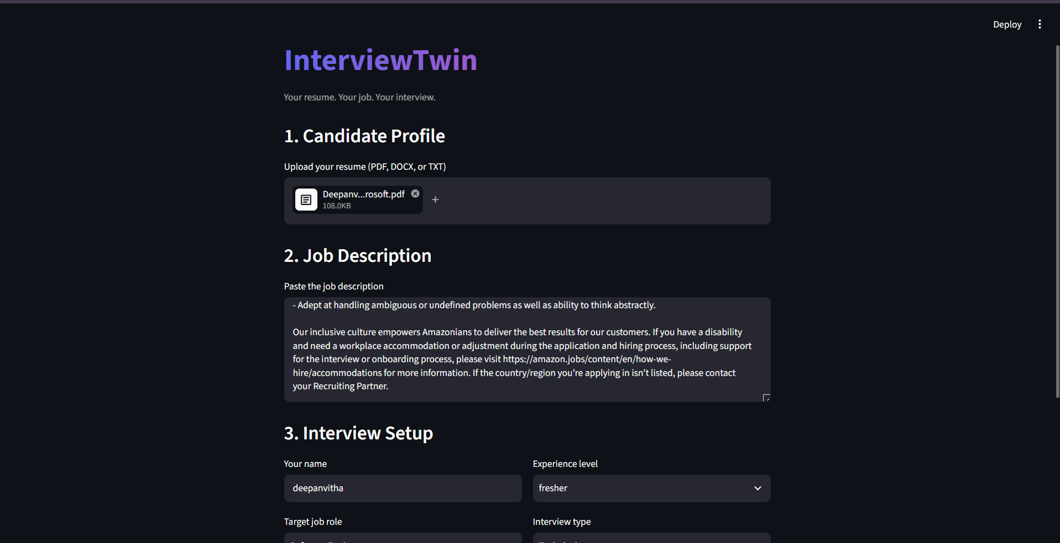

Slide 14
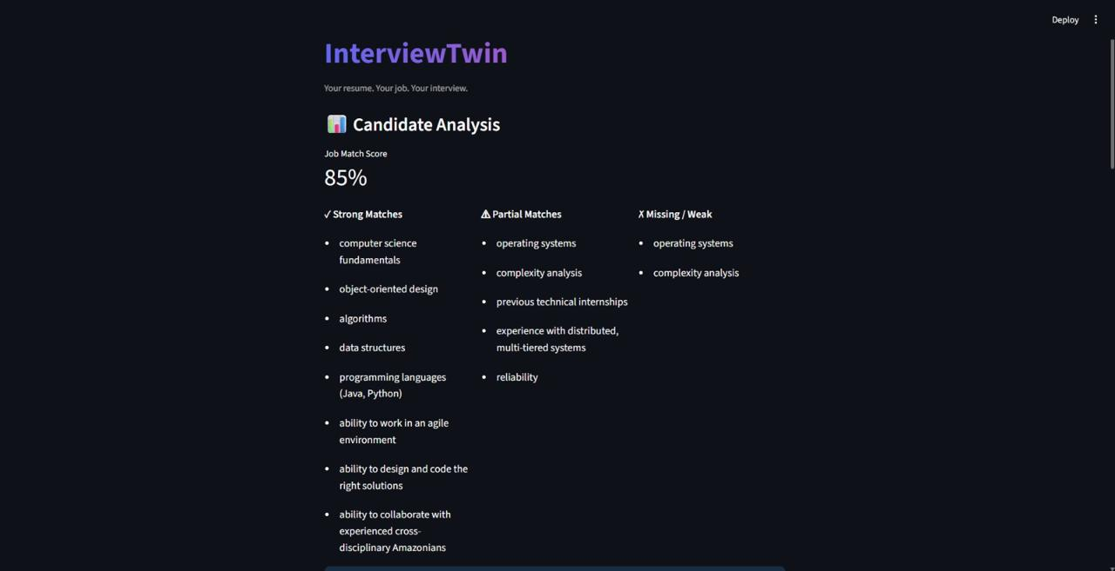
Candidate Analysis: Job Match & Skill Gaps
·
·
·
Shows job match score, strong matches, partial matches, and missing skills, generated by IBM Granite.

Slide 15
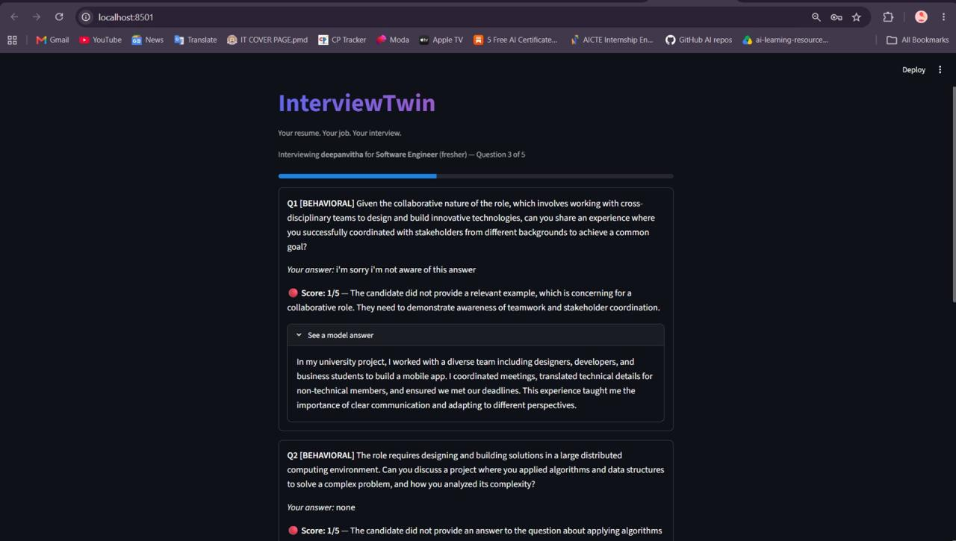
Personalized Adaptive Interview Question
·
·
·
A RAG-retrieved question tailored to the candidate’s resume and the job description, with "Why am I being asked this?" explanation.

Slide 16
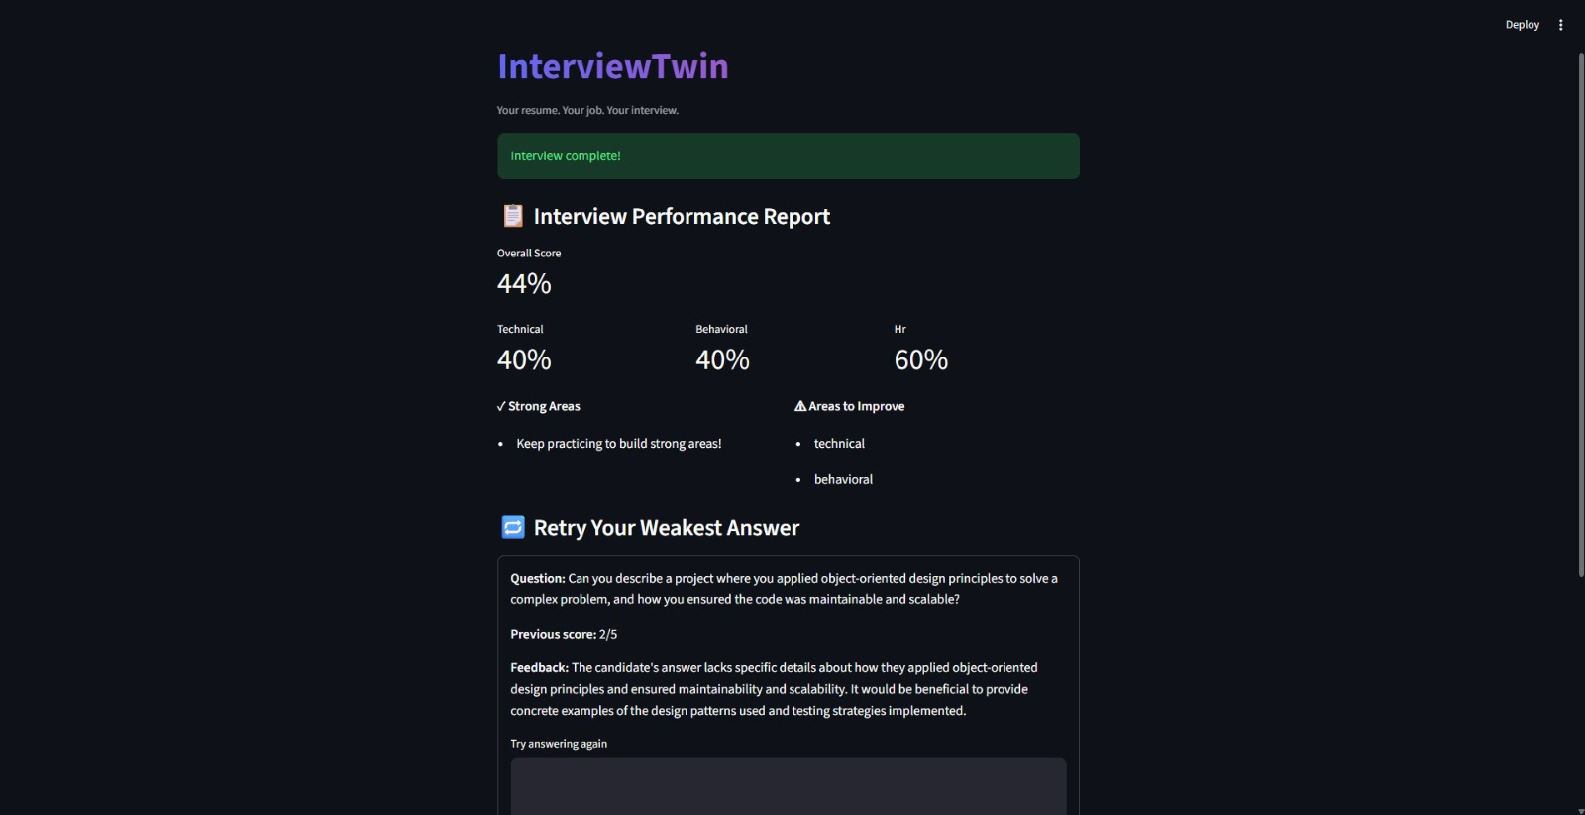
Final Report, Retry & Prep Plan
·
·
·
Overall score breakdown, weakest-answer retry with before/after comparison, and a personalized 7-day preparation plan.

Slide 17
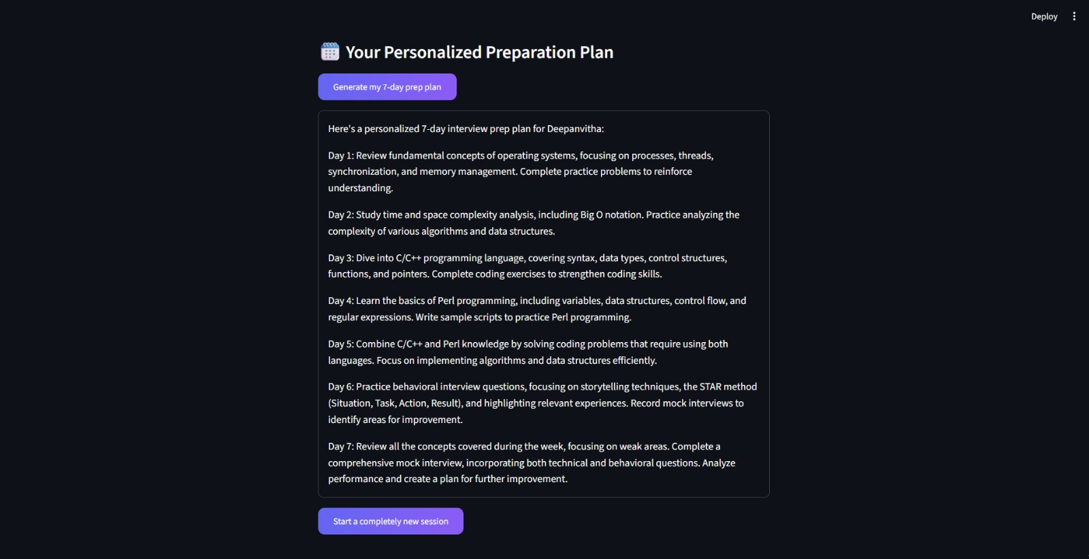

Slide 18
Novelty and Uniqueness
InterviewTwin stands out by combining Agentic AI, RAG, and personalization into a single intelligent interview coach.
Resume + JD Gap Analysis – Compares the candidate’s actual resume against the real job description to compute a match score and highlight missing skills before the interview even starts.
RAG-Based Accuracy – Grounds every question in a real 1,400+ question knowledge base via semantic retrieval, instead of letting the LLM invent questions freely.
Hyper-Personalization – Rewrites retrieved questions using the candidate’s actual resume details and the job description’s specific responsibilities.
Real-Time Adaptive Difficulty – Continuously adapts question difficulty and focus area based on the candidate’s answers.
Retry & Improve – Lets candidates retry their weakest answer and see a direct before/after improvement comparison.
Personalized Prep Plan – Generates a dynamic 7-day study plan based on the candidate’s actual weak areas and missing skills.
Scalable & Enterprise-Ready – Built on IBM watsonx.ai with IBM Granite models, ensuring reliability and governance.
This makes the solution a smart, adaptive, and proactive interview coach, not just a static question generator.

Slide 19
Git Hub Link
https://github.com/deepanvithakatari/interview-trainer-agent.git
·
·
·

Slide 20
Future Scope
1. Interviewer Personality Modes & Trap Detector –
Add selectable interviewer styles (Friendly, Professional, Technical Expert, Stress) and a built-in "trap detector" that flags commonly mishandled questions with tips on how to answer them well.
2.Persisted Interview History & Voice-Based Practice –
Store interview attempts across sessions so candidates can track score improvement over time, and add voice-based answer input/output to simulate a real spoken interview more closely.
·
·
·

Slide 21
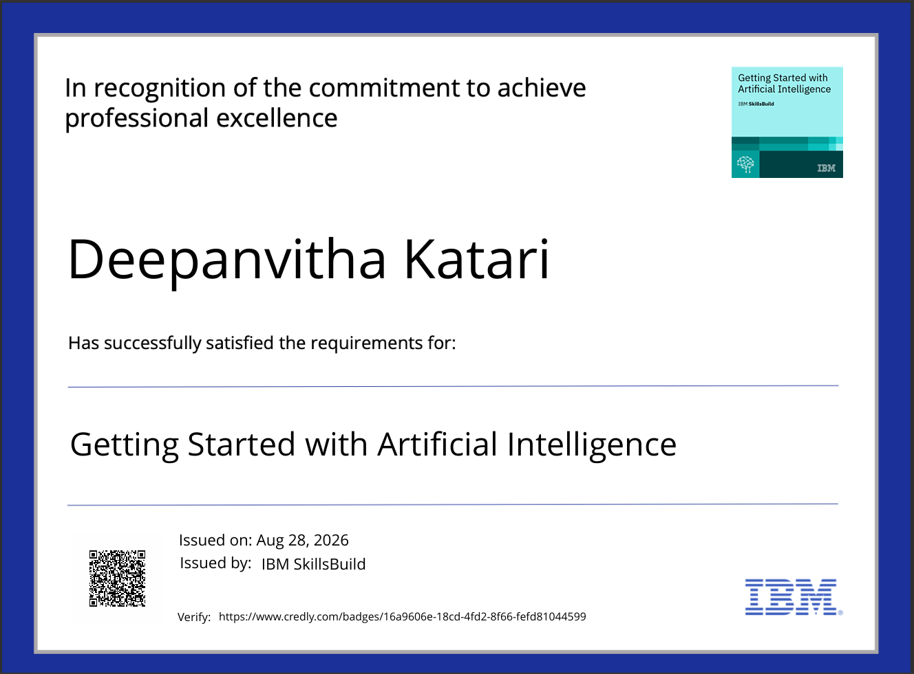
Certificates Earned:
Getting Started with Artificial Intelligence

Slide 22
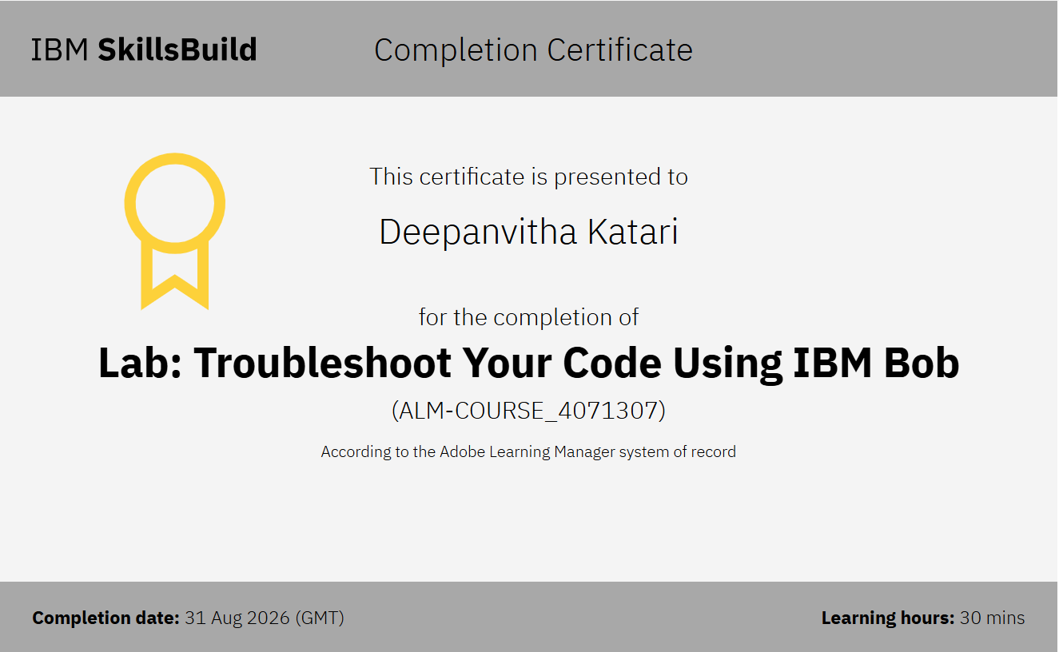
Certificates Earned:​
Add your IBM BOB Certificate

Slide 23


