Slide 1


Sentiment Analysis of Movie Reviews
Deepa Borkar
August 10, 2022
Final Presentation
Notes:
Hey everyone, my name is Deepa and I will be looking at sentiment analysis of movie reviews.

Slide 2

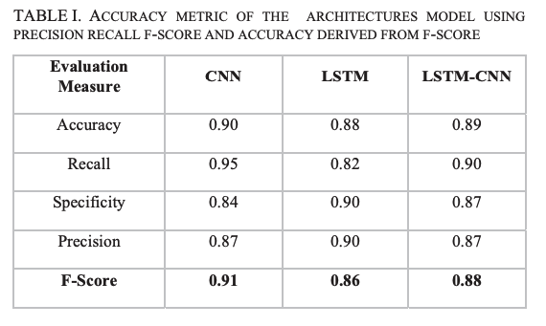
Research
Reference:
Haque, Md. Rakibul, et al. “Performance Analysis of Different Neural Networks for Sentiment Analysis on IMDb Movie Reviews .” Performance Analysis of Different Neural Networks for Sentiment Analysis on IMDb Movie Reviews, July 2020, https://www.researchgate.net/publication/343046458.

Slide 3



Dataset
Dataset: Hugging Face IMDB
Examples: 50,000 Text Reviews
Labels: +/- Rating
Notes:
The dataset I have started looking at is from Torchtext and it is a collection of IMDB movie reviews. There are 25,000 reviews in the training set and 25,000 reviews in the test set. Each review has a positive or negative label

Slide 4
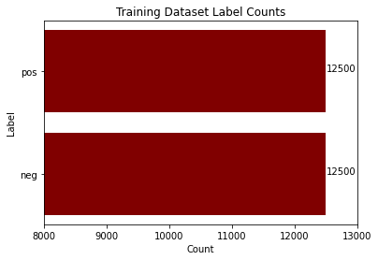
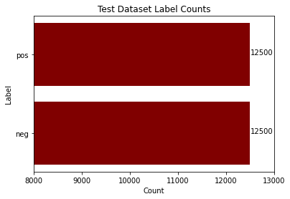
Data Exploration
('pos', "I don't know why I like this movie so well, but I never get tired of watching it.")
('neg', "I wouldn't rent this one even on dollar rental night.")
Notes:
From doing some initial data exploration, it seems both the training and test sets are evenly split so there is not a bias towards one of the labels. From looking at this data and the evaluation metrics used in the research papers I reviewed it seems that accuracy is a good way to evaluate model performance. I have also provided a couple of examples from the dataset at the bottom of the slide.

Slide 5
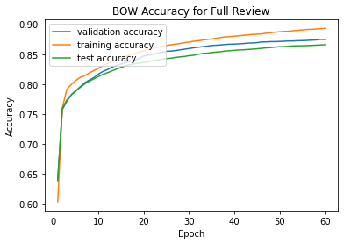
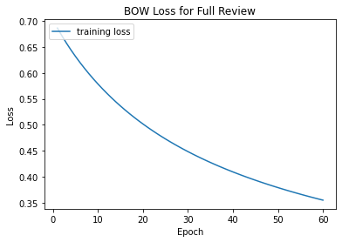
Base Model: BOW Classifier

Slide 6
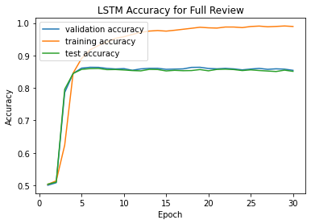
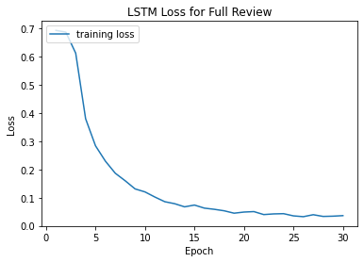
RNN Model: LSTM

Slide 7
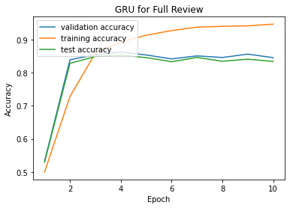
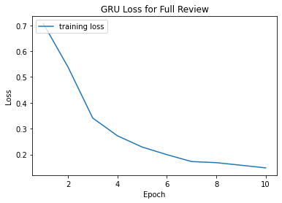
RNN Model: GRU

Slide 8

Results

Slide 9
Future Work
Train with CNN models
01
Try training on just the last sentence of the review to reduce data needed
03
Utilize pre-trained embeddings
02
Notes:
I would like to apply more complicated models like RNNs, including LSTMs and GRUs, and CNNs. Since this is a small dataset, I would also like to incorporate pretrained word embeddings like word2vec and glove. Training the simple BOW model took a surprisingly long time, so I would like to try to utilize AWS resources if needed to improve speed. As a final step, I would like to compare my results with research done on similar datasets, like the research paper mentioned earlier.

Slide 10
Lessons Learned

Slide 11

Q&A
Notes:
Thanks for listening to my presentation. Are there any questions?

