Slide 1


Sentiment Analysis of Movie Reviews
Deepa Borkar
August 10, 2022
Final Presentation

Slide 2
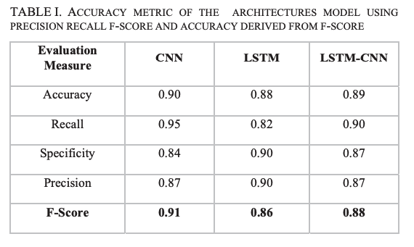

Research
Reference:
Haque, Md. Rakibul, et al. “Performance Analysis of Different Neural Networks for Sentiment Analysis on IMDb Movie Reviews .” Performance Analysis of Different Neural Networks for Sentiment Analysis on IMDb Movie Reviews, July 2020, https://www.researchgate.net/publication/343046458.
Notes:
50,000 IMDB examples
70/30 training/test split
80/20 training/validation split of training data
Did not use a pre-trained embedding like word2vec or glove
Used a keras vocab of 8000
And embedding dimension is 100

Slide 3
Research
Reference:
Haque, Md. Rakibul, et al. “Performance Analysis of Different Neural Networks for Sentiment Analysis on IMDb Movie Reviews .” Performance Analysis of Different Neural Networks for Sentiment Analysis on IMDb Movie Reviews, July 2020, https://www.researchgate.net/publication/343046458.
Notes:
Mainly concerned with accuracy to help with evaluating my own work
Accuracies are in the 80-90% range

Slide 4



Dataset
Dataset: Hugging Face IMDB
Examples: 50,000 Text Reviews
Labels: +/- Rating
Notes:
Dataset is from Hugging Face library
50,000 IMDB examples – full text reviews
50/50 training/test split
75/25 training/valid split of training data
Labels are 0 for negative sentiment and 1 for positive sentiment

Slide 5
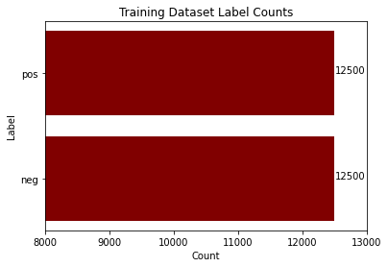
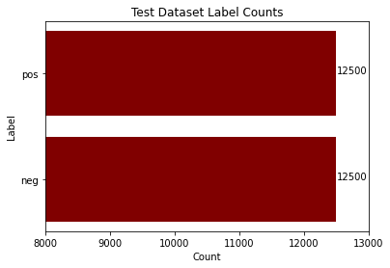
Data Exploration
('pos', "I don't know why I like this movie so well, but I never get tired of watching it.")
('neg', "I wouldn't rent this one even on dollar rental night.")
Notes:
From doing some initial data exploration, it seems both the training and test sets are evenly split so there is not a bias towards one of the labels. From looking at this data and the evaluation metrics used in the research papers I reviewed it seems that accuracy is a good way to evaluate model performance. I have also provided a couple of examples from the dataset at the bottom of the slide.

Slide 6
Data Exploration
('pos', "I don't know why I like this movie so well, but I never get tired of watching it.")
('neg', "I wouldn't rent this one even on dollar rental night.")
Notes:
Positive example

Slide 7
Data Exploration
('pos', "I don't know why I like this movie so well, but I never get tired of watching it.")
('neg', "I wouldn't rent this one even on dollar rental night.")
Notes:
Negative example
Reviews range from over 2,000 words to only about 10 words

Slide 8
Data Processing
1. Input Text Movie Review
2. Tokenize Review
3. Remove Stop Words
4. Transform to Numerical Values
This movie was amazing!
['this', 'movie', 'was', 'amazing', '!']
['movie', 'amazing', '!']
[5, 351, 10]
Notes:
Before inputing and training the models, I first process the data. First tokenize the data using a tokenize from the torchtext library.
Then removed stop words using the nltk library because most of those words do not improve analysis.
Transform these tokens to numerical values – either bow vector or indexes based on a vocab object built from all the tokens in the training dataset

Slide 9
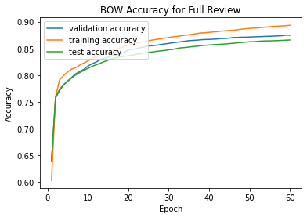
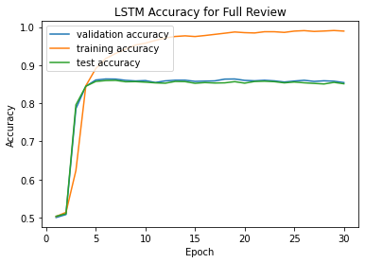
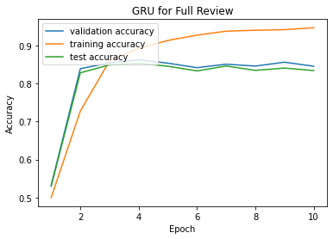
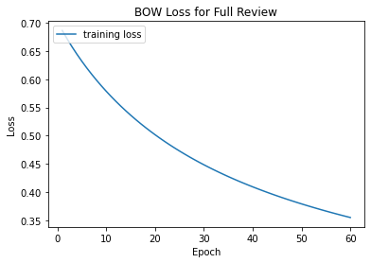
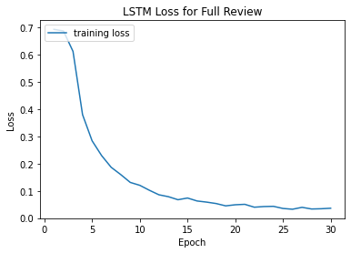
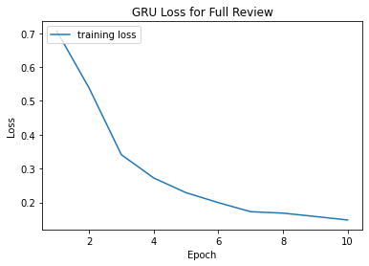
Models
BOW
LSTM
GRU

Slide 10

Summary of Results

Slide 11
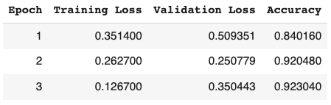
Pretrained Transformers Model
Using Hugging Face Library
Test Accuracy: 0.92316

Slide 12
Web App Demo

Slide 13
Future Work
Train with CNN and Transformer models
01
Try training on just the last sentence of the review to reduce data needed
03
Utilize pre-trained embeddings
02

Slide 14
Q&A
Notes:
Thanks for listening to my presentation. Are there any questions?

Slide 15
Base Model: BOW Classifier

Slide 16
RNN Model: LSTM

Slide 17
RNN Model: GRU

