Slide 1
Data Analyst Internship
Task 4: Dashboard Design
Designed using Power BI
Submitted by:
Deepa Umesh Savita]

Slide 2
Objective
Design an interactive dashboard for business stakeholders using Power BI.

Slide 3
Dataset Used
Superstore Sales Dataset (CSV format)
Source: Kaggle
Includes Sales, Profit, Region, Category, Sub-category, and Date.

Slide 4
Key KPIs
- Total Sales
- Total Profit
- Profit Margin
- Sales by Region
- Sales Growth (YoY or MoM)

Slide 5
Dashboard Features
- Slicers for Region, Category, and Date
- Interactive Cards showing KPIs
- Line chart for Sales Trend
- Bar chart for Category-wise Sales
- Map for Regional Sales

Slide 6
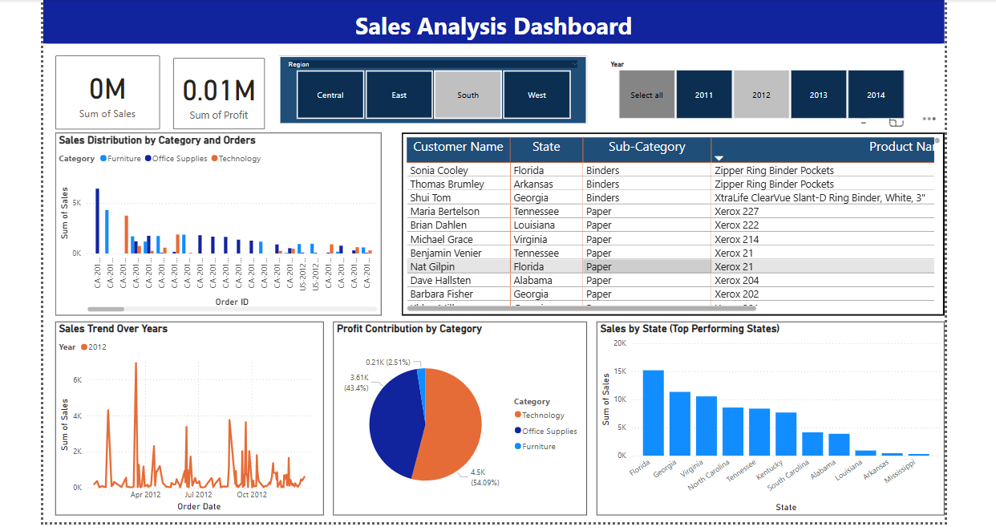

Slide 8
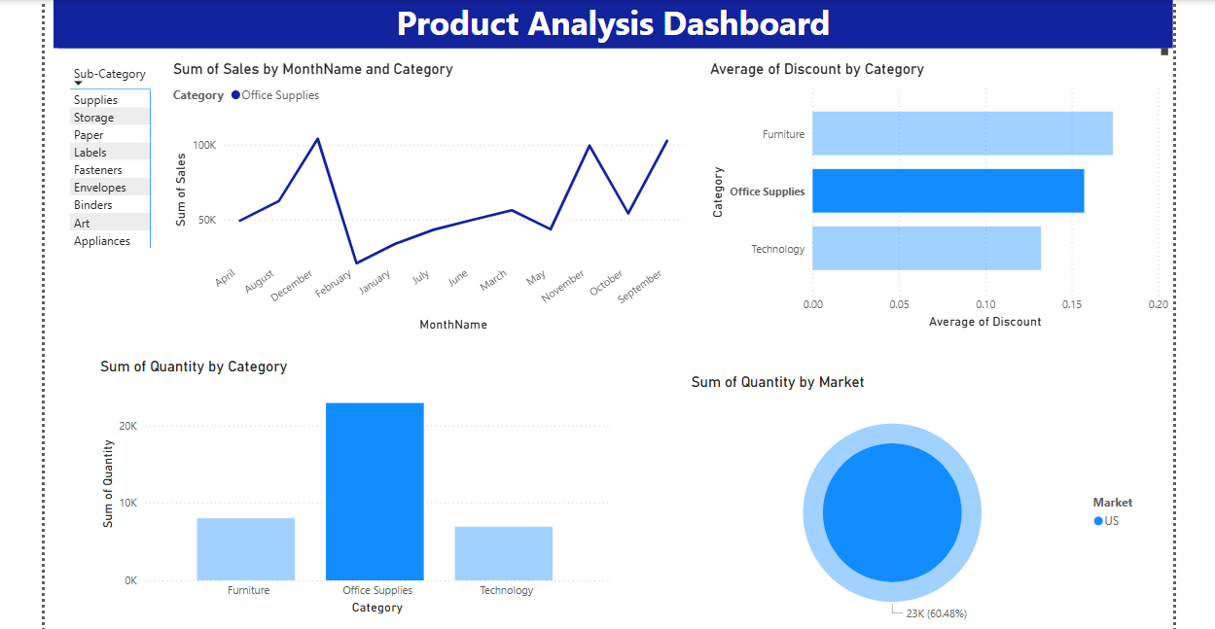

Slide 9
Insights Gained
- Western Region has highest sales.
- Technology category yields highest profit.
- December shows peak sales across years.
- Sub-Category 'Phones' contributes most.

Slide 10
Challenges Faced
- Understanding relationships in dataset
- Creating dynamic time-based calculations
- Designing a visually consistent theme

Slide 11
Conclusion
Successfully created an interactive Power BI dashboard to analyze and visualize business performance.

Slide 12
Thank You

