Slide 1
Amex AI/ML Hackathon
Geek Goddess 2019
[which person should be approved a credit card and which not]

Slide 2

Brief explanation of idea what makes it unique
Among the large number of applications received for credit card, Logistic Regression was employed in Python on ML concept for automated scrutiny of applications on the basis of past customer performance and credibility report. As a result out of 100 applications in Test, system has identified 12 applications for which the credit card can be approved.

Slide 3
Problem being solved
The problem being solved here is the tedious task of scrutinising the credit card applications and identifying eligible customers based on the customer credibility and other factors identified from analysing previous customers.
This volume of data are being analysed by system using ML concept by training the system using analysed past data. This saves many man hours in identifying eligible customers manually and results are much more accurate.

Slide 4
Technical architecture/ POC
Import Directory Files
Read Train.csv
Read Test.csv
Check Dependent Variable Ratio
DATA
PREPARATION
Outlier Treatment
Missing Value Treatment
Dummy Variable Creation

Slide 5
Separate Dependent Variable
Split Data
Perform Logistic Regression
Calculate the Prediction
Calculate the Accuracy
Prepare the Model
Apply Model in Test data
Final Prediction

Slide 6
Technology / Tool Stack
MS EXCEL
PYTHON
JUPYTER NOTE BOOK
SUPERVISED MACHINE LEARNING (LOGISTIC REGRESSION)

Slide 7
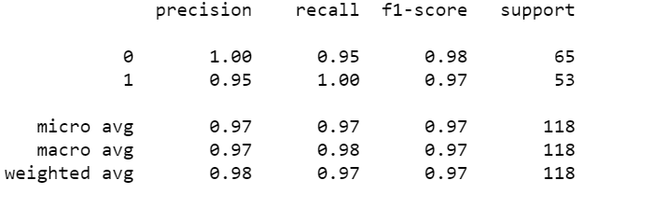
Prototype Demo(Video/Screenshots)
MODEL ACCURACY

Slide 8
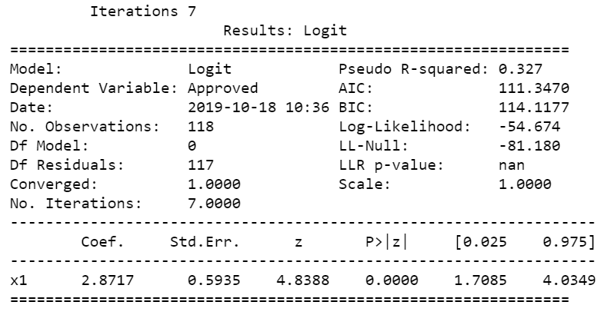
Prototype Demo(Video/Screenshots)
MODEL SUMMARY

Slide 9
Impact of usage
Using the concept of ML through logistic regression we were able to identify the accurate most eligible customers for credit card. By identifying this, the chance of awarding credit card to non creditable customers is avoided and increase in company’s liability towards recovering money from default customers is greatly minimised.

Slide 10
Possible Improvement
Identify more variables for most accurate results.
More customer records in Train data for most accurate model.
Identify variables for issuing type related credit cards.

Slide 11
Challenges faced
Amount of customer records and variables are less for preparing a accurate model.
Considerable amount of missing data in Train data set.
Non-availability of Variable description.

Slide 12


