Slide 1
TAKENMIND GLOBAL DATA
ANALYTICS INTERNSHIP
EMPLOYEE ATTRITION PROBLEM IN COMPANY X

Slide 2
OBJECTIVE:
Finding what type of employees are leaving
Finding the reasons/factors why employees are leaving.
Predict which employees are prone to leave next using predictive model

Slide 3
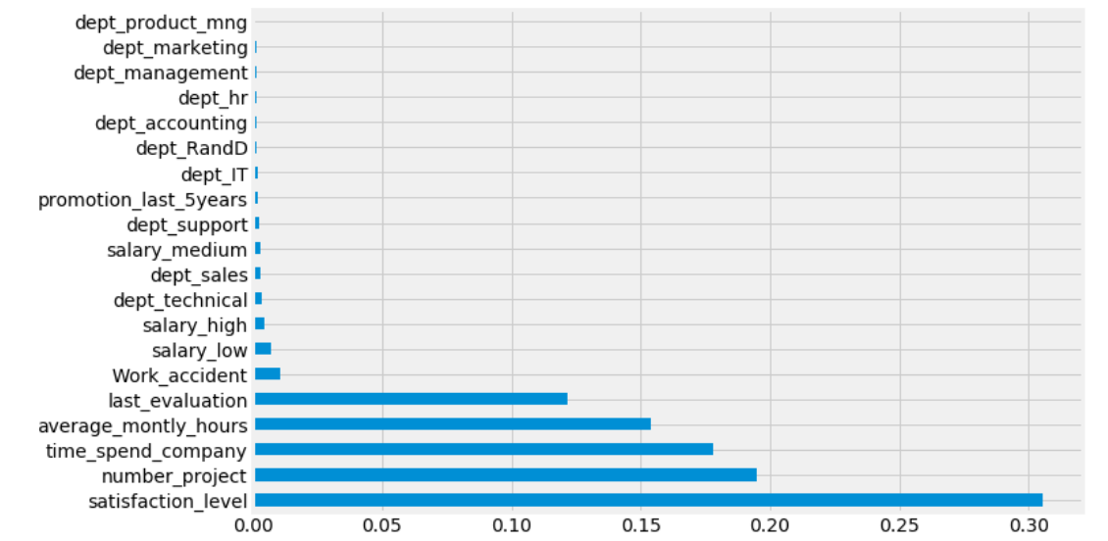
% OF FACTORS AFFECTING EMPLOYEE ATTRITION
Satisfaction Level 30.5423
Number of Project 19.4673
Time Spend Company 17.8225
Average Monthly Hours 15.4004
Last Evaluation 12.1761
Work Accident 1.0408
Salary Low 0.7152
Salary High 0.4263
Dept Technical 0.333
Dept Sales 0.3098
Salary Medium 0.3049
Dept Support 0.2618
Promotion Last 5years 0.189
Dept IT 0.1684
Dept R&D 0.1596
Dept Accounting 0.1581
Dept HR 0.1547
Dept Management 0.1455
Dept Marketing 0.1141
Dept Product mng 0.11

Slide 4
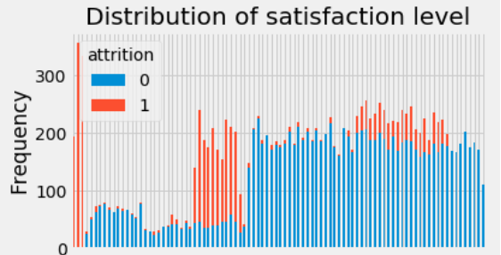
SATISFACTION LEVEL - 30.5%

Slide 5
Employees who had really low satisfaction levels (0.2 or less) left the company more
Employees who had low satisfaction levels (0.3~0.5) left the company more
Employees who had really high satisfaction levels (0.7 or more) left the company more

Slide 6
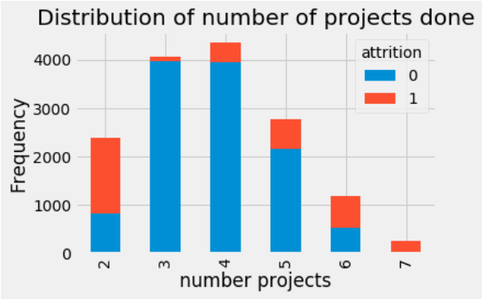
NUMBER OF PROJECT – 19.5%
More than half of the employees with 2,6, and 7 projects left the company
All of the employees with 7 projects left the company

Slide 7
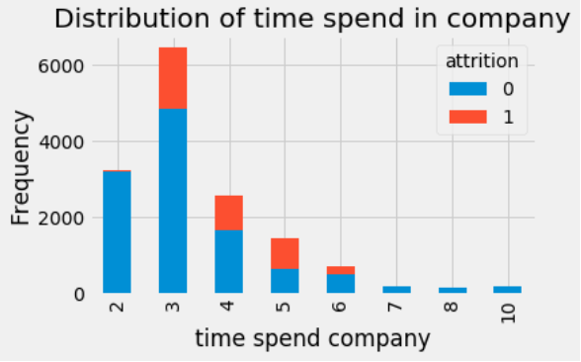
TIME SPEND AT THE COMPANY – 17.8%
The 3,4 and 5 year time spend were the top 4 to have employee attrition.
All of the employees work 7,8,10 year didn’t left the company.

Slide 8
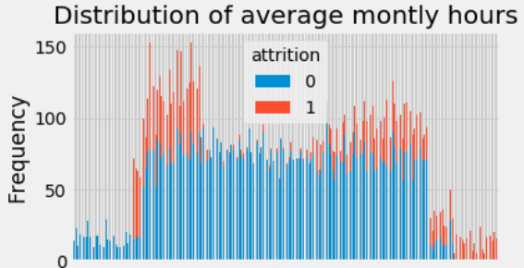
AVERAGE MONTHLY HOURS – 15.4%

Slide 9
Employees who had less hours of work (~150hours or less) left the company more
Employees who had too many hours of work (~250 or more) left the company
Employees who left generally were underworked or overworked.

Slide 10
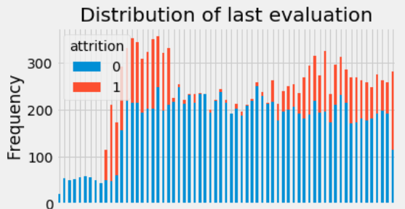
LAST EVALUATION – 12.2%
Employees with low performance tend to leave the company more (0.4~0.6)
Employees with high performance tend to leave the company more (0.8-1)
The sweet spot for employees that stayed is within 0.6-0.8 evaluation

Slide 11
EMPLOYEES IDENTIFIED WHO ARE
PRONE TO LEAVE NEXT
EMP_ID | Probability for Attrition
3129 | 21
7005 | 21
7878 | 21
8523 | 21
5995 | 22
6077 | 22
7863 | 22
5566 | 23
6605 | 23
2416 | 27
7078 | 27
EMP_ID | Probability for Attrition
7990 | 27
6359 | 28
7763 | 29
10099 | 33
3781 | 34
5848 | 35
7444 | 36
9782 | 37
6264 | 38
6467 | 41

Slide 12
THANK YOU

