Slide 1
TAKENMIND GLOBAL DATA
ANALYTICS INTERNSHIP
PROJECT REPORT ON
EMPLOYEE ATTRITION PROBLEM
-BY DEEPA SOMAN

Slide 2
OBJECTIVE:
By analyzing the given datasets of company X, we will find out the following
Finding what type of employees are leaving
Finding the reasons/factors why employees are leaving.
Predict which employees are prone to leave next using predictive model

Slide 3
Attributes:
The attributes available for every employee in the two datasets “Existing employees” and “Employees who have left” are
Satisfaction Level
Last evaluation
Number of projects
Average monthly hours
Time spent at the company
Whether they have had a work accident
Whether they have had a promotion in the last 5 years
Departments (column sales)
Salary

Slide 4
METHODOLOGY
DATA
COLLECTION
DATA PREPARATION
DATA CLEANING
MODEL SELECTION
EMPLOYEE ATTRITION IDENTIFIED
USE PREDECTIVE MODEL TO PREDICT EMPLOYEE ATTRITION
DEPLOY
MODEL

Slide 5
Data Collection
Examine the given data
Add a new column “Attrition” to both sheets “Existing employees” and “Employees who have left”
Assign “0” to Employees who have left and “1” to Existing employees
Combine the both input sheet
Data Preparation
Analysis the input data
Check dependent variable ratio
Remove the dependent variable
Add dependent variable to another array
Data Cleaning
Check missing values
Check outliers using box plot
Remove duplicate values

Slide 6
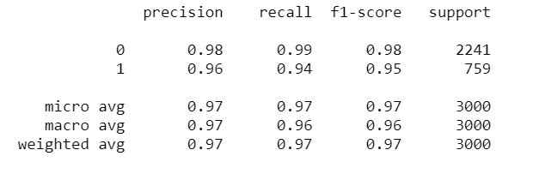
MODEL SELECTION
Apply different algorithms to get the best fitted model
Algorithms to be used to get the best fitted model
Decision Tree Classifier
Logistic Regression
Random Forest Classifier
KNN Classifier
Navie Model Development
DECISION TREE CLASSIFIER
Decision Tree Classifier is used with maximum depth starting from 1 to 5.
Decision Tree Classifier doesn’t require feature scaling.
‘Gini’ was used as criterion for choosing the next feature/attribute.
Accuracy 97%

Slide 7
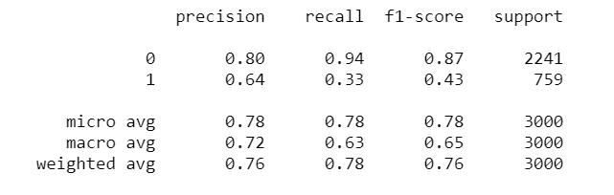
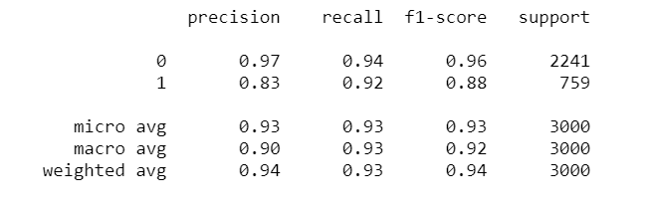
LOGISTIC REGRESSION
Logistic regression is used with maximum iteration 100.
Accuracy 79%
KNN CLASSIFIER
KNN Classifier is used with n_neighours 5 and leaf size is 30.
Accuracy 95%

Slide 8
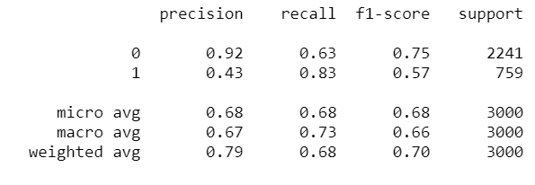
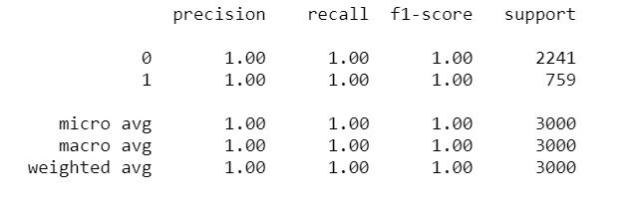
NAVIE MODEL DEVELOPMENT
Gaussian Naive Bayes according to prediction and true value with priors is none and var_smoothing = 1e-09
Accuracy 67%
RANDOM FOREST CLASSIFIER
(FINAL MODEL)
Random Forest Classifier is used ‘Gini’ as criterion for choosing the next feature/attribute
Accuracy 100%
As this model’s accuracy is 100%, RFC is the final model for this dataset analysis.

Slide 9
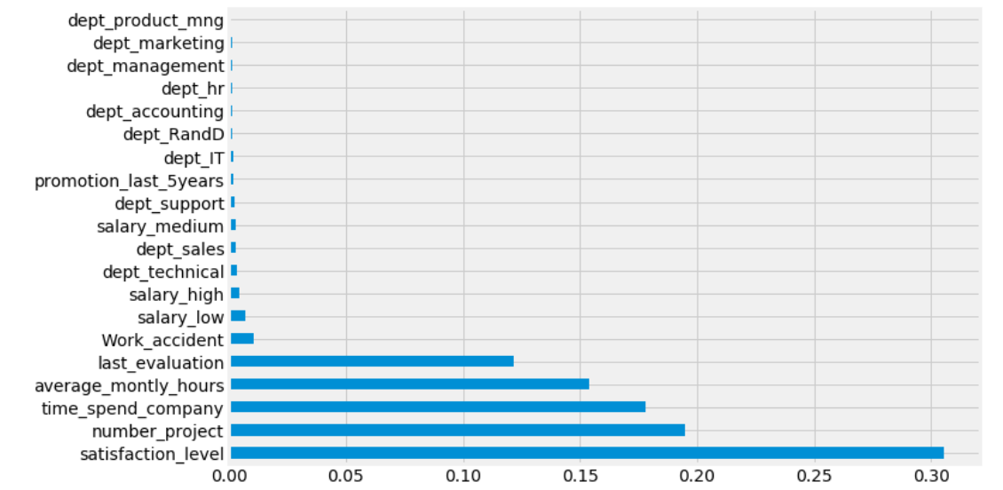
OUTPUT :- % of Factors Affecting Employee Attrition
Satisfaction Level 30.5423
Number of Project 19.4673
Time Spend Company 17.8225
Average Monthly Hours 15.4004
Last Evaluation 12.1761
Work Accident 1.0408
Salary Low 0.7152
Salary High 0.4263
Dept Technical 0.333
Dept Sales 0.3098
Salary Medium 0.3049
Dept Support 0.2618
Promotion Last 5years 0.189
Dept IT 0.1684
Dept R&D 0.1596
Dept Accounting 0.1581
Dept HR 0.1547
Dept Management 0.1455
Dept Marketing 0.1141
Dept Product mng 0.11

Slide 10
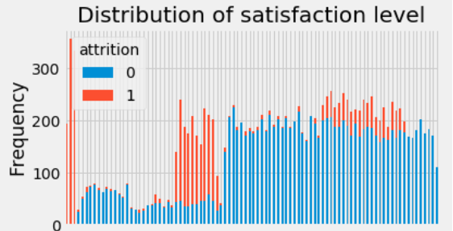
ANALYZING FIVE MAJOR ITERATION ATTRIBUTES
SATISFACTION LEVEL - 30.5%
Employees who had really low satisfaction levels (0.2 or less) left the company more
Employees who had low satisfaction levels (0.3~0.5) left the company more
Employees who had really high satisfaction levels (0.7 or more) left the company more

Slide 11
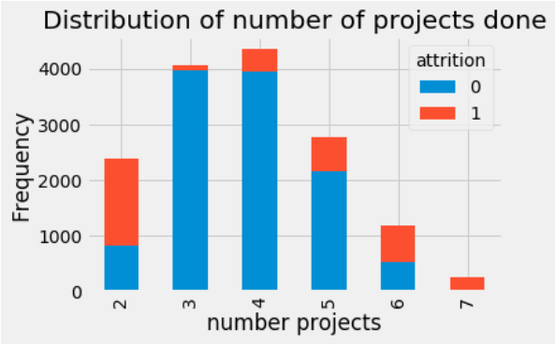
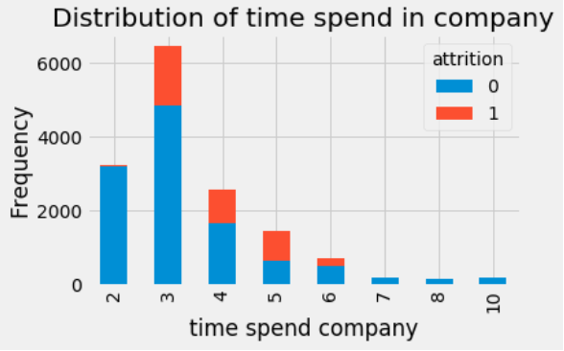
NUMBER OF PROJECT – 19.5%
More than half of the employees with 2,6, and 7 projects left the company
All of the employees with 7 projects left the company
TIME SPEND AT THE COMPANY – 17.8%
The 3,4 and 5 year time spend were the top 4 to have employee attrition.
All of the employees work 7,8,10 year didn’t left the company.

Slide 12
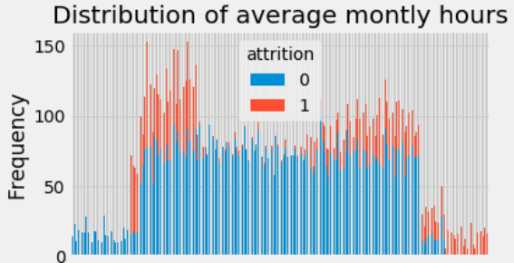
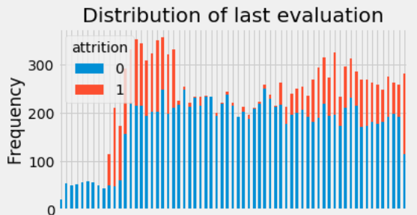
AVERAGE MONTHLY HOURS – 15.4%
Employees who had less hours of work (~150hours or less) left the company more
Employees who had too many hours of work (~250 or more) left the company
Employees who left generally were underworked or overworked.
LAST EVALUATION – 12.2%
Employees with low performance tend to leave the company more (0.4~0.6)
Employees with high performance tend to leave the company more (0.8-1)
The sweet spot for employees that stayed is within 0.6-0.8 evaluation

Slide 13
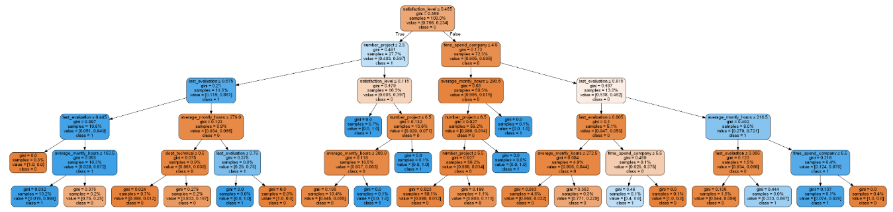
Random Forest Classifier – Tree for Employee Attrition

Slide 14
EMPLOYEES IDENTIFIED WHO ARE
PRONE TO LEAVE NEXT
EMP_ID | Probability for Attrition
3129 | 21
7005 | 21
7878 | 21
8523 | 21
5995 | 22
6077 | 22
7863 | 22
5566 | 23
6605 | 23
2416 | 27
7078 | 27
EMP_ID | Probability for Attrition
7990 | 27
6359 | 28
7763 | 29
10099 | 33
3781 | 34
5848 | 35
7444 | 36
9782 | 37
6264 | 38
6467 | 41

Slide 15
SOLUTION & CONCLUSION:
By analyzing the two given sets of data, we were able to identify the attributes contributing to the employees attrition and also the employees who are prone to leave the company next in company X.
By knowing the attributes of the employees attrition and the employees who are prone to leave the company next, the company is in an advantageous position to take adequate measures and steps to reduce / avoid employee attrition accordingly.

Slide 16
THANK YOU

