Slide 1
Simple Inventory Management System for Neev(SIMS)

Slide 2
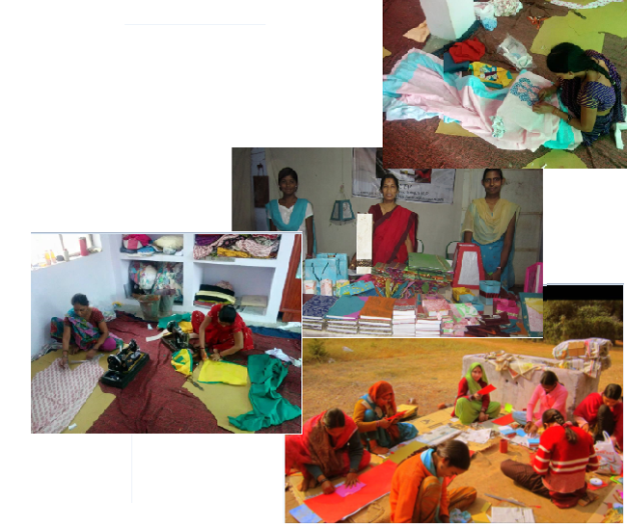
About Neev
Neev is a small NGO based in Madhya Pradesh, Shivpuri district working towards the women empowerment
Women work on ad-hoc basis with Neev
Neev procures raw materials from local vendors Currently
they run a project with a group of twenty five women,
who make and sell products like handmade paper
products, table linen…

Slide 3

Do they face any challenges now???
Neev is maintaining the inventory of raw materials on paper and its tedious manual job to track their stock.
No way to track material consumption

Slide 4
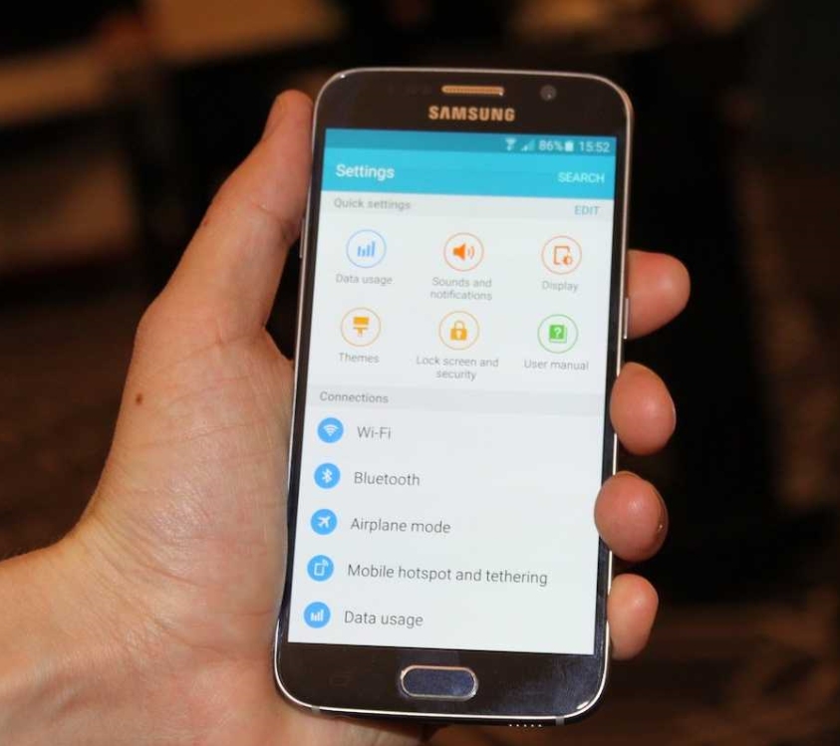
Getting aligned to Neev’s vision with SIMS
Easy app which will have dashboard to show the
items in stock, their value, items sold, items
returned in a glance for a given period
Handle the inflow and outflow in simple and easy
manner as the users will be less educated
Increase productivity by eliminating the manual
work to track stock and materials
Accurate and timely inventory information at finger
tips
Maintain right level of inventory and materials;
Hence no interruption to delivery!!!

Slide 5
SIMS – A Quick Overview

Slide 6
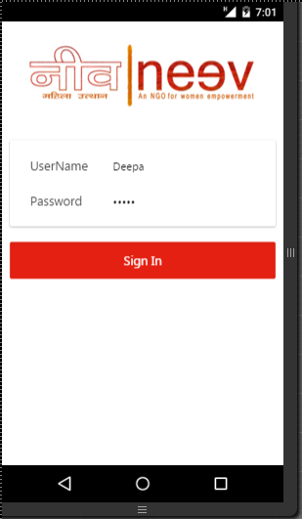
Users can login to the application by entering user name and password.

Slide 7
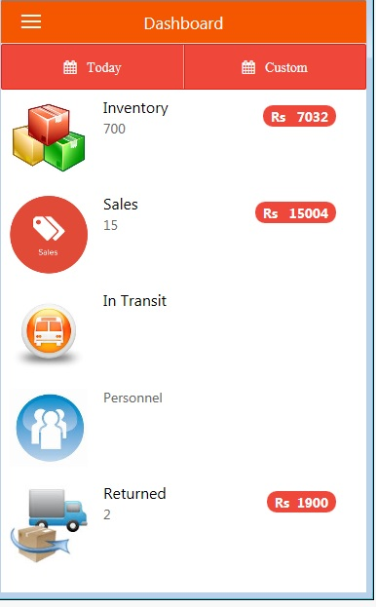
Online and Offline inventory tracking at your finger tips!!! Snapshot of the inventory of raw materials, sold items and returned items along with their value at a glance

Slide 8
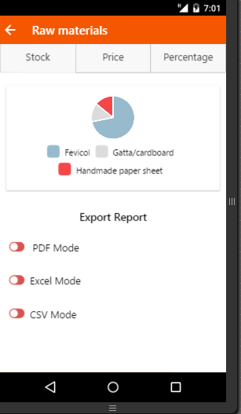
You got Stock, Price and Percentage!!! Clicking on Inventory takes to the graphical representation of the materials by quantity. User has flexibility to view graphs by price or by percentage
All reports can be exported to PDF, Excel or CSV files using export feature

Slide 9
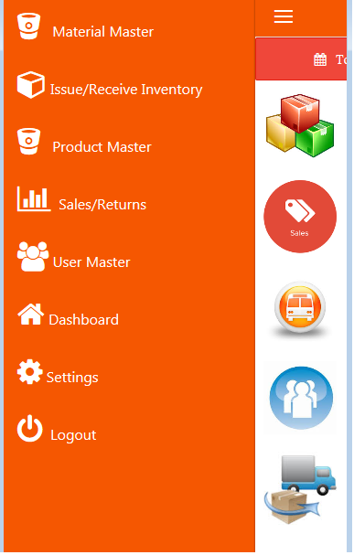
Menu
Authorization based on levels!!!
Menu for admin user has the all the features

Slide 10
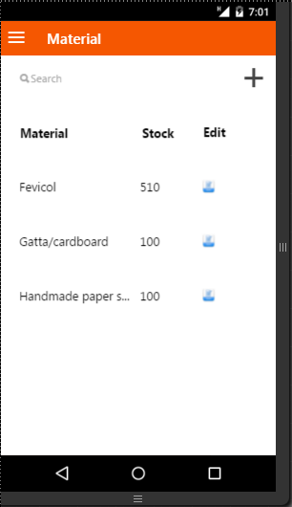
Smart and Simple Material Management!!!
Material Master displays the raw materials in the catalogue along with the stock as of now. Admin has the flexibility to add new material or edit any existing material.
Add
Too many items???
We have got Search !!!
Edit

Slide 11
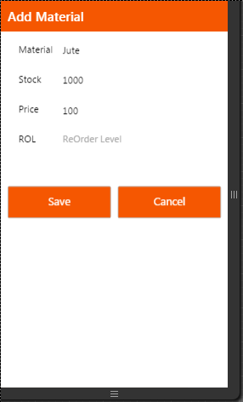
User can enter the name of material, stock, unit price and reorder level. Reorder level will be used to alert admin when stock goes below the level.

Slide 12
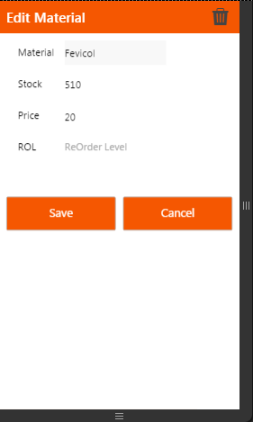
User can edit existing material details with this feature.

Slide 13
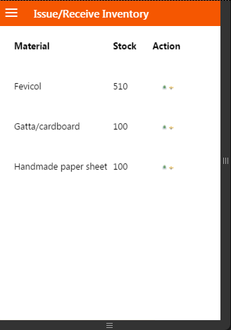


Takes care of issuing and adding materials!!!
By clicking on this, the user is taken to receive screen.
By clicking on this, the user is taken to Issue screen.

Slide 14
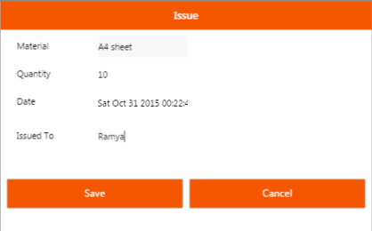
Issue screen gives the flexibility to enter the number of items issued to any working women of Neev.
You can even track the person to which it is issued!!!

Slide 15
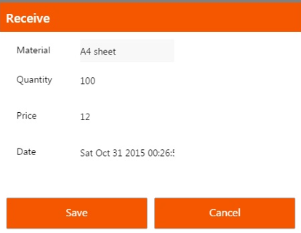
Receive screen is used to enter the number of items received from any vendor. Entering here updates the stock of raw materials and all others are aware of the updated stock when they access instantaneously.

Slide 16
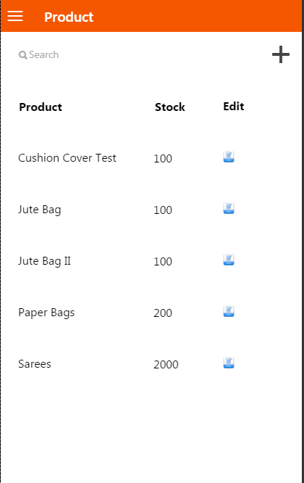
Product master screen is available for admin to enter the products being developed by women of Neev. Their stock can be updated here.

Slide 17
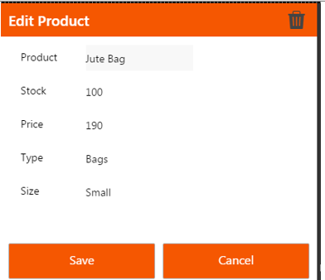
Product information can be edited by using this screen.

Slide 18
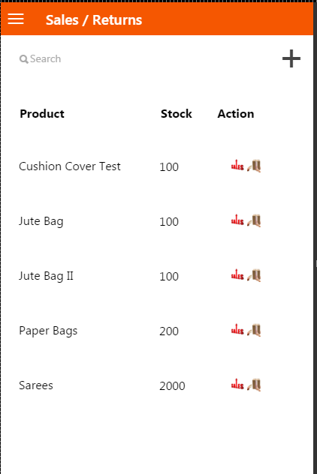


Sales/Returns: This screen gives option for Admin and Team Leads to enter the items sold or returned
Clicking on this takes to Sales screen where items sold can be entered
Clicking on this takes to Returns screen to track the items returned

Slide 19
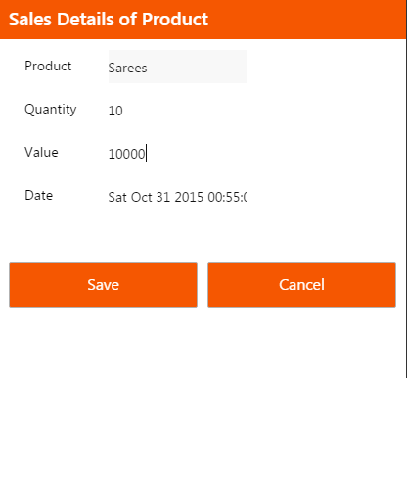
This screen gives option for Admin and Team Leads to enter the items sold on a particular day.

Slide 20
Future Enhancements
Tracking the In-Transit Items
User Management - Tracking the personnel working in Neev along with user management
Auto Mail functionality for the exported reports
Predictive Analytics to plan the next month production
Most used Raw materials in the last month
Most Sold Finished Product from Neev
Determining the next month Order Raw materials based on the Predictive analysis
Alert on limits reaching the minimum Threshold
Business Continuity in case of core system failure
Integration with Retail Neev stores

Slide 21
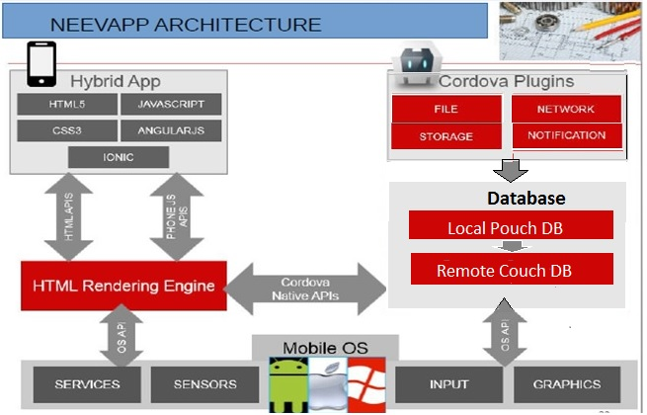
Architecture

Slide 22
Technology Stack Selection Criteria
Hybrid App - No Dependency on Location and Platform
Open Source – No Cost Required for the Software Licences
HTML 5 – Responsiveness on the Devices used
Couch and Pouch DB – Offline support. Offline and Online Syncing of data

Slide 23
Why Ionic Framework?
Ionic lets you package applications into multiple frameworks once you're done developing, which saves time that might be spent rewriting code
It's easy to get started thanks to an inherent familiarity with the technology. Developer with Angular can get started immediately
It gives you a lot of pre-generated app setups that can get you started quickly with a simple layout application
It's easy to hook it up to common back-end technologies like Node/Express

Slide 24
Advantages of HTML 5
An exponential reduction in time and effort in getting to market, as the app produced instantly works on browsers across all devices
Easy discoverability, as apps need not be submitted to an app store
Less maintenance and easy upgrades of apps (HTML5 is an open-source language that most developers already know and use, and the app can be updated without having to re-submit to an app store.)

Slide 25
Plus Points of Angular JS
Enable you to create software more quickly and with less effort
More Maintainable applications
Improves the testability
Allows to collaborate more easily with other developers by means of good readability

Slide 26
Pouch and Couch Awesomeness
Easy syncing of the Offline Database to Online
Free of Cost – An Open Source Database
No SQL
Documents stored can be in any index

Slide 27
Assumptions
We are not Dealing with complex relationship between data and hence following a no SQL Approach
The Data stored is not huge to retrieve on and perform basic manipulations.

Slide 28
Thank you

