Slide 1

Cant buy a property TO-LET?
Would like some rent ?

Slide 2
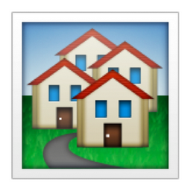
Awesome Property Fund
Denzel , Deepa, Lonnie , Patrick, Abel
(Rajesh, Joel)

Slide 3

Use Case
Invest in Property Management Fund

Slide 4

Domain Vocabulary : PROPERTY

Slide 5

Domain Vocabulary : FUND MANAGER

Slide 6

Domain Vocabulary : INVESTORS

Slide 7


Domain Vocabulary : FUND

Slide 8
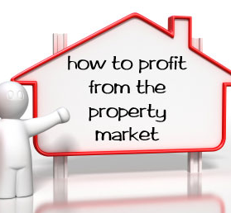
Fund Manager creates Fund on a set of Properties
Collects Rental Income
Distributes Dividend
Join the trend ..

Slide 9


What we have..
Register Property
Create Fund.
Pay Dividend
Sell my share of fund
View Registered Property
View my Dividend
View all available funds
http://github.com/deepaverma79/cordacodeclub
FundState
Property
Investors
Fund Manager
Issue
DividendState
Fund Name
Value
Issue

Slide 10
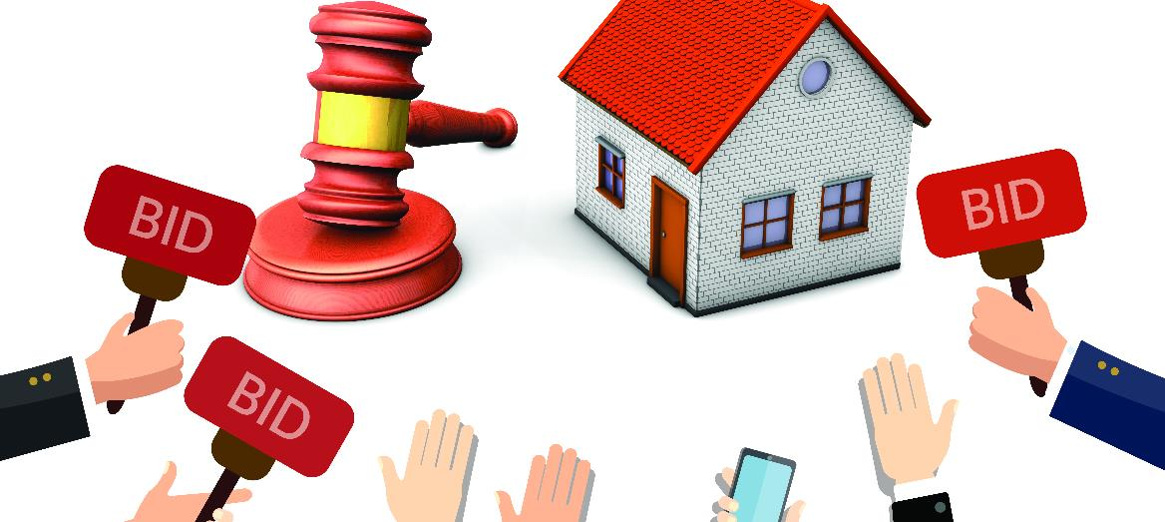
Our further expansion plans ..
Verification of property against land registry
Fund Manager creates Fund on a set of Properties
Invite bids from Investors
Handle shareholders for different share values
Collects Rental Income
Distributes Dividend to share holders as per their share

Slide 11
Phase 2
https://github.com/corda/observer-cordapp

