Slide 1

Cant buy a property TO-LET?
Would like some rent ?

Slide 2

Awesome Property Fund
Daniel , Deepa, Lonnie , Patrick, Abel
(Rajesh, Joel)

Slide 3

Use Case
Invest in Property Management Fund

Slide 4

Domain Vocabulary : PROPERTY

Slide 5

Domain Vocabulary : FUND MANAGER

Slide 6

Domain Vocabulary : INVESTORS

Slide 7


Domain Vocabulary : FUND

Slide 8

Fund Manager creates Fund on a set of Properties
Collects Rental Income
Distributes Dividend
Join the trend ..

Slide 9


What we have..
Register Property
Create Fund.
Pay Dividend
Sell my share of fund
View Registered Property
View my Dividend
View all available funds
http://github.com/deepaverma79/cordacodeclub
FundState
Property
Investors
Fund Manager
Issue
DividendState
Fund Name
Value
Issue

Slide 10
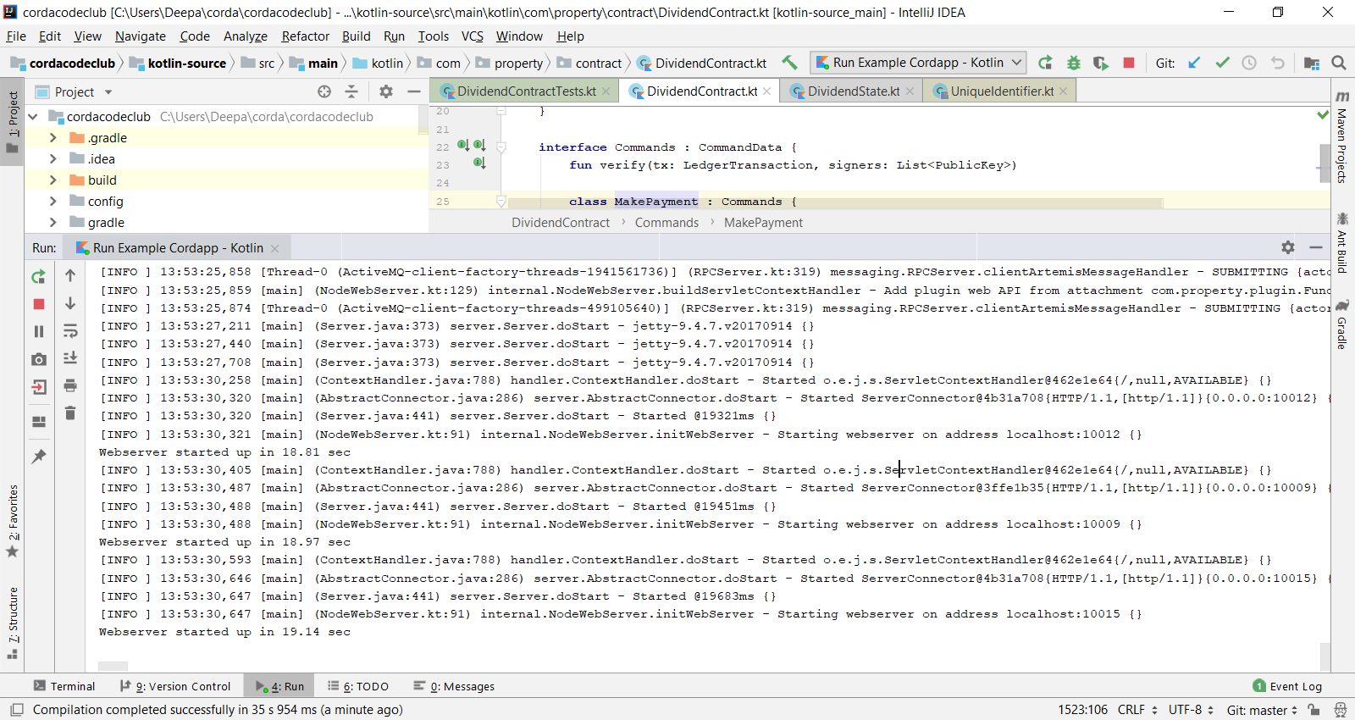

Slide 11
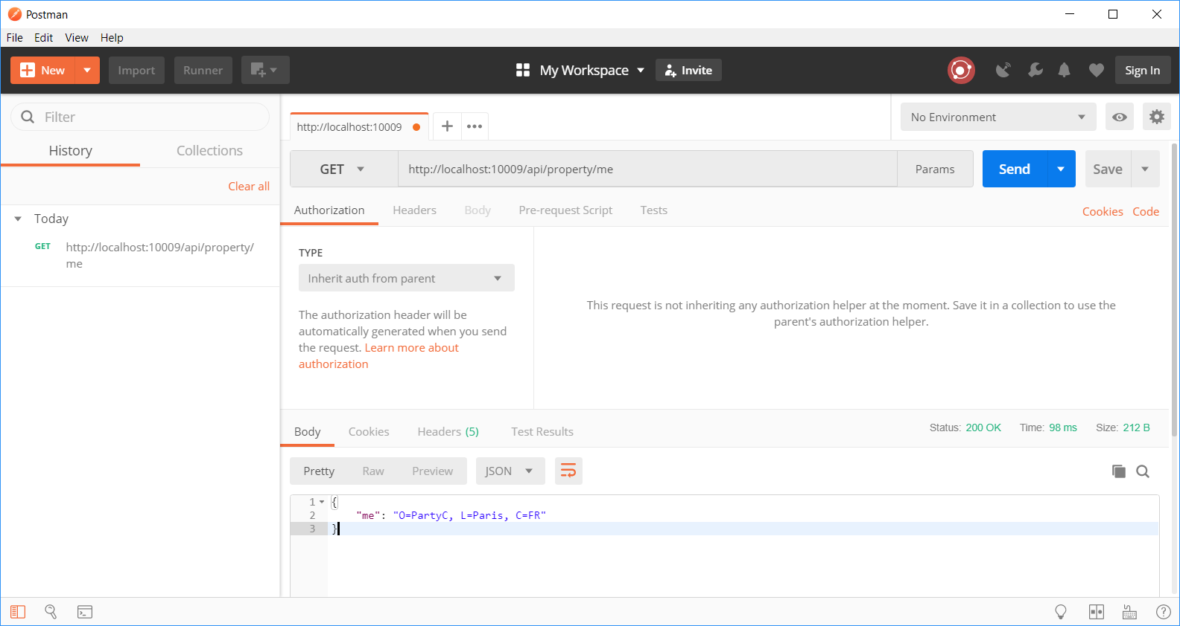
http://localhost:10009/api/property/me
Party C
(Fund Manager)

Slide 12
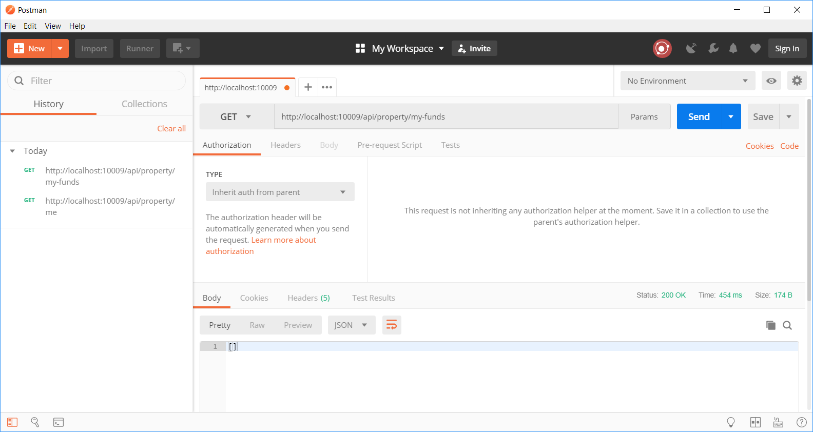
http://localhost:10009/api/property/my-funds
Currently holds no funds

Slide 13
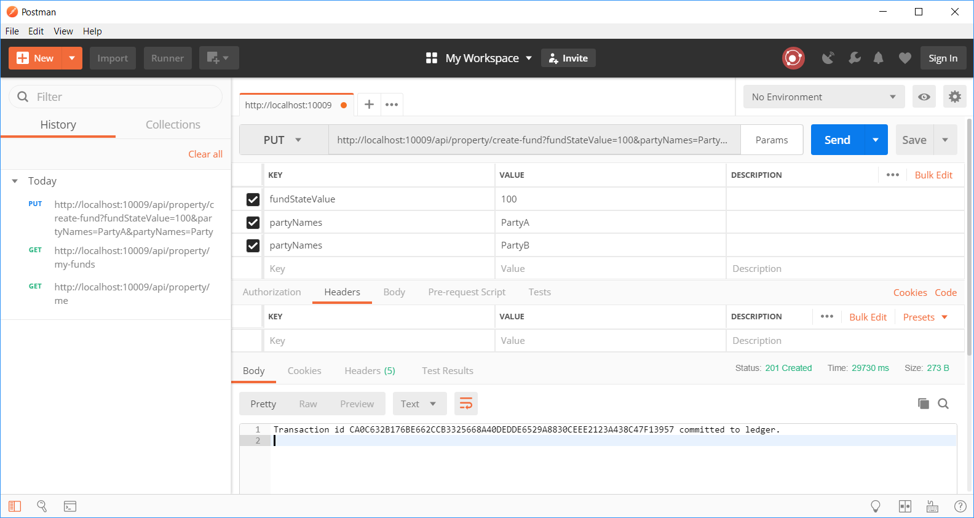
http://localhost:10009/api/property/create-fund?fundStateValue=100&partyNames=PartyA&partyNames=PartyB
Creates a fund
With PartyA & PartyB

Slide 14
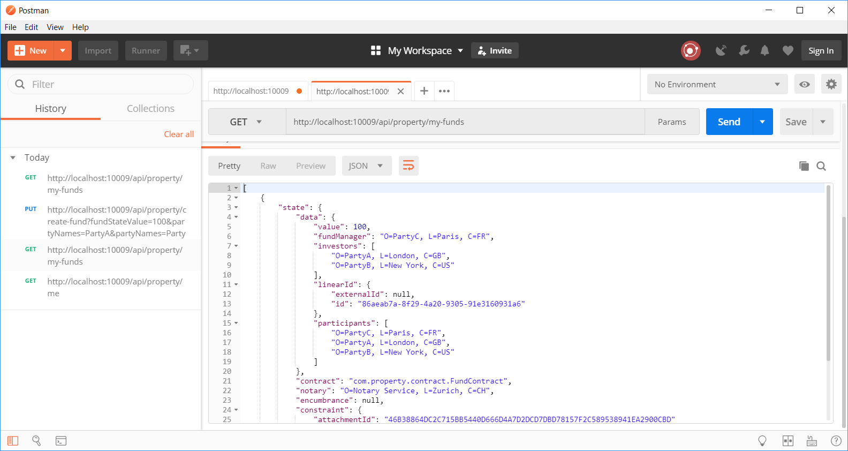
http://localhost:10009/api/property/my-funds
My Fund

Slide 15
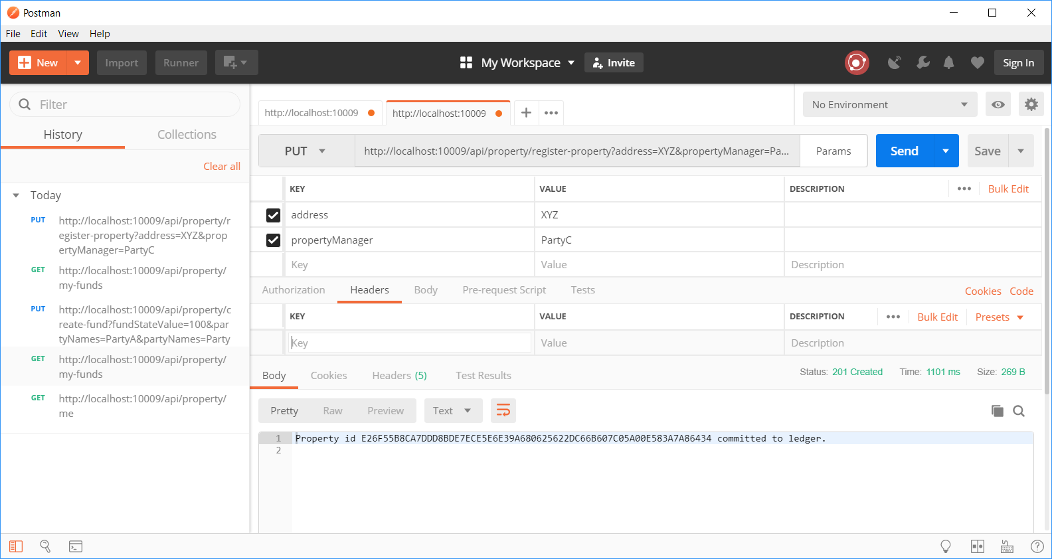
http://localhost:10009/api/property/register-property?address=XYZ&propertyManager=PartyC
Registers a Property

Slide 16
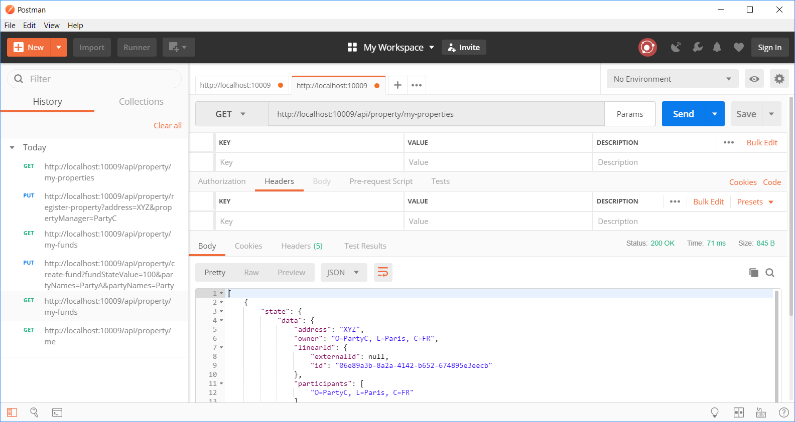
http://localhost:10009/api/property/my-properties
Property Registered (PartyC)

Slide 17
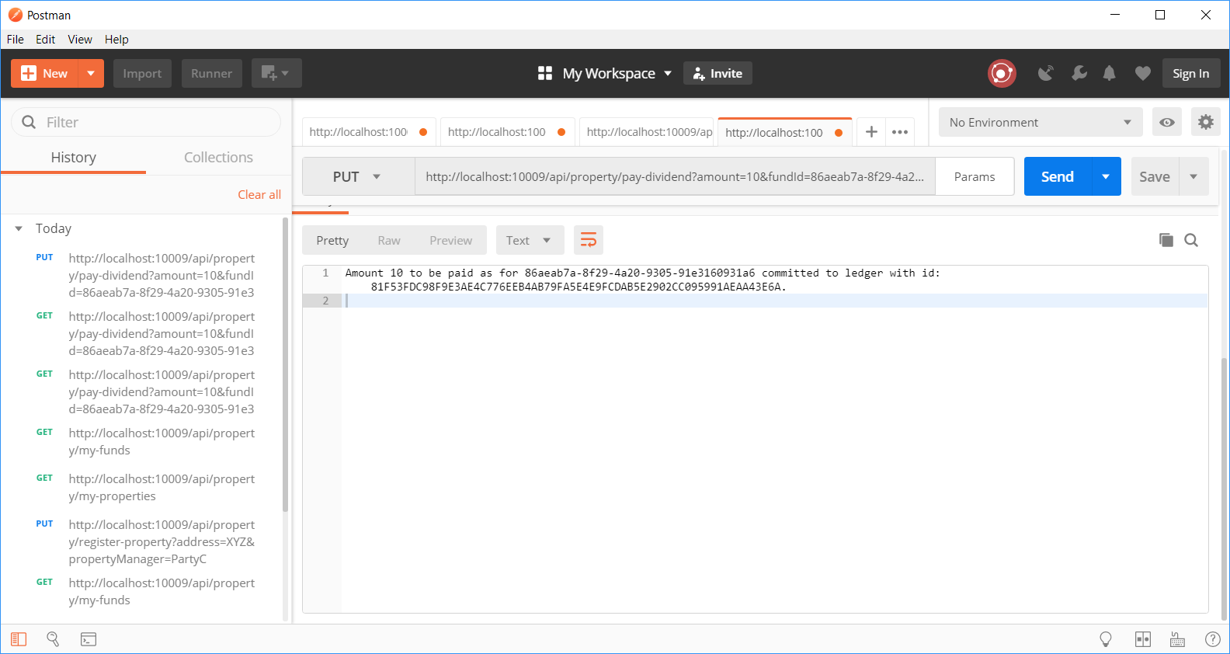
http://localhost:10009/api/property/pay-dividend?amount=10&fundId=86aeab7a-8f29-4a20-9305-91e3160931a6
Pays Dividend

Slide 18
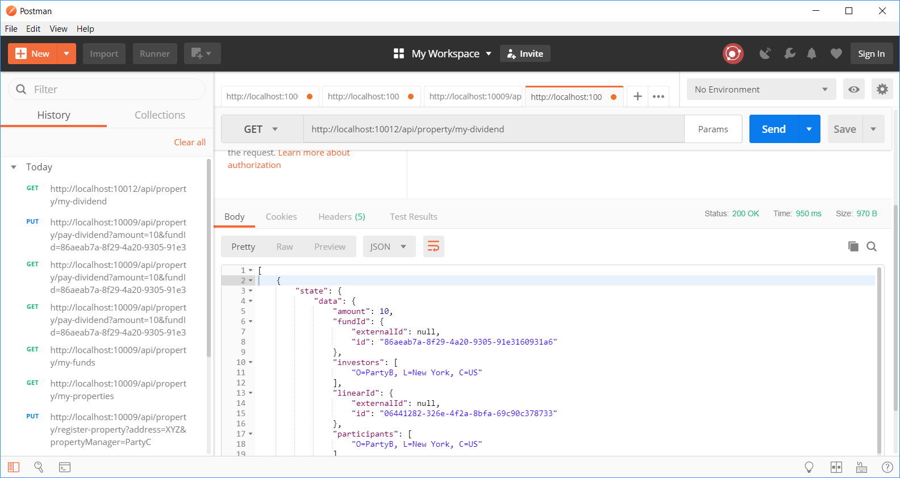
http://localhost:10012/api/property/my-dividend
PartyB receives Dividend

Slide 19
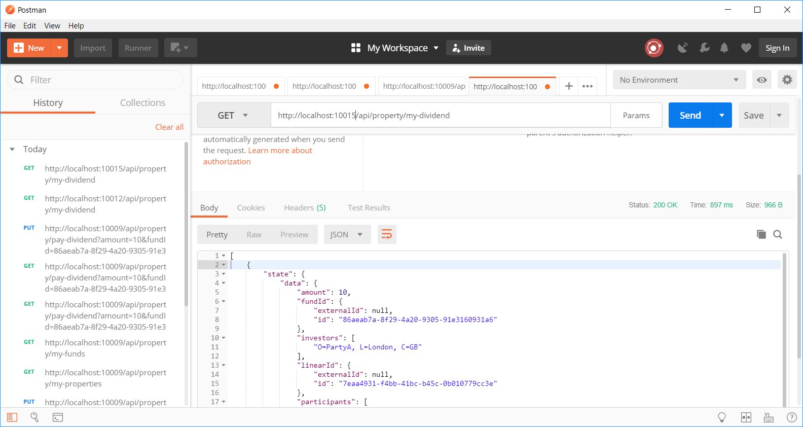
http://localhost:10015/api/property/my-dividend
PartyA receives Dividend

Slide 20
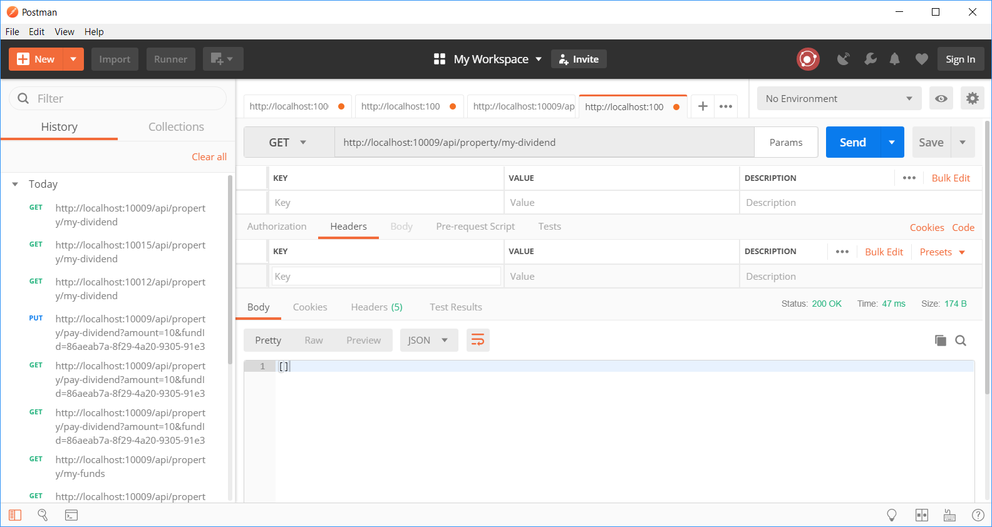
http://localhost:10009/api/property/my-dividend
PartyC No Dividend

Slide 21
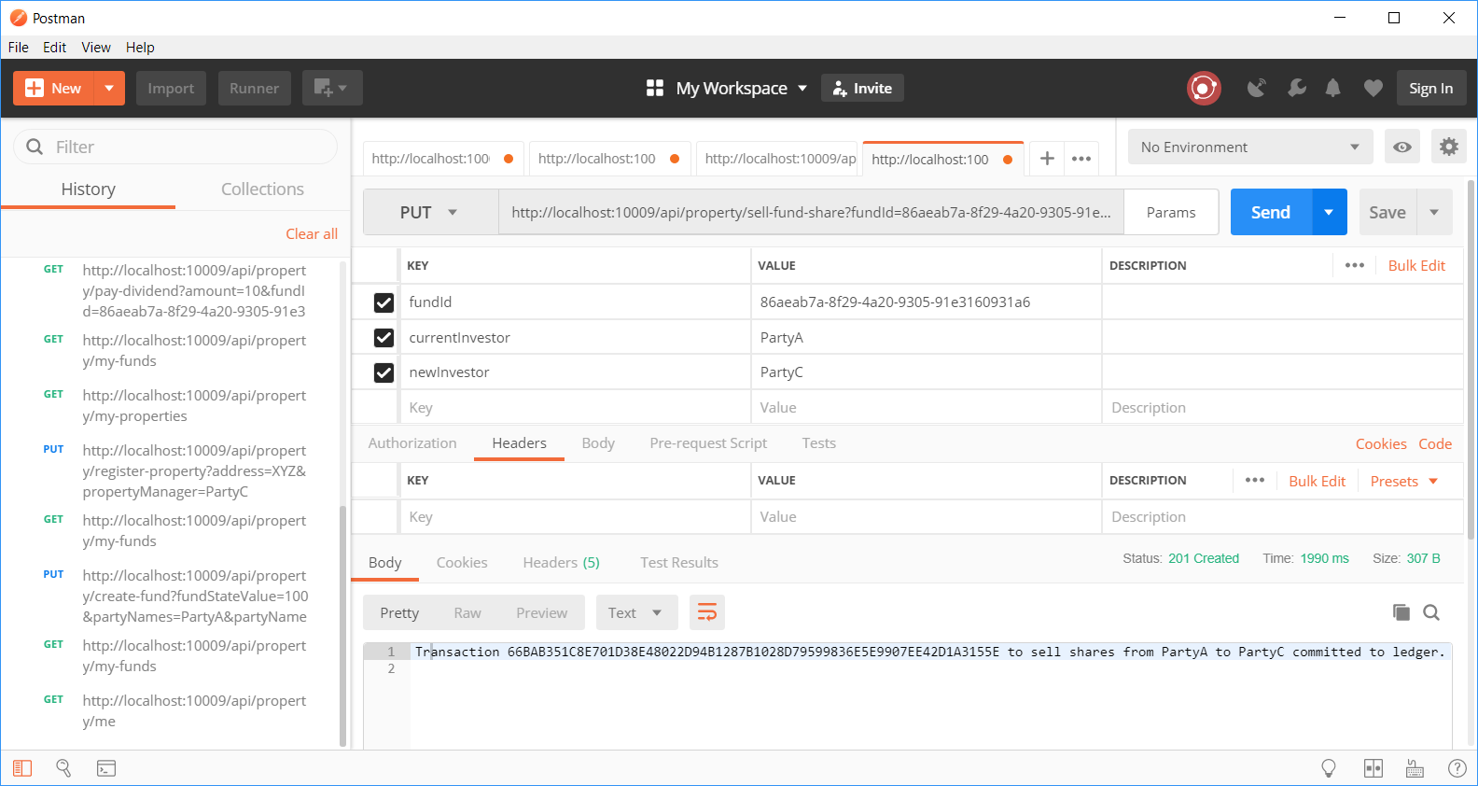
http://localhost:10009/api/property/sell-fund-share?fundId=86aeab7a-8f29-4a20-9305-91e3160931a6&currentInvestor=PartyA&newInvestor=PartyC
PartyA sells to PartyC

Slide 22
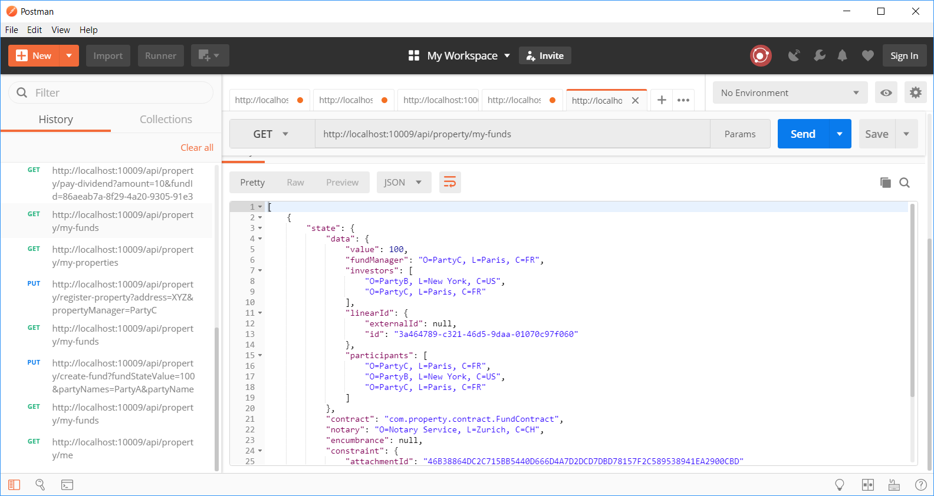
http://localhost:10009/api/property/my-funds
PartyC & PartyB are the new investors

Slide 23
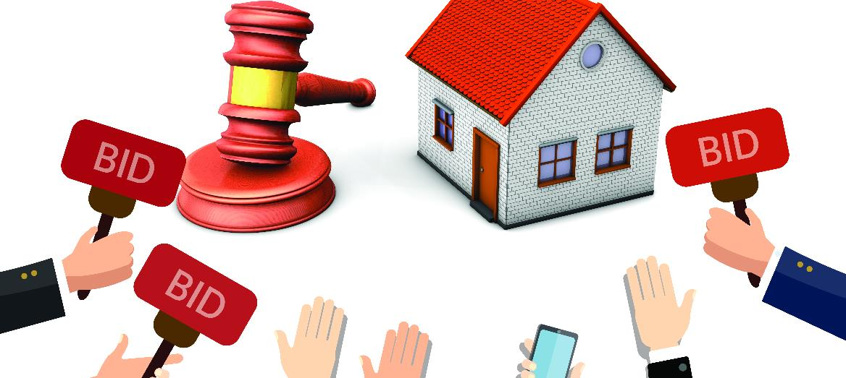
Our further expansion plans ..
Verification of property against land registry
Fund Manager creates Fund on a set of Properties
Invite bids from Investors
Handle shareholders for different share values
Collects Rental Income
Distributes Dividend to share holders as per their share

Slide 24

Thank you !

