Slide 1
Angular 2, 4
Chapter 1 - Introduction

Slide 2
Angular 4
Angular:
Angular is a framework for building client applications in HTML, CSS, and either JavaScript or a language like TypeScript that compiles to JavaScript. It is developed by Google.
Framework:
By framework, it means that it has all the features and code that is needed to write client side apps.
For example: manage browser history, security features, async operations, handle routing, can do templating logic, write testable code etc…
Angular 4 is an upgraded version from Angular 2, but completely different from Angular 1.*
Script Language: Typescript

Slide 3
Why Angular ?
Angular 4 is easy to learn and use
Cross platform
Better speed and performance
Code is well structured and maintainable.
Testable application.
Written in Typescript - A superset of JavaScript that implements many new ES2016+ features.
Implements dependency injection concept
Angular 2 was designed for mobile from the ground up.
Angular be combined with tools like Redux to simplify state management in an asynchronous, event-driven world
Testing: With Karma for unit tests, you can identify your mistake on the fly and Protractor makes your scenario tests run faster and in a stable manner.

Slide 4
Building Blocks
Components
Templates
Meta Data
Directives
Modules
Data Binding / Event Binding
Services
Dependency Injection
Controls a patch of screen called a view
Is a mechanism to group components, directives, pipes and services that are related
A form of HTML that tells Angular how to render the component.
Tells Angular how to process a class like a Component / Directive
Tells Angular how to process a class.
3 Types:
Component
Structural
Attribute
Routing
keep your application linkable and bookmarkable and allow users to share links with others.
It is optional
Reduce amount of info a component needs to know about its dependencies.
Easy unit testing
A class with a narrow, well-defined purpose.
Available to components through Dependency Injection
Coordinates parts of a template with parts of a component.
Tells Angular how to connect both sides.

Slide 5
Additional Learning
Redux
Use the concept of redux for State Management

Slide 6
Directive - Attributes example - 1

Slide 7
Directives Structural - example - 2

Slide 8

Architecture
SERVICES
Data-Binding
META
DATA
Dependency Injection
COMPONENTS (Type of Directive)
Manages
TEMPLATES
MODULES
Mechanism to group Components, Directives, Services
Event-Binding
META
DATA
attach behavior to elements in DOM
ROUTING
DIRECTIVES
COMPONENT 1
COMPONENT 2
TEMPLATE 1
TEMPLATE 2

Slide 9
Angular 4 Setup
Verify versions: [node > = 6.9.x, Npm > = 3.x.x]
On Cmd Prompt
node -v
npm -v
Install the Angular CLI globally:
On Cmd Prompt
npm install -g @angular/cli
Start New Project:
On Cmd Prompt
ng new my-app
Launch:
On Cmd Prompt
cd my-app
ng serve –open
Create a folder: my-angular-project
cd my-angular-project
Install npm, node.js
Install any IDE:
Visual Studio Code
Webeclipse
Sublime Text 3

Slide 10
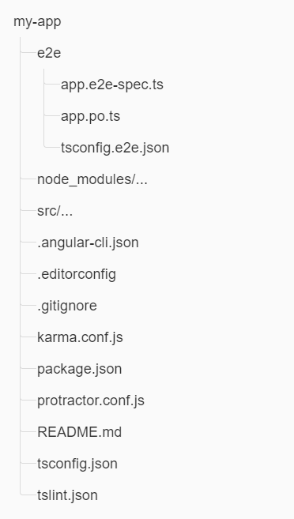
Files in root folder
e2e folder contains e2e test related files
All third party files/modules listed in package.json, are in node_modules
Configurations for:
Angular-cli: set defaults, files included in project build
Editor: common settings for all project users
Gitignore: Do not commit files into source control
Karma: test runner for unit testing
Protractor: framework for e2e testing
Package: npm settings for 3rd party packages
Typescript compiler for IDE settings
Lint: settings for code styling

Slide 11
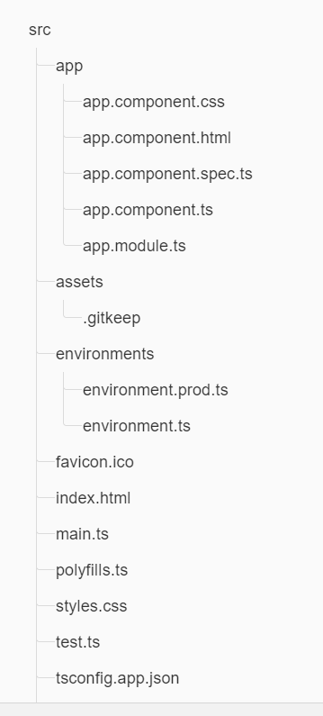
Files in src folder
App: app related class, html, css, spec files
Assets: images
Environments: to set production / development env
Favicon: fav icon
Index.html: The main html page when someone visits page
Main.ts: The main entry point for the app. Bootstarps app.module to run in the browser
Polyfills.ts: normalize different browsers’ standards for scripts
Styles: global styles
Test.ts: main entry point for unit-tests
Tsconfig.app.json: typescript compiler configuration for angular app

Slide 12
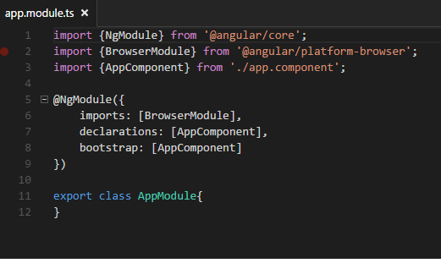
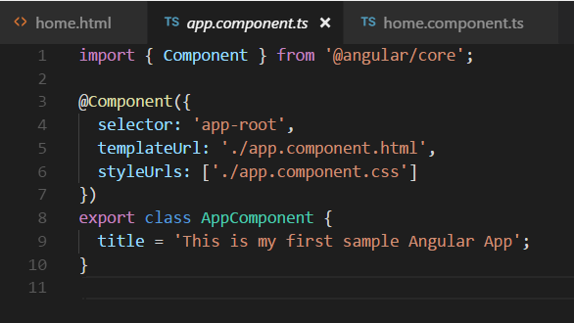
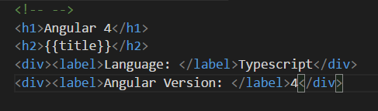
First Look
app.component.ts
app.component.html
Output:
Angular 4
This is my first sample Angular App
Language: Typescript
Angular Version: 4

