Slide 1
Bootstrap 4
layout

Slide 2
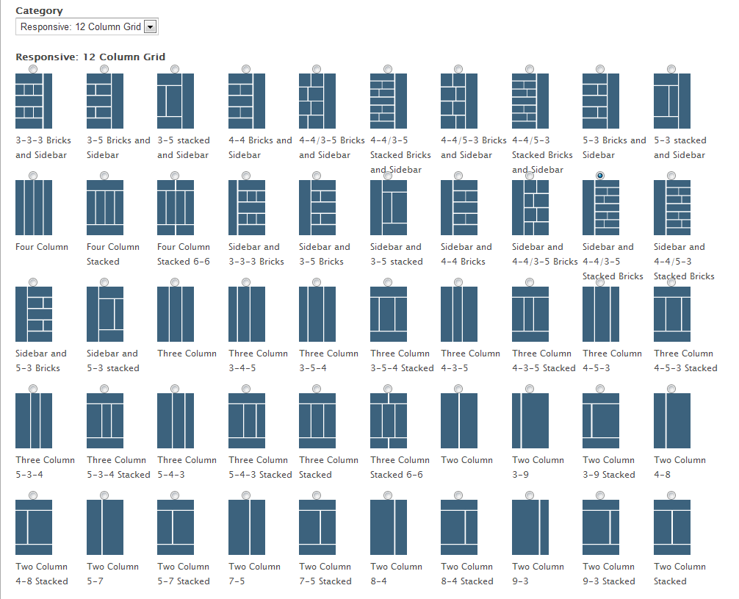
Layouts 12 column grid responsive layout - examples

Slide 3
Flexbox Grid System
Bootstrap 4 Grid System Layout:
Is powerful mobile-first flexbox grid system
It is a 12 column system
5 tier default responsive tiers
SaSS Variables & Mixins [A Mixin is a block of code that lets us group CSS declarations we may reuse throughout a site]
Has several Pre-defined classes
Uses Flexbox to build
layouts of all shapes and sizes,
align and distribute space among items in a container
A flex layout gives the container:
The ability to alter its items' width/height (and order) to best fill the available space (mostly to accommodate to all kind of display devices and screen sizes).

Slide 4

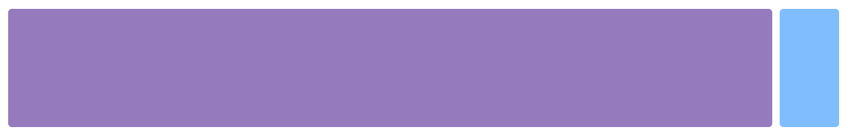
container
<div class="container">
<!-- Content here -->
</div>
Use .container-fluid for a full width container, spanning the entire width of the viewport.
<div class="container-fluid">
...
</div>

Slide 5
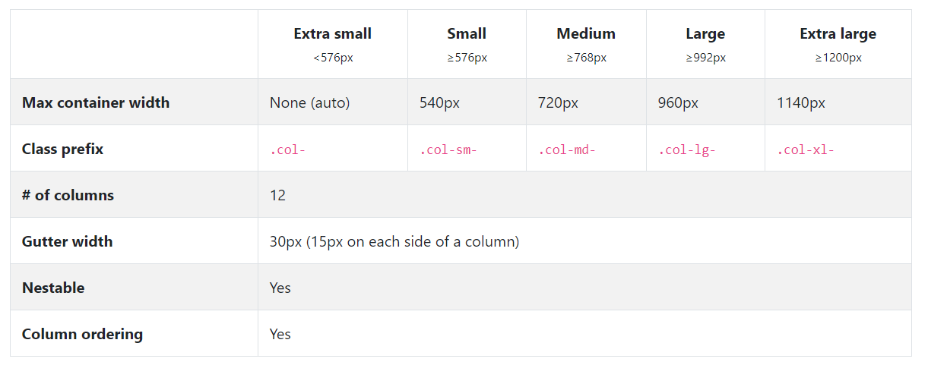
Device – Break points (Grid Options)

Slide 6
Responsive Design – Grid System
12 Column Grid Layout structure
Bootstrap provides 12 column grid layout structure to make the layout responsive. Bootstrap divides the complete device width into 12 columns
If you do not want to use all 12 columns individually, you can group the columns together to create wider columns:
Columns: 12
Columns: 3 (Equal Width)
Columns: 2 (Variable width)
Columns: 2 (Equal width)
Column: 1
unit 1 | unit 1 | unit 1 | unit 1 | unit 1 | unit 1 | unit 1 | unit 1 | unit 1 | unit 1 | unit 1 | unit 1
unit 4 |  |  |  | unit 4 |  |  |  | unit 4
unit 4 |  |  |  | unit 8
unit 6 |  |  |  |  |  | unit 6
unit 12

Slide 7
How to create rows, columns
Example – for “SMALL” Device.
<div class="container">
<div class="row">
<div class="col-sm"> 1 of 3 columns </div>
<div class="col-sm"> 2 of 3 columns </div>
<div class="col-sm"> 3 of 3 columns </div>
</div>
</div>
<div class="container">
<div class="row">
<div class="col-sm-4"> 1 of 3 columns </div>
<div class="col-sm-4"> 2 of 3 columns </div>
<div class="col-sm-4"> 3 of 3 columns </div>
</div>
</div>

Slide 8
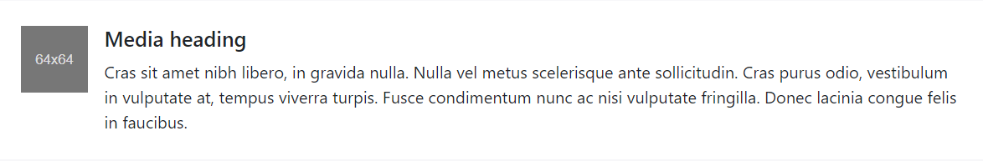
Media objects
<div class="media">
<img class="mr-3" src="..." alt="Generic placeholder image">
<div class="media-body">
<h5 class="mt-0">Media heading</h5>
Cras sit amet nibh libero, in gravida nulla. Nulla vel metus scelerisque ante sollicitudin. Cras purus odio, vestibulum in vulputate at, tempus viverra turpis. Fusce condimentum nunc ac nisi vulputate fringilla. Donec lacinia congue felis in faucibus.
</div>
</div>

Slide 9
Utilities
Display Utility
Flexbox Utility
Spacing & Margin Utility
Visibility Utility

