Slide 1
Bootstrap
Create Responsive layout in Bootstrap 3, 4

Slide 2
Responsive Design
What is Responsive Web Design ?
It makes your web page look good on all devices (desktops, laptops, tablets, and mobiles).
How do we do it ?
Use HTML and CSS to resize, hide, shrink, enlarge, or move the content.
What components can responsive design be applied ?
Layouts
Images
Table
Menu
Slider

Slide 3
Why a Responsive Design?
[Earlier, more than one site was built in order to accommodate different screen sizes]
Responsive web design creates a system for a single site to react to the size of a user’s device—with one URL and one content source.
A responsive website has a fluid and flexible layout which adjusts according to screen size.
It offers an optimized browsing experience.
Looks good on all devices
For Businesses:
Increase reach to customers and clients on smaller devices (tablets & smartphones)
Increase lead generation, sales and conversions
Analytics, tracking and reporting can be consolidated in one place
Time and cost on site content management is decreased

Slide 4
How a Non-Responsive Site Looks
https://dequeuniversity.com/library/responsive/1-non-responsive
https://www.amazon.in/

Slide 5
How a Responsive Site Looks
https://www.smashingmagazine.com/

Slide 6
Responsive Design – Grid System
12 Column Grid Layout structure
Bootstrap provides 12 column grid layout structure to make the layout responsive. Bootstrap divides the complete device width into 12 columns
If you do not want to use all 12 columns individually, you can group the columns together to create wider columns:
Columns: 12
Columns: 3 (Equal Width)
Columns: 2 (Variable width)
Columns: 2 (Equal width)
Column: 1
unit 1 | unit 1 | unit 1 | unit 1 | unit 1 | unit 1 | unit 1 | unit 1 | unit 1 | unit 1 | unit 1 | unit 1
unit 4 |  |  |  | unit 4 |  |  |  | unit 4
unit 4 |  |  |  | unit 8
unit 6 |  |  |  |  |  | unit 6
unit 12

Slide 7
Grid options for Devices
 | Extra small <576px | Small ≥576px | Medium ≥768px | Large ≥992px | Extra large ≥1200px
Max container width | None (auto) | 540px | 720px | 960px | 1140px
Class prefix | .col- | .col-sm- | .col-md- | .col-lg- | .col-xl-
# of columns | 12
Gutter width | 30px (15px on each side of a column)
Nestable | Yes
Column ordering | Yes

Slide 8
Live Example
Live Example - Demo

Slide 9
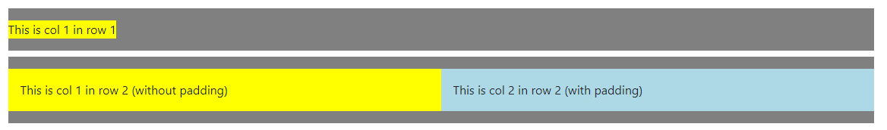
Spacing Between Rows and Columns
Notation
The classes are named using the format {property}{sides}-{size} for xs and {property}{sides}-{breakpoint}-{size} for sm, md, lg, and xl.
Property is one of:
m - for classes that set margin
p - for classes that set padding
Sides is one of:
t - for classes that set margin-top or padding-top
b - for classes that set margin-bottom or padding-bottom
l - for classes that set margin-left or padding-left
r - for classes that set margin-right or padding-right
x - for classes that set both *-left and *-right
y - for classes that set both *-top and *-bottom
Size is one of:
0, 1, 2, 3, 4, 5
<div class="row mt-2 pt-3 pb-3" style="background-color: grey;">
<div class="col-xs-12" style="background-color:yellow;">
This is col 1 in row 1
</div>
</div>
<div class="row mt-2 pt-3 pb-3 " style="background-color: grey;">
<div class="col-6 p-3" style="background-color:yellow;">
This is col 1 in row 2 (without padding)
</div>
<div class="col-6 p-3" style="background-color:lightblue;">
This is col 2 in row 2 (with padding)
</div>
</div>

Slide 10
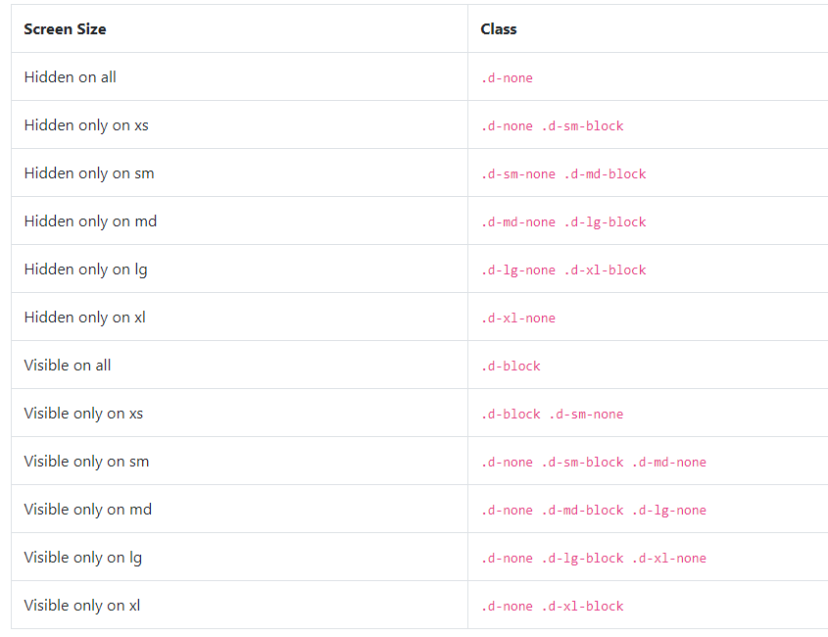
Hide / View classes
As such, the classes are named using the format:
.d-{value} for xs
.d-{breakpoint}-{value} for sm, md, lg, and xl.
Where value is one of:
none
inline
inline-block
block
table
table-cell
table-row
flex
inline-flex

