Slide 1
Bootstrap 4
Introduction

Slide 2
Objective
At the end of this course, you will be able to:
Create Responsive Websites
Create JS Bootstrap Components
Create a sample website
By the end of the course, we will complete a Bootstrap integrated eComm mini-site.

Slide 3
Pre-requisites
BASICS OF CSS
BASICS OF JS / JQUERY
BASICS OF HTML

Slide 4
What we will learn in this course ?
Bootstrap 4
Layouts (Grid System)
Components
Utilities (New in Bootstrap 4)
Customization
Optimization
A sample eComm Website

Slide 5

What is Bootstrap ?
Bootstrap is the most popular HTML, CSS, and JavaScript framework for developing responsive, mobile-first websites.
Bootstrap’s classes are designed for “screen-readers” too
Screen Readers are software programs that allow blind or visually impaired users to read the text that is displayed on the computer screen with a speech synthesizer or braille display.

Slide 6
Installation / Setup
.NET - install and manage Bootstrap’s CSS or Sass and JavaScript using NuGet:
Install-Package bootstrap
RubyGems
- Using Bundler (recommended) and RubyGems by adding the following line to the Gemfile:
gem 'bootstrap', '~> 4.0.0’
Node.js - with the npm package:
npm install bootstrap
npm install jquery
npm install popper.js
Need an Editor to try Bootstrap:
Use: https://code.visualstudio.com/download

Slide 7
Bootstrap Requires
Bootstrap needs CSS and JS files. Can Download Or By Reference :
----------------------------------------
Download Compiled CSS and JS
Compiled and minified CSS bundles
Compiled and minified JavaScript plugins
Using BootstrapCDN
CSS File
<link rel="stylesheet" href="https://maxcdn.bootstrapcdn.com/bootstrap/4.0.0/css/bootstrap.min.css" integrity="sha384-Gn5384xqQ1aoWXA+058RXPxPg6fy4IWvTNh0E263XmFcJlSAwiGgFAW/dAiS6JXm" crossorigin="anonymous">
JS/Jquery Files:
<script src="https://maxcdn.bootstrapcdn.com/bootstrap/4.0.0/js/bootstrap.min.js" integrity="sha384-JZR6Spejh4U02d8jOt6vLEHfe/JQGiRRSQQxSfFWpi1MquVdAyjUar5+76PVCmYl" crossorigin="anonymous"></script>
<script src="https://code.jquery.com/jquery-3.2.1.slim.min.js" integrity="sha384-KJ3o2DKtIkvYIK3UENzmM7KCkRr/rE9/Qpg6aAZGJwFDMVNA/GpGFF93hXpG5KkN" crossorigin="anonymous"></script>
<script src="https://cdnjs.cloudflare.com/ajax/libs/popper.js/1.12.9/umd/popper.min.js" integrity="sha384-ApNbgh9B+Y1QKtv3Rn7W3mgPxhU9K/ScQsAP7hUibX39j7fakFPskvXusvfa0b4Q" crossorigin="anonymous"></script>

Slide 8
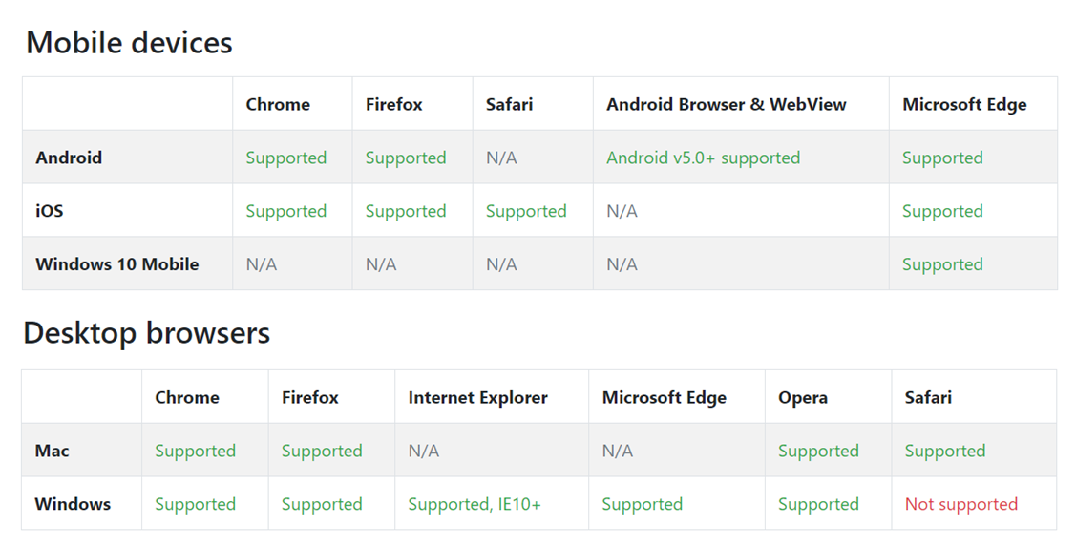
support

Slide 9
THEMING USING SASS
In Bootstrap 4, theming is accomplished by Sass variables, Sass maps, and custom CSS.
Sass (Syntactically Awesome StyleSheets)
Sass is an extension of CSS that adds power and elegance to the basic language.
It allows you to use variables, nested rules, mixins, inline imports, and more
Sass helps keep large stylesheets well-organized, and get small stylesheets up and running quickly
Example:
$font-stack: Helvetica, sans-serif;
$primary-color: #333;
body {
font: 100% $font-stack;
color: $primary-color;
}
The following CSS will be produced:
body {
font: 100% Helvetica, sans-serif;
color: #333;
}

Slide 10
Customization of bootstrap 4
Install gulp, gulp-sass
Create a task In gulp
Cutomization can be done by creating customization using sass files
Not recommended to edit the SASS files directly
Create a .scss file. Write new over-ride data for the variables
Compile it using gulp
A .css file gets generated
Reference the .css file in your pages

Slide 11
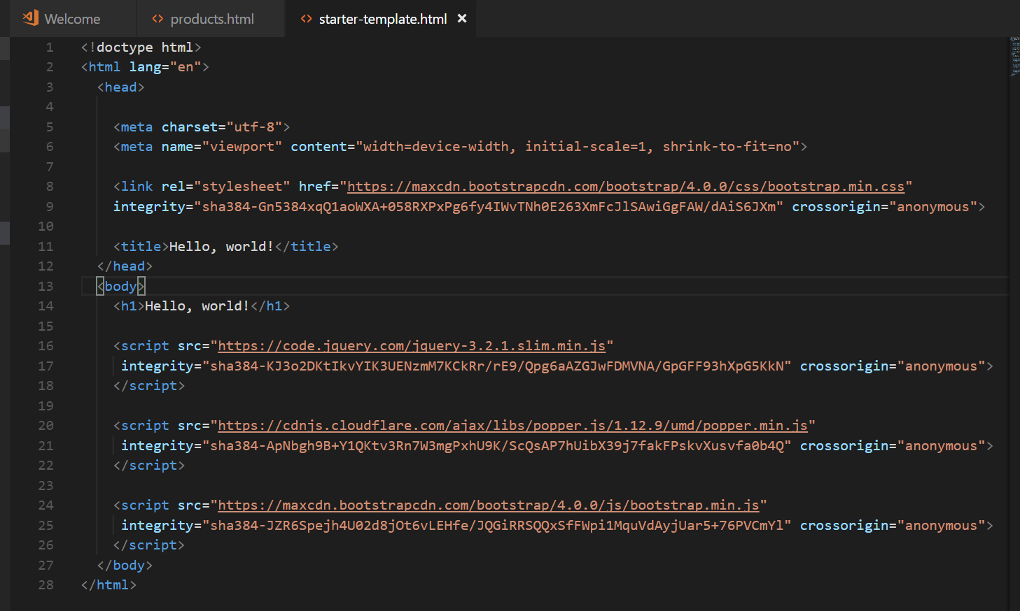
Starter Template

