Slide 1

INSIGHTVISTA 2026
GROUP NAME
Data Dudes
Student Performance Data
ENROLLMENT NUMBERS
240840116055
240840116057
240840116063
240840116068
250843116002
Data Analytics and Visualisation
Subject Code: 1 IT508
Notes:
Introduce the event (INSIGHTVISTA 2026), the subject (Data Analytics and Visualisation, 1 IT508), and the team (Data Dudes).

Slide 2




Raw Data: Observations and Problems
1,000
student records
8
columns
Messy column headers
Names like "race/ethnicity" and "math score" contain spaces and slashes.
Every value is quoted
Even scores are wrapped in quotes, so tools may import them as text.
0
missing values
0
duplicate rows
Inconsistent labels
Categories such as "group B" are capitalised; formats need standardising.
Source: 6__StudentsPerformance.csv. Gender, ethnicity group, parental education, lunch type, test prep, and 3 exam scores.
Extreme values
A math score of 0 (and 8 math outliers by IQR) needs to be checked.
Notes:
Raw file: 1,000 rows x 8 columns, no nulls, no duplicates. Problems are about structure and formatting: headers with spaces/slashes, fully quoted values, inconsistent capitalisation of categories, and a math score of 0 that must be checked (kept as a valid score).

Slide 3
Data Cleaning and Pre-processing
1
Load raw CSV
1,000 rows x 8 columns
import pandas as pd
df = pd.read_csv("raw.csv")
df.columns = (df.columns.str.lower()
.str.replace(r"[ /]", "_", regex=True))
cat = df.select_dtypes("object").columns
df[cat] = df[cat].apply(
lambda s: s.str.strip().str.lower())
score = ["math_score", "reading_score",
"writing_score"]
df[score] = df[score].astype(int)
assert df.notna().all().all()
df.to_csv(
"Updated_students_performance.csv",
index=False)
2
Rename columns
lowercase snake_case, e.g. race_ethnicity
3
Standardise labels
trim spaces, lowercase text values
4
Fix data types
convert the 3 score columns to integers
5
Validate
0 nulls, 0 duplicates, scores within 0-100
6
Export final CSV
Updated_students_performance.csv
Notes:
Cleaning is structural: rename headers to snake_case, lowercase and trim category labels, make score columns numeric, validate, and export Updated_students_performance.csv. No rows were removed; the 0 math score is a valid value, so it was kept.

Slide 4
Final Clean Dataset: Problems Solved
Issue | Raw dataset | Final clean dataset
Column names | race/ethnicity, math score | race_ethnicity, math_score
Category labels | group B, mixed formats | group b, consistent lowercase
Score fields | Quoted values ("72") | Integers, range 0-100
Quality checks | Not verified | 0 nulls, 0 duplicates
Record count | 1,000 rows | 1,000 rows (none lost)
1,000 x 8
tidy, analysis-ready table
100%
complete, no missing data
Power BI ready
clean fields for slicers and visuals
Notes:
The final file Updated_students_performance.csv has the same 1,000 records as the raw file, with clean names, consistent labels and numeric scores. It loads directly into Power BI, where gender and race_ethnicity slicers work on clean fields.

Slide 5
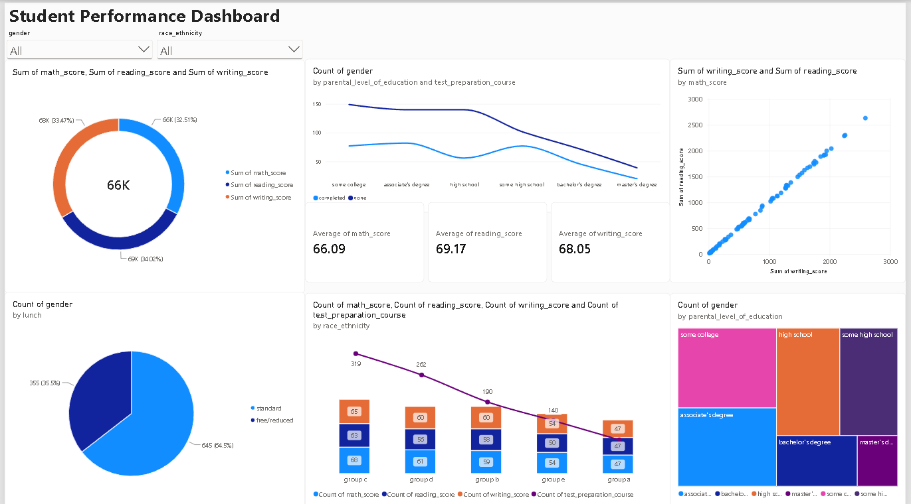
Visualised Dashboard
Student Performance Dashboard with gender and race_ethnicity filters
Notes:
Walk through the dashboard: KPI cards (average math 66.09, reading 69.17, writing 68.05), score share donut, parental education vs test prep line chart, reading vs writing scatter, lunch pie, ethnicity-group combo chart and parental education treemap.

Slide 6
Dashboard Observations and Insights
69.17
Reading scores lead
Average reading beats writing (68.05) and math (66.09). Score share is near equal at 32.5 / 34.0 / 33.5%.
r = 0.96
Reading and writing move together
The scatter plot forms an almost straight line: strong students excel in both.
642 vs 358
Test prep not completed
"None" outnumbers "completed" at every parental education level.
64.5%
Standard lunch
355 students (35.5%) receive free or reduced lunch.
319
Group C is largest
Followed by D (262), B (190), E (140); group A is smallest (89).
44.8%
Parents: some college or associate's
Master's degree is rare (5.9%); counts fall as education rises.
Notes:
Observations come straight from the dashboard visuals. Reading/writing correlation r = 0.955 was computed on the cleaned dataset.

Slide 7




Recommendations
Expand test-prep courses
Completers average 72.7 vs 65.0, yet only 35.8% of students have taken one.
Improve the dashboard
Show averages instead of sums in the donut and scatter plot.
Plot individual students to expose outliers.
Add average score by test prep and lunch type.
These are associations, not proof of cause.
Support free/reduced-lunch students
Average score 62.2 vs 70.8; the widest gap is in math (11.1 points).
Target subject gaps by gender
Math help for girls (63.6 vs 68.7); reading and writing for boys (7-9 points behind).
Mentor lower-parental-education homes
High school averages 63.1 vs 73.6 for a master's; add tutoring and mentoring.
Notes:
Figures: avg total score by test prep 72.7 vs 65.0; lunch 62.2 vs 70.8 (math gap 11.1); gender math 63.6 vs 68.7 (girls vs boys) and reading/writing 72.6/72.5 vs 65.5/63.3; parental education high school 63.1 vs master's 73.6. Note the dashboard uses Sum of scores in the donut and scatter, which is better shown as averages.

