Slide 1
Can NBA success be bought?
Team Members: Deep Bhattacharyya, Kevin Walsh, Phil Waddilove, Leith Bakhit and Arthur Moran

Slide 2
Research Questions Background
Questions to answer:
Does having a higher aggregate NBA team salary lead to success?
Can we identify correlations that result in success
Player height
Offensive statistics
Defensive statistics
Success determined by leveraging a simulation of n games between two teams
NBA 101
30 NBA teams with ~15 players per team
Dataset from 2008 to 2018
Regular season data - 82 games per team
Salary cap floor and ceiling set each year depending on a number of factors

Slide 3
Data Acquisition
There were three data sources that we had to deal with
NBA.com - Team Performance Metrics
Offensive Statistics
Defensive Statistics
Win Loss Record
Opponent Statistics
HoopsHype.com - Team Specific Salary Spend
Kaggle
Player Descriptive statistics
Individual game scores
In total, we dealt with 7 individual csv files

Slide 4
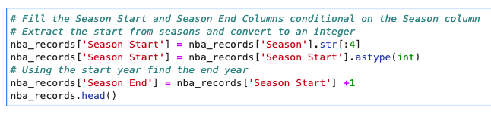

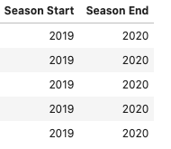
Data Cleaning
Make the Season’s Attribute more workable

Slide 5

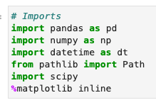
Data Cleaning
Filtering Dates

Slide 6
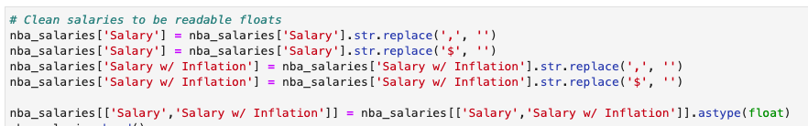
Data Cleaning
Convert Salary Information to Numerical Data

Slide 7

Data Cleaning
Standardize the Team Attribute Across DataFrames

Slide 8
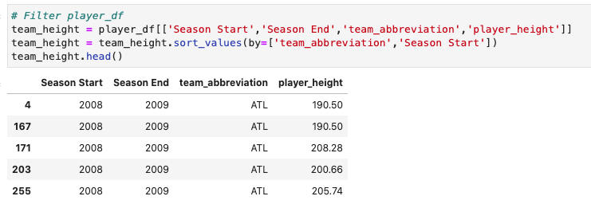

Data Cleaning
Grouping Player Data by Team and Year

Slide 9

Data Sharing
Saved cleansed and joined dataframes as csv files to facilitate sharing across project team

Slide 10
Correlations and Visualizations

Slide 11



Analysing the data
Analysis
Leverages cleaned .csv datasets
Concats team perf. with player attributes (i.e. win/loss record, off/def stats, team heights and salaries)
Groups the data by team and year
Statistics: means, correls, stdevs
Further analysis: OLS and t-test (SciPy) - timed out
Visualization libraries
Seaborn
Matplotlib.pyplot
Hvplot
Scatter
Bars

Slide 12
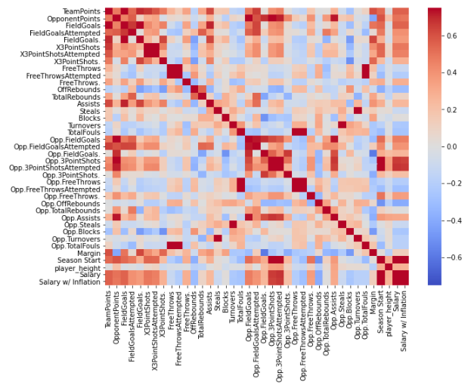
Correlation
What does it show?
Medial positive correlation between team height, salary and margin
Strong correlation between salary and 3pt shots for/ against (causation? See also: season!)
Notes:
Calculates sharpe ratio on win/loss margins for each team, each game, over lookback period (‘08 -’18)
Sharpe = avg team margin - avg league margin / Stdev team margin

Slide 13
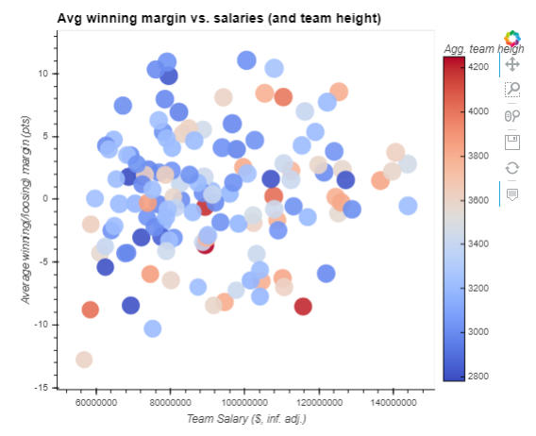
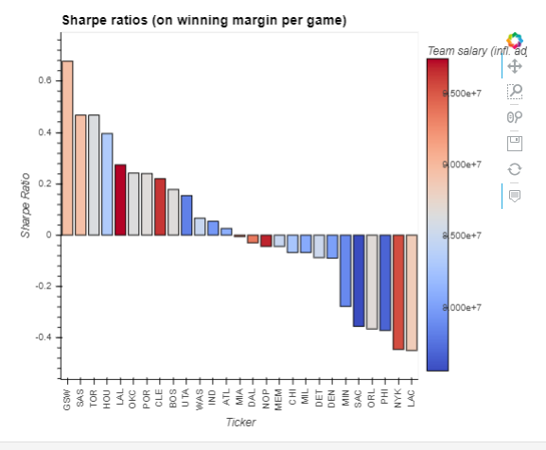
Scatter
What does it show?
A tall, expensive team does not necessarily equate to winning margins over time
“Heart over height” - Nate Robinson
Notes:
Calculates sharpe ratio on win/loss margins for each team, each game, over lookback period (‘08 -’18)
Sharpe = avg team margin - avg league margin / Stdev team margin

Slide 14
Sharpe
Ratios
What does it show?
Avg. league margin ~zero (intuitive: zero sum game)
LAL and NYK are expensive teams
SAS is cheaper but a consistent performer
Gambler: “who tends to win?”
Owner: “does an expensive franchise give me results?”

Slide 15
Using Folium & GeoCode to Map NBA Salaries

Slide 16
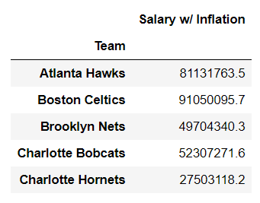
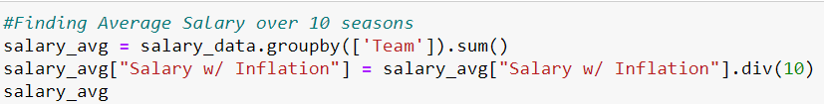
Data preparation for mapping

Slide 17

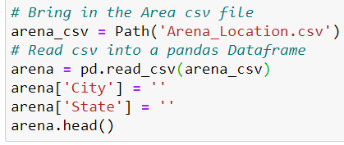
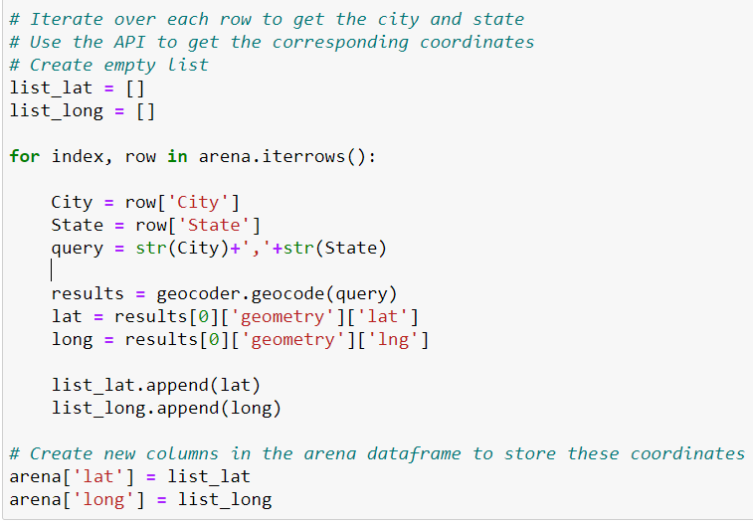
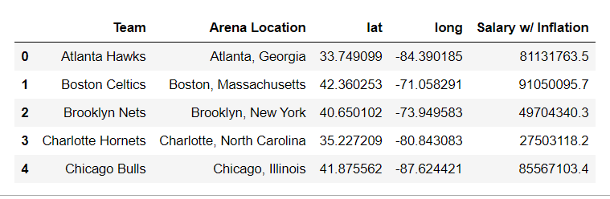
from opencage.geocoder import OpenCageGeocode

Slide 18
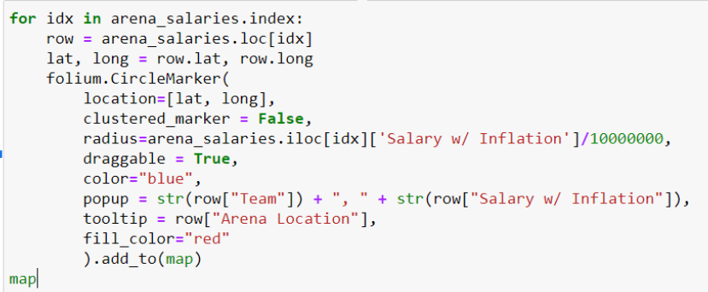
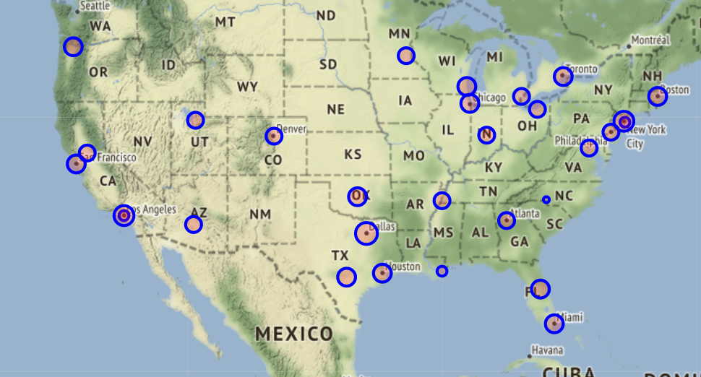
import folium

Slide 19
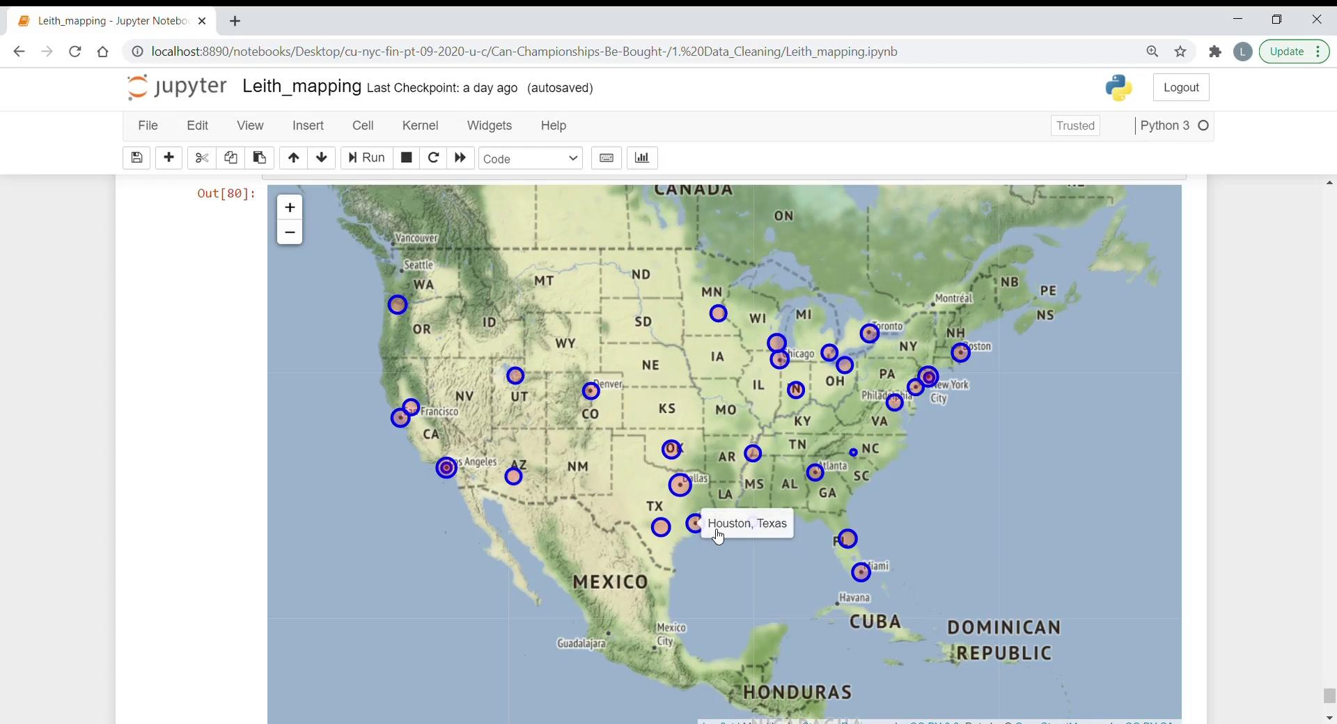

Slide 20
Simulating Games

Slide 21
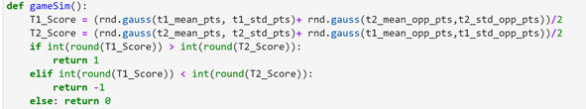
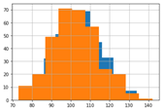
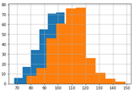

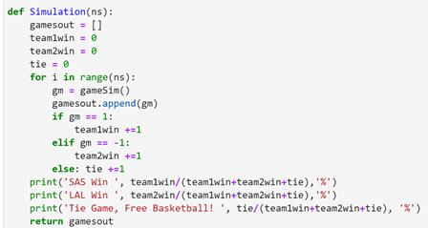


Based on points scored and points allowed by team we are able to simulate games to determine success
A
C
E
D
B

Slide 22
Conclusion
A team that spends the most money does not necessary have the most regular season success
It might easier to dunk a basketball if you are 7 feet tall, but a taller team does not necessarily lead to greater success
Northwest United States ripe for potential team expansion
There are a wide number of player, statistic and opponent stats can further refine the analysis - we have shown that having a higher salary (LAL or NYK) does not guarantee success
Results of simulation do not guarantee future success
Please gamble responsibly
Gambling problem? Call 1-800-GAMBLER

