Slide 1
Our programming project
Haven’t demonstrated problem solving as much -> try demonstrate roadblocks and solutions in the code (e.g scheduler)
By Ella D, Adam B3, Prabhdeep N, Naomi M

Slide 2
Step 1: Planning
We read over the documentation together so we all had the same understanding
We created a Kanban on ClickUp , splitting up all that tasks and assigning to the team members
But when we set up the Github repository we switched to the issue managing system there so everything was centralised

Slide 3
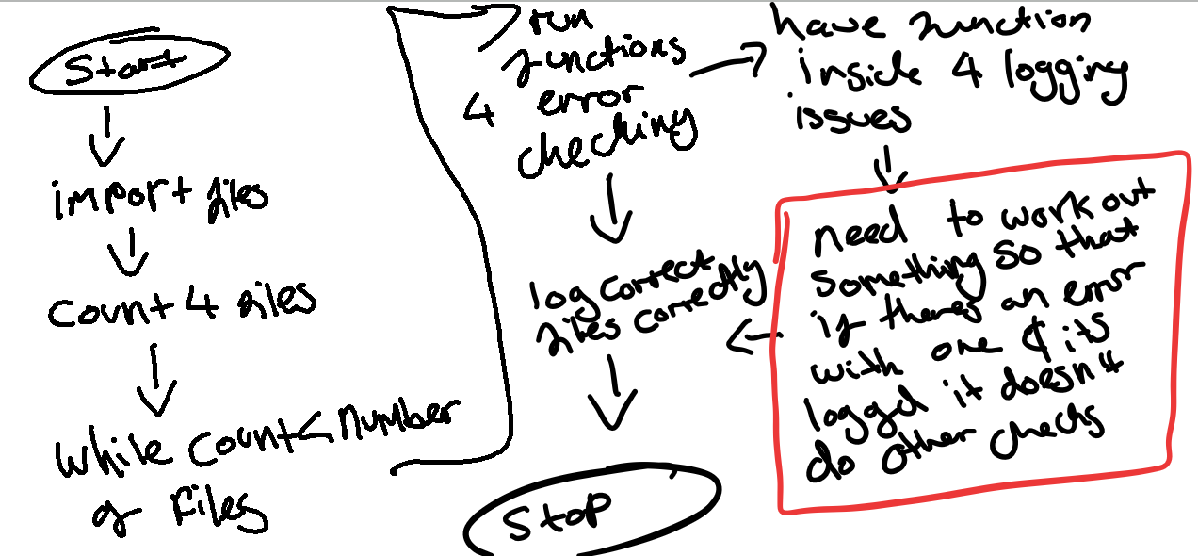
Step 2: outlining the code
We then went a bit deeper into how we were going to link all the code together and what we wanted the output to look like
For example, the plan was for multiple people to work on the code that validated whether data files was ok to use, so we outlined how we wanted to connect things together

Slide 4
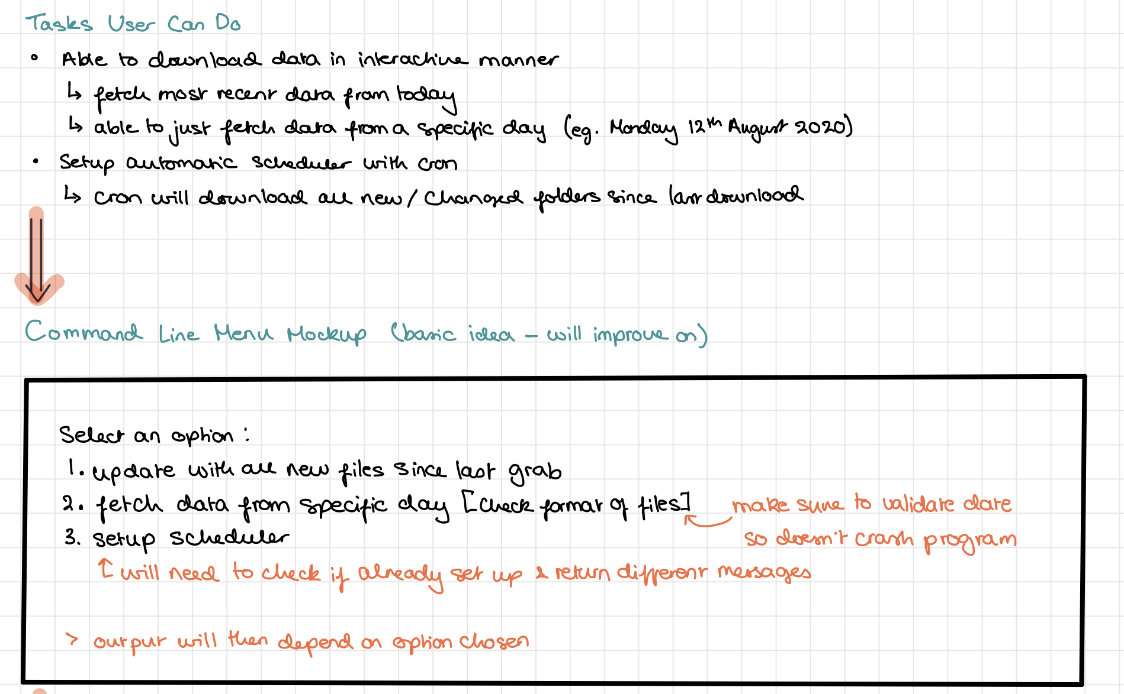
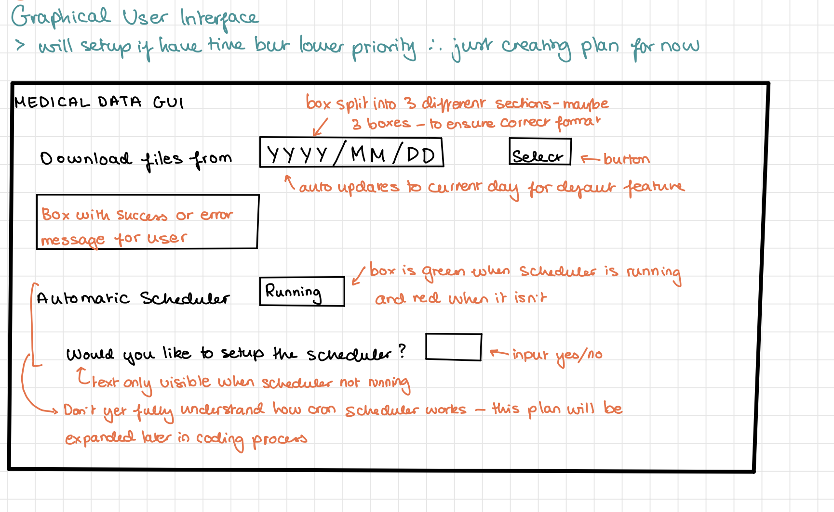
Step 2: outlining the code cont.
We also outlined our user interface plans
Now onto the code….

Slide 5
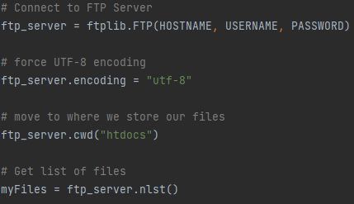
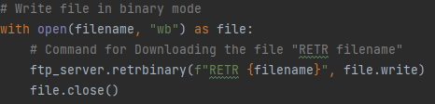
Ftp server
Ftp server
Initial Plan:
Initial Plan:
Locally host both the client and the server, initial plan was to use the Twisted library to do so.
Soon realised that this would limit the real-world application of the client
Implementation:
Implementation:
Server hosted using a free FTP server online
Protected by username and password
Client downloads and views file with the ftplib python library.

Slide 6
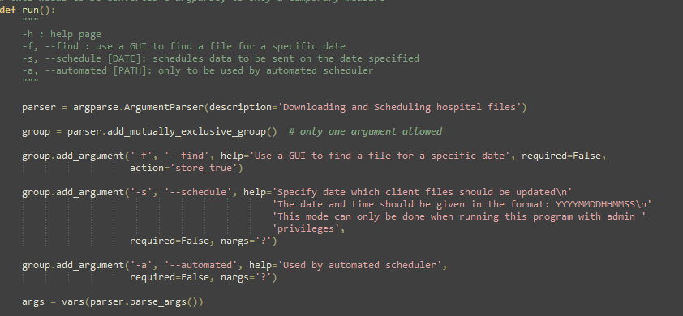
Command line ARGPARSE

Slide 7
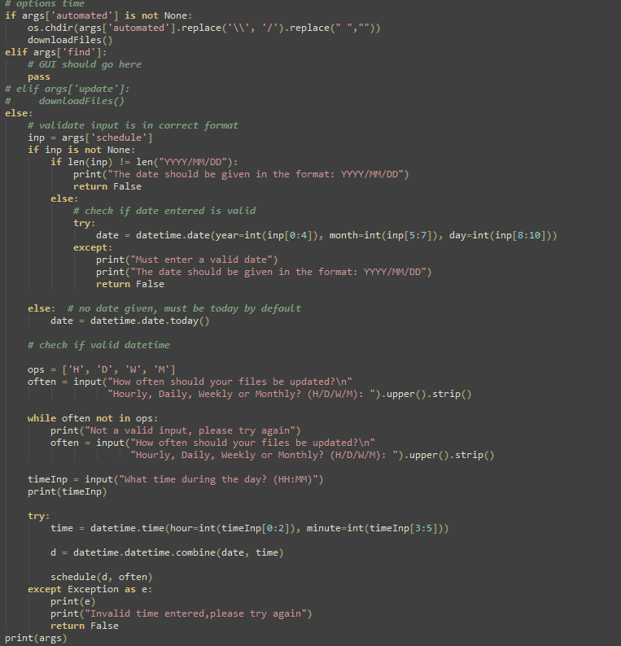
Command line PROCESSING ARGS

Slide 8
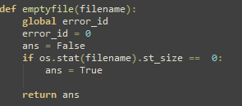
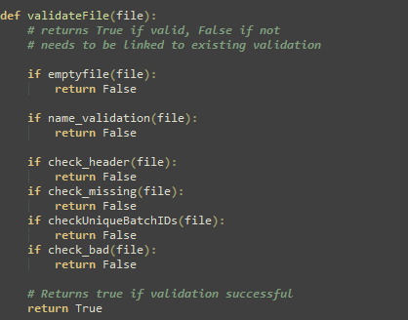
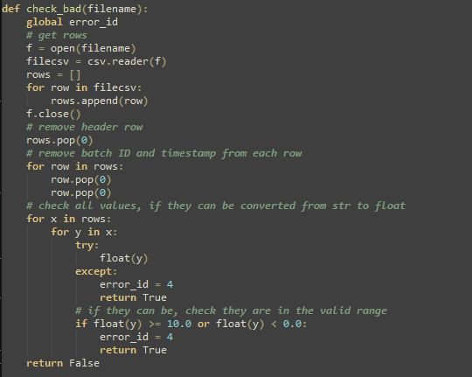
Data validation

Slide 9
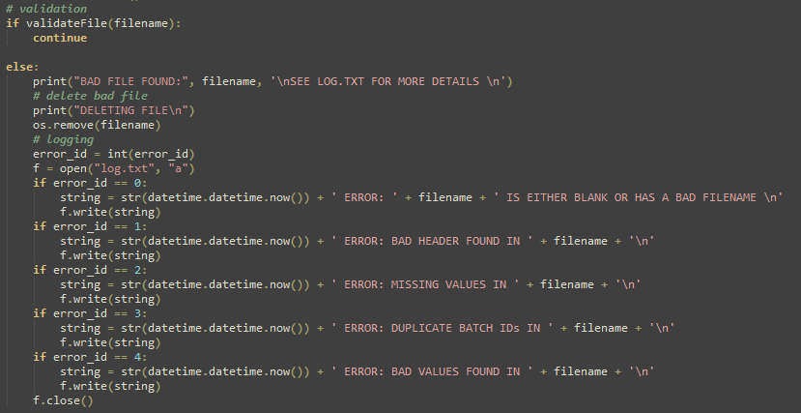
BASIC ERROR LOGGING

Slide 10
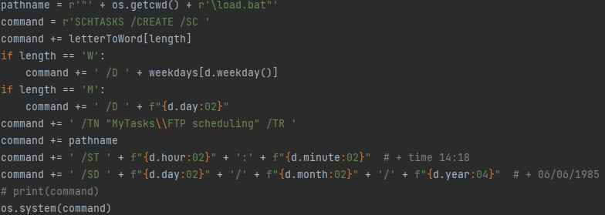
Scheduling
Firstly, create a batch file for the program
Within this batch file store details of how the file should be run
Create a cmd command specifying the scheduling details
Run this command, which then schedules the batch file to be executed at the time and frequency dictated by the user

Slide 11
A little magic and we brought all the code together

Slide 12
CONCLUSION: outcome and lessons learned
SUCCESSES
We also setup a GitHub immediately. Once we all figured out how to use it, we found it an effective way to collect and combine our code
Some kind of effective problem solving success point here
LEARNING POINTS
We setup a Discord immediately but still had some miscommunications (two people wrote the same code) – next time we would setup regular calls so we could all get together and regularly discuss progress
As recommended, we setup tasks in a 3 week sprint but we had so much fun at the academy that we only got working again once we were home – only the GUI was sacrificed

Slide 13
CONCLUSION: outcome and lessons learned
SUCCESSES
We also setup a GitHub immediately. Once we all figured out how to use it, we found it an effective way to collect and combine our code
Some kind of effective problem solving success point here
LEARNING POINTS
We setup a Discord but still had some miscommunications – next time we would setup regular calls so we could all get together and regularly discuss progress
As recommended, we setup tasks in sprints but we had so much fun at the academy that we only got working again once we were home – only the GUI was sacrificed

Slide 14
CONCLUSION: outcome and lessons learned
We setup a Discord immediately but still had some miscommunications (two people wrote the same code) – next time we would setup regular calls so we could all get together and regularly discuss progress
We also setup a GitHub immediately. Once we all figured out how to use it, we found it an effective way to collect and combine our code
As recommended, we setup tasks in a 3 week sprint but we had so much fun at the academy that we only got working again once we were home – only the GUI was sacrificed

