Slide 1
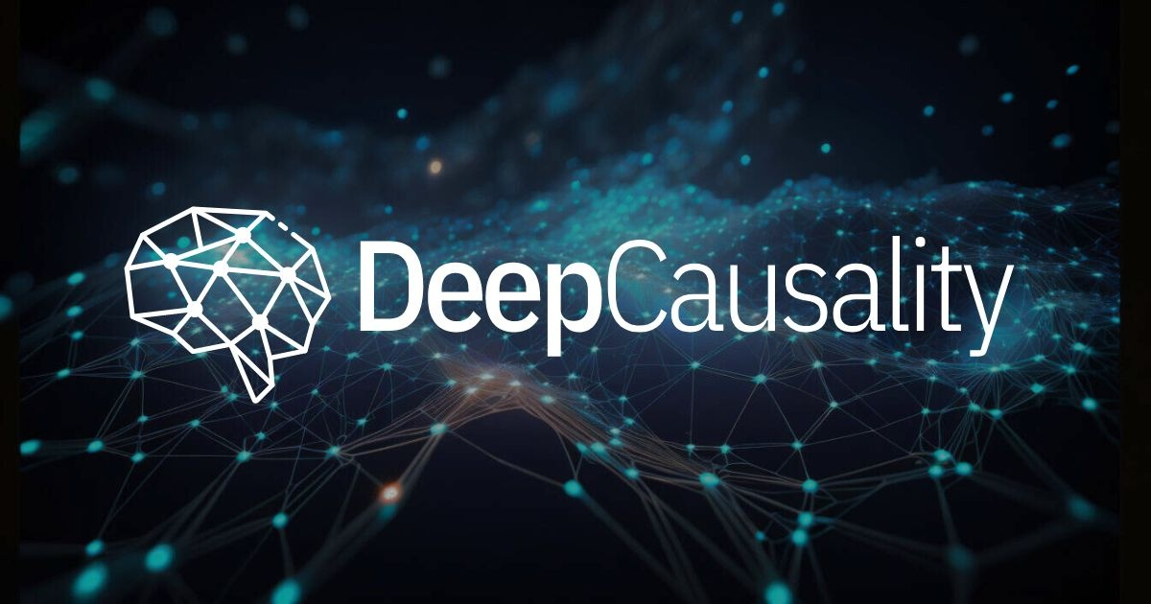
DeepCausality: One Stack from Discovery to Deployment
Marvin Hansen · Director, Center for Dynamic Causality
marvin.hansen@causalcenter.com
LF AI & DATA · TECHNICAL ADVISORY COUNCIL · 2026

Slide 2

ACKNOWLEDGMENT
DeepCausality project sponsors
DEEPCAUSALITY · LF AI & DATA · TAC 2026
Notes:
Thank you to our sponsors

Slide 3
AGENDA
What this talk covers
01
The premise
Why DeepCausality starts from a different premise
02
The axiom
One working definition, two computable primitives, one safety layer
03
One causal stack
Discovery, modeling, action, governance, deployment in a single substrate
04
Downstream projects
Counterfactual fluid dynamics, quantum causal models, DeepBrain, and Scrith
05
Case study
DeepCausality at United Airlines via the ServiceRadar integration
06
Project health
Project health and where collaboration would help
DEEPCAUSALITY · LF AI & DATA · TAC 2026
Notes:
Six parts.
First the premise — one slide on why we did not simply build another causal-graph
library. Then the axiom and the primitives that make it computable. Then the piece I
most want you to take away: one causal stack running from raw data to a governed
production action.
Then two downstream projects built on that stack, which are in my view the proof that
the substrate generalizes: counterfactual fluid dynamics, and quantum causal models.
Then a case study, and finally project health and where we could use help.
Roughly a minute per slide. Stop me at any point.

Slide 4
PREMISE
Dynamic Causality for a dynamic world
Every classical framework inherits a definition of causality that is two thousand years old
CLASSICAL CAUSALITY
DYNAMIC CAUSALITY
Seneca → Pearl
Whitehead → process
Time is a straight arrow. Cause precedes effect.
Causality is a dynamic process.
The causal rules are fixed.
Causal rules may evolve while the system is running.
Space and time are static background. The model is a static snapshot in time with a fixed regime.
Spacetime is context with a variable regime.
Structure may emerge at runtime and still be governable.
Structure is enumerated up front, then held constant.
Quantum physics and general relativity broke the fixed
background spacetime assumption.
Sound on its own ground.
DEEPCAUSALITY · LF AI & DATA · TAC 2026
Notes:
This is the slide the project rests on, so I will spend a full minute here.
Classical computational causality traces its definition of cause back to Seneca — two
thousand years old — and it inherits the static spacetime that came with it. Pearl's
structural causal models, Granger, Rubin, dynamic Bayesian networks: all excellent, all
well validated, and all assuming time runs straight, that the rules are fixed at design
time, and that the causal structure is enumerated up front.
That is not a flaw. It is a scope. And contemporary science has already moved outside
it. In quantum physics and in general relativity the fixed background does not hold.
Closer to home, any system that crosses a physical or operational regime boundary
changes its own causal rules mid-flight.
So we change the starting point. We root the project in Whitehead's process philosophy —
causality as a process of becoming — and make spacetime data the model reads rather than
a frame the model assumes.
The consequence is on the right: rules may evolve at runtime, structure may emerge, and
— the part that matters for production — it is still governable. I will come back to
that.

Slide 5
THE AXIOM
One working definition
m₂ = m₁ >>= f
Dynamic causality is the spacetime-agnostic monadic process in which one propagating effect is obtained from
another by applying a causal function within the monadic composition.
Monadic composition
Causal function
Spacetime-agnostic
Explicit context
An arity-5 monad: value,
state, context, error, and
audit log. The monad laws
thread that bookkeeping
through every step.
Time and space are not
built into the relation. They
are declared inputs the
causal function reads.
Euclidean, Minkowski,
anything in between.
Anything time-like,
space-like, and all data
live in a queryable
hypergraph.
Each effect is obtained
from the previous one by
applying a causal function f.
Chained, those steps
propagate effect.
Imagine a ripple in a pond. One ripple is an effect; it propagates and produces the next. DeepCausality defines how ripples spread, what each carries, and
what happens when the rules for spreading themselves change dynamically.
DEEPCAUSALITY · LF AI & DATA · TAC 2026
Notes:
Here is the whole premise in one line: m-two equals m-one bind f.
Read it as: dynamic causality is the spacetime-agnostic monadic process in which one
propagating effect is obtained from another by applying a causal function within the
monad.
Four things are packed in there.
Monadic process — the carrier is an arity-five record: value, state, context, error, and
an audit log. Because it obeys the monad laws, that bookkeeping is threaded
automatically. That is where end-to-end explainability comes from; nobody has to remember
to log.
Functional dependency — each effect comes from the previous one by applying a causal
function. Chain those and you get effect propagation.
Spacetime-agnostic — time and space are not in the relation. They are inputs.
And because they are not built in, anything time-like or space-like has to live somewhere
explicit: the Context, a typed hypergraph. That is what lets the same model run in
Euclidean space, in Minkowski spacetime, or in a non-Euclidean context.
The intuition, if you want one: a ripple in a pond. One ripple is an effect, it
propagates, it produces the next one. We define how ripples spread — and what happens
when the rules for spreading change.

Slide 6
CONSEQUENCE
Classical frameworks fall out as special cases
The axiom sits low enough in the stack that we did not have to replace anything.
SPECIALIZATIONS
WHAT THE AXIOM ADDS
SCM
Pearl structural causal models
DYNAMIC
Causal structure changes as the context
changes
DBN
Dynamic Bayesian networks
ADAPTIVE
Causal rules update themselves at runtime
GRANGER
Granger causality
EMERGENT
Structure not enumerable at design time
RUBIN
Rubin causal model and CATE
Three modalities a fixed-structure framework cannot express.
Each implemented under examples/classical_causality_examples.
Causal reasoning becomes emergent
Where structure emerges at runtime, static verification of the reasoning stops being deterministic. Verifiability is restored at the action boundary
via the Effect Ethos.
DEEPCAUSALITY · LF AI & DATA · TAC 2026

Slide 7
THE STACK
One causal stack: from discovery to deployment
One uniform substrate for the whole causal process
DISCOVER
Surface causal structure from raw observational data.
SURD · MRMR · BRCD
Causal Discovery Language
MODEL
Encode causal structure as composable logic with an
explicit context.
Singleton · collection
· graph
Causaloid & Context
ACT
Turn a causal verdict into an action and interact with the
outside world.
State inferred at
runtime
Causal State Machine
GOVERN
Verify deterministically what is allowed to happen.
Defeasible deontic
calculus
Effect Ethos
RUN
Run the model thread-safely and asynchronously at scale.
Embeds in any Rust
sync or async runtime
Serve the Model
DEEPCAUSALITY · LF AI & DATA · TAC 2026
Notes:
This is the slide I would ask you to remember.

Slide 8
PRIMITIVES
Dynamic causal process with a safety layer
All primitives emit the same carrier, so structural and sequential reasoning compose in one path.
Causaloid
structural reasoning
OBLIGATORY / OPTIONAL
Action fires
+ audit entry
PropagatingEffect
Causal State Machine
Effect Ethos
Context
infers active states at runtime
verdict?
IMPERMISSIBLE
Action stopped
+ reason locked to log
Causal Monad
sequential reasoning
DEEPCAUSALITY · LF AI & DATA · TAC 2026

Slide 9
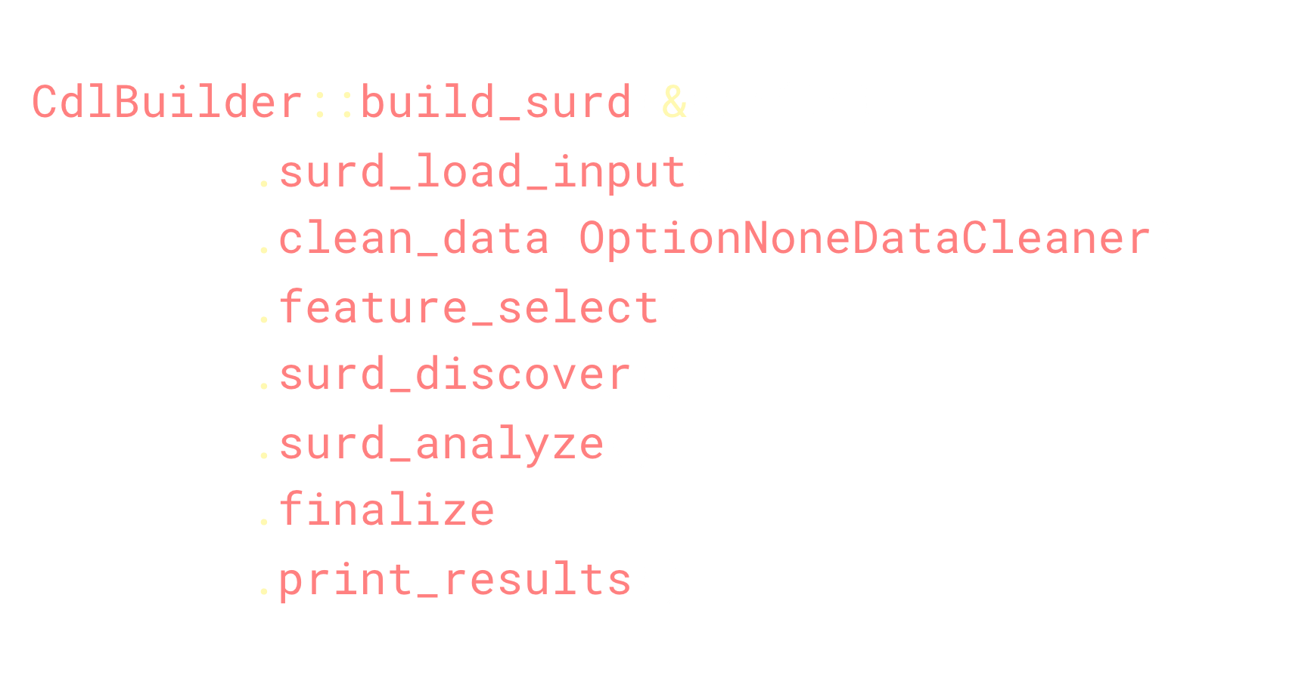
THE STACK
DeepCausality CDL: Causal Discovery Language
Causal discovery, simplified via the CDL
DEEPCAUSALITY · LF AI & DATA · TAC 2026

Slide 10
DOWNSTREAM PROJECTS
DeepCausality: downstream projects
A shared foundation across projects. More details at www.deepcausality.com
01 / 03 RELEASED · ON CRATES.IO
02 / 03 IN DEVELOPMENT · QCL IN DESIGN
03 / 03 DESIGN STAGE · NO CODE YET
Counterfactual fluid dynamics
Quantum causal models
Knowledge propagation
Three solver families, one Flow DSL: DEC Navier-Stokes, tensor-train marchers, fitted closures.
Fork a live run into counterfactual worlds, each with its own provenance log.
Fourteen verification programs gate CI against analytic and published references.
Ships today: quantum causal models on the causal monad; the quantum Markov condition is checked at graph freeze.
In the making: QCL, a Quantum Causal Language. One builder, one decision form: validate, then control.
Status: architecture and ontology documents only. No code exists yet.
Thesis: knowledge propagates the way the causal monad propagates effects.
Design: one embedded graph store links papers, specs, Lean proofs, and code into one audit chain.
DEEPCAUSALITY · LF AI & DATA · TAC 2026

Slide 11
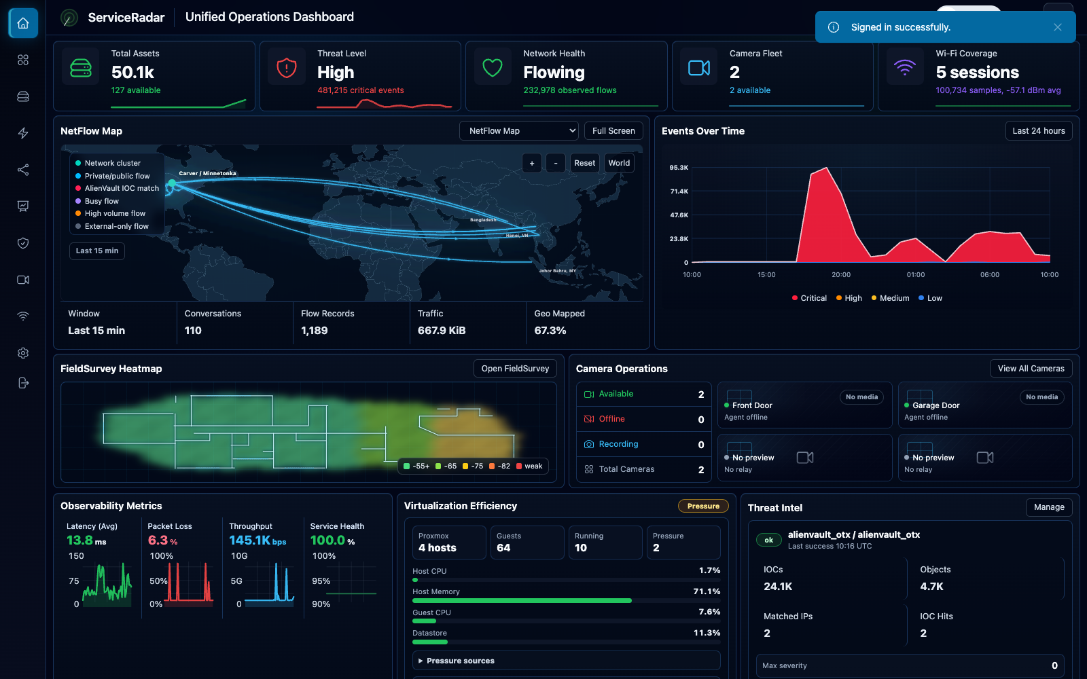
CASE STUDY
DeepCausality at United Airlines
Where the integration stands today
ServiceRadar
Unified Network Solution
Network monitoring.
Network management.
Security management.
IT Ops.
Deployed at United Airlines.
DeepCausality
Real-time anomaly detection
1 million ops/sec
Components used:
UltraGraph
DeepCausality Core
Dynamic Context
DEEPCAUSALITY · LF AI & DATA · TAC 2026

Slide 12
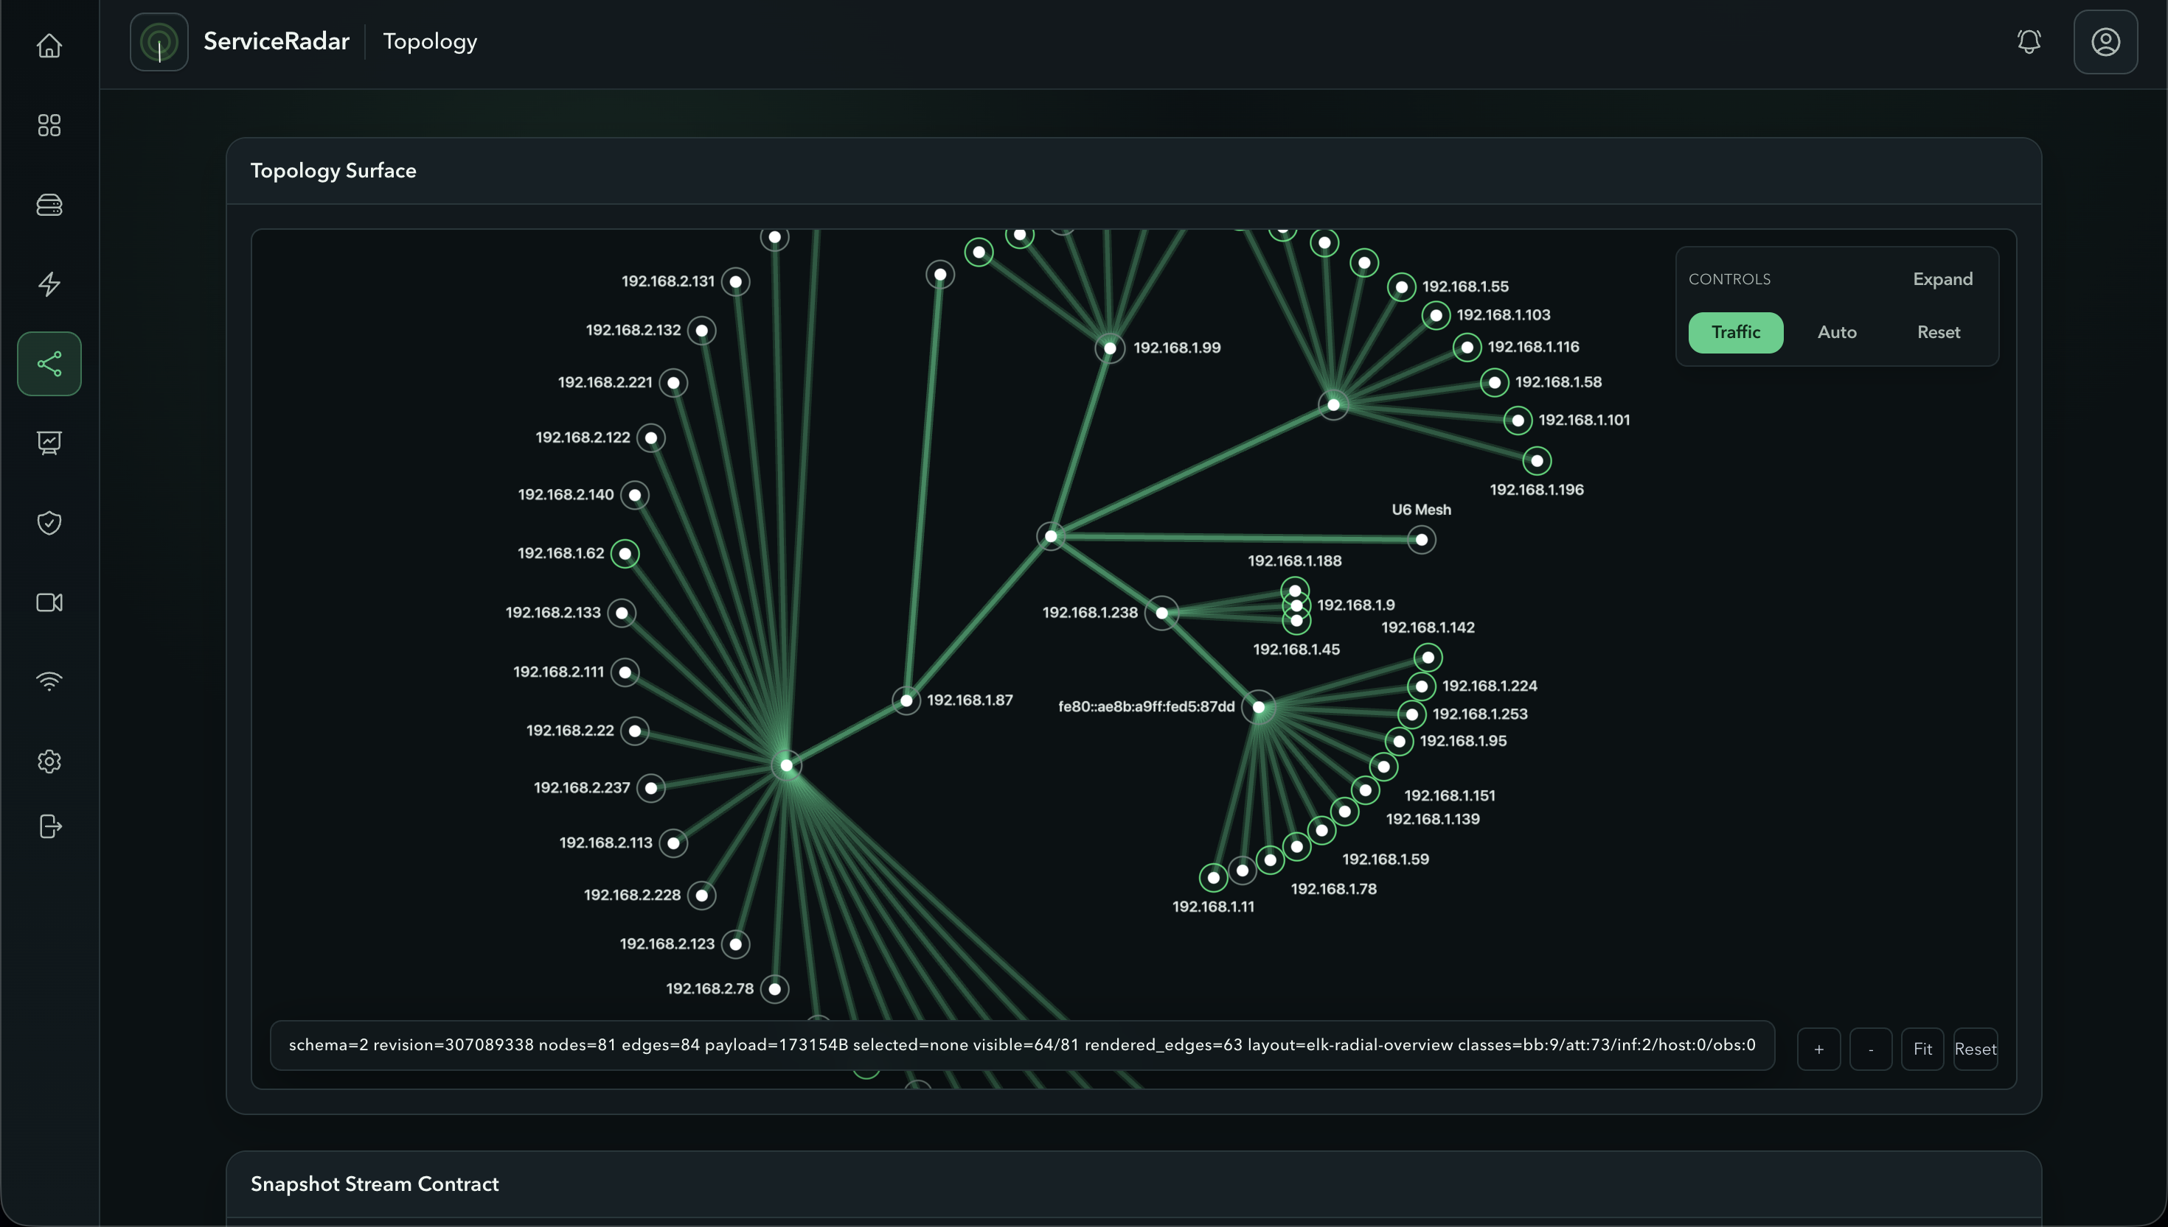
CASE STUDY
DeepCausality at United Airlines
Where the integration goes next
ServiceRadar
Works toward:
Holistic security
Cross-domain diagnostics
Dynamic incident response
DeepCausality
Foundational to the initiative
Anticipated usage:
Dynamic causal reasoning
Dynamic context
DeepBrain ontology
DEEPCAUSALITY · LF AI & DATA · TAC 2026

Slide 13

WHAT COMES NEXT
Scrith.ai: dynamic context and ontology
A joint project of the Center for Dynamic Causality and Carver Automation.
FROM DEEPCAUSALITY
Dynamic causality
Causal Monad, explicit context, and Effect Ethos: causal reasoning that keeps working while the context keeps changing.
DYNAMIC CONTEXT + ONTOLOGY FOR DYNAMIC CAUSAL REASONING · VISION STAGE · SCRITH.AI
A causal operations layer: a live model of the objects in an environment, how they relate, and how cause moves between them, that people and AI query and then write governed action back through.
+
01 EXPLAIN
02 SIMULATE
03 GOVERN
Answer why
Simulate reality
Act safely
FROM DEEPBRAIN
The model carries cause: it explains an incident when it happens.
Simulate counterfactual dynamics to inform targeted intervention.
Agents are safeguarded by the Effect Ethos, which enforces operational parameters.
Knowledge propagation
An ontology of objects and relations, provenance on every edge, and knowledge that propagates the way effects do.
Design stage, no code yet.
JOINT PROJECT
Center for Dynamic Causality
DEEPCAUSALITY · LF AI & DATA · TAC 2026

Slide 14
PROJECT HEALTH
Where the project stands in 2026
In September 2023, at the LF Sandbox admission, the project was in its infancy.
29
438k
14,463
CRATES
LINES OF RUST
TESTS
Four in 2023
20.7k in 2023
534 in 2023
113
183
23 / 29
RUNNABLE EXAMPLES
LEAN THEOREMS
ZERO-DEPENDENCY CRATES
Across 14 domains
Bound to Rust witnesses
No external dependencies
Dynamic Causality is just getting started
ServiceRadar integration just began and is structured to continue.
Research in advanced topics started only in mid-2026 and will continue.
DEEPCAUSALITY · LF AI & DATA · TAC 2026

Slide 15
COLLABORATE
Where the project seeks help and offers value in return
Domain partners
Adjacent LF projects
Reviewers
Seeks
The stack is strongest where a domain
needs verification and an audit trail. If your team struggles to meet verification and audit requirements for dynamic processes, dynamic causality may help.
The propagating effect is a natural seam
for anything that already produces a
verdict and then needs to explain it. If your
project has that shape, please explore what dynamic causality has to offer.
The Lean layer publishes its open edges.
Extending the proven surface is ongoing work and any help is welcome.
Expertise
Research
Integration
Dynamic Causality is new, has a learning
curve, and offers novel solutions. The Center for Dynamic Causality is here to help with large or complex projects.
The propagating effect is the foundation
of ongoing research in advanced fields
such as CFD and quantum causality.
All results are open source.
ServiceRadar only scratches the surface
of what a product can do when
augmented with dynamic causality.
Deeper integrations will unlock
advanced functionality.
Offers
DEEPCAUSALITY · LF AI & DATA · TAC 2026

Slide 16
www.deepcausality.com
THANK YOU
Marvin Hansen · Director, Center for Dynamic Causality
marvin.hansen@causalcenter.com
LF AI & DATA · TECHNICAL ADVISORY COUNCIL · 2026

