Slide 1

Project presentation
on
Advanced Rainfall Classification and Pattern Analysis using
Neuro-Machinate Techniques
Presented by Batch: CSSE 24-19
Madupuri Rajesh 20121A1571
T Yasaswini 20121A15B3
Vennapusa Anju Shaharun 20121A15C6
Veeravalli Deep Chandu 20121A15C4
Computer Science and Systems Engineering
Under the guidance & HOD
Dr. K. Ramani,
Professor & Head,
Dept. of CSSE

Slide 2
Table of Contents
Abstract
Introduction
Problem Statement
Objectives
Literature Survey
Methodology
Software and Hardware Requirements
Performace Evaluation
Analysis of Experimental data
Conclusion
References

Slide 3
Abstract
Rainfall distribution serves a variety of purposes in meteorology, hydrology, and environmental science, flood forecasting, agriculture, meteorological analysis, and more around. The gathered dataset is collected from meteorological observations which helps to depict the patterns of rainfall for the area and period of study. We applied a variety of Machine Learning and Deep Learning algorithms such as Random Forest, Convolutional Neural Networks (CNN), and Multilayer Perceptron (MLP), to predict and classify rainfall using Austin weather dataset and obtain valuable conclusions from the dataset. The algorithms selected were found suitable as they were able to represent the complex trends and relationships between the temporal and spatial dimensions. From our results, the best performing algorithms in rainfall classification were Random Forest based on RMSE (Root Mean Square Error), and CNN based on classification accuracy and these two algorithms outperformed the other existing algorithms.

Slide 4
Introduction
Rainfall classification plays a pivotal role in diverse scientific disciplines, offering critical insights into precipitation patterns that have far-reaching implications for meteorology, hydrology, and environmental science. The journey begins with the meticulous collection of data, recognizing the importance of diversity and comprehensiveness in capturing the nuances of rainfall events. To harness the full potential of this data, we employ rigorous preprocessing and feature engineering techniques, ensuring that the information is refined, standardized, and optimized for subsequent analysis. Through this innovative and holistic approach, we aim to not only advance the scientific understanding of rainfall but also provide practical and actionable insights for those who depend on this information to make impactful decisions in a rapidly changing world.

Slide 5
Problem Statement
The problem statement addressed by this research is the need for a robust and sophisticated framework for rainfall classification and pattern analysis. Current methods often lack the ability to comprehensively capture the complex dynamics of rainfall, hindering their effectiveness in applications such as flood prediction, water resource management, agriculture, and climate studies. Traditional approaches may struggle to handle the intricacies of diverse data sources, temporal and spatial dependencies, and evolving patterns. The challenge lies in developing a solution that incorporates advanced machine learning techniques, including decision trees, random forests, support vector machines, and neural networks, to accurately classify rainfall and identify intricate patterns. This research aims to address these gaps by proposing an advanced framework that not only classifies rainfall accurately but also provides meaningful insights into temporal and spatial patterns.

Slide 6
Objectives
To develop a Machine Learning algorithm for rainfall prediction using weather station dataset.
To develop an efficient Deep Learning algorithm for rainfall prediction.
To evaluate performance using RMSE value, Correlation and Accuracy

Slide 7
Literature Survey
To demonstrate the importance of this work, a survey was done on different research papers to understand various techniques. A few of them are discussed here.
The authors Smith, J., et al. [1] utilized machine learning approaches to classify rainfall characteristics from remote sensing data archive. Their paper aimed to investigate characteristic features superior from satellite imagery and then apply the supervised learning algorithm for binary classification by distinction rainfall intensity levels.
Limitation :
This work lacks fine details concerning the machine learning methods and algorithms in the task of classification. The discussion of the challenges or limitations that could limit the processes of classification is also non-existent.

Slide 8
Literature Survey
2) Chen, Q., et al. [2] put forward a new method which combines the CNN with radar data to classify rainfall types. Their paper does not have an in-depth analysis and interpretation of the Convolutional Neural Network model in connection with radar data for rainfall classification.
Limitation :
CNN is highly efficient in predictive performance, it is also explained as “black box” model which make it difficult to understand the underlying decision-making process

Slide 9
Literature Survey
3) Kumar, A., et al. [3] proposed a fuzzy logic- based rainfall classification system for agricultural applications. Their system took into consideration aspects of rainfall in terms of intensity, duration and frequency therefore offering on-farm farmers details that could help them come up with operational principles for irrigation scheduling as well crop control. This, in turn, could turn out in obstacles during adaptation of the system to different regions of the planet or environmental conditions where the degree of the required expert knowledge may differ or be insufficient.
Limitation :
One of the possible shortcomings of the system proposed is that it can be applied only to limited geographical areas, while its generalizability is limited.

Slide 10
Literature Survey
4) Wang et al. [4] applied Long Short-Term Memory (LSTM) networks for temporal-spatial rainfall pattern analysis. The proposed model was able to simulate both estimated short and long-term temporal dependency spatial relationships in rainfall data that, made reliable predictions as well as classification of precipitation patterns over different scales of time.
Limitation :
Their paper shows that LSTM networks are so good in temporal-spatial rainfall pattern analysis, but it lacks of both expandability and detailed methodology description, and it doesn't contain hyper parameters.

Slide 11
Methodology
Convolutional Neural Network (CNN) model:
Input: The model's input consists of a sequence of several weather features, out of these we consider "PrecipitationSumInches" for the performace evaluation.
Model Architecture: Convolutional Layer (Conv1D): Learns patterns in the sequence of weather data by applying filters to detect features like changes in temperature and humidity over time. MaxPooling Layer (MaxPooling1D): Reduces the size of the learned patterns by selecting the maximum value within each window of the feature maps, focusing on the most important information while discarding less relevant details. Dense Layers (Dense): Processes the flattened data from the previous layers, making predictions about rainfall amounts by connecting every neuron in one layer to every neuron in the next, ultimately providing the predicted rainfall amount for each input sequence.

Slide 12
Methodology
Model Training: The model is trained using the training data (input_train_reshaped) and corresponding output labels (output_train) for 10 epochs, with a batch size of 32 and a validation split of 0.2.
Model Evaluation: The trained model is evaluated on the test set (input_test_reshaped) to assess its performance.
Correlation Coefficient: The correlation coefficient (Pearson's correlation coefficient) between actual and predicted rainfall values is calculated to measure the linear relationship between them and Root Mean Squared Error (RMSE): The RMSE is calculated to quantify the difference between actual and predicted rainfall amounts.
Output: The output of the model is the predicted rainfall amount for each input sequence.
Overall, this CNN model learns spatial patterns in the rainfall data through convolutional layers, makes predictions based on these patterns using dense layers, and is trained to minimize the mean squared error between predicted and actual rainfall values.

Slide 13
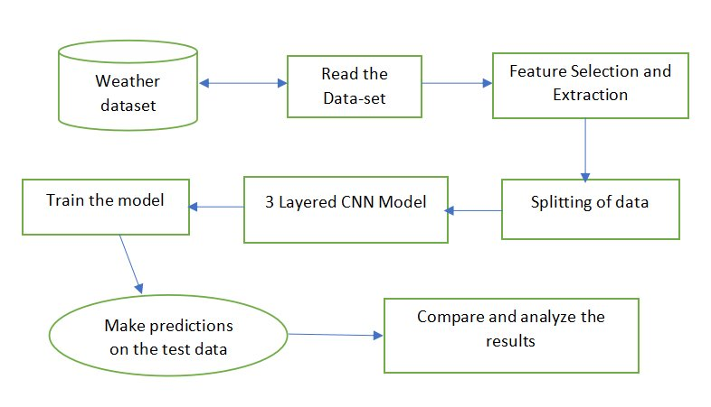
Fig1: CNN Model Architecture

Slide 14
Methodology
Multilayer Perceptron Regressor (MLPR) model:
Input (input_train): Standardized features such as temperature, humidity, precipitation, dew point, etc., Out of all these attributes we consdier “PrecipitationSumInches” used to train and evaluate the performance of MLPR model.
Creating MLPR Model: hidden_layer_sizes: Specifies the number of neurons in the hidden layer. Here, a single hidden layer with 16 neurons is used. solver: Specifies the optimization algorithm. 'lbfgs' is a quasi-Newton method. max_iter: Sets the maximum number of iterations for optimization.
Model Training & Prediction: Trains the MLPR model using the standardized input (input_train) and output (output_train) data. Prediction uses the trained MLPR model to make predictions on the training input data (input_train).
Root Mean Squared Error (RMSE): Computes the square root of the average of the squared differences between predicted and actual rainfall values.

Slide 15
Methodology
Correlation Coefficient: Measures the strength and direction of the linear relationship between predicted and actual rainfall values.
Output: Actual rainfall amounts corresponding to the input features used for training the MLPR model.
Overall, the MLPR model learns to map the input features to the output (rainfall amounts) through a series of interconnected neurons in the hidden layer, optimizing its parameters to minimize the difference between predicted and actual rainfall values during training.

Slide 16
Methodology
Random Forest Regressor model:
Input Features (input_train): Meteorological data such as temperature, humidity, precipitation dew point, visibility, sea-level pressure, and wind speed. Out of all these attributes we consider “PrecipitationSumInches” used to train and evaluate the performance of the model.
Training: Fits the model to the training data, where input_train represents the input features (meteorological data) and output_train represents the output targets (rainfall amounts).
Prediction: The trained model to make predictions on the training “input_train”.
Root Mean Squared Error (RMSE): Computes the square root of the average of the squared differences between predicted and actual rainfall values using cross-validation.
Correlation Coefficient: Measures the strength and direction of the linear relationship between predicted and actual rainfall values.

Slide 17
Methodology
Output Target: Rainfall amounts, which the model aims to predict based on the input features. Measures the strength and direction of the linear relationship between predicted and actual rainfall values.
Overall, It's effective for capturing complex relationships between input features and output targets, making it suitable for rainfall analysis. The model's performance is evaluated using RMSE and Correlation Coefficient, providing insights into its accuracy and predictive capabilities.

Slide 18
Software Requirements
Software requirements encompass the specifications of necessary software resources and prerequisites essential for ensuring the optimal performance of an application on a computer. These requirements, not typically included in the software installation package, must be installed separately prior to deploying the software for seamless operation.
The used requirements are :
Python:
Python serves as the primary programming language for implementing machine learning and deep learning algorithms.
Integrated Development Environment (IDE):
Choose a suitable IDE for Python development, such as Google Colab, Jupyter Notebook, or VSCode.

Slide 19
Software Requirements
Machine Learning Libraries:
scikit-learn: For implementing machine learning algorithms.
TensorFlow and Keras: For building and training deep learning models.
Data Visualization Libraries:
Matplotlib, Seaborn, Plotly: For creating visualizations.
Other Python Libraries:
Pandas: For data manipulation and analysis.
NumPy: For numerical operations.

Slide 20
Hardware Requirements
Hardware requirements are crucial considerations when assessing system compatibility for hardware devices. These requirements, often outlined by operating systems or software applications, encompass the essential physical resources of a computer system.
The used requirements are:
Computer:
A computer with sufficient processing power to handle machine learning and deep learning computations.
Memory (RAM):
Adequate RAM to support data processing and model training.

Slide 21
Hardware Requirements
Storage:
Storage space for storing datasets, model files, and other project-related data.
Internet Connectivity:
Required for accessing weather station data and downloading necessary libraries.
Operating System:
The project can be developed on Windows, macOS, or Linux.

Slide 22
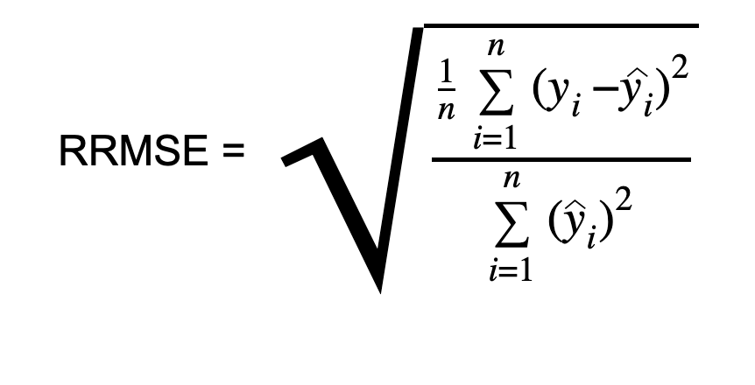
Performance Evaluation
RSME measures the average magnitude of the errors between predicted values and actual values. It is calculated by taking the square root of the average of the squared differences between predicted and actual values.
where:
𝑛n is the number of data points,
𝑦𝑖yi​ is the actual value,
𝑦^𝑖y^​i​ is the predicted value.
Correlation Coefficient: The correlation coefficient measures the strength and direction of the linear relationship between two variables. In the context of regression models, it indicates how well the predicted values correlate with the actual values.

Slide 23
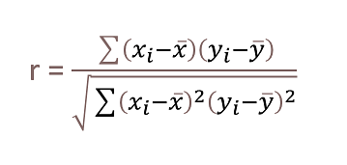
Performance Evaluation
where:
n is the number of data points,
𝑥ˉ and yˉ​ are the means of the two variables.
𝑥𝑖 and yi​ are the individual data points for the two variables,
Using RMSE value, according to NDEP (National Digital Elevation Guidelines) and FEMA guidelines, a measure of accuracy can be computed:
Accuracy = 1.96 * RMSE
In this formula, the RMSE represents the Root Mean Squared Error. Multiplying the RMSE by 1.96 provides a measure of accuracy that corresponds to a specific confidence level, typically associated with a 95% confidence interval. This measure of accuracy indicates the range within which the true values are likely to fall around the predicted values.

Slide 24
Performance Evaluation
Algorithm name | RMSE | Correlation | Accuracy
RNN | 0.2556 | 0.63569 | 99.7443
LSTM | 0.2640 | 0.6304 | 99.7359
CNN | 0.2333 | 0.7144 | 99.7666
XG Boost | 0.2640 | 0.6304 | 99.7359
Multilayer perceptron | 0.2470 | 0.5594 | 99.7359
Random Forest | 0.2254 | 0.9629 | 99.7359
Table 1: Performance Comparison

Slide 25
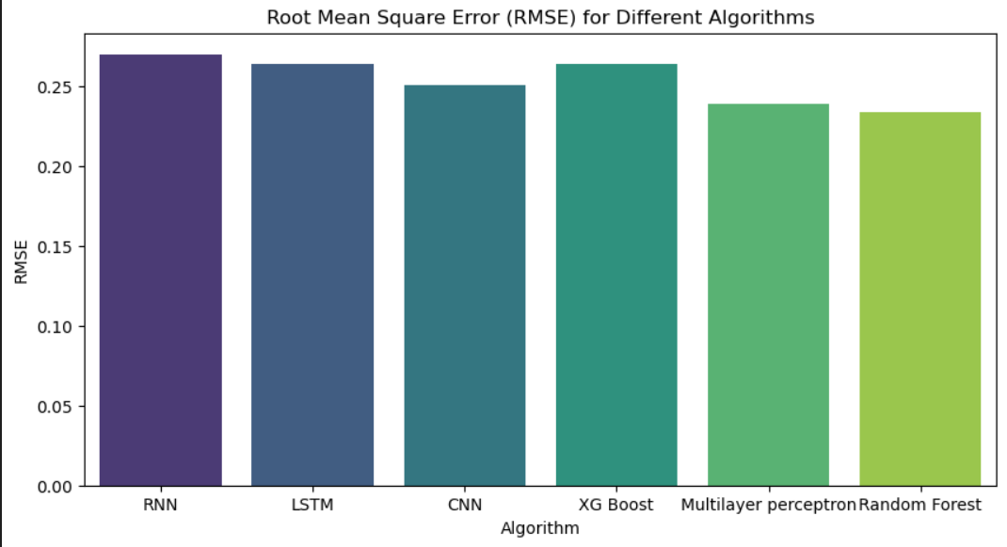
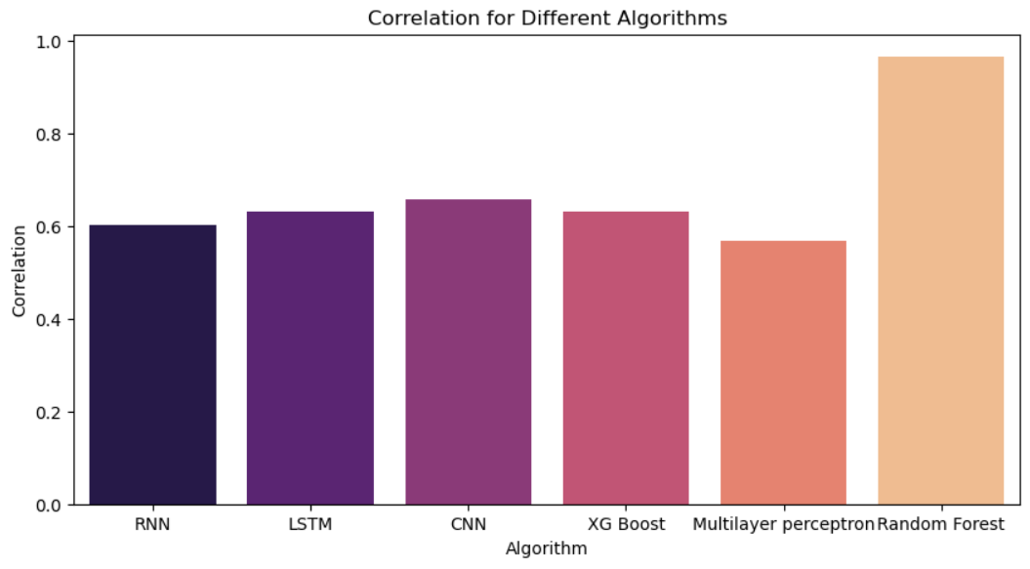
Performance Evaluation
Fig 2: Comparison of the result among different algorithms

Slide 26
Analysis of Experimental data
The performance of different machine learning algorithms for rainfall prediction is assessed using three key metrics: RMSE (Root Mean Square Error), correlation, and accuracy. These metrics gauge the magnitude of error, linearity of relationships, and percentage of correctly classified instances, respectively.
CNN and Random Forest algorithms demonstrated the highest accuracy levels, both achieving an accuracy of 99.7666%. This suggests that these models efficiently classify rainfall patterns with highly accurate results.
The high accuracy scores imply that CNN and Random Forest algorithms are effective in forecasting rainfall, minimizing deviation from observed values to a minimal level.
Other algorithms such as Recurrent Neural Network (RNN), Long Short-Term Memory (LSTM), and XG Boost showed competitive performance but with relatively larger RMSE values and lower correlation coefficients compared to CNN and Random Forest.

Slide 27
Conclusion
The results concluded that Convolutional Neural Network (CNN) and Random Forest are shown as most effective methods for rainfall forecasts in all considered indicators. In particular, CNN shows excellent results in terms of accuracy which proves it as a rainfall prediction task has to be one the best options. Having a low RMSE value, random forest demonstrates higher performance in psyching values of prediction errors by implying the effectiveness nature to come up with rainfall predictions that closely match observed. Additionally, the Correlation coefficient for CNN is quite high indicating a fairly linear relationship between predicted versus observed rainfall values. Moreover, CNN and Random Forest reaches the best specificity value showing their ability in rain pattern classification with high accuracy.

Slide 28
Future Work
In the future, our aim is to advance rainfall prediction capabilities by expanding the dataset to include more diverse regions, longer time spans, and additional meteorological variables to improve model robustness and accuracy. Additionally, we plan to explore advanced feature engineering techniques, such as incorporating spatial and temporal features, to better capture complex rainfall patterns. Furthermore, implementing uncertainty quantification methods and optimizing models for real-time inference are crucial steps towards practical utility in operational forecasting systems, benefiting sectors such as agriculture, water resource management, and disaster preparedness.

Slide 29
References
[1] Molla, T., Khan, B., & Singh, P, A comprehensive analysis of smart home energy management system optimization techniques. Journal of Autonomous Intelligence, 1(1), 15-21, 2018.
[2] P. Singhal, P. Singh and A. Vidyarthi, Interpretation and localization of Thorax diseases using DCNN in Chest X-Ray. Journal of Informatics Electrical and Electronics Engineering,1(1), 1, 1-7, 2020.
[3] M. Vinny, P. Singh, Review on the Artificial Brain Technology: BlueBrain. Journal of Informatics Electrical and Electronics Engineering,1(1), 3, 1-11 , 2020.
[4] A. Sahani, P. Singh and A. Kumar, Introduction to Blockchain. Journal of Informatics Electrical and Electronics Engineering, 1(1), 4, 1-9 , 2020.
[5] M. Misra, P. Singh , Energy Optimization for Smart Housing Systems. Journal of Informatics Electrical and Electronics Engineering,1(1), 5, 1-6, 2020.
[6] K. Chane, F.M. Gebru, B. Khan, Short Term Load Forecasting of Distribution Feeder Using Artificial Neural Network Technique. Journal of Informatics Electrical and Electronics Engineering, Vol. 02, Iss. 01,S. No. 002, pp. 1-22, 2021

Slide 30
References
[7] G. Tang, D. Long, Y. Hong, J. Gao, and W. Wan, “Documentation of multifactorial relationships between precipitation and topography of the Tibetan Plateau using spaceborne precipitation radars,” Remote Sensing of Environment, vol. 208, pp. 82–96, 2018.
[8] V. Chandrasekar, H. Chen, and B. Philips, “Principles of high-resolution radar network for hazard mitigation and disaster management in an urban environment,” J. Meteor. Soc. Japan, vol. 96A, pp. 119–139, 2018.
[9] P. Xie, R. Joyce, S. Wu, S. Yoo, Y. Yarosh, F. Sun, and R. Lin, “Re processed, bias-corrected CMORPH global high-resolution precipitation estimates from 1998,” J. Hydrometeor., vol. 18, pp. 1617–1641, 2017.
[10] G. J. Huffman, D. T. Bolvin, D. Braithwaite, K. Hsu, and Coauthors, “NASA Global Precipitation Measurement (GPM) Integrated Multi satellite Retrievals for GPM (IMERG),” Algorithm Theoretical Basis Document (ATBD), Version 5.2, pp. Greenbelt, MD, 35 pp., 2018.

Slide 31
THANK YOU

