Slide 1
Machine learning workshop 10.22
Chaoran zhang, deep chatterjee

Slide 2
What is Machine Learning(ML)?
Machine learning is a field of artificial intelligence that uses statistical techniques to give computer systems the ability to “learn” from data, without being explicitly programmed.
Within the field of data analytics, machine learning is a method used to devise complex models and algorithms that lend themselves to prediction. These analytical models allow researchers to "produce reliable, repeatable decisions and results" and uncover "hidden insights" through learning from historical relationships and trends in the data.
(credit: wiki)

Slide 3
Why machine learning?
don’t have well studied knowledge of what you’re trying to predict
Uncover the insight behind data
More…

Slide 4
Machine learning tasks
Supervised learning: The computer is presented with example inputs and their desired outputs, given by a “teacher”, and the goal is to learn a general rule that maps inputs to outputs.
Semi-supervised learning: The computer is given only an incomplete training signal: a training set with some (often many) of the target outputs missing.
Active learning: The computer can only obtain training labels for a limited set of instances (based on a budget), and also has to optimize its choice of objects to acquire labels for. When used interactively, these can be presented to the user for labeling.
Unsupervised learning: No labels are given to the learning algorithm, leaving it on its own to find structure in its input. Unsupervised learning can be a goal in itself (discovering hidden patterns in data) or a means towards an end (feature learning).
Reinforcement learning: Data (in form of rewards and punishments) are given only as feedback to the program‘s actions in a dynamic environment, such as driving a vehicle or playing a game against an opponent.
(Credit: wiki)

Slide 5
Machine learning applications
In classification, inputs are divided into two or more classes, and the learner must produce a model that assigns unseen inputs to one or more of these classes. This is typically tackled in a supervised way. Spam filtering is an example of classification, where the inputs are email (or other) messages and the classes are "spam" and "not spam".
In regression, also a supervised problem, the outputs are continuous rather than discrete.
In clustering, a set of inputs is to be divided into groups. Unlike in classification, the groups are not known beforehand, making this typically an unsupervised task.
Density estimation finds the distribution of inputs in some space.
Dimensionality reduction simplifies inputs by mapping them into a lower-dimensional space. topic modeling is a related problem, where a program is given a list of human language documents and is tasked to find out which documents cover similar topics.
(credit: wiki)

Slide 6
Classical machine learning
Differ from deep learning, older fashion
Abundant ML algorithms: decision tree regression/classification, random forest regression/classification, k-nearest neighbors regression/classification, Support Vector Machines, Bayes Decision Boundary…
“Class”: a label given to each data point, the output of classifiers
“features”: parameters describe the characteristic of a data point

Slide 7
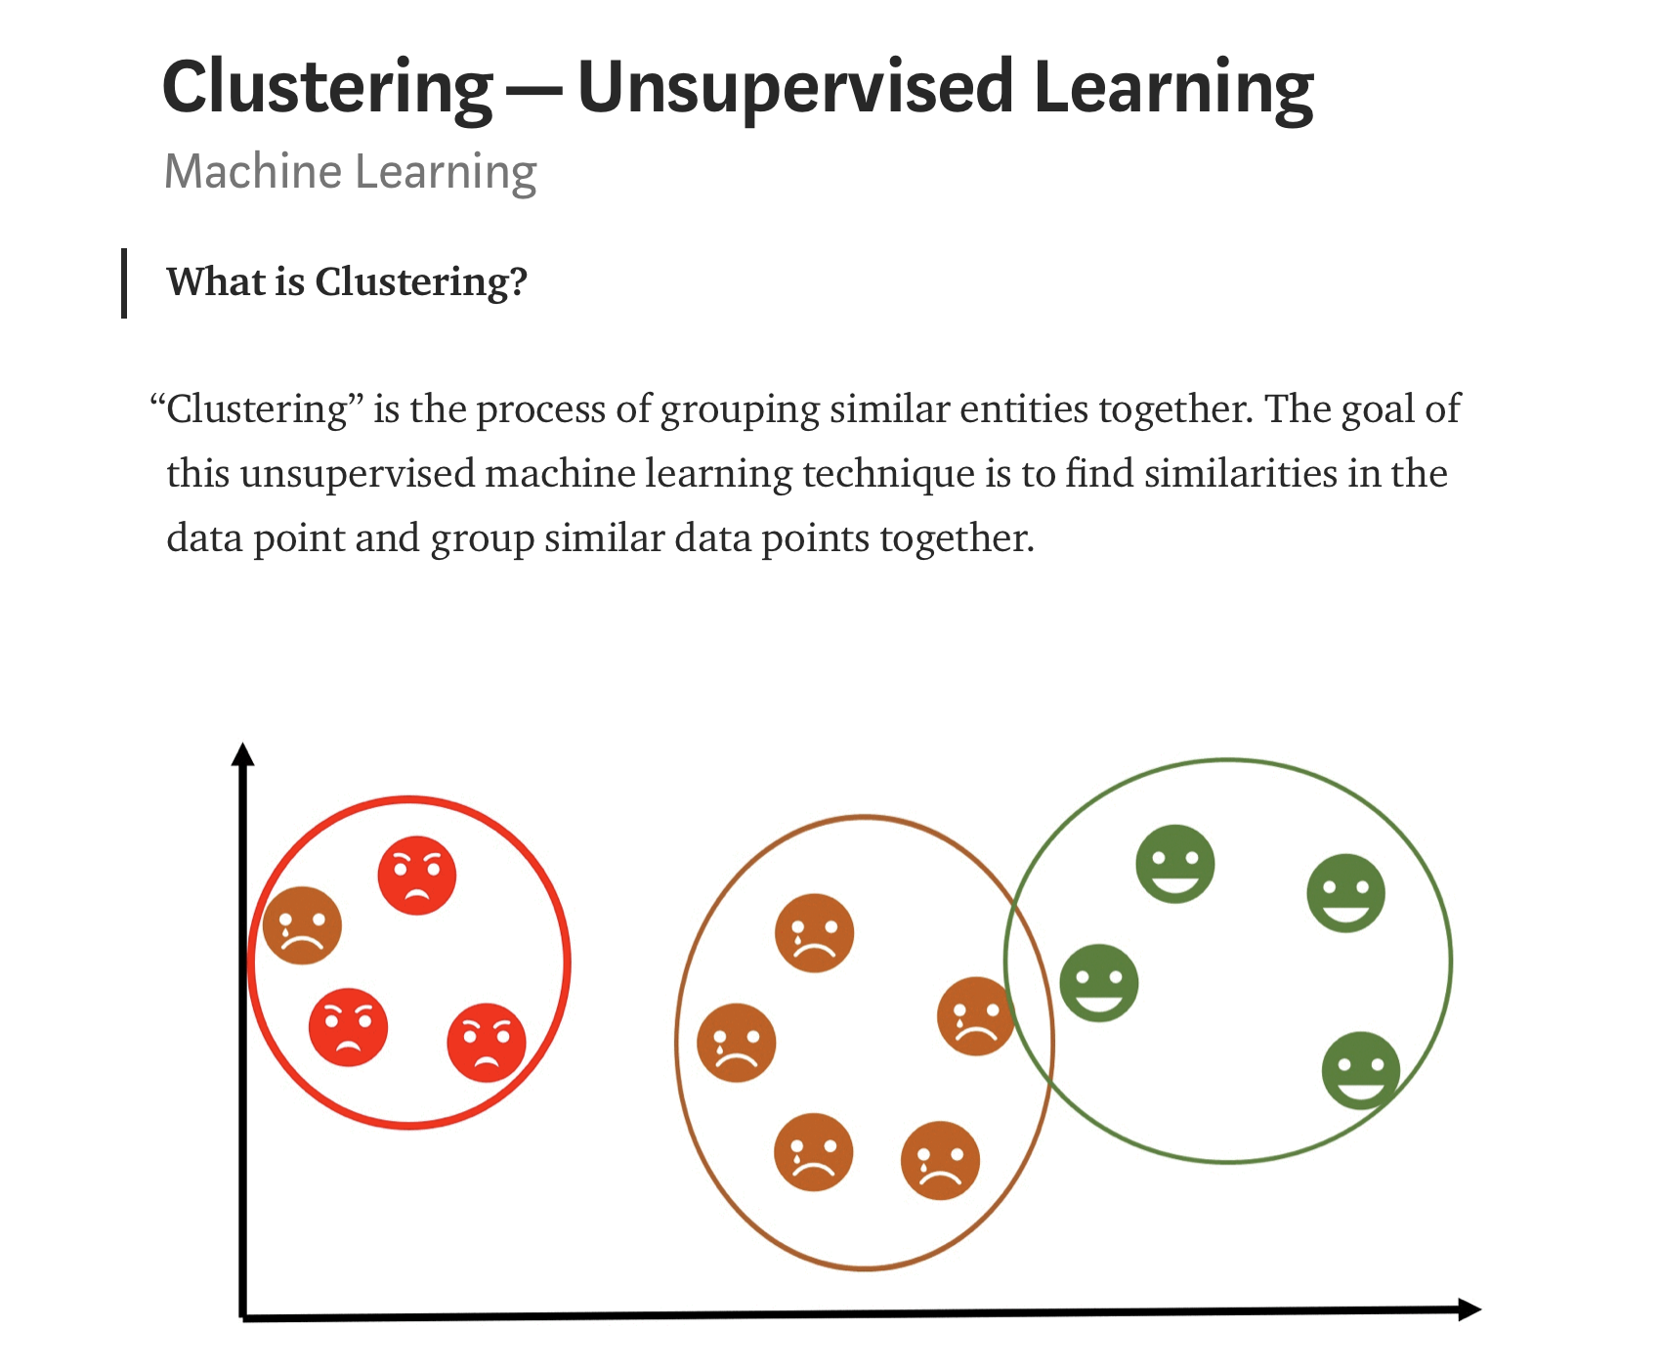
A few examples of ML methods
(credit: Towards Data Science)

Slide 8
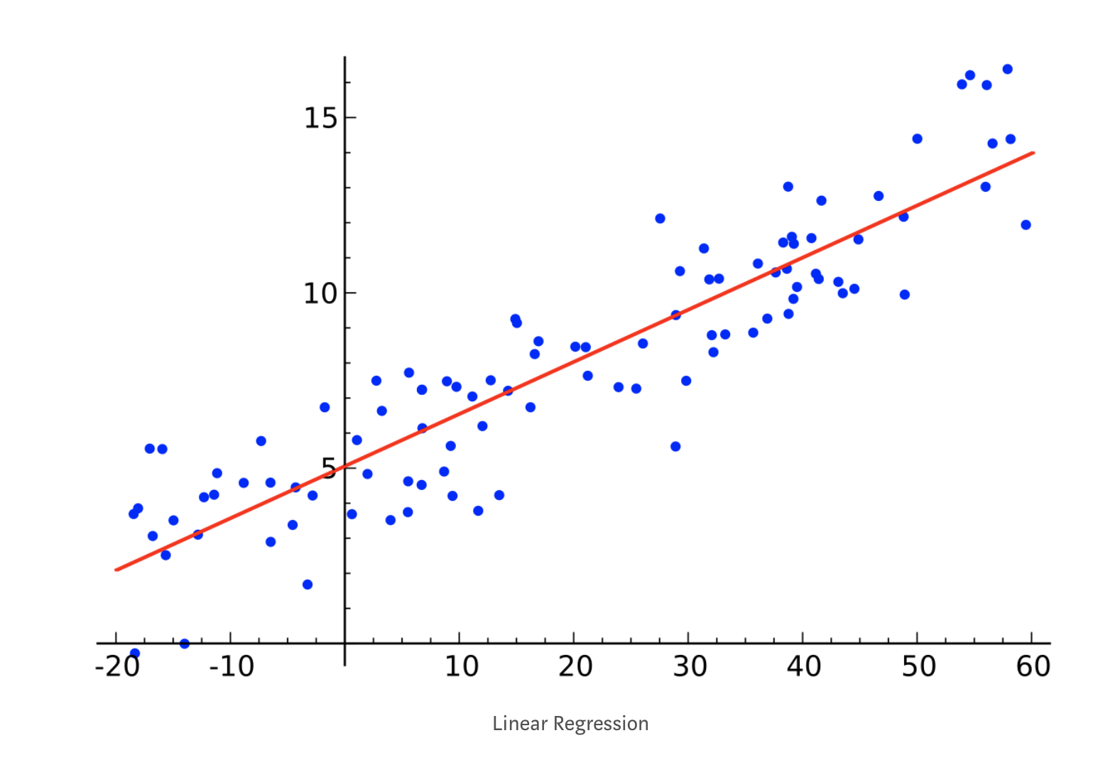
Linear regression
(credit: Towards Data Science)

Slide 9
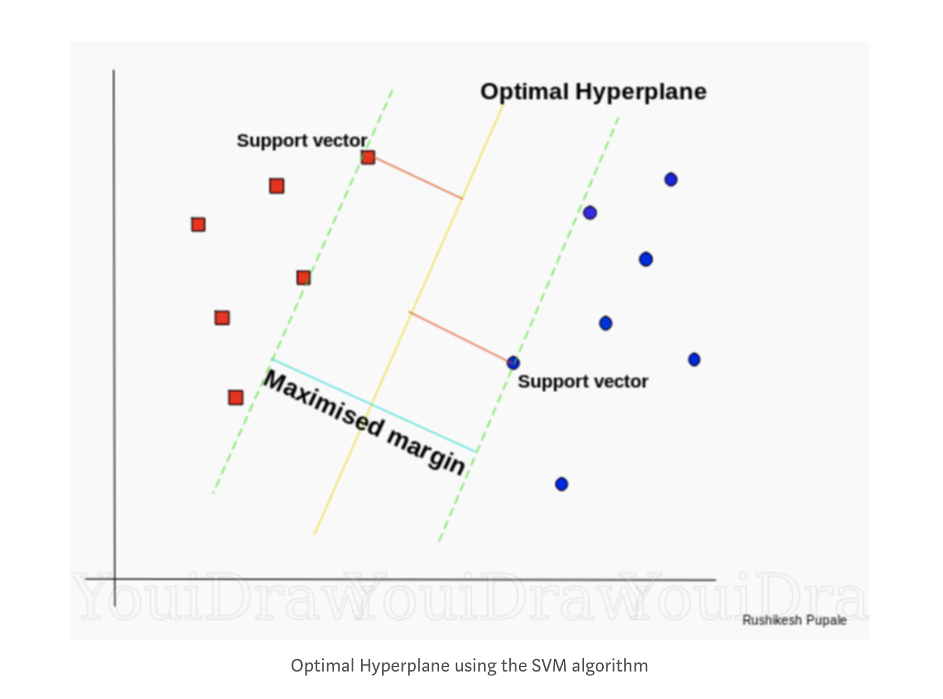
Support Vector Machines(SVM)--supervised learning
(credit: Towards Data Science)

Slide 10
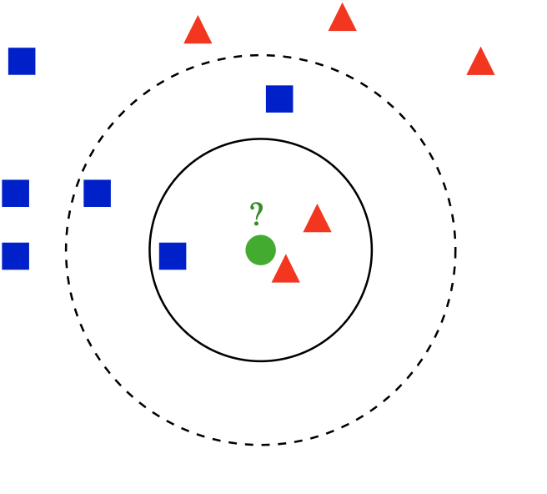
k-nearest neighbors classifier--supervised learning
(credit: wiki)

Slide 11
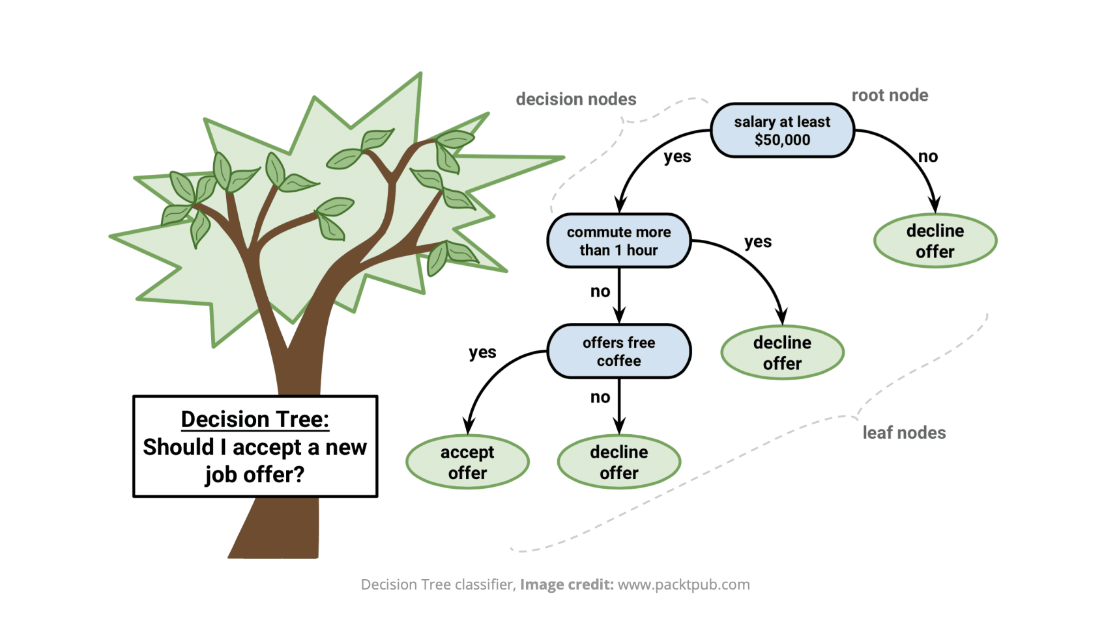
Decision tree classifier--supervised learning

Slide 12
Positives & negatives in classification
For a targeting class, a positive is a data point in the class, a negative is not in the class
True positives(TP): actually positive, machine predicted right
False positives(FP): actually negative, machine predicted wrong
True negatives(TN): actually negative, machine predicted right
False negatives(FN): actually positive, machine predicted wrong

Slide 13
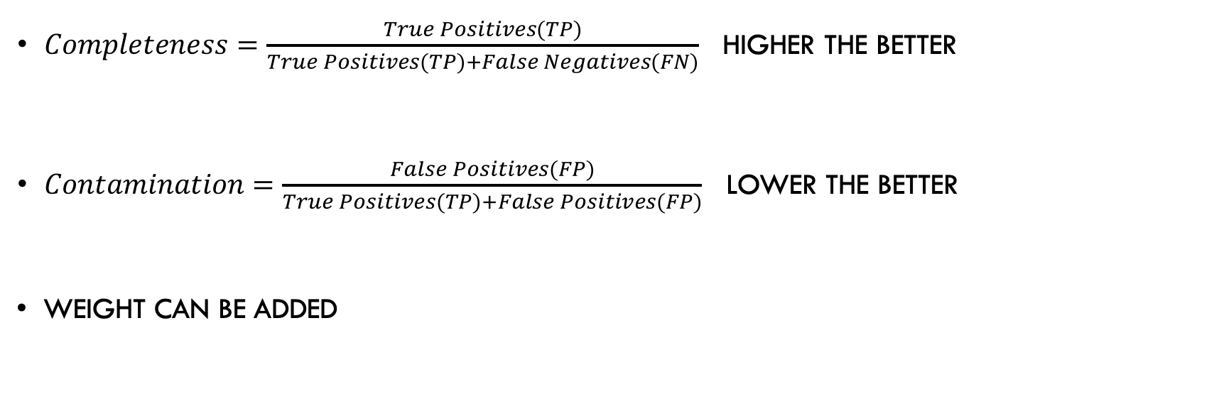
Completeness & contamination
$Completeness=\frac{True Positives(TP)}{True Positives(TP)+False Negatives(FN)}$ higher the better
$Contamination=\frac{False Positives(FP)}{True Positives(TP)+False Positives(FP)}$ lower the better
Weight can be added

Slide 14
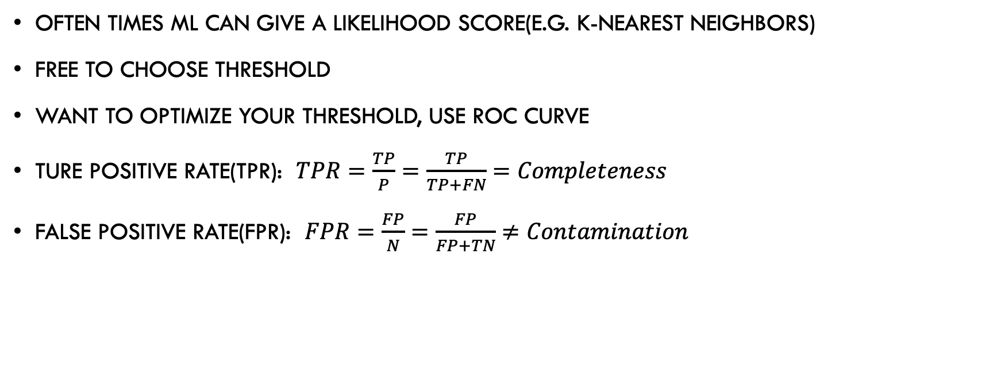
Receiver operating characteristic(ROC)
Often times ML can give a likelihood score(e.g. k-nearest neighbors)
Free to choose threshold
Want to optimize your threshold, use ROC curve
Ture positive rate(TPR): $TPR=\frac{TP}{P}=\frac{TP}{TP+FN}=Completeness$
False positive rate(FPR): $FPR=\frac{FP}{N}=\frac{FP}{FP+TN}≠Contamination$

Slide 15
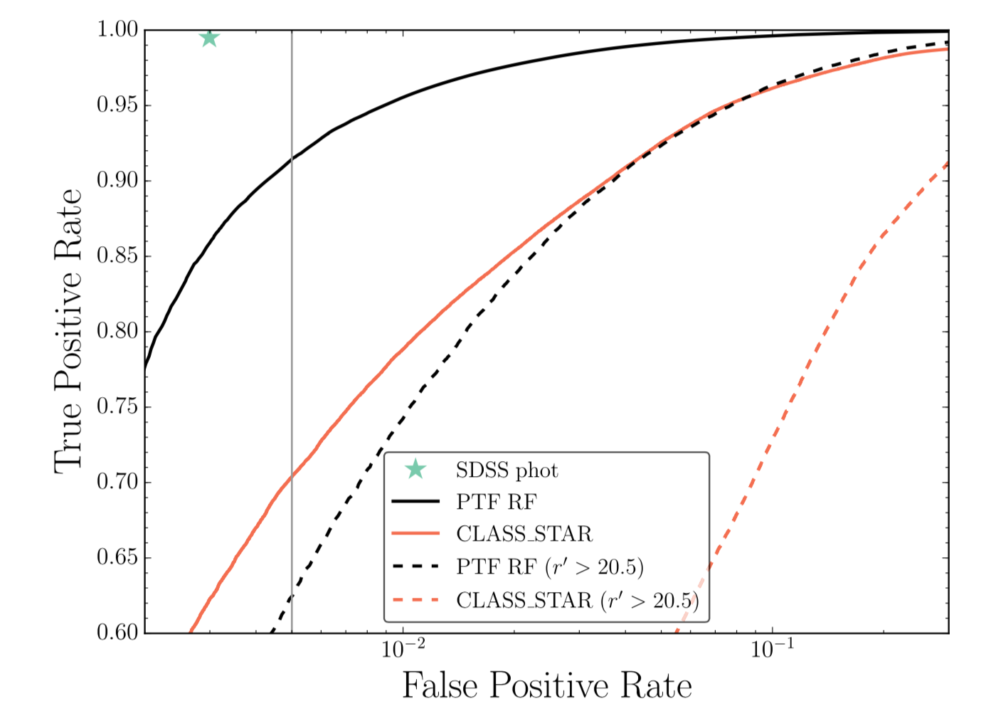
A example of ROC curve
(Credit: The Astronomical Journal, 153:73 (15pp), 2017 February )

