Slide 1

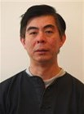
Goodbye
Advanced Topics in Machine Learning (02901)
Computational Tools for Machine Learning in Python
Ph.D. Summer School
20nd of August – 24th of August 2018
We thank our sponsor:
DTU Compute Graduate School ITMAN
A big thanks for all the administrative help
Wanja Andersen
Kim Phat Em Phan

Slide 2
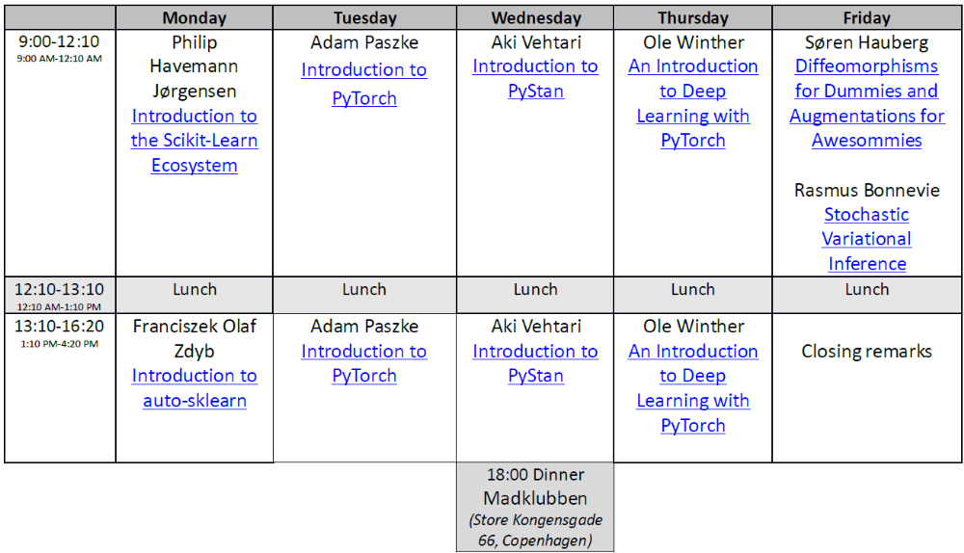
The Completed Course Programme
Course material is available from the following dropbox link:
https://www.dropbox.com/sh/8s172bp70yd4gv8/AAAUC4YnxyRif0b1oe3ojtLSa?dl=0
use the password:ctfmlip

Slide 3
The report
Deadline: 9th of September
Hand-in by sending an email to mmor@dtu.dk
Length: 3-5 pages
Introduction
This section should include a description of the course method(s) the report covers.
Methods/Theory
Provide an overview/brief review of the relevant theory.
Results
Preferably you should apply the method(s) to your own domain, but you can also apply the method(s) to other data, simulated data, or problem domain.
Discussion
A discussion of your findings.
Course diploma will be send to you upon passing the course

