Slide 1
Welcome to
Advanced Topics in Machine Learning (02901)
Computational Tools for Machine Learning in Python
Ph.D. Summer School
20th of August – 24th of August 2018
We thank our sponsor:
DTU Compute Graduate School ITMAN

Slide 2
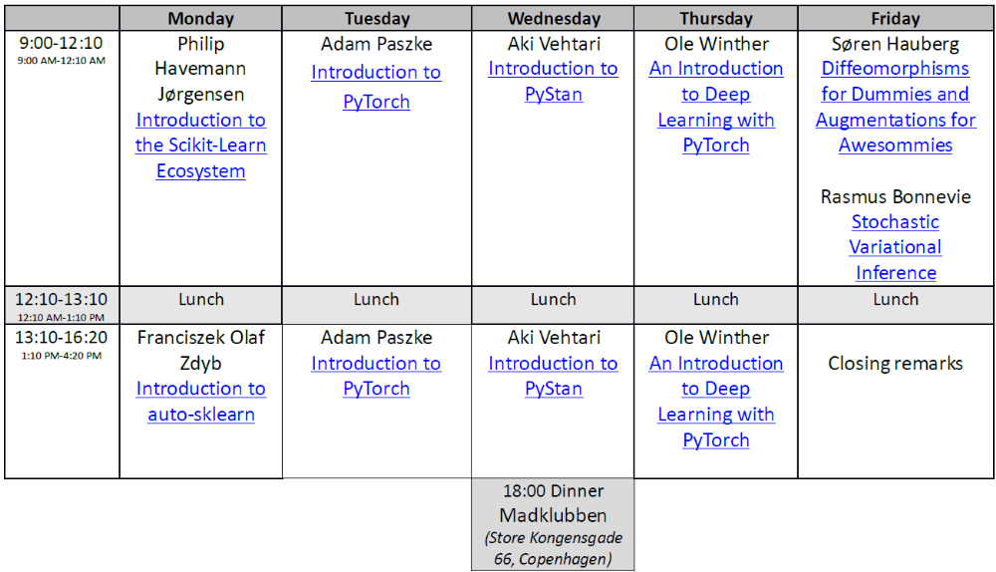
Course Programme
Course material is available from the following dropbox link:
https://www.dropbox.com/sh/8s172bp70yd4gv8/AAAUC4YnxyRif0b1oe3ojtLSa?dl=0
use the password:ctfmlip

Slide 3
Course details
- The course gives 2.5 ECTS
- The course is passed by handing in a small report on one or
more of the topics covered in the lectures and exercises
preferably applied to your own domain.
- Report evaluation: Pass/Fail
- Report length: 3-5 pages
- Deadline for submitting report: Sunday 9th of September
- Report should be sent to (mmor@dtu.dk)

