Slide 1
DeepClause
Turn an SOP into a harness
Robust · Reliable · Responsible · Auditable

Slide 2
DeepClause
Traditional agent harnesses fail where it matters most
LLM-only workflows hallucinate steps, skip checks, and cannot explain a decision.
Regulated industries need accountable agents: every action traced, every gate deterministic.
Hand-written scripts are brittle — every SOP change becomes a maintenance project.
Audits today are manual: prompts, model versions, and policy drift are invisible.

Slide 3
DeepClause
DML: neurosymbolic AI is the key differentiator
Prolog owns the workflow: sequencing, branching, constraints, fallbacks.
LLM leaves own only judgment, extraction, and synthesis — bounded and typed.
Bounded judgment predicates: choose, verify, probability — constrained answers, not free text.
Deterministic gates fail closed; model fallbacks are explicit and visible.
The artifact is valid DML today — no compiler, no pi-only runtime assumptions.

Slide 4
DeepClause
s2h: SOP -> validated harness -> self-hosted runtime
s2h init / create / commit / export: one CLI to author, version, and ship a harness.
create drives a pi agent session; validation is deterministic before anything is accepted.
Export produces an API, chat web app, MCP server, and Docker image.
Read-only by default; shell steps run in an AgentVM sandbox (network off).
Use the UI directly or integrate through MCP.

Slide 5
DeepClause
Accountable agents by construction
Provenance: SOP source, authoring session, model, and version are recorded.
Auditable routing: AGENTS.md policy table mirrored in harness.json.
Deterministic validation gates; no silent overwrites; git-versioned harnesses.
Security defaults: root-confined reads, no host shell, secrets from env only.
Every skill keeps a static non-LLM fallback.

Slide 6
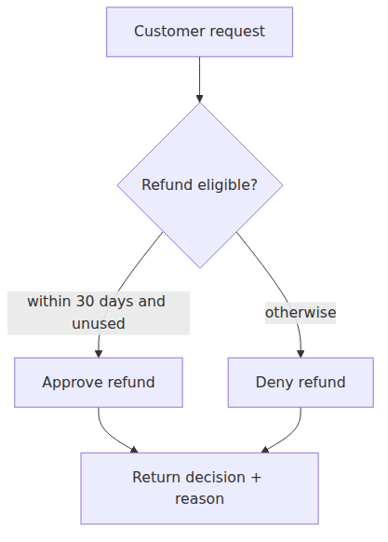
DeepClause
Example — Refund desk (presentation grade)
Human-facing overview
One skill per procedure.
Read-only decision with reason.
Authored from the SOP, not hand-coded.

Slide 7
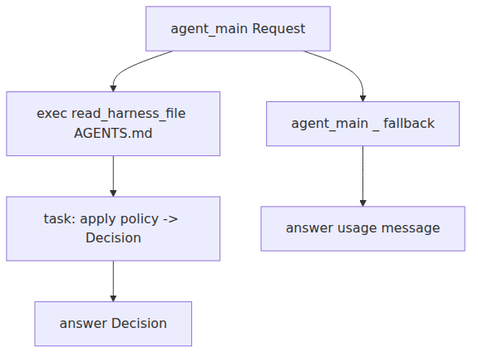
DeepClause
Example — Refund desk (specification grade)
Engineering detail
agent_main + static fallback.
Root-confined read of policy docs.
Task leaf returns typed Decision.

Slide 8
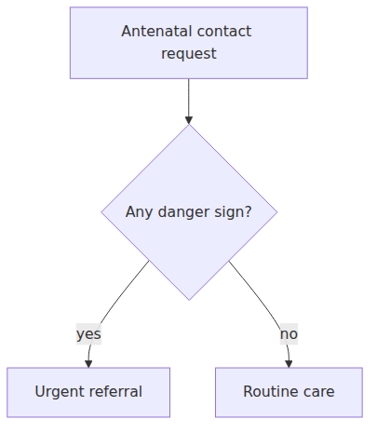
DeepClause
Example — Antenatal danger-sign triage (judgment leaves)
Bounded judgment, not an agent loop
verify: is a danger sign present?
choose: routine / urgent / emergency.
Answer constrained to the allowed labels.

Slide 9
DeepClause
Business model
Open-core developer tooling: self-hosted CLI + export runtime.
Hosted solution for smaller clients: recurring revenue + markup on inference pricing.
Bespoke consulting for in-house integration into existing systems.
Distribution: use the UI directly, or integrate through the MCP server.
Land with open-core, expand with managed inference and compliance integrations.

Slide 10
DeepClause
The ask
We are raising to productize DeepClause end-to-end.
Seed: engineering, design, and first regulated-industry design partners.
Milestones: hosted control plane, compliance pack, and enterprise MCP integrations.

