Slide 1

Presented by
Nipun - 2451-26-735-061
Deepankar-2451-26-735-480
Rishith-2451-26-735-271

Slide 2



PROBLEM STATEMENT: SECURE SATELLITE SIMULATOR
Develop a Secure Telemetry and Command Validation Simulator to validate synthetic satellite messages, verify data integrity and command authorization, detect invalid or outdated messages, and log acceptance or rejection reasons. The system must operate locally without connecting to real satellite systems or implementing custom cryptography.

Slide 3


SOLUTIONS: SECURITY & VALIDATION ARCHITECTURE
Zero-Trust Input Verification
Type Safety & Bounds
Anti-Replay & Freshness
Dual Audit Trails
Intercepts type confusion and enforces safe physical bounds (e.g., RF power clamped between 0.0% and 100.0%).
Dynamic ISO 8601 clock drift detection (−300s to +60s) prevents stale replay. Stateful sequence tracking rejects duplicates.
Every decision classified with reason codes and saved in real-time to both readable audit.log and SIEM-ready audit.jsonl.
Rejects non-JSON syntax and missing required fields (message_id, sequence, timestamp, command, value).

Slide 4



SECURE SATELLITE SIMULATOR
Zero-Trust Telemetry Engine
System Architecture
Decoupled 5-Stage Gate
Stateful Session Memory
Dual Presentation Tier
Fail-Fast Validation: Sequential message evaluation with immediate termination on first anomaly.
Anti-Replay Cache: In-memory sequence tracking prevents packet repetition & rollbacks.
CLI & Web Dashboard: Headless batch engine paired with real-time interactive GUI.
Deterministic execution speed
Zero replay vulnerability
Live telemetry streams

Slide 5
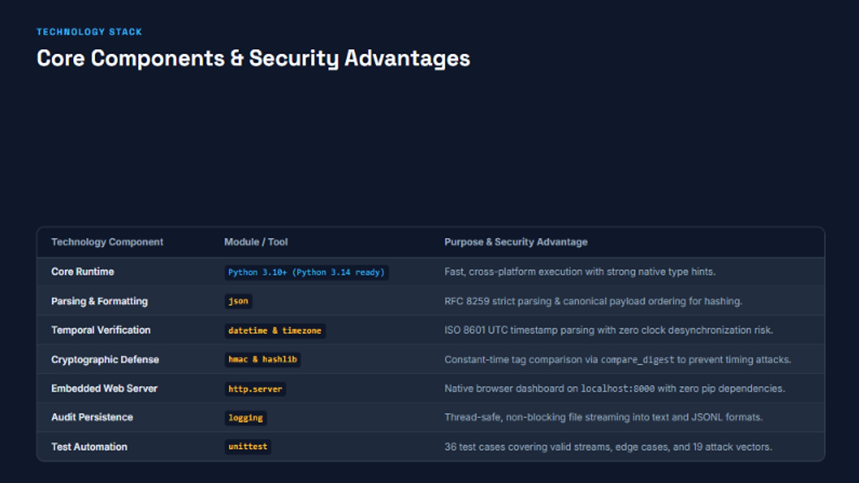

Slide 6
SATGUARD / SECURITY VALIDATION
LOCAL SIMULATION ONLY
LIVE SECURITY TEST RESULTS
Synthetic-message test plan • Expected outcomes for the local simulator
TEST CASES
EXPECTED ACCEPT
EXPECTED REJECT
07
01
06
TEST MATRIX
VALIDATION OBJECTIVES
TEST CASE
EXPECTED OUTCOME
01
Schema & required fields
Valid telemetry
ACCEPT
02
Physical-value range checks
Missing required field
REJECT
03
Timestamp freshness
Invalid temperature
REJECT
Stale timestamp
REJECT
04
Sequence / replay protection
Duplicate sequence
REJECT
05
Command allowlist
Unauthorized command
REJECT
06
JSON parsing & error handling
Malformed JSON
REJECT
DEMO NOTE • Show each input, decision, rejection reason and audit entry live.
SATGUARD • 01

Slide 7
SATGUARD / PROJECT VALUE
SECURITY BY DESIGN
WHY SECURE/TELEMETRY COMMAND SIMULATOR?
A safe, testable approach to validating synthetic satellite messages.
01
LOCAL
02
VALIDATE
03
DETECT
LOCAL-FIRST & SAFE
LAYERED VALIDATION
REPLAY & FRESHNESS
Runs on synthetic local data—no live satellite connection or real command execution.
Checks message structure, required fields, data types and policy before simulated processing.
Uses timestamps and sequence tracking to identify stale or repeated messages.
04
AUDIT
05
VERIFY
06
IMPROVE
EXPLAINABLE DECISIONS
AUTOMATED TESTING
HONEST ROADMAP
Records accept/reject outcomes with clear reasons for investigation and review.
Uses valid and seeded-invalid cases to verify expected security behaviour.
Documents current limitations, with standard sender authentication as a future enhancement.
◆
SATGUARD makes each validation decision visible, explainable and testable.
SATGUARD • WHY US

