Slide 1
Deep Code Curator DARPA ASKE – Phase 2 Kickoff meeting Ioannis Akrotirianakis & Amar Viswanathan Kannan Siemens Corporate Technology, Princeton, NJ
siemens.tld/keyword
© Siemens AG 2018

Slide 2
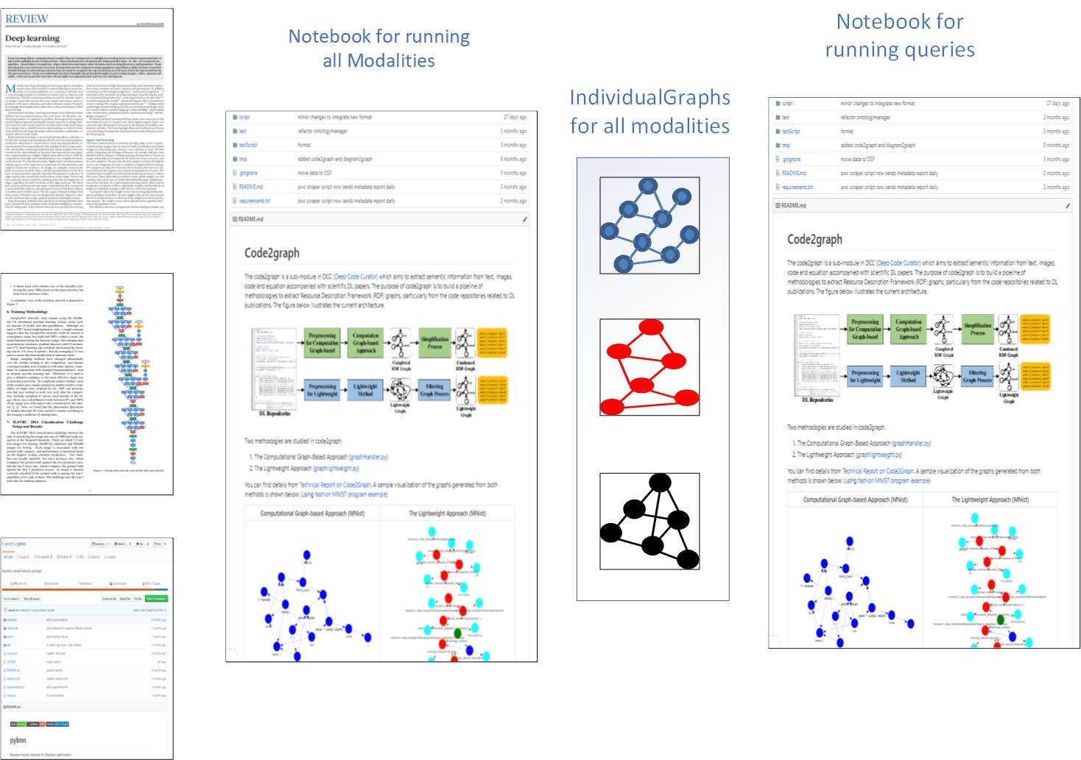
DCC demo - overview

Slide 3
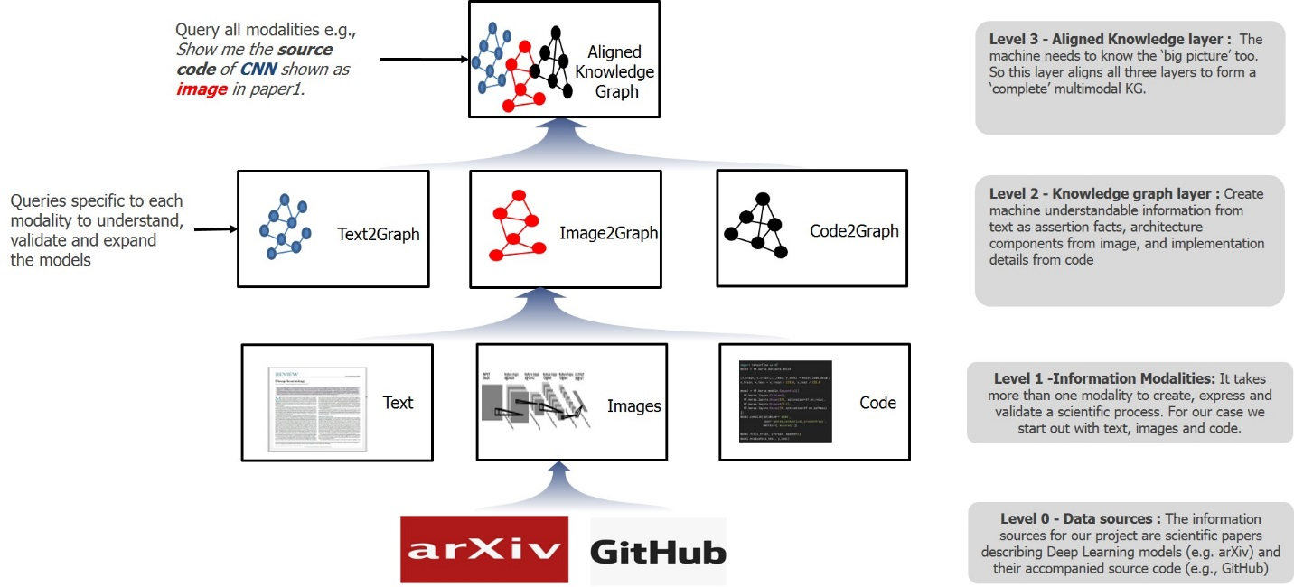
DCC within the ASKE framework

Slide 4
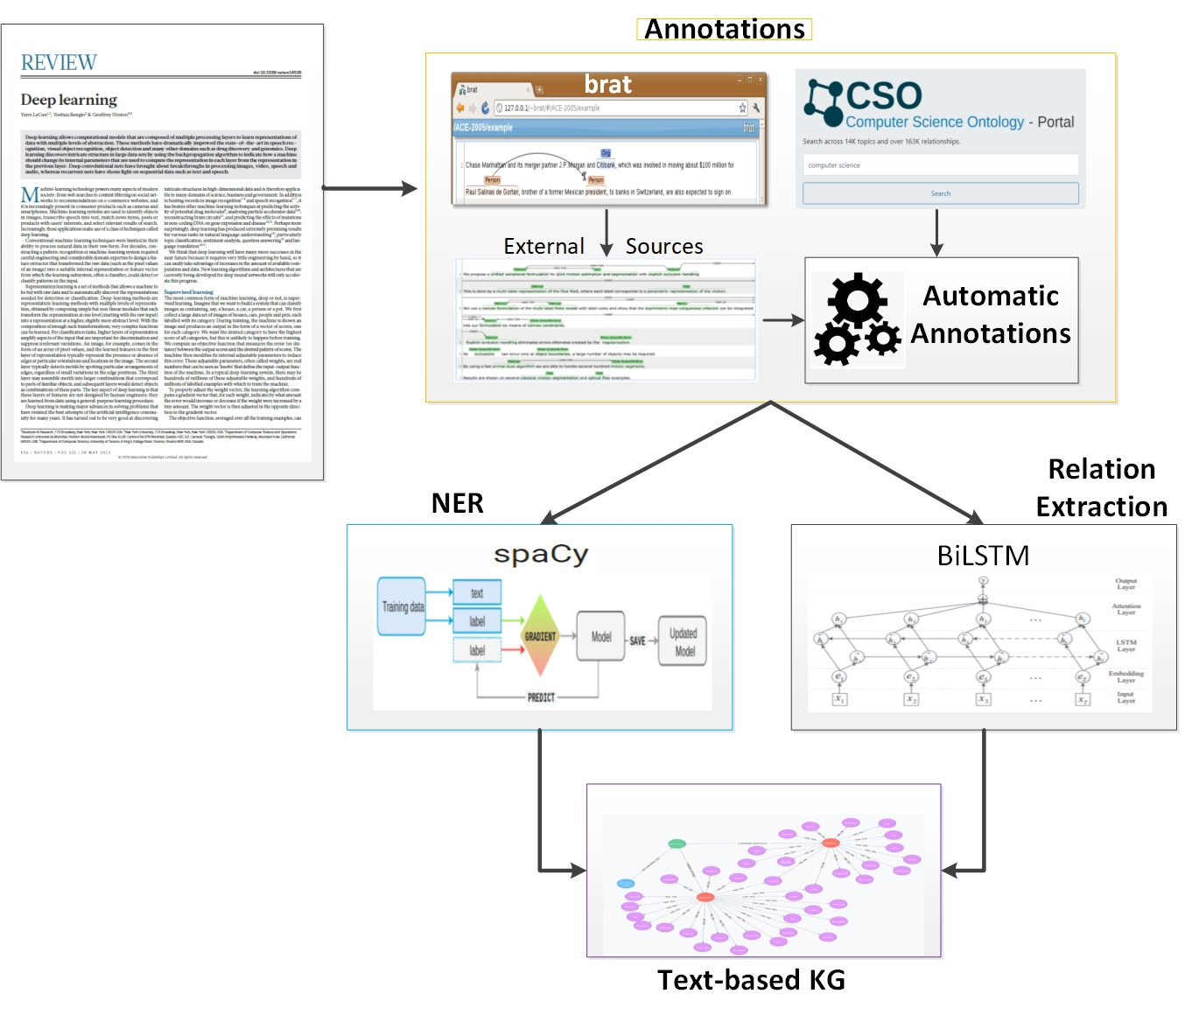
Text2Graph
Overview:
End-to-End extraction framework (BiLSTM based models)
Extracts :
Methods (CNN, RNN, Auto-Encoders, etc.)
Tasks (e.g., forecasting, image processing, etc.)
Evaluation Metrics (e.g., precision, recall, f1 test, etc.)
Material (e.g., datasets, corpus, etc.)
The output is a KG built from extracted components.
654 DL papers with source code is the starting corpus

Slide 5
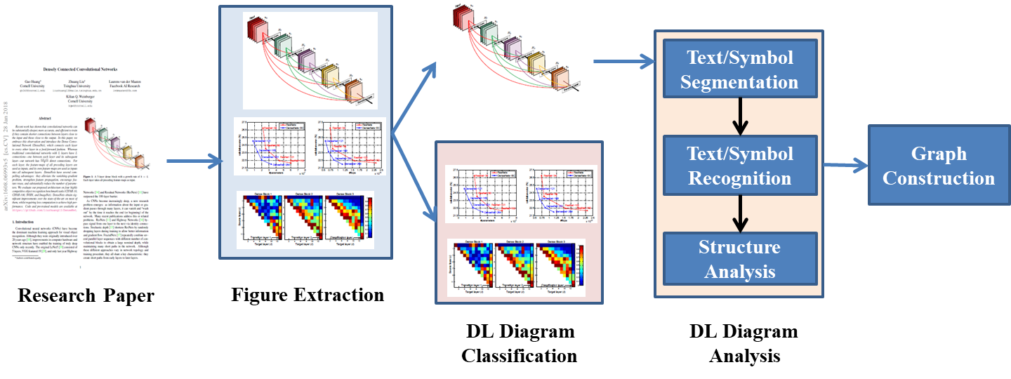
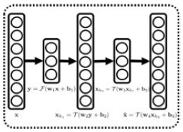
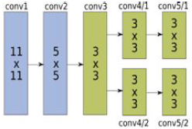
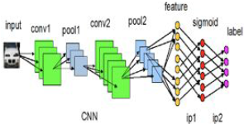
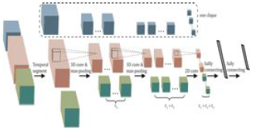
Image2Graph
Overview
Identify figures showing DL architectures
Perform diagram analysis
Locate nodes, edges
Text detection within nodes/layers
Flow detection from direction of arrows
Build Image KG
Information used: nodes, edges and text
987 images extracted and have been classified.
Neuron plots
2D box
Stacked 2D box
3D box

Slide 6
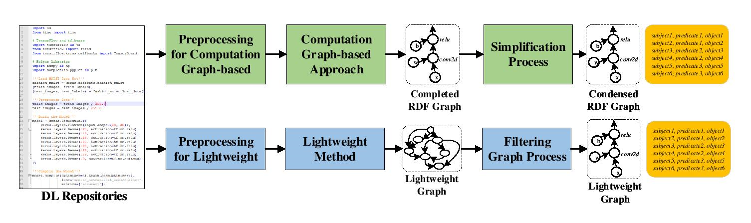
Code2Graph
Overview
Lightweight approach:
It is a deep code finder
It syntactically traverses the code by looking for keywords
AST extraction
Captures the syntactic structure of the Python/TF code
The AST structure consists of modules and methods used in Deep Learning applications
It helps us to extract the DL architecture and create the relevant ontology

Slide 7
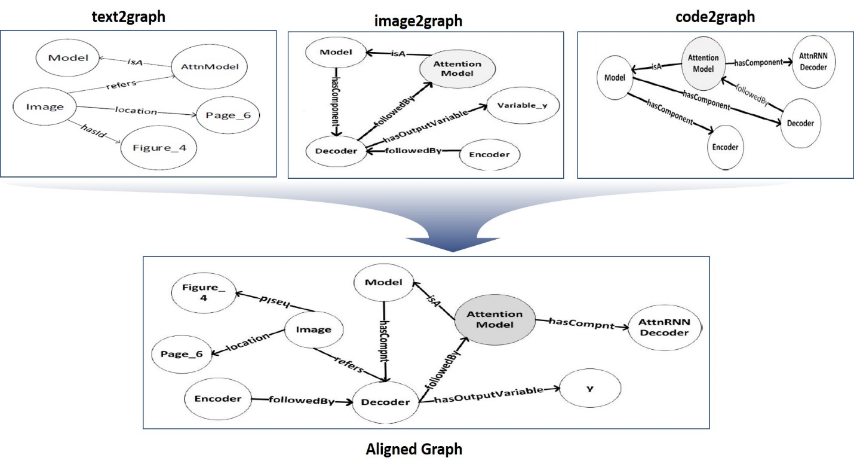
Grounding - Graph Alignment
Overview:
Graph Construction
Hand curation and machine curation:
Domain constraints represented in OWL
Hierarchies in RDF- Schema (RDFS)
Order is explored in SHACL – Shapes constrained language.
Graph Alignment
Concept alignment: uses structural features to align nodes with similar definitions
Instance alignment: uses data aware methodology where the features of the node define a similarity metric
Major challenges:
Representation

