Slide 1

-----IBM PBEL(PROJECT BASED EXPERIMENTAL LEARNING)-----
Page 01
*PROJECT TITLE*
Loan Default Prediction Using Feature Engineering
NAME :PRANDEEP DEBNATH
ID:231001001206

Slide 2


📌 Project Agenda
PProject Agenda
Page 02
1️⃣ Problem Definition:
Identify potential loan defaulters using applicant and loan-related data.
2️⃣ Data Collection & Preprocessing:
Load dataset, handle missing values, encode categorical data, and scale features
3️⃣ Feature Engineering:
Create new features such as Total_Income, Loan_Income_Ratio, and Debt_Term_Ratio to enhance model performance.
4️⃣ Exploratory Data Analysis (EDA):
Visualize target distribution, income spread, loan amount trends, and feature correlations.
5️⃣ Model Development:
Train a Random Forest Classifier on engineered features for accurate default prediction.
6️⃣ Model Evaluation:
Assess performance using accuracy, classification report, and feature importance.
g

Slide 3


🏦 Introduction
Page 03
Loan default prediction plays a vital role in the financial sector by enabling institutions to assess credit risk effectively and minimize potential losses.
This project employs Python-based data analysis and machine learning techniques to determine whether a loan applicant is likely to default or successfully repay the loan.
Feature engineering techniques are utilized to enhance model performance by generating additional informative variables, such as Total Income and the Loan-to-Income Ratio.

Slide 4


Page 04
⚙ Tools and Technologies used
🔹 Programming Language:
Python
🔹 Data Handling & Analysis:
pandas
numpy
🔹 Data Visualization:
matplotlib
seaborn
🔹 Machine Learning & Modeling:
scikit-learn
(train_test_split, RandomForestClassifier, StandardScaler, LabelEncoder, metrics)
🔹 Development Environment:
Jupyter Notebook

Slide 5

🧠 Libraries Supporting Data Analysis and Model Building
Page 05
pandas – Used for structured data loading, cleaning, and manipulation.
NumPy – Provides efficient mathematical and numerical array operations.
matplotlib – Used for visualizing data trends through various charts and plots.
seaborn – Enhances statistical data visualization with advanced plots and heatmaps.
scikit-learn – Offers tools for preprocessing, model building, and performance evaluation.

Slide 6
Code Explanation
Page 06
pandas (pd):
Used for loading CSV files, cleaning data, and creating new engineered features.
numpy (np):
Supports mathematical operations while calculating EMI, total income, balance income, etc.
train_test_split:
Splits the dataset into training and testing parts to evaluate model performance.
LogisticRegression():
Builds a classification model to predict default probability.
DecisionTreeClassifier():
Creates a tree-based model to learn decision rules from data.
RandomForestClassifier():
Uses multiple decision trees to improve accuracy and reduce overfitting.
predict_default() function:
Applies the same feature engineering on user inputs and predicts whether the loan will default.
matplotlib / seaborn:
Used for plotting graphs (histograms, bar charts, trends) for data understanding.

Slide 7
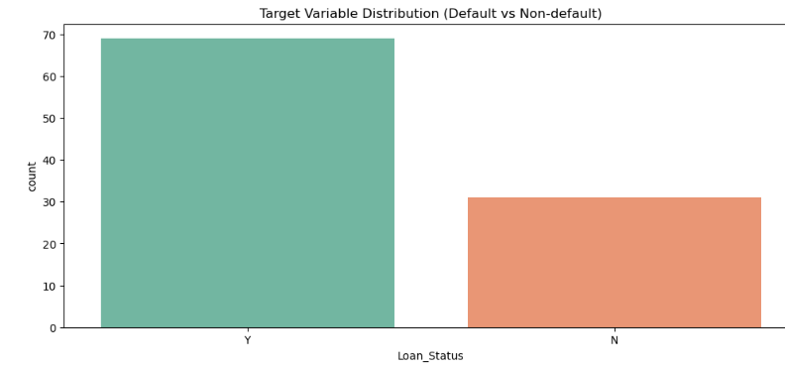
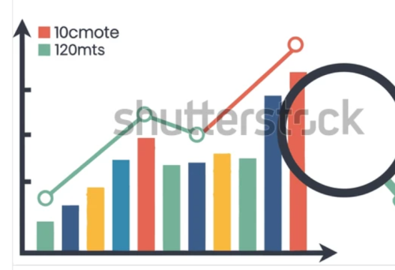
Graphical Representation-Part 1
Page 07
Bar plot
OBSERVATIONS
The number of ‘Y’ (loan approved / non-default) cases is significantly higher than the number of ‘N’ (loan rejected / default) cases.
This indicates a class imbalance in the dataset — the dataset contains more non-default cases than default cases.

Slide 8
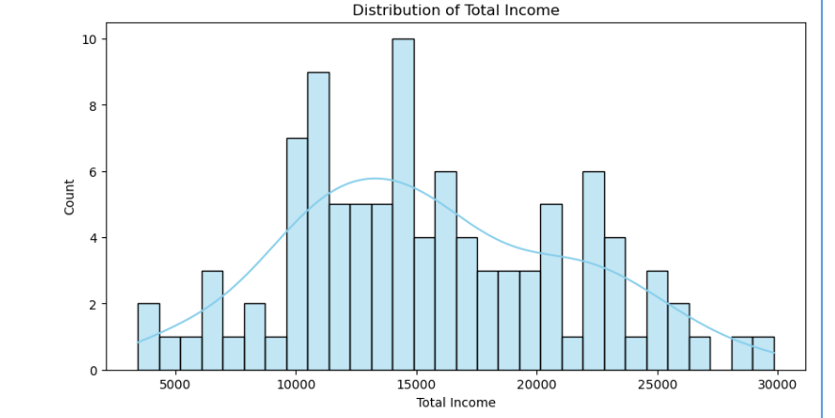
Graphical Representation-Part2
Page 08
Histogram
Observations
Distribution Shape
The distribution is roughly bell-shaped → close to normal distribution but slightly right-skewed.
A mild right skew means a few applicants have very high total income.
Income Range
Total income values appear to lie mostly between 5,000 to 30,000.
Very low incomes (< 5,000) and very high incomes (> 28,000) are rare.
Highest Frequency Group
The most common incomes are between 10,000 and 16,000, where the histogram peaks.
This indicates that majority of loan applicants fall in middle-income range.
KDE (Kernel Density Estimate ) Interpretation
KDE curve peaks around 13,000–15,000, confirming this is the most common income zone.
KDE curve smoothness confirms the distribution is continuous with no unusual gaps.

Slide 9
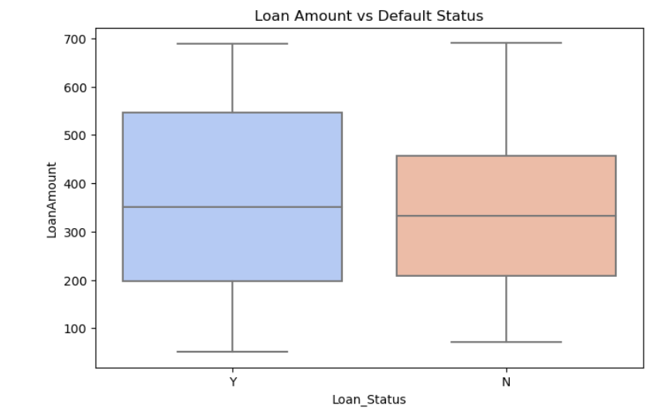
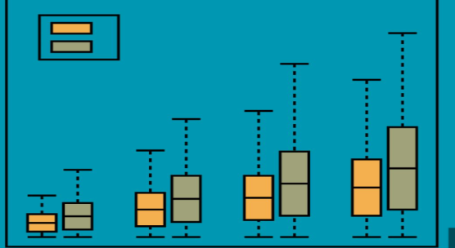
Graphical Representation-Part3
Page 09
Box-plot
Observations
Median Loan Amount
Default (Y) group has a slightly higher median loan amount than the Non-default (N) group.
This indicates that applicants who default generally took higher loan amounts.
Loan Amount Spread
The Y (Default) group shows larger variability in loan amounts.
The N (Non-default) group has a narrower spread, indicating more consistent loan amounts.
IQR (Box Height) Comparison
The Y group has a wider IQR, meaning loan amounts for defaulters vary significantly.
The N group is more compact, suggesting non-defaulters are more uniform in loan amounts

Slide 10
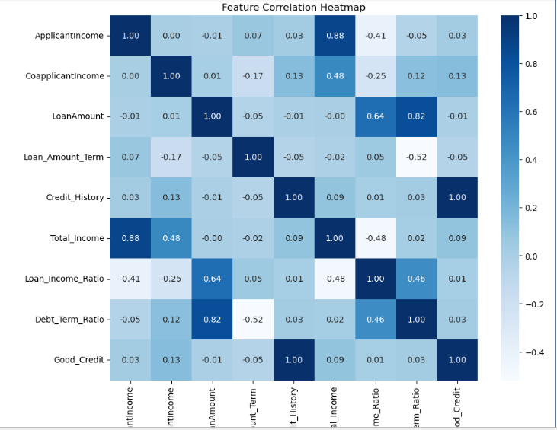

Graphical Representation-Part4
Page 10
Heatmap
Observations
The darker the color (closer to dark blue), the stronger the positive correlation (values closer to +1.00).
The lighter the color (closer to white/light blue), the weaker the correlation (values closer to 0.00).
The darkest color at the bottom (if present) would indicate a strong negative correlation (values closer to -1.00).
The diagonal is always 1.00 because a variable is perfectly correlated with itself.

Slide 11

Page 11
✅Future Scope
Integrate advanced ML models such as Gradient Boosting, XGBoost, LightGBM for higher prediction accuracy.
Deploy the model as a web or mobile app for real-time loan risk assessment.
Include alternative data sources (transaction history, spending patterns, credit bureau scores) for richer feature engineering.
Apply deep learning models for complex pattern recognition in large datasets.
Implement automated feature selection and hyperparameter tuning to improve model generalization.
Use graph-based relationships (co-borrowers, shared addresses, credit links) to detect hidden risk patterns.
Integrate fraud detection mechanisms using anomaly detection algorithms.
Expand dataset size to improve robustness and reduce model bias.

Slide 12

Page 12
Thank
You
-

