Slide 1
Explainable
Market
Market intelligence you can understand
ENT207TC Demo Day
Notes:
PITCH SCRIPT
Imagine opening a market app and seeing a sharp price movement. The number is clear. The context takes more work. Where did the data come from? What do the headlines actually say? How much confidence should you place in a forecast? We built Explainable Market to help people answer those questions.
SOURCES
https://github.com/deepdevjose/explainable-market/blob/f7bd85fe44f215ba83ba9e6e308c858a4f8b140d/README.md
Product screenshots captured from the running application on 12 November 2026. Business proposals and research targets are explicitly labelled on the slides. No user testimonials or traction numbers are asserted.

Slide 2
The confidence gap
A moving price
raises questions
Where is the source?
How fresh is it?
What does it mean?
Initial audience: students and first-time market learners
Problem hypothesis to test with real users
02
Notes:
PITCH SCRIPT
Our starting user is a student or first-time market learner. They move between price charts, news articles, and unfamiliar terminology. Every extra tab makes the research harder to follow. Explainable Market keeps that journey together. Students can explore a real movement, check the evidence, and learn the concepts they need along the way. We want their first market experience to feel approachable.
SOURCES
https://github.com/deepdevjose/explainable-market/blob/f7bd85fe44f215ba83ba9e6e308c858a4f8b140d/docs/PRODUCTO.md
Product screenshots captured from the running application on 12 November 2026. Business proposals and research targets are explicitly labelled on the slides. No user testimonials or traction numbers are asserted.

Slide 3
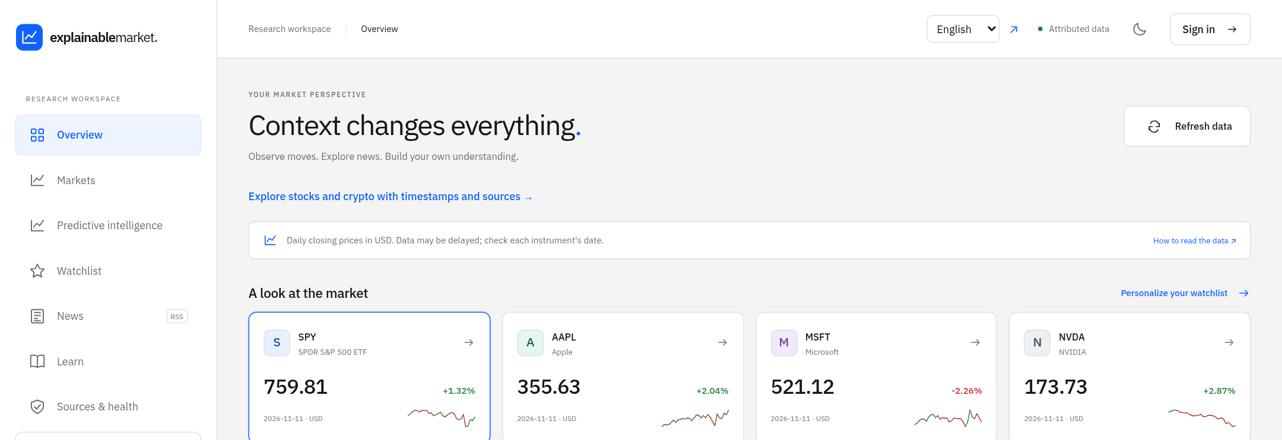
A complete research journey
Explore an asset, inspect its history, read the news, ask a question
03
Notes:
PITCH SCRIPT
Explainable Market brings prices, historical charts, source-linked news, and educational guidance into one workspace. A user can explore an asset, inspect its history, and follow the information behind it. The core research pages open without registration. When someone wants a personal watchlist, they can create an account and save it. We already have a working application that people can try.
SOURCES
https://github.com/deepdevjose/explainable-market/blob/f7bd85fe44f215ba83ba9e6e308c858a4f8b140d/market_explained/application.py
https://github.com/deepdevjose/explainable-market/blob/f7bd85fe44f215ba83ba9e6e308c858a4f8b140d/templates/dashboard.html
Product screenshots captured from the running application on 12 November 2026. Business proposals and research targets are explicitly labelled on the slides. No user testimonials or traction numbers are asserted.

Slide 4
Different sources, one research experience
JSON APIs
Live data streams
RSS / XML headlines
A shared language
for the app and AI
Consistent records per data type
Source and time stay attached
The app checks incoming fields
Today: JSON and RSS/XML input, CSV export. CSV/Excel imports and BI connectors remain extension paths
04
Notes:
SPEECH
Behind that experience is a translation layer, our middleware. It receives information in the formats providers use and creates consistent records for each data type. Today, that includes JSON market feeds and RSS or XML news. We preserve the source and date, check the fields, and prepare structured context for AI. CSV export already works. CSV or Excel imports and BI connections would use additional adapters. Those integrations are our extension path.
SOURCES
https://github.com/deepdevjose/explainable-market/blob/f7bd85fe44f215ba83ba9e6e308c858a4f8b140d/collector.py
https://github.com/deepdevjose/explainable-market/blob/f7bd85fe44f215ba83ba9e6e308c858a4f8b140d/ai.py
https://github.com/deepdevjose/explainable-market/blob/f7bd85fe44f215ba83ba9e6e308c858a4f8b140d/market_explained/providers/binance.py
https://github.com/deepdevjose/explainable-market/blob/f7bd85fe44f215ba83ba9e6e308c858a4f8b140d/market_explained/application.py
PRESENTER BACKGROUND
Middleware describes the data adaptation and validation role distributed across current modules. It is not a newly implemented standalone service.

Slide 5
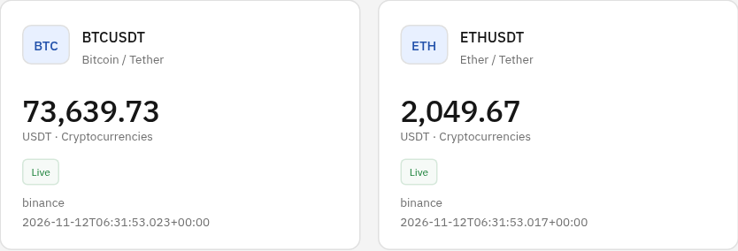
Live crypto, with a visible source
BTCUSDT
ETHUSDT
Binance Spot
5-second browser refresh
Visible source
UTC timestamp
Product capture, 12 Nov 2026. US stock data uses historical daily closes
05
Notes:
PITCH SCRIPT
Here is one working example: Bitcoin and Ether prices arrive from Binance Spot. The browser refreshes the stored market state every five seconds, and the interface shows the provider and timestamp. If the feed becomes stale, the label changes. US stocks use daily historical closes. We make that distinction visible, so users can understand what kind of information they are seeing.
SOURCES
https://github.com/deepdevjose/explainable-market/blob/f7bd85fe44f215ba83ba9e6e308c858a4f8b140d/market_explained/ingestion/workers.py
https://github.com/deepdevjose/explainable-market/blob/f7bd85fe44f215ba83ba9e6e308c858a4f8b140d/market_explained/storage/repository.py
https://github.com/deepdevjose/explainable-market/blob/f7bd85fe44f215ba83ba9e6e308c858a4f8b140d/static/app.js
Product screenshots captured from the running application on 12 November 2026. Business proposals and research targets are explicitly labelled on the slides. No user testimonials or traction numbers are asserted.

Slide 6
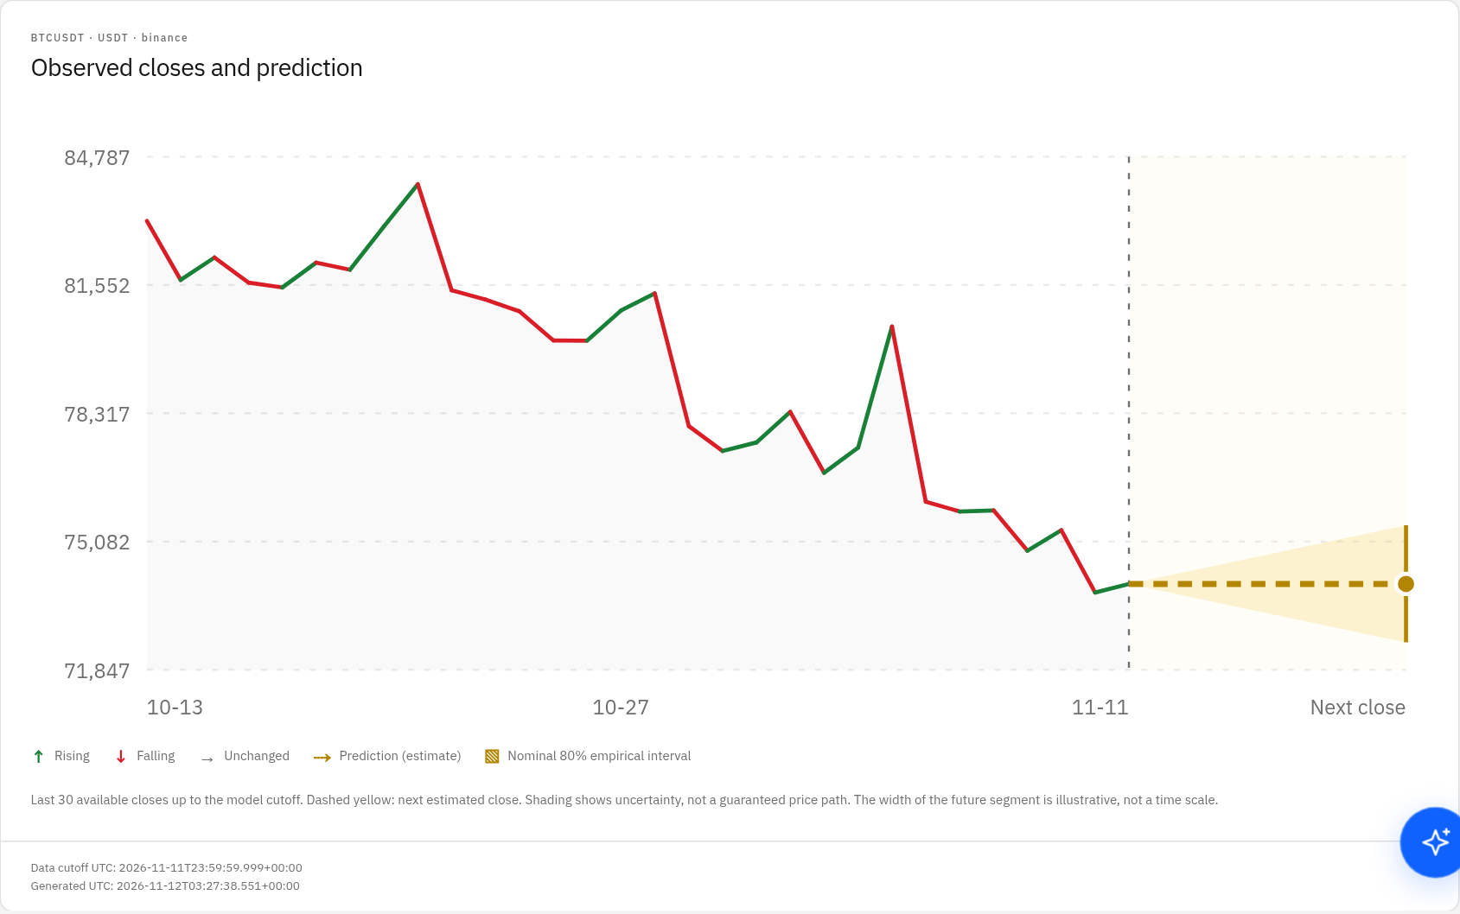
Forecasts that show their limits
Observed prices
Green: up
Red: down
Yellow: estimate
Uncertainty stays visible
Models face a baseline
Limited historical evaluation. No independent validation or guaranteed interval coverage
06
Notes:
PITCH SCRIPT
The prediction view makes uncertainty part of the experience. Green and red show observed price movements. The yellow section shows the next-close estimate, with an uncertainty band. Behind it, we compare persistence, ridge regression, and optional XGBoost using chronological evaluation. A simple baseline can win. The historical evaluation and model limits remain visible. Users can examine the estimate, question it, and understand the difference between an observation and a possible outcome.
SOURCES
https://github.com/deepdevjose/explainable-market/blob/f7bd85fe44f215ba83ba9e6e308c858a4f8b140d/market_explained/intelligence/forecasting.py
https://github.com/deepdevjose/explainable-market/blob/f7bd85fe44f215ba83ba9e6e308c858a4f8b140d/templates/intelligence.html
Product screenshots captured from the running application on 12 November 2026. Business proposals and research targets are explicitly labelled on the slides. No user testimonials or traction numbers are asserted.

Slide 7
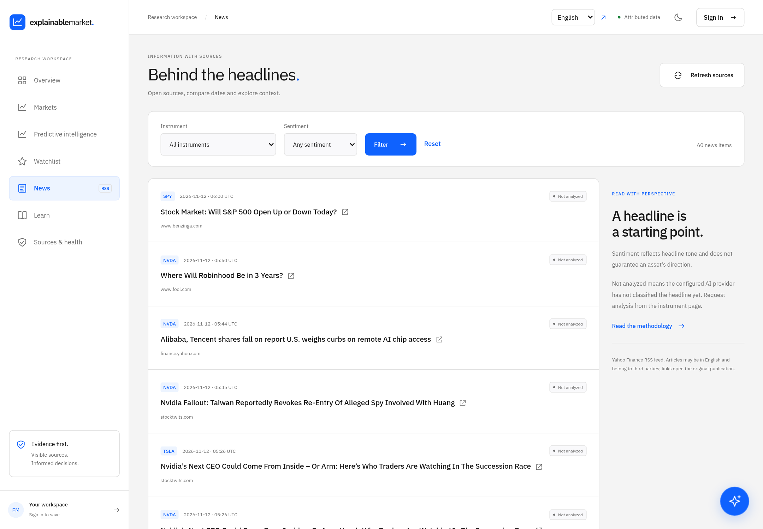
News prepared for analysis
Consistent news records
Educational assistant
Structured context
Validated AI responses
Related headlines provide context. Timing alone does not establish cause
07
Notes:
PITCH SCRIPT
News makes the benefit tangible. Our adapter takes RSS or XML headlines and prepares consistent records with a source, link, and publication time. The sentiment service receives selected headlines as structured JSON, and we validate its response before saving it. The assistant can use richer context to explain financial concepts. This creates a predictable path from incoming information to educational insight, while keeping the original source visible.
SOURCES
https://github.com/deepdevjose/explainable-market/blob/f7bd85fe44f215ba83ba9e6e308c858a4f8b140d/ai.py
https://github.com/deepdevjose/explainable-market/blob/f7bd85fe44f215ba83ba9e6e308c858a4f8b140d/templates/news.html
https://github.com/deepdevjose/explainable-market/blob/f7bd85fe44f215ba83ba9e6e308c858a4f8b140d/market_explained/application.py
Product screenshots captured from the running application on 12 November 2026. Business proposals and research targets are explicitly labelled on the slides. No user testimonials or traction numbers are asserted.
News sentiment currently classifies headline text only. Source/date metadata remain in storage and the assistant context. The classifier receives IDs and headlines, not raw RSS or full articles. BigModel/DeepSeek are external providers, not a language model trained by this project. Consistent inputs are an engineering benefit, not independently measured gains in AI accuracy.

Slide 8
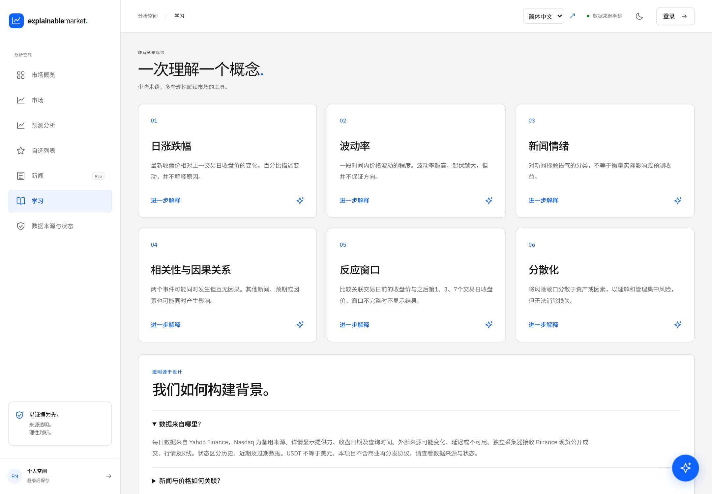
Three languages, one learning experience
English
Español
Simplified Chinese
Interface translations. External news retains the publisher’s original language
08
Notes:
PITCH SCRIPT
The interface supports English, Spanish, and Simplified Chinese. That lets different students explore the same product in a language they are comfortable using. External news retains its original language. Alongside the educational library, the assistant, and clear source labels, this gives us an accessible starting point for international campus communities.
SOURCES
https://github.com/deepdevjose/explainable-market/blob/f7bd85fe44f215ba83ba9e6e308c858a4f8b140d/market_explained/localization.py
https://github.com/deepdevjose/explainable-market/blob/f7bd85fe44f215ba83ba9e6e308c858a4f8b140d/market_explained/locales/messages.json
Product screenshots captured from the running application on 12 November 2026. Business proposals and research targets are explicitly labelled on the slides. No user testimonials or traction numbers are asserted.

Slide 9
Students first. Campus pilots next.
Proposed business model
Free core
Potential paid offer
Students and first-time learners
Open research pages
Optional personal watchlists
Campus pilots and learning tools
University societies and educators
Willingness to pay still to test
Data licensing and AI operating costs shape any commercial offer
09
Notes:
PITCH SCRIPT
Our initial audience is students and first-time learners. Our proposed business model keeps core exploration free, then tests demand for advanced learning tools and university pilots. We will validate willingness to pay before setting prices. Data licensing and AI operating costs will shape any commercial offer. The open-source core also gives us a practical way to invite contributors and show how the product works.
SOURCES
https://github.com/deepdevjose/explainable-market/blob/f7bd85fe44f215ba83ba9e6e308c858a4f8b140d/README.md
https://github.com/deepdevjose/explainable-market/blob/f7bd85fe44f215ba83ba9e6e308c858a4f8b140d/LICENSE
Product screenshots captured from the running application on 12 November 2026. Business proposals and research targets are explicitly labelled on the slides. No user testimonials or traction numbers are asserted.

Slide 10
Ten real users before Demo Day
10
The test
Find an asset
Check its source and freshness
Explain what the forecast means
real testers
Recruitment target
Tell us what needs to change
Measure task completion and connect feedback to a dated product improvement
10
Notes:
PITCH SCRIPT
Our next milestone is feedback from at least ten real users before Demo Day. Each tester will find an asset, check the source and freshness, explain the forecast in their own words, and tell us what needs to change. We will record task completion and connect each useful piece of feedback to a product improvement. The goal is a stronger product shaped by the people who will actually use it.
SOURCES
https://github.com/deepdevjose/explainable-market/blob/f7bd85fe44f215ba83ba9e6e308c858a4f8b140d/README.md
Product screenshots captured from the running application on 12 November 2026. Business proposals and research targets are explicitly labelled on the slides. No user testimonials or traction numbers are asserted.

Slide 11
Financial understanding
should be for everyone
Student testers and campus partners
Try one asset. Tell us what becomes clearer.
Open the demo
Educational information. No trade execution or guaranteed returns.
Notes:
PITCH SCRIPT
Explainable Market gives people a place to begin understanding financial information. We have built the research experience, connected real data, and made uncertainty visible. Now we are looking for student testers and campus partners to help shape the next step. Try one asset and tell us what becomes clearer. Our ambition is simple: financial understanding should be for everyone. Thank you.
SOURCES
https://github.com/deepdevjose/explainable-market/blob/f7bd85fe44f215ba83ba9e6e308c858a4f8b140d/README.md
Product screenshots captured from the running application on 12 November 2026. Business proposals and research targets are explicitly labelled on the slides. No user testimonials or traction numbers are asserted.

Slide 12
Current market coverage
Category | Working scope | Boundary
Stocks | 12 US instruments, Yahoo/Nasdaq | Historical daily closes
Crypto | BTCUSDT and ETHUSDT, Binance Spot | USDT quote currency, 5 s web refresh
Forex | Optional Twelve Data REST adapter | Public display requires permission
Commodities | Optional gold feed through Twelve Data | Public display requires permission
Indices | Registered SPX and FTSE entries | Unavailable with tested access
Current demo: supervised laptop and temporary tunnel. Independent cloud hosting remains pending
12
Notes:
JUDGE Q&A
Current working scope: 12 US stock instruments use Yahoo/Nasdaq daily closing history. Binance Spot supports BTCUSDT and ETHUSDT, quoted in USDT. The browser polls every five seconds. Forex and gold have an optional Twelve Data adapter, but external display is disabled by default and requires appropriate permission. Index entries are unavailable with the tested access. Do not describe five asset classes as five live feeds. Public research pages do not require login, while personal watchlists do. The demo runs on a supervised laptop with a temporary Cloudflare tunnel. The laptop must stay awake and connected. A permanent independent cloud deployment is not verified.
SOURCES
https://github.com/deepdevjose/explainable-market/blob/f7bd85fe44f215ba83ba9e6e308c858a4f8b140d/README.md
https://github.com/deepdevjose/explainable-market/blob/f7bd85fe44f215ba83ba9e6e308c858a4f8b140d/docs/PREDICTIVE_INTELLIGENCE.md

Slide 13
Prediction methodology
Persistence
Ridge regression
Optional XGBoost
At least 120 closed daily observations
Next observed daily return
Chronological walk-forward evaluation
Model selection by calibration error
Nominal 80% empirical interval
No independent validation or future coverage guarantee. Model contributions do not prove cause
13
Notes:
JUDGE Q&A
The forecasting worker requires at least 120 closed daily observations and predicts the next observed daily return. Candidate models are persistence, ridge and optional CPU XGBoost. Selection uses calibration MAE, followed by a separate chronological walk-forward test period. The displayed interval uses an empirical residual quantile with nominal 80% coverage. It has no future coverage guarantee. The selected model can be persistence, producing zero predicted return. Feature contributions explain model calculations and do not establish causal relationships. No independent evaluation, return guarantee, trading execution or brokerage integration is claimed.
SOURCES
https://github.com/deepdevjose/explainable-market/blob/f7bd85fe44f215ba83ba9e6e308c858a4f8b140d/README.md
https://github.com/deepdevjose/explainable-market/blob/f7bd85fe44f215ba83ba9e6e308c858a4f8b140d/docs/PREDICTIVE_INTELLIGENCE.md

