Slide 1


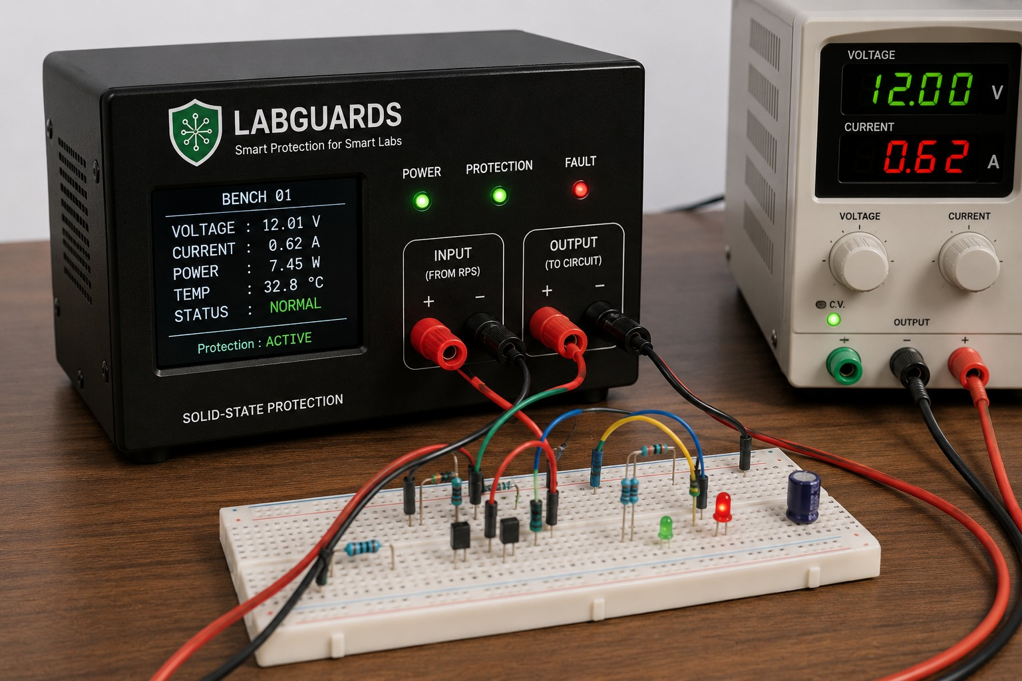
SMART INDIA HACKATHON 2026
Problem Statement ID – 6
Problem Statement Title – Laboratory Protection and Monitoring System
Theme - Open innovation – SMART LabGuard
PS Category – Internet of Things (IoT)
Team Name - TECHTRONIX

Slide 2
TECHNICAL APPROACH
TECHTRONIX
PROBLEM STATEMENT
"Accidental electrical faults in laboratory experiments can damage expensive equipment, increase maintenance costs, and cause downtime. The lack of real-time, bench-level monitoring also makes it difficult for lab in-charges to detect faults early and perform proactive maintenance."
PROPOSED SOLUTION
LabGuards is a smart protection system that monitors voltage, current, power, and temperature at every laboratory bench. It detects electrical faults and quickly isolates the circuit to prevent equipment damage, while an ESP32 sends real-time data and alerts to the lab in-charge dashboard. Fault history and equipment health monitoring also enable proactive maintenance.
Monitor → Detect → Protect → Alert → Maintain

Slide 3
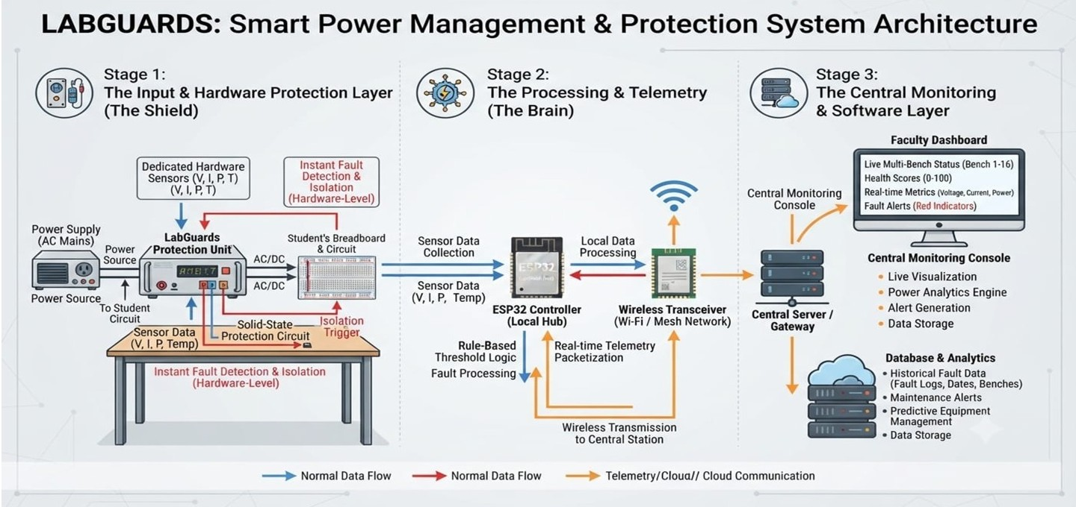
SYSTEM ARCHITECTURE
TECHTRONIX

Slide 4
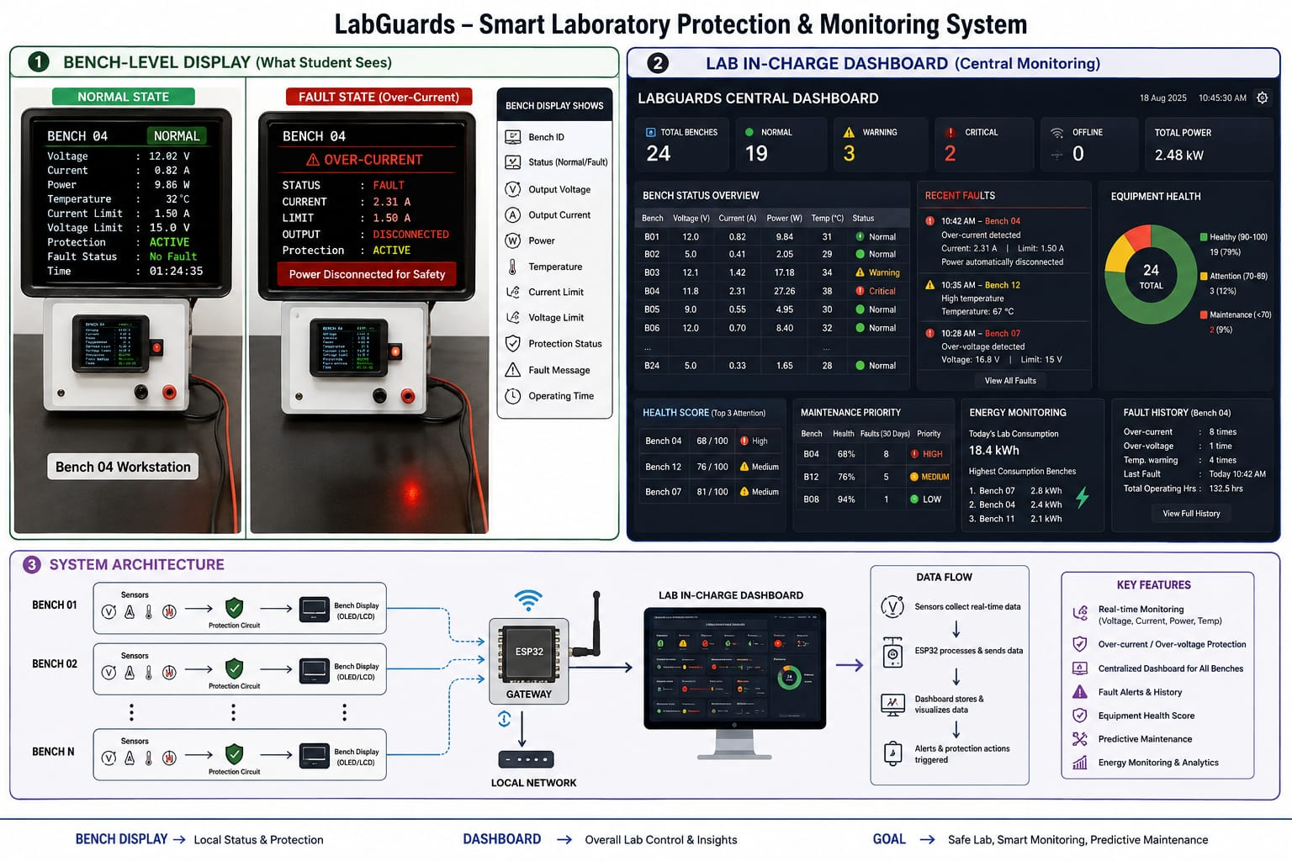
SETUP

Slide 5
FEASIBILITY AND VIABILITY
TECHTRONIX
Cost-Effective:
Helps reduce equipment damage, repair costs, and replacement expenses.
Low Maintenance:
Automated monitoring reduces the need for continuous manual supervision
Reliable Alerts:
Two-level warning mechanism helps minimize false alarms.
Reliable Operation:
Safety protection works even when Wi-Fi or the software dashboard is unavailable.
Long-Term Benefits:
Improves lab safety, extends equipment life, and reduces electronic waste.
Easy Deployment:
Can start with one lab bench and gradually expand to the entire laboratory.

Slide 6
IMPACT AND BENEFITS
TECHTRONIX
Sub-Millisecond Protection:
Instant hardware isolation prevents equipment burnout during electrical faults.
Real-Time Bench Telemetry:
Continuous display of voltage, current, and temperature provides clear feedback to students.
Centralized Faculty Control:
Web dashboard enables live monitoring and multi-bench supervision from one screen.
Automated Fault Logging:
Stores fault history to streamline troubleshooting and lower maintenance costs.
Fearless Student Learning:
Builds student confidence by creating a safe, anxiety-free environment for hands-on experimentation.
Stop Lab Losses:
One wiring mistake can ruin a ₹8,000+ power supply—installing a single ₹1,200-₹2,000 LabGuard node prevents the damage before it happens, paying for itself on day one.

Slide 7
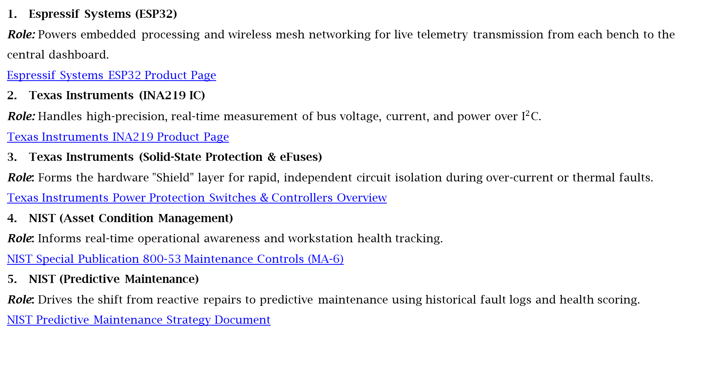
RESEARCH AND REFERENCES
TECHTRONIX
Espressif Systems (ESP32)
Role: Powers embedded processing and wireless mesh networking for live telemetry transmission from each bench to the central dashboard.
Espressif Systems ESP32 Product Page
Texas Instruments (INA219 IC)
Role: Handles high-precision, real-time measurement of bus voltage, current, and power over ${\text{I}}^{2}\text{C}$.
Texas Instruments INA219 Product Page
Texas Instruments (Solid-State Protection & eFuses)
Role: Forms the hardware "Shield" layer for rapid, independent circuit isolation during over-current or thermal faults.
Texas Instruments Power Protection Switches & Controllers Overview
NIST (Asset Condition Management)
Role: Informs real-time operational awareness and workstation health tracking.
NIST Special Publication 800-53 Maintenance Controls (MA-6)
NIST (Predictive Maintenance)
Role: Drives the shift from reactive repairs to predictive maintenance using historical fault logs and health scoring.
NIST Predictive Maintenance Strategy Document

