Slide 1
Customer Spendings Patterns Analysis
By Esraa & Deepender

Slide 2
Objectives
Is the business operate the same way in all the four countries.
Is there any differences in the customer spendings patterns for each country.

Slide 3
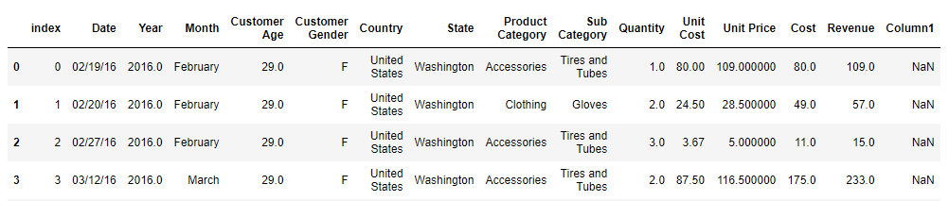
Data
Using data from Kaggle.com on 4 different countries which contains information about customers demographic and different product category.
The number of rows are 32867 and 16 Columns.
Notes:
This dataset covers the two years 2015 and 2016

Slide 4
Data
We have Data of four countries i.e. United States, Germany, United Kingdom, and France.
We have Data of 2015 and 2016.
The Data consist of three product categories.
Notes:
This dataset covers the two years 2015 and 2016

Slide 5
Data Wrangling
Converted categorical data into integer using map function.
Customer Gender will be converted from categorical value to numerical column (Assign 0 and 1 to male and female respectively).
Created the Profit column.
Checked outliers and deleted extreme values.
Number of rows and columns after Data cleaning ( 32129, 17 ).
Notes:
This dataset covers the two years 2015 and 2016

Slide 6
Hypothesis
Hypothesis 1: The average revenue in the 4 countries are almost the same which is equal to the average total revenue of 493.59.
Hypothesis 2: The average profit is the same in the 4 countries which is equal to the average total profit of 62.32.
Notes:
Both hypothesis have been rejected. At least there are two countries have an avergae revenue and average profit different from the average total revenue and the average total profit, respectivly.
As we will see from the graphs in the next slides.

Slide 7
Results
Notes:
Both hypothesis have been rejected. At least there are two countries have an avergae revenue and average profit different from the average total revenue and the average total profit, respectivly.
As we will see from the graphs in the next slides.

Slide 8
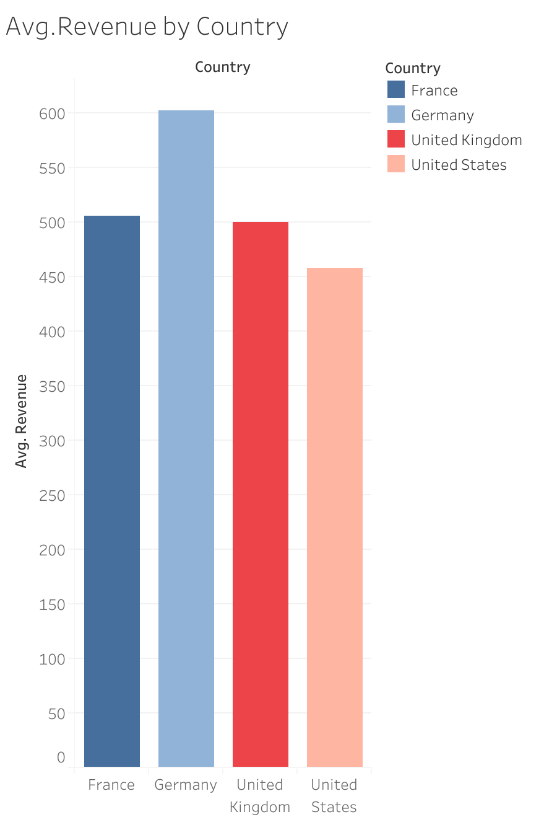
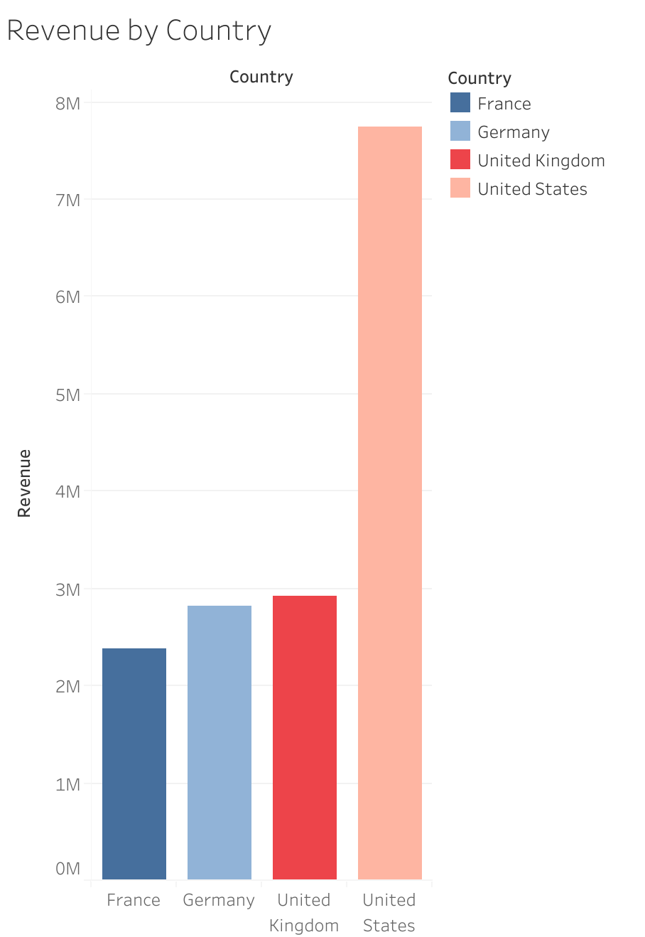
Notes:
- Starting by looking at the revenue generated in each country, we can see that USA generated the highest revenue while France has the lowest total revenue.
- Although that we can see United states has the highest total revenue but the sceniro is diiferent when we look at the average revenue which indicates the amount of profit generated per unit.
Considering the average revenue give us more insight into the data and show clearly which country generate the most profits, because an increase in total revenue doesn’t always lead to profit maximization.

Slide 9
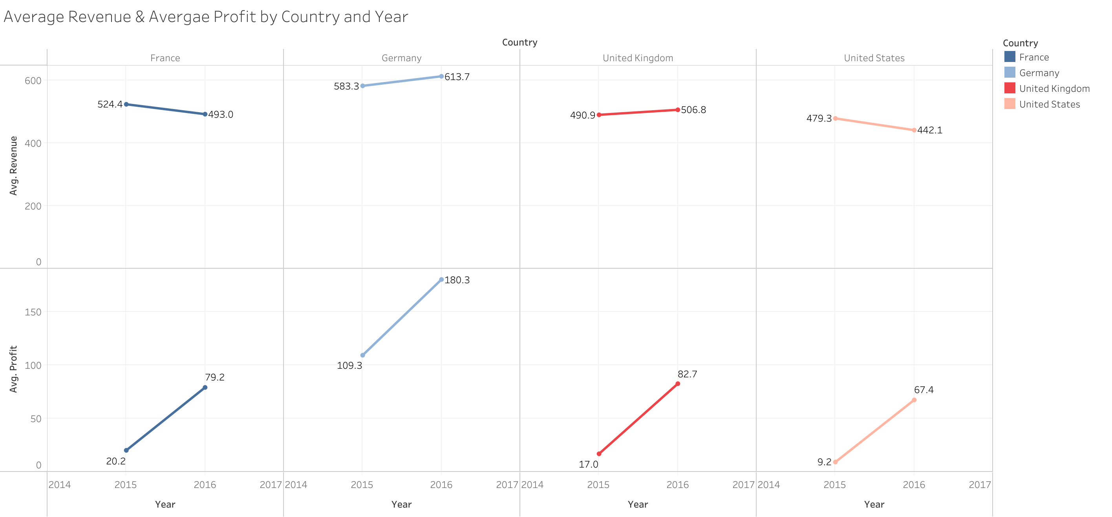
Notes:
Therefore, its important to look at the average proft rather than just consider the average revenue.
Average profit identify the profit margin that can be achieved on each unit of the product that is sold.
This graphs show both the average revenue and the average profit in each country during 2015 and 2016

Slide 10
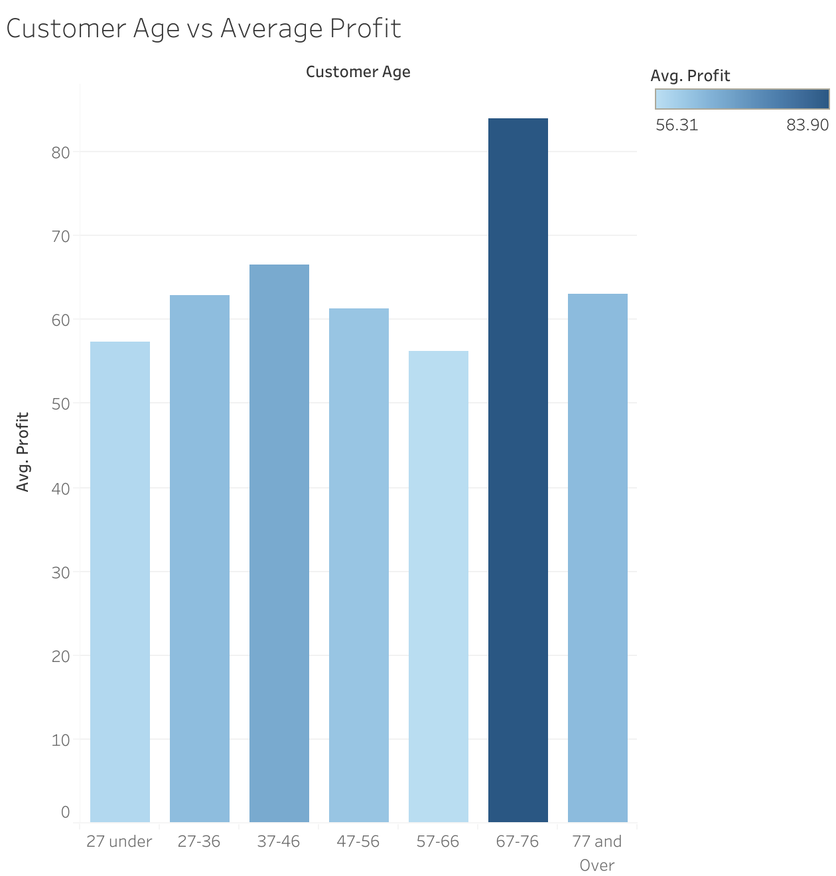
Notes:
This graph illustrate the relationship between the customer age and average profit.
- The most profit achieved by the age group 67-76.

Slide 11
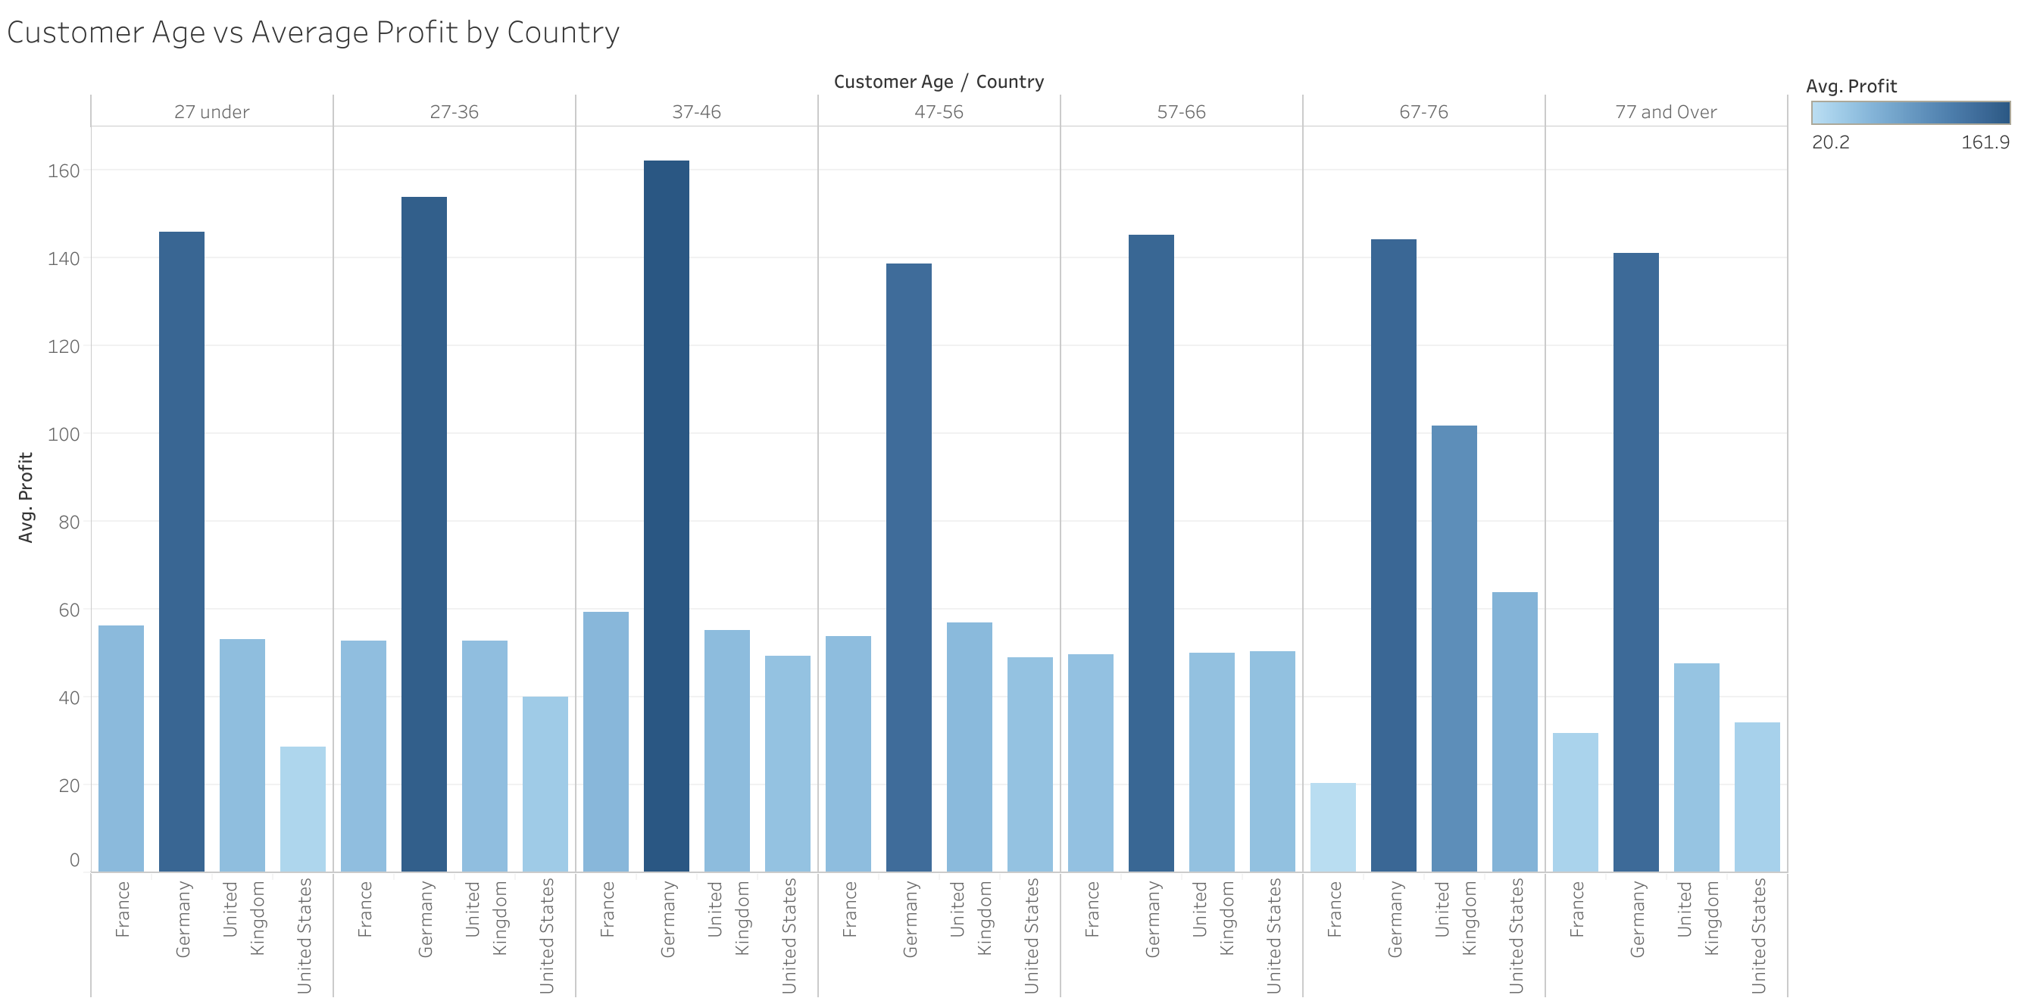
Notes:
To see this age groups by country, this graph show that the case is diffferent in each country.
- The most profit come from the age groups 37-46 and 27-36 in Germany, while the UK and USA generate a high profit from the age group 67-76

Slide 12
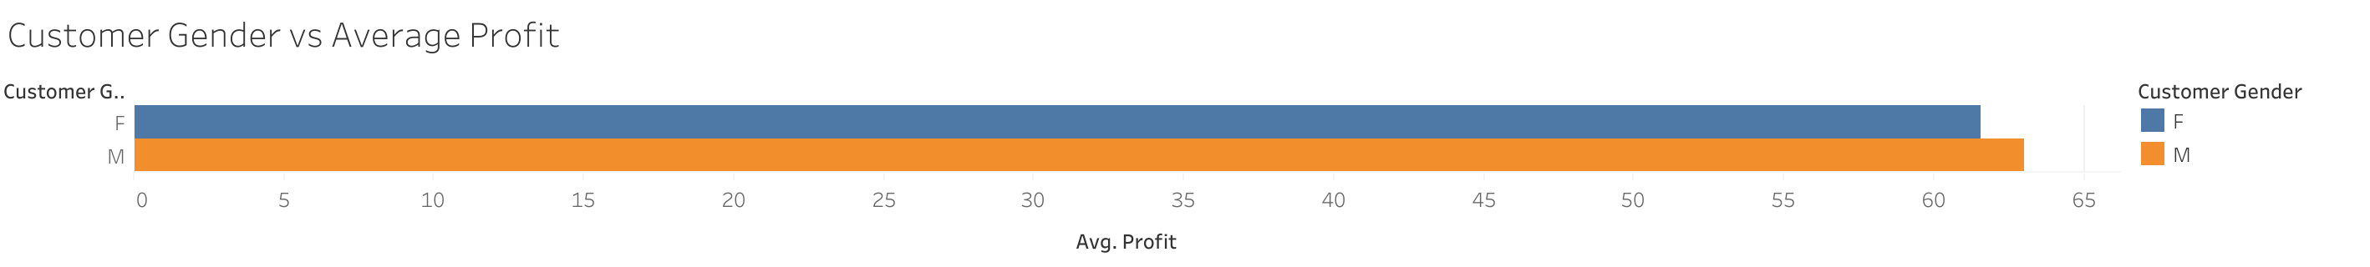

Slide 13
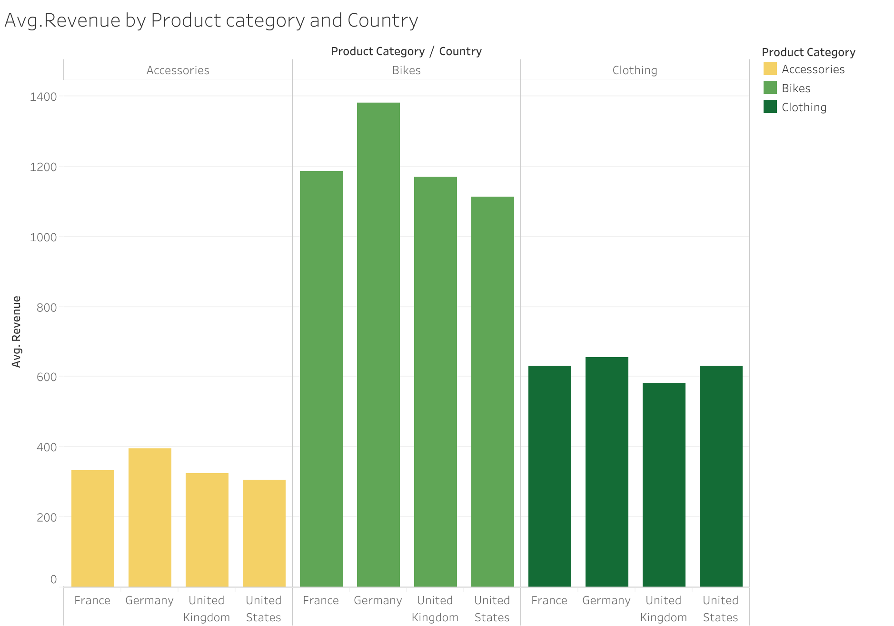
Notes:
For all countries Bikes generates the highest average revenue (as expected)

Slide 14
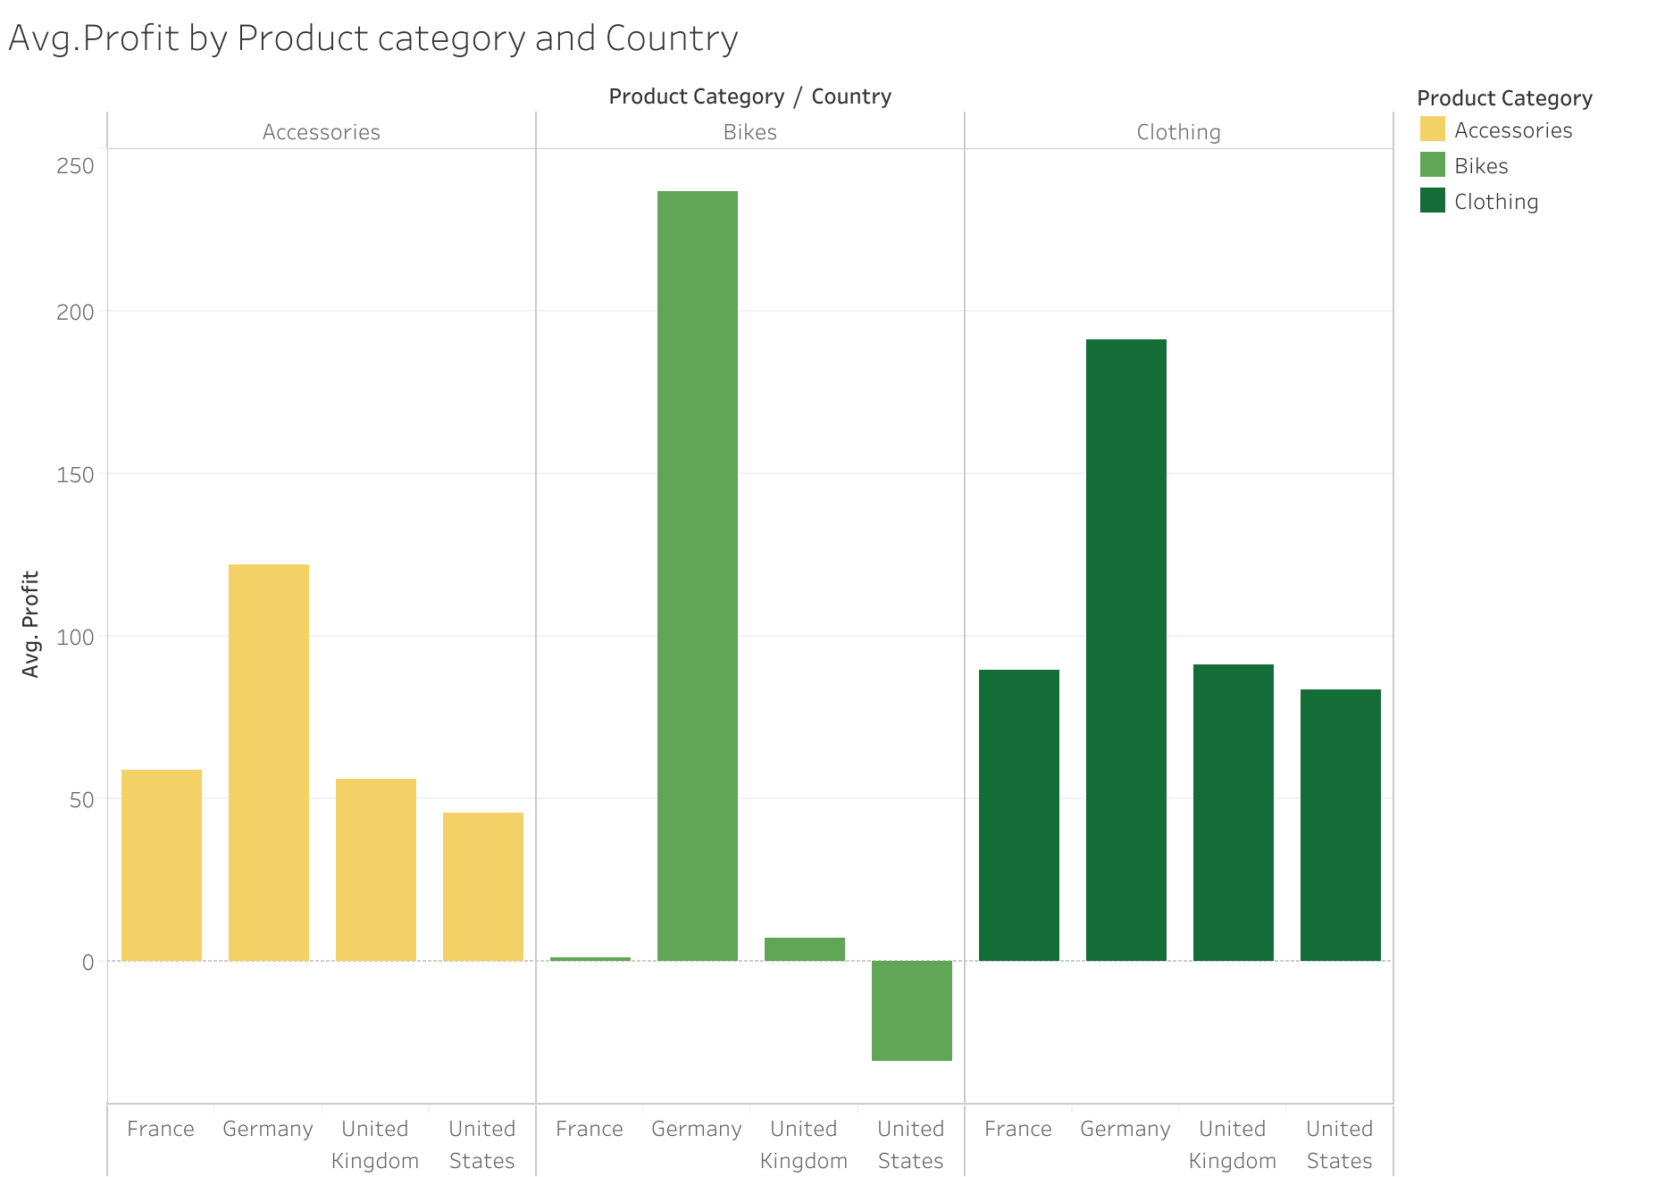
Notes:
However, when we look at the average profit of each product category.
- It can be seen that clothing generate the highest profit in most of the countries. Whereas, Bikes is even genrates negative profit in USA. This means that USA faced a high cost of production compared to its total revenue.

Slide 15
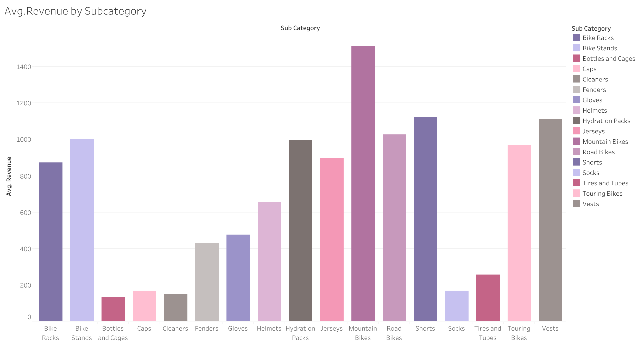

Slide 16
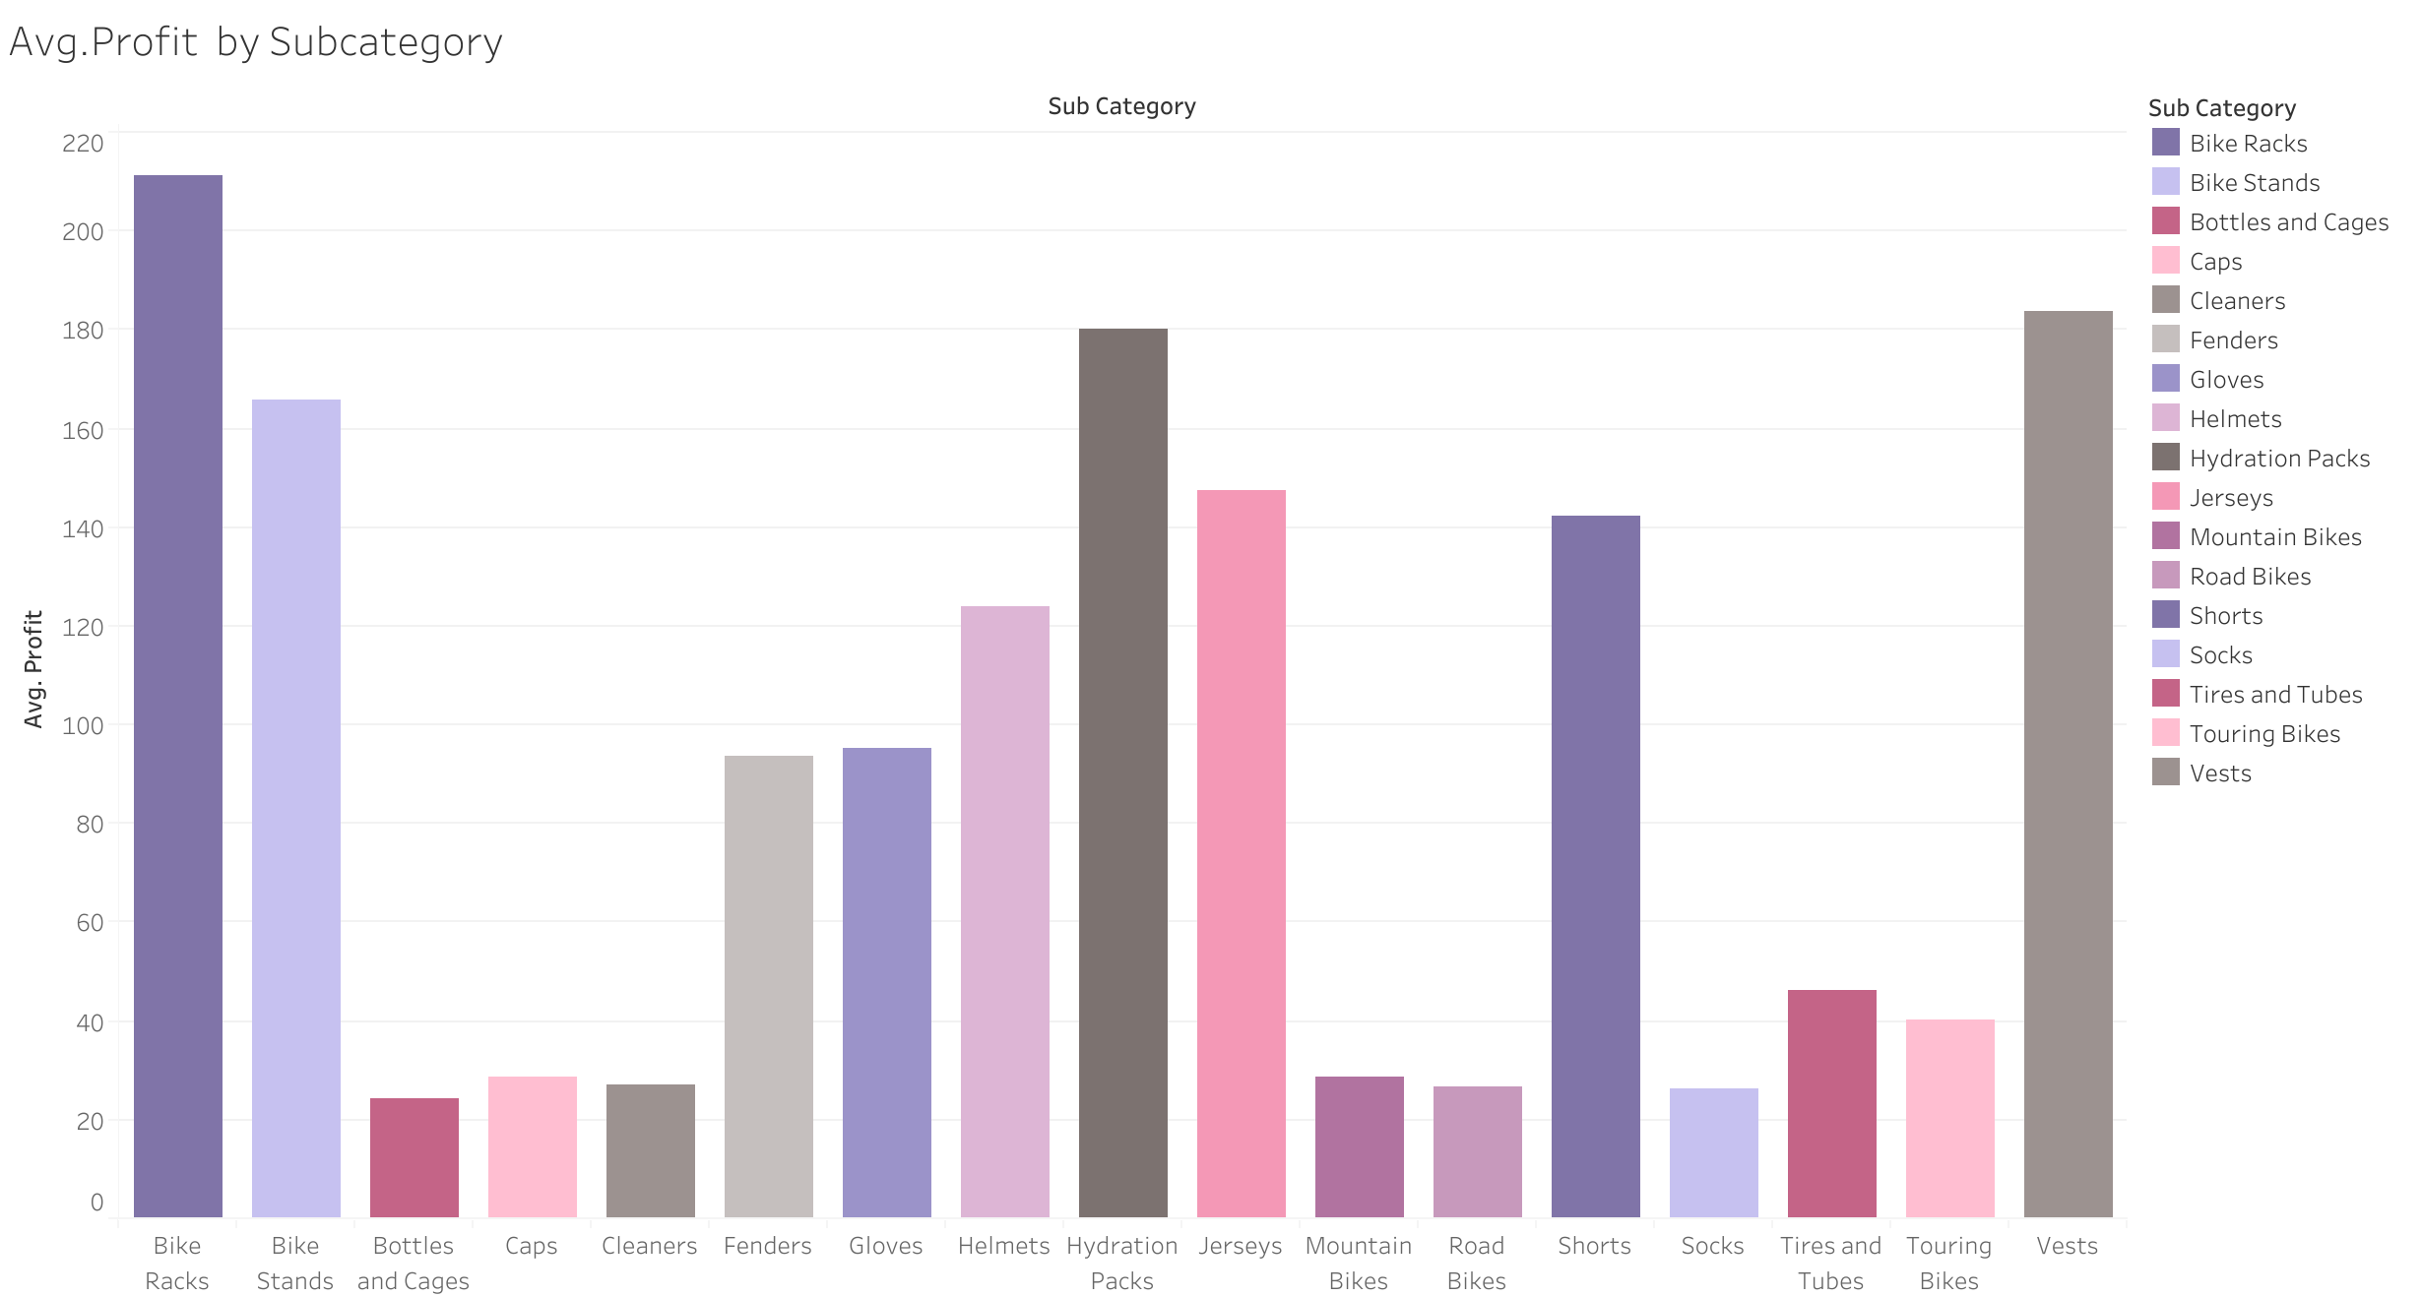

Slide 17
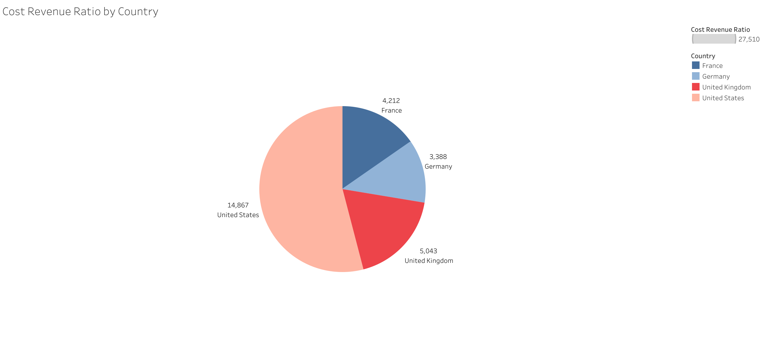
Notes:
To measure the efficiency of this business, we adapt the cost revenue ratio to compare this business expenses’s to its earnings.
- As its shown in this pie chart, USA has a very high ratio of 14,8 which is not a positive sign. This confirm that indeed USA faces a high costs.
- Germany has the lowest ratio of 3,38, which means the company there can produce more revenue with lower costs.

Slide 18
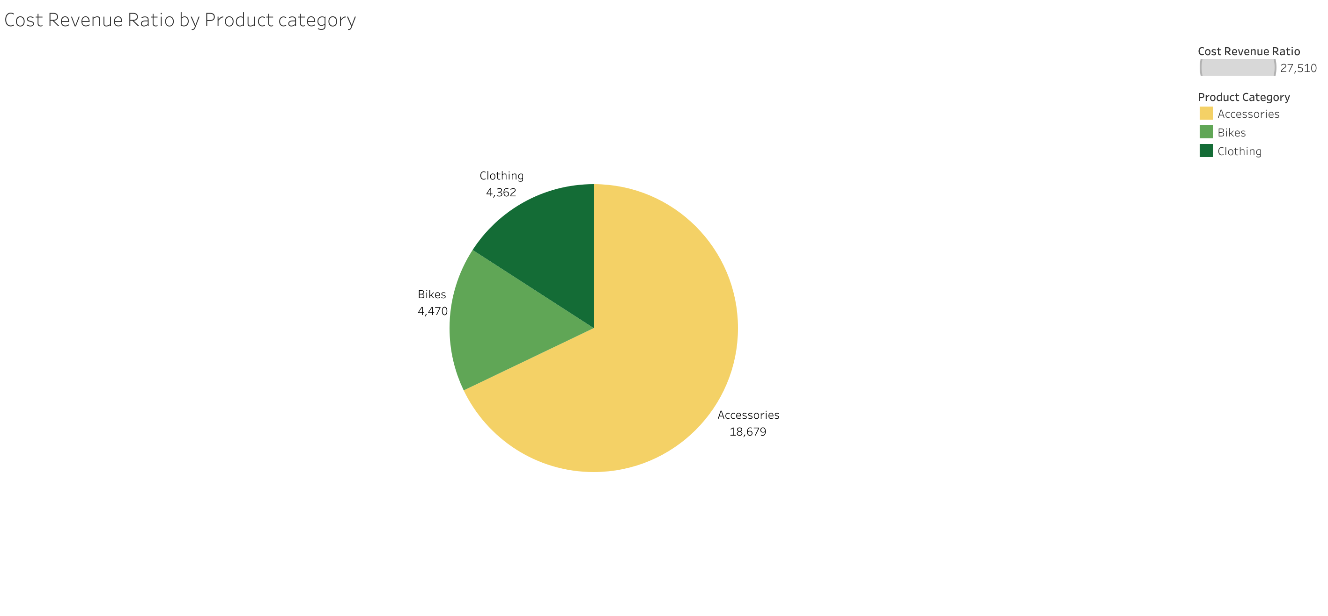
Notes:
Here we want to see which product category has the lowest ratio.
Clothing has the lowest follwed by Bikes.
Accessories seems to have a very high ratio.

Slide 19
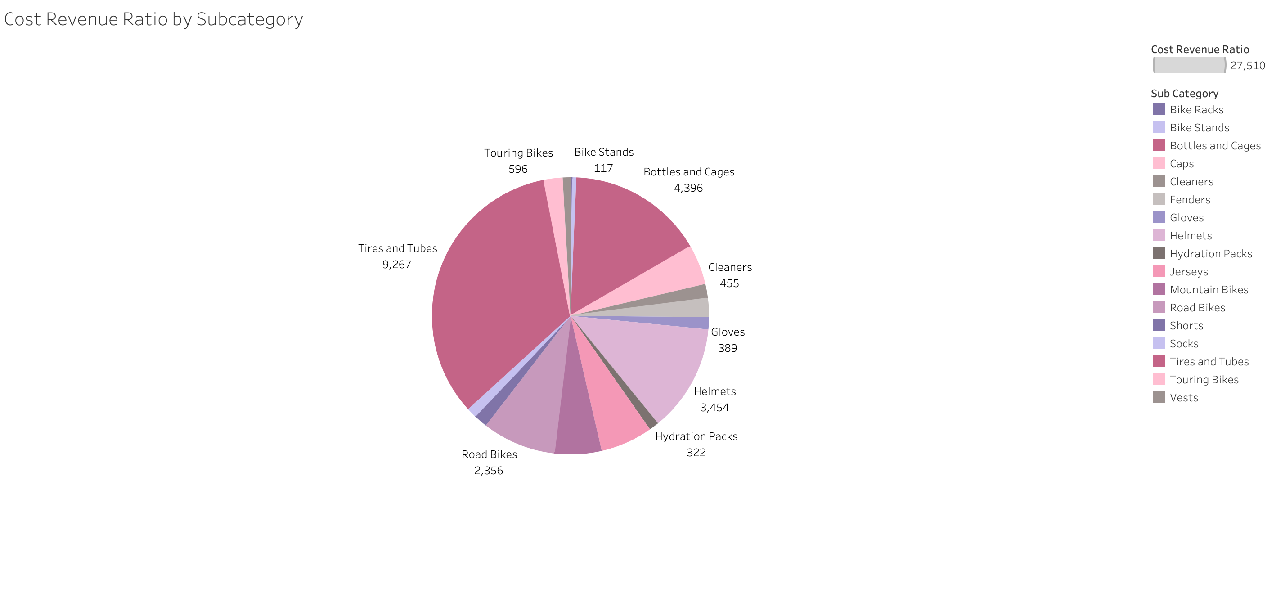
Notes:
Here we can see that Tires & Tubes is the highest subcatogry in terms of the cost revenue ratio, confirming that Accessories has the highest ratio

Slide 20
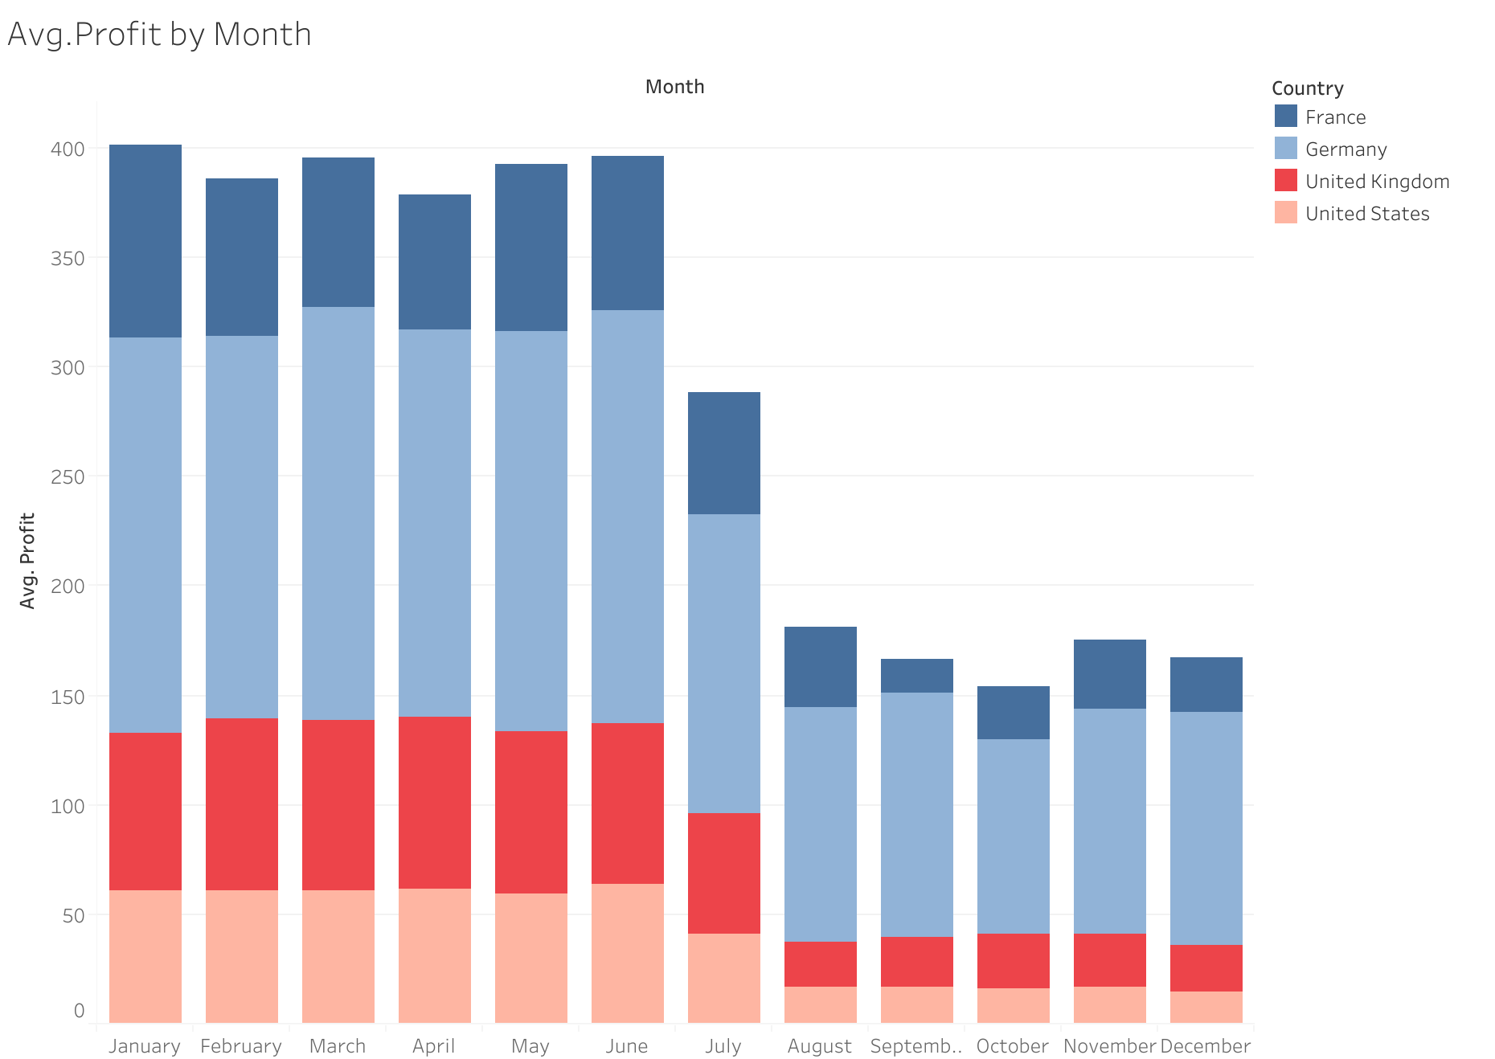
Notes:
Last but not final. This bar chart shows the monthly avg. profit , by which we can take into account the most profitable months.
The beginning of the year until July the company generate more profit that at the end of the year (from Aug to December)
That can be attributed to the fact that this type of products seems to be cheaper in winter (most of the companies offer discounts at this time to increase the purchase)

Slide 21
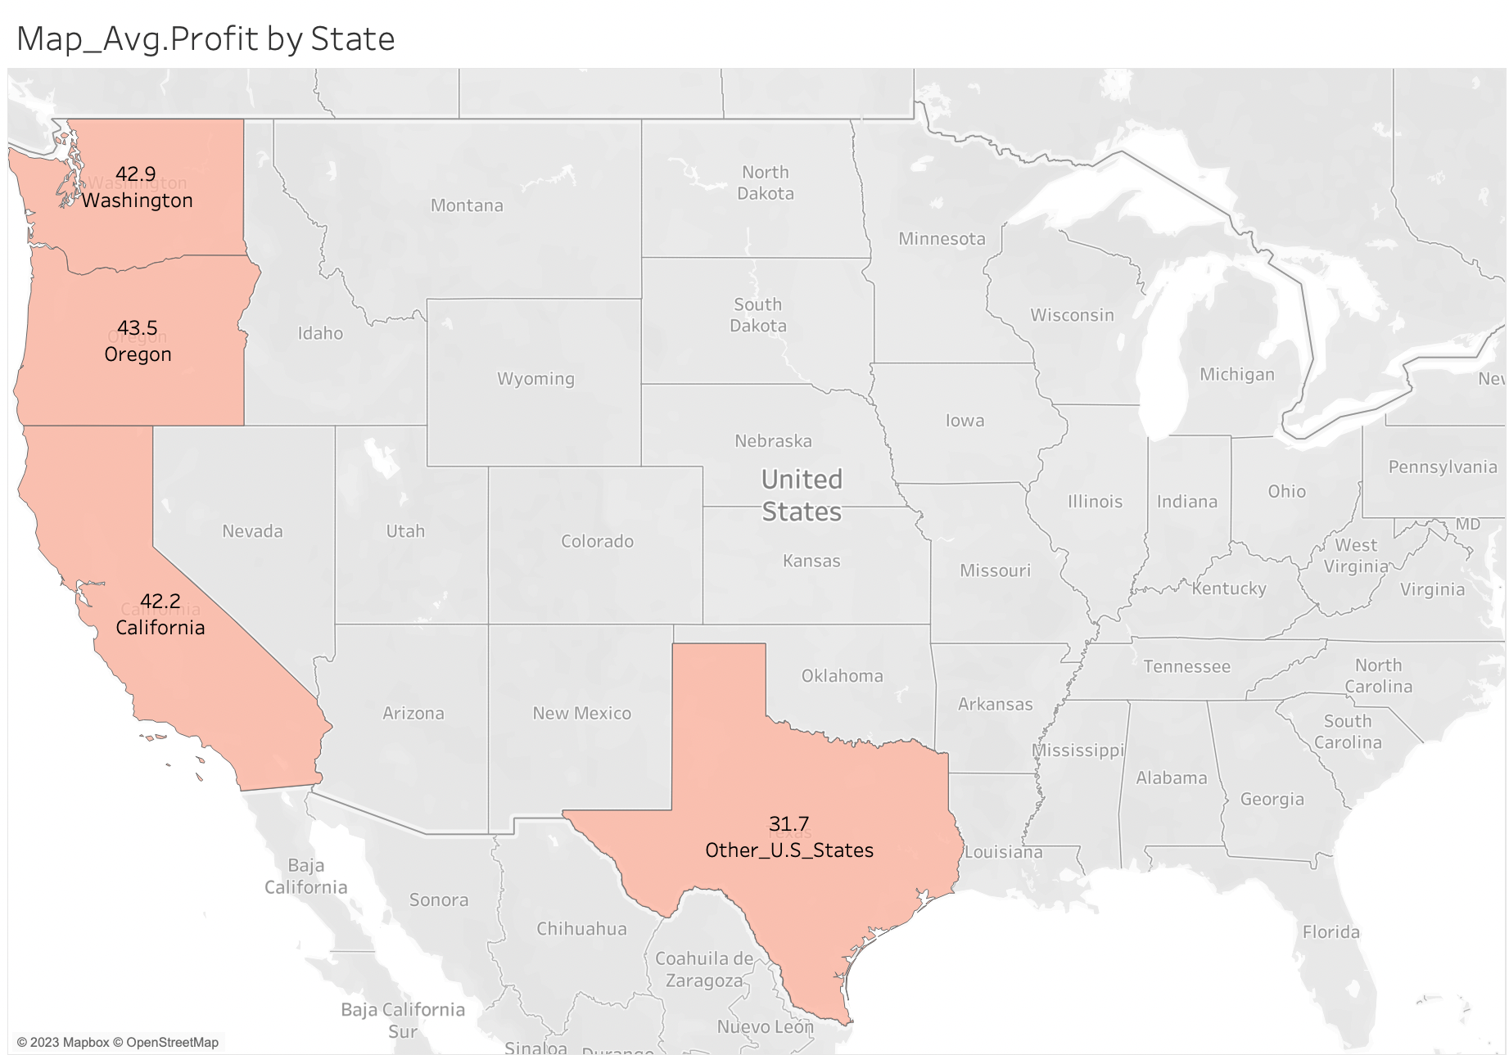
Average Profit by State
Notes:
Lastly, this map show the avg.profit by different states in USA.

Slide 22
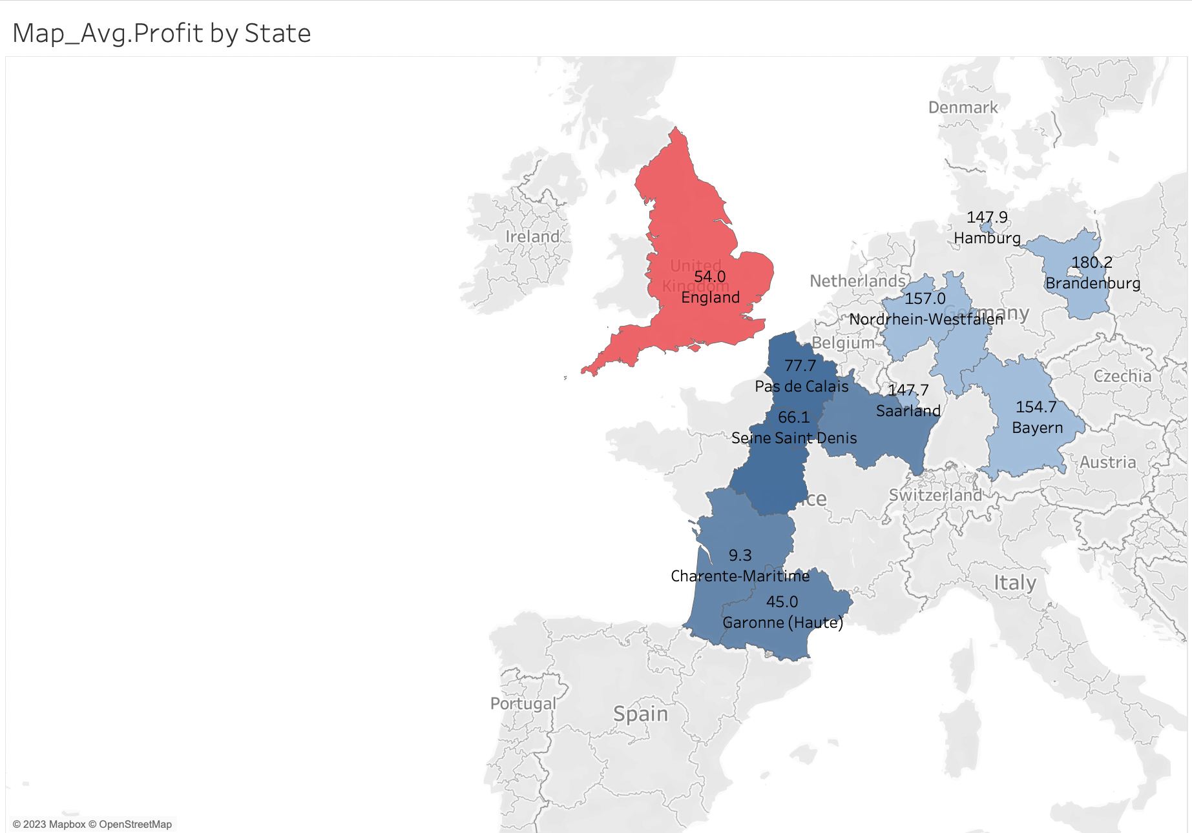
Average Profit by State
Notes:
The avg.profit by different states in Germany, France and the UK

Slide 23
Conclusion & Recommendations
This business operate differently in each country and is there is indeed differences in the customer spendings patterns in each country.
The company should reconsider the decision of continue running the business in USA.
Focusing on Clothing sales would be more beneficial, however we cannot conclude that the company should stop selling the other product catogries, due to short time period we considerd.

Slide 24

Thank You

