Slide 1
Pure Maths – Trigonometry II – Applications
International Study Centre
Huddersfield

Slide 2
Contents
Sine Rule & Cosine Rule
Areas of Triangles
Elevation, Depression, Applications
Notes:
Define positive and negative numbers
Round decimal places and significant figures
Use the 4 rules with fractions
Solve problems involving decimals and percentages
Evaluate standard form
Solve Percentage increase and decrease
Evaluate Profit and loss
Explain Value Added Tax (VAT)
Interpret simple and compound interest
Solve problems involving ratios and proportion

Slide 3
Contents
Sine and Cosine Rule
Areas of triangles
Elevation/Depression/Applications
Notes:
Define positive and negative numbers
Round decimal places and significant figures
Use the 4 rules with fractions
Solve problems involving decimals and percentages
Evaluate standard form
Solve Percentage increase and decrease
Evaluate Profit and loss
Explain Value Added Tax (VAT)
Interpret simple and compound interest
Solve problems involving ratios and proportion

Slide 4
Sine and cosine rule
A Triangle having a two sides joining at 90 degrees is a right angled triangle
Hypotenuse
Opposite
Adjacent

Slide 5

Sin Rule
$\frac{a}{\sin{A}}=\frac{b}{\sin{B}}$= $\frac{c}{\sin{C}}$

Slide 6
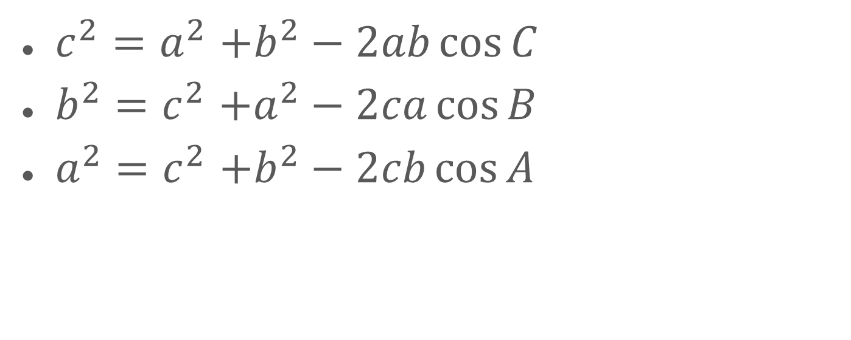
Cosine Rule
$c^{2}{=a}^{2}+b^{2}−2ab\cos{C}$
$b^{2}{=c}^{2}+a^{2}−2ca\cos{B}$
$a^{2}{=c}^{2}+b^{2}−2cb\cos{A}$

Slide 7
Any Questions?
Let’s do a mini-quiz..[2]

Slide 8
Contents
Sine and cosine rule
Areas of Triangles
Elevation/Depression/Application
Notes:
Define positive and negative numbers
Round decimal places and significant figures
Use the 4 rules with fractions
Solve problems involving decimals and percentages
Evaluate standard form
Solve Percentage increase and decrease
Evaluate Profit and loss
Explain Value Added Tax (VAT)
Interpret simple and compound interest
Solve problems involving ratios and proportion

Slide 9

Area of Triangles
$\sqrt{s\left(s−a\right)(s−b)(s−c)}$
$s=\frac{a+b+c}{2}$
$\frac{1}{2}ab\sin{C}$

Slide 10
Any Questions?
Let’s do a mini-quiz..[4]

Slide 11
Contents
Sine and Cosine rule
Areas of Triangle
Elevation/Depression/Applications
Notes:
Define positive and negative numbers
Round decimal places and significant figures
Use the 4 rules with fractions
Solve problems involving decimals and percentages
Evaluate standard form
Solve Percentage increase and decrease
Evaluate Profit and loss
Explain Value Added Tax (VAT)
Interpret simple and compound interest
Solve problems involving ratios and proportion

Slide 12

Elevation and Depression
Elevation
Reference horizon
Depression
Notes:
Define positive and negative numbers
Round decimal places and significant figures
Use the 4 rules with fractions
Solve problems involving decimals and percentages
Evaluate standard form
Solve Percentage increase and decrease
Evaluate Profit and loss
Explain Value Added Tax (VAT)
Interpret simple and compound interest
Solve problems involving ratios and proportion

Slide 13
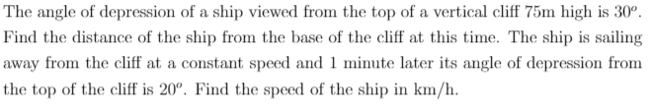
Application
Notes:
Define positive and negative numbers
Round decimal places and significant figures
Use the 4 rules with fractions
Solve problems involving decimals and percentages
Evaluate standard form
Solve Percentage increase and decrease
Evaluate Profit and loss
Explain Value Added Tax (VAT)
Interpret simple and compound interest
Solve problems involving ratios and proportion

Slide 14
Any Questions?
Let’s do a mini-quiz..[4]

