Slide 1
Pure Maths – Algebra II – Simultaneous and Quadratics
International Study Centre
Huddersfield

Slide 2
Contents
Simultaneous equations
Quadratic equations
Equations with quotients
Notes:
Define positive and negative numbers
Round decimal places and significant figures
Use the 4 rules with fractions
Solve problems involving decimals and percentages
Evaluate standard form
Solve Percentage increase and decrease
Evaluate Profit and loss
Explain Value Added Tax (VAT)
Interpret simple and compound interest
Solve problems involving ratios and proportion

Slide 3
Contents
Simultaneous equations
Quadratic equations
Equations with quotients
Notes:
Define positive and negative numbers
Round decimal places and significant figures
Use the 4 rules with fractions
Solve problems involving decimals and percentages
Evaluate standard form
Solve Percentage increase and decrease
Evaluate Profit and loss
Explain Value Added Tax (VAT)
Interpret simple and compound interest
Solve problems involving ratios and proportion

Slide 4
Methods to solve simultaneous equations
Substitution
Elimination
Matrix (Linear algebra) methods (not applicable at this level)

Slide 5
Any Questions?
Let’s do a mini-quiz..[2]

Slide 6
Contents
Simultaneous equations
Quadratic equations
Equations with quotients
Notes:
Define positive and negative numbers
Round decimal places and significant figures
Use the 4 rules with fractions
Solve problems involving decimals and percentages
Evaluate standard form
Solve Percentage increase and decrease
Evaluate Profit and loss
Explain Value Added Tax (VAT)
Interpret simple and compound interest
Solve problems involving ratios and proportion

Slide 7
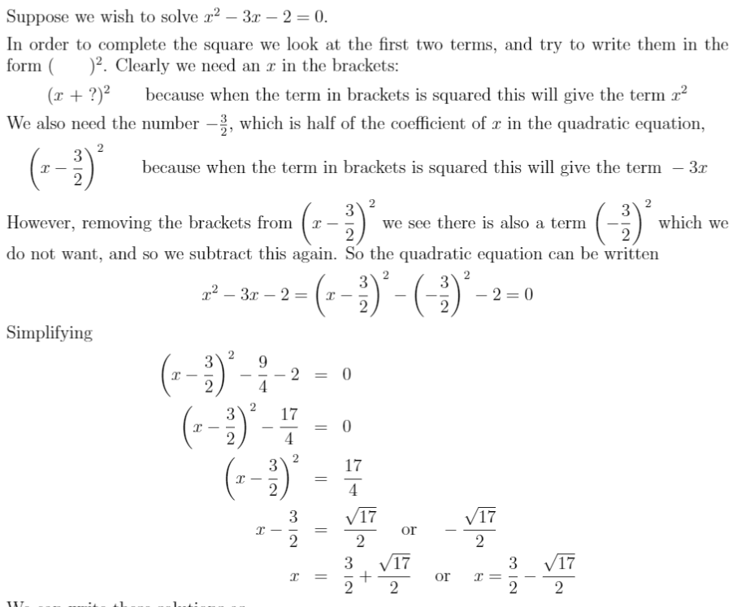
Quadratic Equations Methods
Factorisation
Completing the square
Quadratic formula
Graphing method

Slide 8
Quadratic Equations Methods

Slide 9
Any Questions?
Let’s do a mini-quiz..[4]

Slide 10
Contents
Simultaneous equations
Quadratic equations
Equations with quotients
Notes:
Define positive and negative numbers
Round decimal places and significant figures
Use the 4 rules with fractions
Solve problems involving decimals and percentages
Evaluate standard form
Solve Percentage increase and decrease
Evaluate Profit and loss
Explain Value Added Tax (VAT)
Interpret simple and compound interest
Solve problems involving ratios and proportion

Slide 11
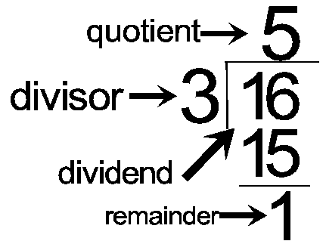
Equations with Quotients
Notes:
Define positive and negative numbers
Round decimal places and significant figures
Use the 4 rules with fractions
Solve problems involving decimals and percentages
Evaluate standard form
Solve Percentage increase and decrease
Evaluate Profit and loss
Explain Value Added Tax (VAT)
Interpret simple and compound interest
Solve problems involving ratios and proportion

Slide 12
Any Questions?
Let’s do a mini-quiz..[4]

