Slide 1
Pure Maths – Trigonometry I – Ratios and Radians
International Study Centre
Huddersfield

Slide 2
Contents
Pythagoras Theorem
Trigonometric Ratios
Radian measurement
Notes:
Define positive and negative numbers
Round decimal places and significant figures
Use the 4 rules with fractions
Solve problems involving decimals and percentages
Evaluate standard form
Solve Percentage increase and decrease
Evaluate Profit and loss
Explain Value Added Tax (VAT)
Interpret simple and compound interest
Solve problems involving ratios and proportion

Slide 3
Contents
Pythagoras Theorem
Trigonometric ratios
Measurement of Radians
Notes:
Define positive and negative numbers
Round decimal places and significant figures
Use the 4 rules with fractions
Solve problems involving decimals and percentages
Evaluate standard form
Solve Percentage increase and decrease
Evaluate Profit and loss
Explain Value Added Tax (VAT)
Interpret simple and compound interest
Solve problems involving ratios and proportion

Slide 4
Right-angled triangle
A Triangle having a two sides joining at 90 degrees is a right angled triangle
Hypotenuse
Opposite
Adjacent

Slide 5
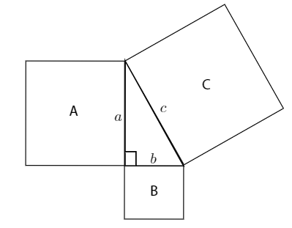
Pythagoras theorem

Slide 6

Pythagoras theorem
$a^{2}+b^{2}=c^{2}$ (for right angled triangles)

Slide 7
Any Questions?
Let’s do a mini-quiz..[2]

Slide 8
Contents
Pythagoras Theorem
Trigonometric Ratios
Radian measurement
Notes:
Define positive and negative numbers
Round decimal places and significant figures
Use the 4 rules with fractions
Solve problems involving decimals and percentages
Evaluate standard form
Solve Percentage increase and decrease
Evaluate Profit and loss
Explain Value Added Tax (VAT)
Interpret simple and compound interest
Solve problems involving ratios and proportion

Slide 9
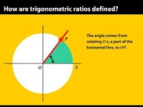
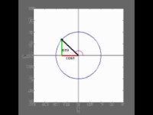
Trigonometric Ratios

Slide 10
Any Questions?
Let’s do a mini-quiz..[4]

Slide 11
Contents
Simultaneous equations
Quadratic equations
Equations with quotients
Notes:
Define positive and negative numbers
Round decimal places and significant figures
Use the 4 rules with fractions
Solve problems involving decimals and percentages
Evaluate standard form
Solve Percentage increase and decrease
Evaluate Profit and loss
Explain Value Added Tax (VAT)
Interpret simple and compound interest
Solve problems involving ratios and proportion

Slide 12
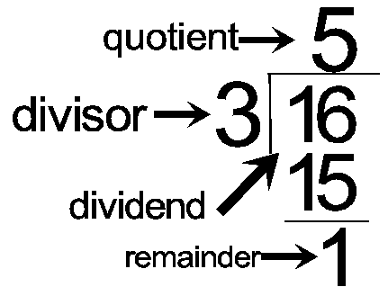
Equations with Quotients
Notes:
Define positive and negative numbers
Round decimal places and significant figures
Use the 4 rules with fractions
Solve problems involving decimals and percentages
Evaluate standard form
Solve Percentage increase and decrease
Evaluate Profit and loss
Explain Value Added Tax (VAT)
Interpret simple and compound interest
Solve problems involving ratios and proportion

Slide 13
Any Questions?
Let’s do a mini-quiz..[4]

