Slide 1
PHYSICS 272
Electric & Magnetic Interactions
Lecture 27
(last lecture)
Electromagnetic Waves and Radiation [Chap 24]

Slide 2
A Few Reminders
Final Exam: 12/13 Tuesday 3:20-5:20 STEW 183
  Special accommodation students: Phys Rm 203 3:20pm
  Students with conflicts: contact me asap by email the plan is to have the exam at 8:30am on Wednesday the 14th
  Equation sheet will be provided/posted
Exam will be 20 multiple choice questions
There will be recitation and lab this week; the lab will be review with some final practice problems

Slide 3
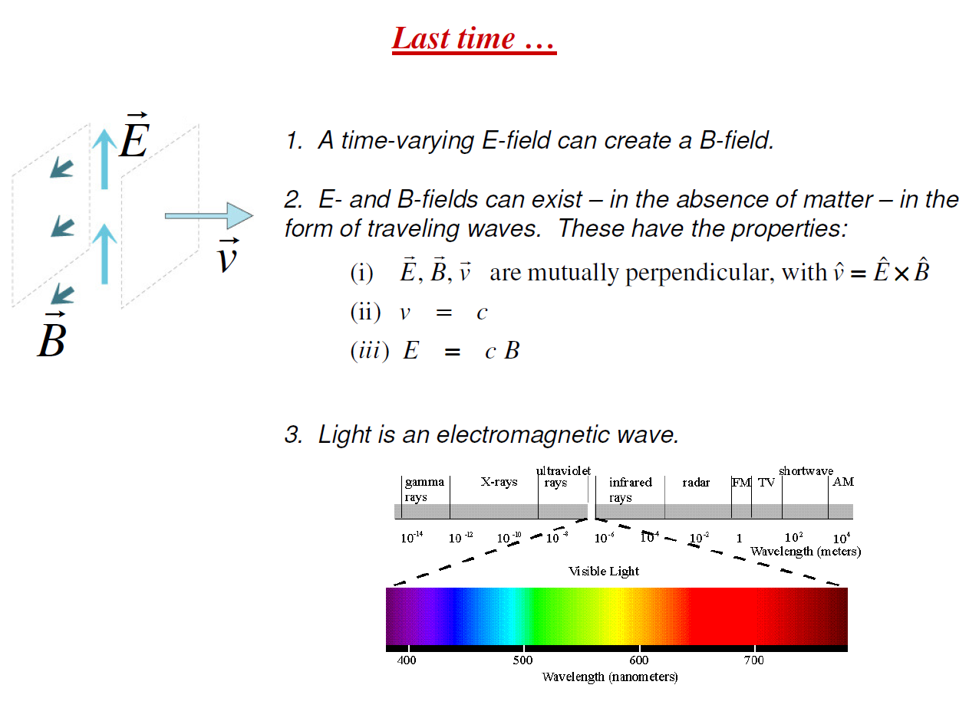
Summary

Slide 4
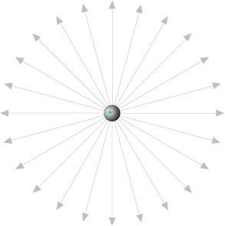
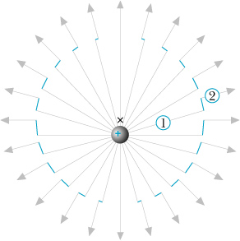
There is a “kink” in the E-field and it travels out in all directions at the speed of light
r = ct

Slide 5
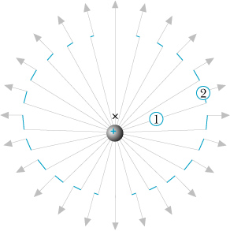
At t = r/c, observer 2 detects a sideways (“transverse”) E-field
The associated B-field points out of the page on the right, and
into the page on the left.

Slide 6
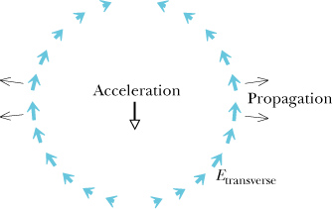
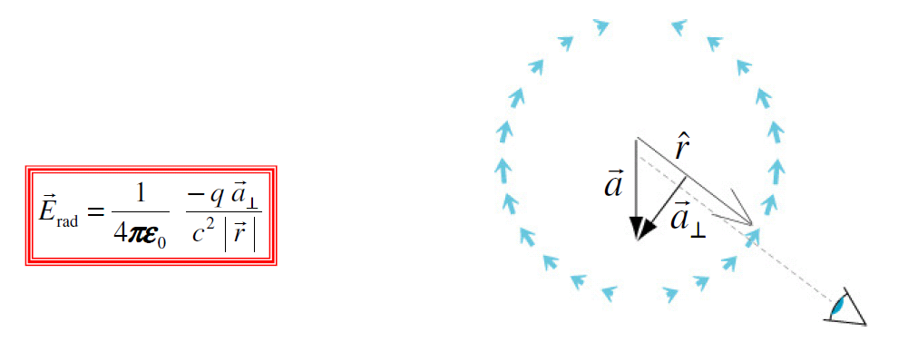
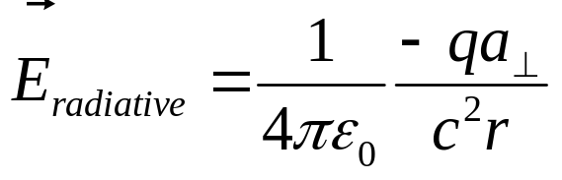
Ordinary B-field
.
x
B = 0
The derivation* is given in 24.11
1. The direction of the field is opposite to qa⊥
2. The electric field falls off at a rate 1/r

Slide 7
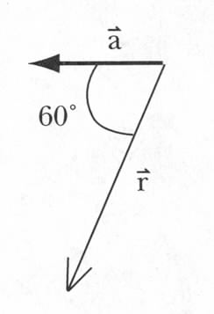


Exercise
a⊥
An electron is briefly accelerated in the direction shown. Draw the electric and magnetic vectors of radiative field.
E
B
1. The direction of the field is opposite to qa⊥
2. The direction of propagation is given by
Notes:
Derivation is too complex for this course
Kink in the electric field
Much slower than 1/r² – makes it possible to affect matter that is very far from the accelerated charges – that is why we see very distant stars.
Quali

Slide 8
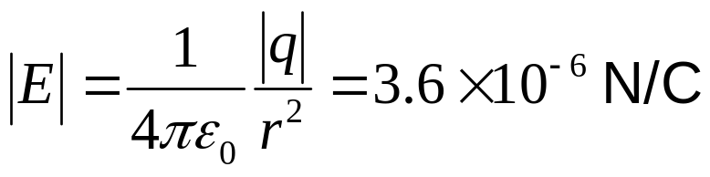
Exercise
An electric field of 10⁶ N/C acts on an electron for a short time. What is the magnitude of electric field observed 2 cm away?
E=10⁶ N/C
B
2 cm
1. Acceleration a=F/m=qE/m=1.78.10¹⁷ m/s²
a
E_{rad}
2. The direction of the field is opposite to qa⊥
3. The magnitude:
E=1.44.10⁻⁷ N/C
4. The direction of propagation is given by
What is the magnitude of the Coulomb field at the same location?
Notes:
Derivation is too complex for this course
Kink in the electric field
Much slower than 1/r² – makes it possible to affect matter that is very far from the accelerated charges – that is why we see very distant stars.
Quali

Slide 9
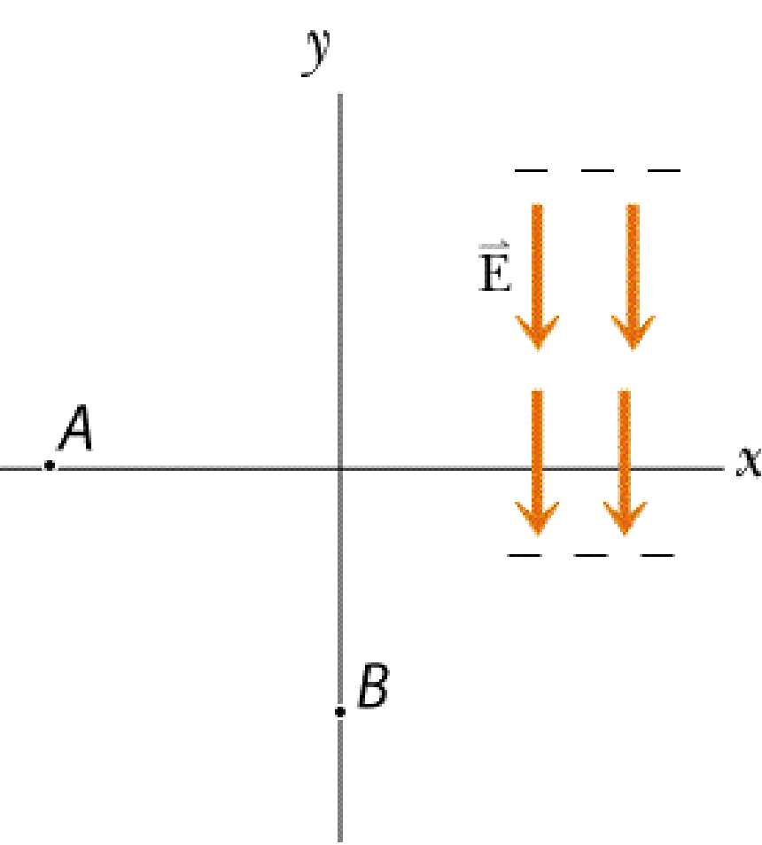
Clicker Question 1
A narrow collimated pulse of radiation propagates in the -x direction. There is an electron at location A. What is the direction of the radiative electric field observed at location B?
A
B
D
C
e⁻
Notes:
B

Slide 10
Clicker Question 1
A narrow collimated pulse of radiation propagates in the -x direction. There is an electron at location A. What is the direction of the radiative electric field observed at location B?
A
B
D
C
e⁻
B

Slide 11
Clicker Question 2
A proton is briefly accelerated as shown below. What is the direction of the radiative magnetic field that will be detected at location A?
A
A) into the page
B) out of the page
C) not enough information
+

Slide 12
Clicker Question 2
A proton is briefly accelerated as shown below. What is the direction of the radiative magnetic field that will be detected at location A?
A
A) into the page
B) out of the page
C) not enough information
+
A

Slide 13
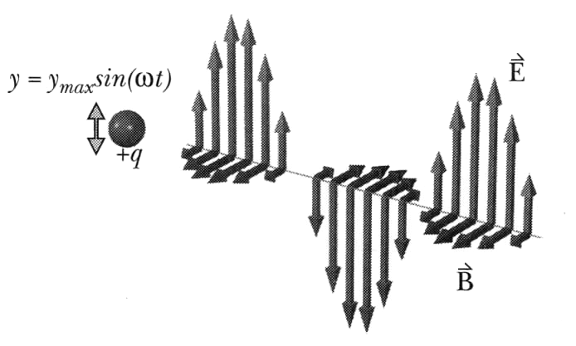
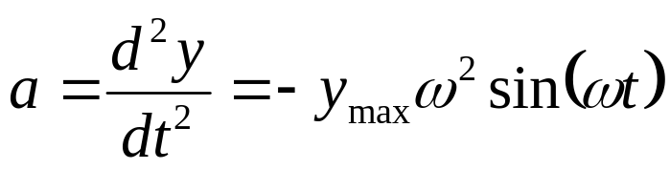
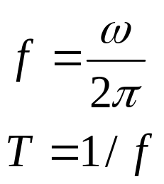
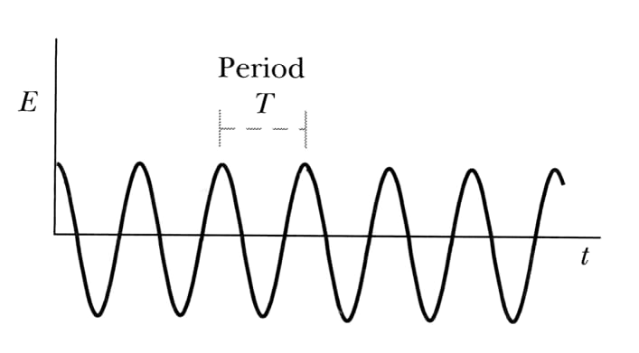
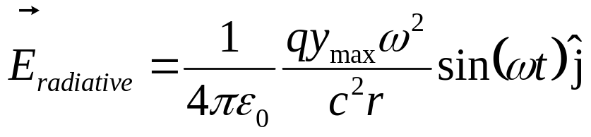
Sinusoidal Electromagnetic Radiation
Acceleration:
Sinusoidal E/M field

Slide 14
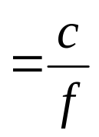

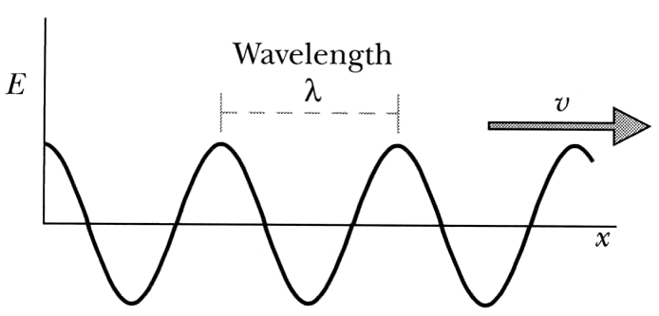
Sinusoidal E/M Radiation: Wavelength
Instead of period can
use wavelength:
Freeze picture in time:
Example of sinusoidal E/M radiation:
atoms
radio stations
E/M noise from AC wires

Slide 15
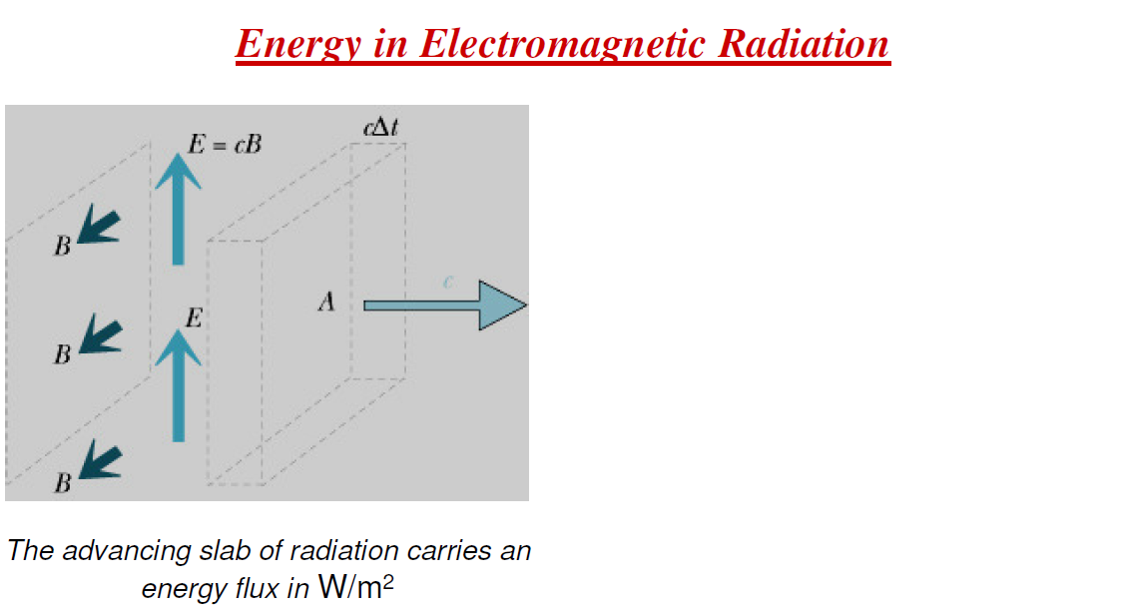
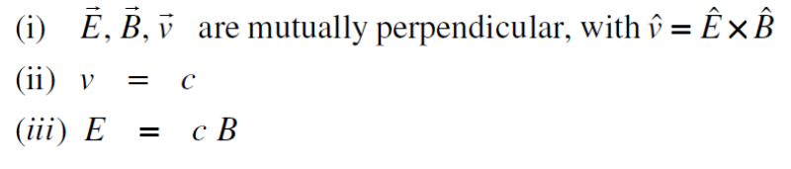
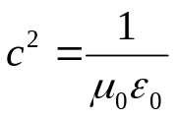
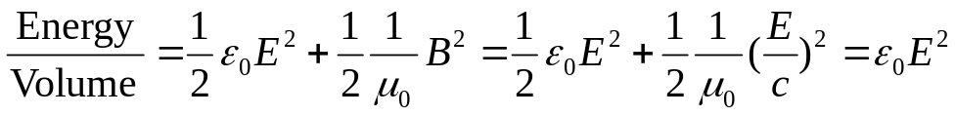
Energy density in E & M fields:

Slide 16


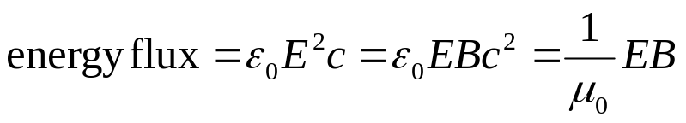
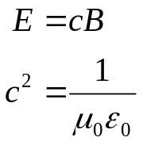
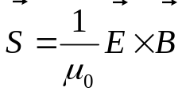
In a time ∆t, a volume
of E & M fields passes through the area A.
The amount of energy is
Define energy flux as J/sec/m²
Define the “Poynting vector”
Its direction is the energy flow direction.

Slide 17
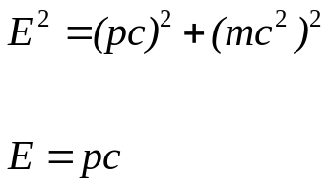
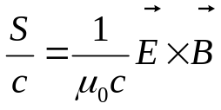
Electromagnetic Radiation Carries Momentum
Einstein’s equation:
For E&M radiation:
Define momentum flux is 1/c times the energy flux given by the Poynting vector
The units of momentum flux are the same as pressure
in N/m²

Slide 18
