Slide 1
Pure Maths – Trigonometry I – Ratios and Radians
International Study Centre
Huddersfield

Slide 2
Contents
Pythagoras Theorem
Trigonometric Ratios
Radian measurement
Notes:
Define positive and negative numbers
Round decimal places and significant figures
Use the 4 rules with fractions
Solve problems involving decimals and percentages
Evaluate standard form
Solve Percentage increase and decrease
Evaluate Profit and loss
Explain Value Added Tax (VAT)
Interpret simple and compound interest
Solve problems involving ratios and proportion

Slide 3
Contents
Pythagoras Theorem
Trigonometric ratios
Measurement of Radians
Notes:
Define positive and negative numbers
Round decimal places and significant figures
Use the 4 rules with fractions
Solve problems involving decimals and percentages
Evaluate standard form
Solve Percentage increase and decrease
Evaluate Profit and loss
Explain Value Added Tax (VAT)
Interpret simple and compound interest
Solve problems involving ratios and proportion

Slide 4
Right-angled triangle
A Triangle having a two sides joining at 90 degrees is a right angled triangle
Hypotenuse
Opposite
Adjacent

Slide 5
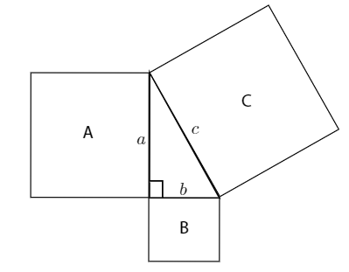
Pythagoras theorem

Slide 6

Pythagoras theorem
$a^{2}+b^{2}=c^{2}$ (for right angled triangles)

Slide 7
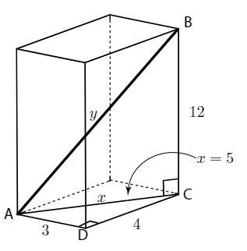
Pythagoras theorem - application
For the cuboid below find the length of the diagonal from the bottom-back corner to the front-top corner.

Slide 8
Any Questions?
Let’s do a mini-quiz..[2]

Slide 9
Contents
Pythagoras Theorem
Trigonometric Ratios
Radian measurement
Notes:
Define positive and negative numbers
Round decimal places and significant figures
Use the 4 rules with fractions
Solve problems involving decimals and percentages
Evaluate standard form
Solve Percentage increase and decrease
Evaluate Profit and loss
Explain Value Added Tax (VAT)
Interpret simple and compound interest
Solve problems involving ratios and proportion

Slide 10
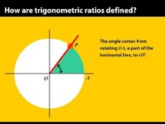
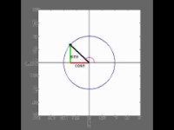
Trigonometric Ratios

Slide 11

Trigonometric Ratios

Slide 12
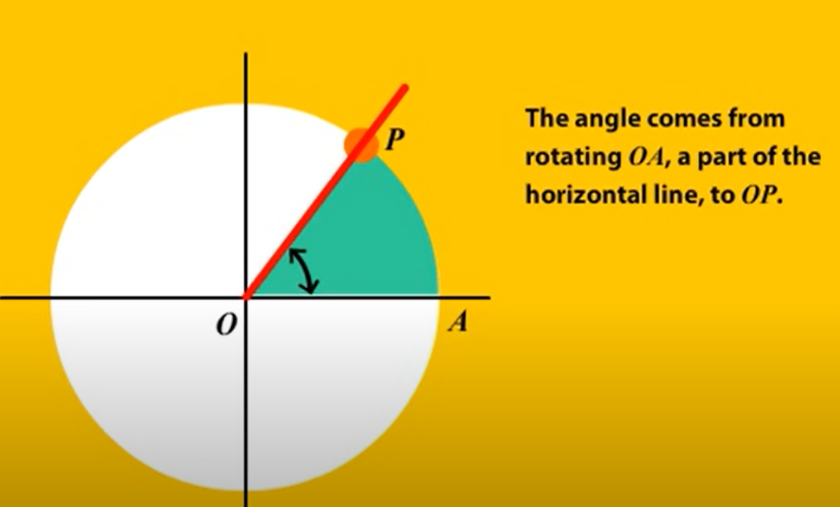
Trigonometric Ratios

Slide 13
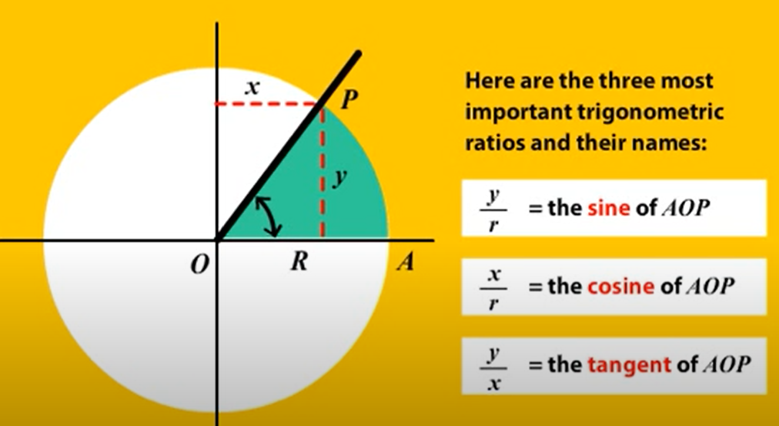
Trigonometric Ratios

Slide 14
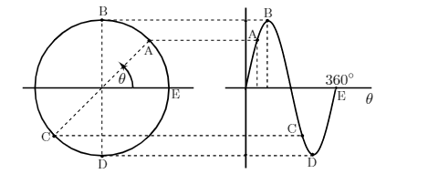
Sine Graph

Slide 15
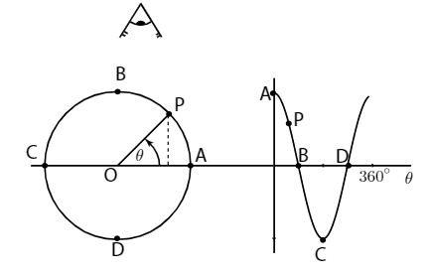
Cosine Graph

Slide 16
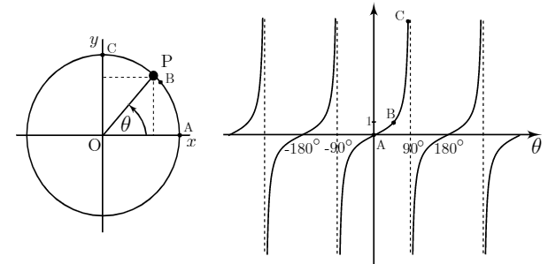
Tangent Graph

Slide 17
Any Questions?
Let’s do a mini-quiz..[4]

Slide 18
Contents
Pythagoras theorem
Trigonometric ratios
Radian measurement
Notes:
Define positive and negative numbers
Round decimal places and significant figures
Use the 4 rules with fractions
Solve problems involving decimals and percentages
Evaluate standard form
Solve Percentage increase and decrease
Evaluate Profit and loss
Explain Value Added Tax (VAT)
Interpret simple and compound interest
Solve problems involving ratios and proportion

Slide 19
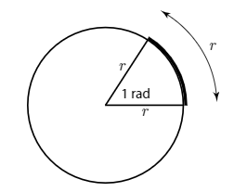
Radian measurement
Notes:
Define positive and negative numbers
Round decimal places and significant figures
Use the 4 rules with fractions
Solve problems involving decimals and percentages
Evaluate standard form
Solve Percentage increase and decrease
Evaluate Profit and loss
Explain Value Added Tax (VAT)
Interpret simple and compound interest
Solve problems involving ratios and proportion

Slide 20
Area of a sector
Notes:
Define positive and negative numbers
Round decimal places and significant figures
Use the 4 rules with fractions
Solve problems involving decimals and percentages
Evaluate standard form
Solve Percentage increase and decrease
Evaluate Profit and loss
Explain Value Added Tax (VAT)
Interpret simple and compound interest
Solve problems involving ratios and proportion

Slide 21
Any Questions?
Let’s do a mini-quiz..[4]

