Slide 1
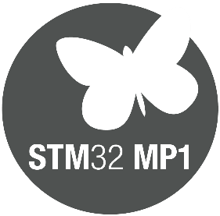
STM32MP1
Coprocessing and scalability from MCU to MPU

Slide 2
Coprocessing Management overview

Slide 3

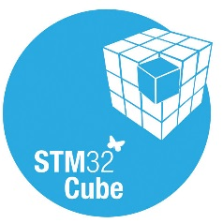
Coprocessing Software Framework
Dual Cortex-A7 @ 650MHz
Cortex-M4 @ 200MHz
application
application
Library from ST
Framework from Community
MCU + Ret. RAM
448kB
OpenAMP
RPMsg
RemoteProc
Mailbox
VirtIO
IPCC

Slide 4
Coprocessing Linux Framework
A list of services are proposed relying on the open-source RemoteProc/RPMsg frameworks and IPCC hardware peripheral:
Load and control Cortex®-M4 firmware by Cortex®-A7
Inter-processor communication based on messages and mailboxes
Resources management
Peripheral assignment to a Core (with access right check)
System resources management (resources that are common to both cores)

Slide 5
Firmware loading
OpenSTLinux load an control the Cortex-M4 firmware execution
The Cortex-M4 firmware is loaded by Cortex-A thanks to services provided by OpenSTLinux RemoteProc framework, uses a resource table to define commun resources (ring buffers and trace buffers).
Firmware is stored in an ELF format file, in OpenSTLinux filesystem /lib/firmware
Load of the firmware is done either :
Automatically when OpenSTLinux has started
Manually at runtime thanks to RemoteProc interface

Slide 6

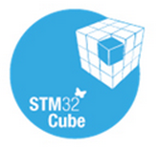
Firmware loading
Legend
3rd Party
ST
Community
Hardware
application
OpenST
Linux
/sys/class/remoteproc/remoteprocX/
Cortex-A
Cortex-M
Step 1: Cortex-M4 Firmware is loaded from the file system. It can be loaded during kernel probe or at runtime by an application using sysfs.
MCUSRAM/RETRAM
Resource table
rproc_core
stm32_rproc
STM32Cube firmware
Step 2: Cortex M4 is clocked and reset is de-asserted to start M4 firmware
RCC

Slide 7


Inter-Processor Communication
Mailbox management is seen as standard protocol (UART, I2C ..)
Dual Cortex-A7 @ 650MHz
Cortex-M4 @ 200MHz
application
application
Library from ST
/dev/ttyRPMSG
virtual_hal_uart
Library from ST
stm32_rpmsg_tty
MCU + Ret. RAM
448kB
Framework from Community
OpenAMP
RPMsg
Mailbox
RemoteProc
IPCC
VirtIO

Slide 8
Shared RAM memory mapping
Cortex-M firmware must start at address 0 of the RETRAM, but can be partially located in MCUSRAM
Cortex-A7 Non-Secure
Cortex-M4
Cortex-A7 Non-Secure
Cortex-M4
MCUSRAM4 (64kB)
DMA buffers
Rev A: SRAM3 (128kB)
Rev B: SRAM3 (64kB) + SRAM4 (64kB)
MCUSRAM3 (64kB)
Inter Process Communication (IPC) buffers
MCUSRAM2 (128kB)
Data
MCUSRAM1 (128kB)
Code
Retention RAM (64kB)
Code & Data
Exception table
Each customer can of course tune this mapping (regions location and sizes) to fit with his product needs

Slide 9
Resources management
Linux system master the resource allocation to M4
OpenSTLinux since beta release for system on A7.M4 seen as a coprocessor.
Masters the resource allocation split between cores (Hw context execution for each IP
For the peripheral allocated to Cortex-M4 ensures reservation of their Clock and GPIOs.
Controls M4 resources (for GPIO, clock config runtime modifications, the M4 asks to A7).

Slide 10
Shared resource configuration set
Whereas some of these resources are instantiated for each core, some other ones, defined as shared resources, are shared by both cores. To avoid contention on these shared resources, they must be controlled by only one core: the Cortex-A which is natively running Linux. The shared resources are:
Clock tree: the clock configuration is managed by the Linux clock framework, the coprocessor is in charge of the clock gating for the peripheral. Not the configuration (frequency)
Pin: the pin configuration is managed by the Linux pinctrl framework. The coprocessor initializes and controls its GPIO and has to declare them to resource manager
Regulator: the power supply is managed by Linux regulator framework.
External interrupt (EXTI): EXTI interrupt is managed by Linux regulartor framework. The coprocessor configures EXTI line and enable the NVIC interrupt. It has to declare its assigned EXTI line(s) to resource manager
The resource configuration service is mainly managed on Cortex-A by Linux. A remote processor shared resource manager (rproc_srm) reserves the shared resources of a peripheral assigned to Cortex-M coprocessor.
Shared resource configurations are based on DeviceTree declaration of shared resource associated to a peripheral

Slide 11

Shared resource configuration set
Legend
3rd Party
ST
Community
Hardware
application
application
HAL_..._MSP
OpenST
Linux
User space
Cortex-A
Cortex-M
Kernel space
rproc_srm_dev
rproc_srm_dev
HAL_Cortex
HAL_GPIO
rproc_srm_dev
HAL_RCC
HAL_XXX
rproc_srm_core
Reserves EXTI interrupts, GPIOs, clock and regulators for Cortex-M XXX peripheral
Configure EXTI
Mask / unmask
EXTI interrupts
Configure & Drive output GPIOs
Enable / disable the peripheral clocks. Cannot change the system clock tree
remoteproc
Hardware
EXTI
Peripheral XXX
GPIO
RCC
PWR

Slide 12
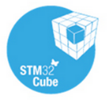
Software Implementation
A7 : Linux Device Tree
M4 : HAL Init
void HAL_I2C_MspInit(I2C_HandleTypeDef *hi2c)
{
…
#if CONFIG_MASTER_MODE
/*##-1- Enable the HSI clock #*/
RCC_OscInitStruct.OscillatorType = RCC_OSCILLATORTYPE_HSI;
RCC_OscInitStruct.HSIState = RCC_HSI_ON;
RCC_OscInitStruct.HSICalibrationValue = RCC_HSICALIBRATION_DEFAULT;
if (HAL_RCC_OscConfig(&RCC_OscInitStruct)!= HAL_OK)
{
/* Error */
while(1);
}
/*##-2- Configure HSI as I2C clock source #*/
RCC_PeriphCLKInitStruct.PeriphClockSelection = RCC_PERIPHCLK_I2Cx;
RCC_PeriphCLKInitStruct.I2c123ClockSelection = RCC_I2CxCLKSOURCE;
HAL_RCCEx_PeriphCLKConfig(&RCC_PeriphCLKInitStruct);
#endif
/*##-3- Enable peripherals and GPIO Clocks #################################*/
/* Enable GPIO TX/RX clock */
I2Cx_SCL_GPIO_CLK_ENABLE();
I2Cx_SDA_GPIO_CLK_ENABLE();
/* Enable I2Cx clock */
I2Cx_CLK_ENABLE();
/*##-4- Configure peripheral GPIO ##########################################*/
HAL_GPIO_Init(I2Cx_SCL_GPIO_PORT, &GPIO_InitStruct);
HAL_GPIO_Init(I2Cx_SDA_GPIO_PORT, &GPIO_InitStruct);
}
@ soc {
i2c1: i2c@40012000 {
compatible = "st,stm32f7-i2c";
status = “disabled";
}
};
@M4_hw_resources {
compatible = "rproc-srm-core";
status = “enable";
M4_IP_I2C@0x400012000 {
compatible = “rproc-srm-dev";
status = “okay";
clocks = <&rcc_clk I2C1_K>;
pinctrl-0 = <i2c1_pins_a>;
};
};
OpenST
Linux
Cortex-A
Cortex-M
System clock tree HSI clocking is handled by Cortex-A7
I2C peripheral drive is disabled on Cortex-A7
I2C peripheral is declared as Cortex-M4 resource and enabled. GPIO and clock used by I2C peripheral are declared.
Clock gating is handled by Cortex-M4
Code generated by STM32CubeMX !
GPIO configuration is handled by Cortex-M4

Slide 13
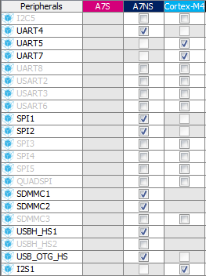
STM32CubeMX Coproc Management
STM32CubeMX ease co-processing System Resource management by generating
OpenSTLinux device tree configuration for resource allocation
Cortex-M4 coprocessor code (as for legacy STM32)

Slide 14
Coproc Management Reset Case
There can be have separate reset for Cortex-A7 et Cortex-M4
Example:
Crash on linux side can reset Cortex-A7 without impacting Cortex-M4

Slide 15
STM32MP1 Coprocessing
Architecture for real time applications
Easy configuration and use of Cortex-M4 inside STM32MP1
STM32 Knowledge and Ecosystem
Notes:
Real time control and monitoring
Deterministic sensor control
Low power applications (i.e. vs. Cortex-A)

Slide 16
Thank you!

