Slide 1
STM32MP1 Workshop Pre-built VM image content

Slide 2
VMware pre-built image content
forwards
This slides explains how to produce a Vmware image from scratch.
Contains the starter, developer packages and the STM32MP1 tools

Slide 3
VMware pre-built image content
Part1 : How to rebuild a VM image from scratch, see the following part1,2,3,4
1/ Get initial Ubuntu 16.04.5 Xenial ubuntu image that will be run by VMware player
We got it from https://www.osboxes.org/ubuntu/
(but now Ubuntu 16.04.5 Xenial is not any more available, take the latest one).
2/ Create a Virtual machine with the ubuntu image downloaded from osboxes.org
Carefully follow the document VMwarePlayerHelp.pdf
https://wiki.st.com/stm32mpu/nsfr_img_auth.php/2/24/VMwarePlayerHelp.pdf
also following document is useful to install VMware tools
https://wiki.st.com/stm32mpu/nsfr_img_auth.php/4/49/PreRequisite-Vmware-tools.pdf
Notes:
Let's start your OpenSTLinux on discovery !

Slide 4
VMware pre-built image content
Part 2:Ubuntu configuration to compile the stm32mp1 software
You have all for this configuration in the section 3 of https://wiki.st.com/stm32mpu/wiki/PC_prerequisites
To be able to compile the ST distribution a set of libraries have to be added to the default Ubuntu machine provide by osboxes.org.
See the slides LinuxHost-Setup-ForStm32mp1.pdf section Linux Host Setup

Slide 5
VMware pre-built image content
Part 3:stm32mp1 software packages
Unzip starter package
install developer package (SDK, sources of Kernel, Uboot, Tf-A, Optee)
For instructions to install all the source code above
see the slides Going-Futher-With-Package.pdf

Slide 6
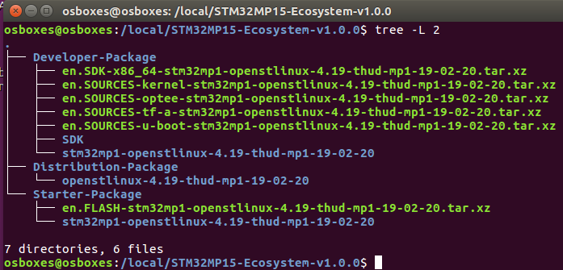
Starter & Developer Packages
VMware pre-built image directory tree
Note : In the terminal window Developer Package path is already defined by $SDK_ROOT in /local/STM32MP15-Ecosystem-v1.0.0/Developer-Package/
SDK Kernel,TF-A,Uboot Source code
Image Flash partitions

Slide 7
VMware pre-built image content
Part 4 : Tools
STM32CubeMX 5.2.0
STM32CubeProgrammer 2.0
AC6 System Workbench for M4 development 2.9.0
To setup the tool please see the Tools section of Linux-Host-Setup-ForStm32mp1.pdf

Slide 8
Thanks

