Slide 1

Customer Shopping Behavior Analysis
Uncovering insights from 3,900 purchases to guide strategic business decisions through data-driven analysis of spending patterns, customer segments, and product preferences.

Slide 2

DATASET OVERVIEW
The Foundation: Our Data
3,900
18
4
Total Purchases
Data Points
Product Categories
Transactions analyzed across all categories
Comprehensive customer and purchase attributes
Clothing, Accessories, Footwear, and Outerwear
Key features include customer demographics (age, gender, location), purchase details (item, category, amount, season), and shopping behavior (discounts, reviews, shipping preferences).

Slide 3
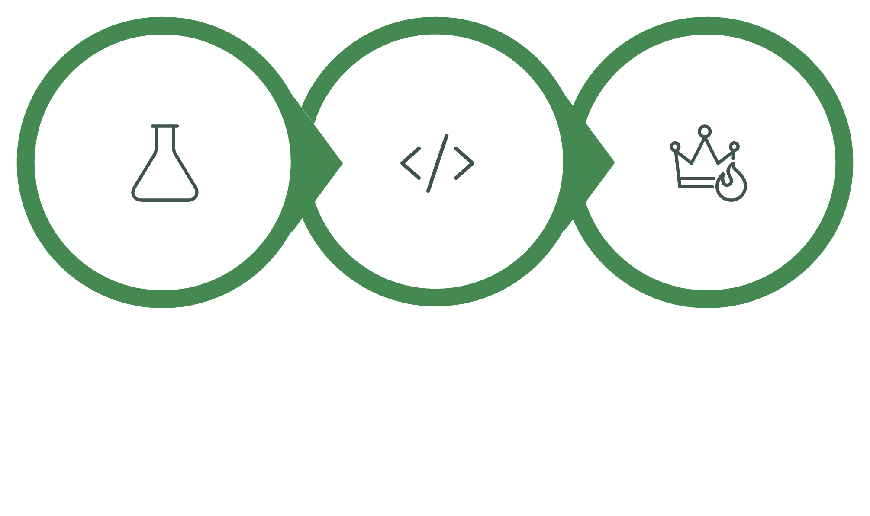
Data Preparation & Analysis Pipeline
Python Cleaning
SQL Analysis
Power BI
Our comprehensive approach combined Python for data preparation, SQL for business intelligence queries, and Power BI for interactive visualization.

Slide 4

Python: Data Cleaning & Engineering
01
Data Loading & Exploration
Imported dataset with pandas, examined structure and summary statistics
02
Missing Data Handling
Imputed 37 missing Review Rating values using median by category
03
Feature Engineering
Created age_group bins and purchase_frequency_days columns
04
Database Integration
Connected to MySQL and loaded cleaned data for SQL analysis

Slide 5
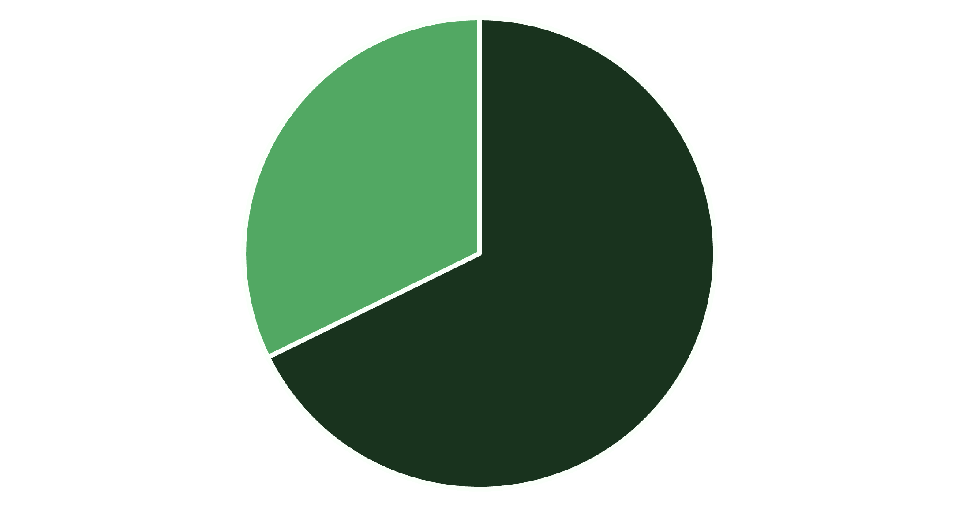
REVENUE INSIGHTS
Gender & Subscription Revenue Analysis
Key Findings
Male customers generated $157,890 in revenue compared to $75,191 from female customers—a 2:1 ratio.
Subscribers and non-subscribers showed similar average spending ($59.49 vs $59.87), but non-subscribers contributed $170,436 total revenue versus $62,645 from subscribers due to volume.
Male
Female

Slide 6

Top Performing Products
Highest Rated Items
Gloves
3.86 average rating
Sandals
3.84 average rating
Boots
3.82 average rating
Hat
3.80 average rating
Skirt
3.78 average rating

Slide 7
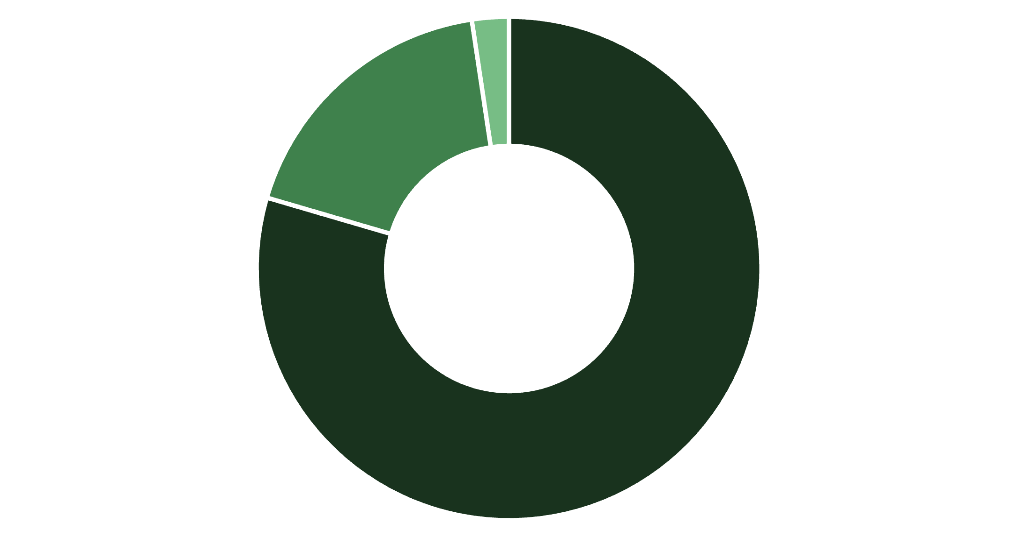
Customer Segmentation Breakdown
Loyalty Dominates
80% of customers are classified as Loyal based on purchase history, with only 2% being new customers. This strong retention indicates effective customer satisfaction strategies.
Loyal
Returning
New

Slide 8
DISCOUNT ANALYSIS
Discount-Dependent Products
50%
49.66%
49.07%
Hat
Sneakers
Coat
Highest discount rate
48.17%
47.37%
Sweater
Pants
These products show the highest percentage of discounted purchases, suggesting price sensitivity in these categories. Interestingly, high-spending customers still purchased above-average amounts even with discounts applied.

Slide 9
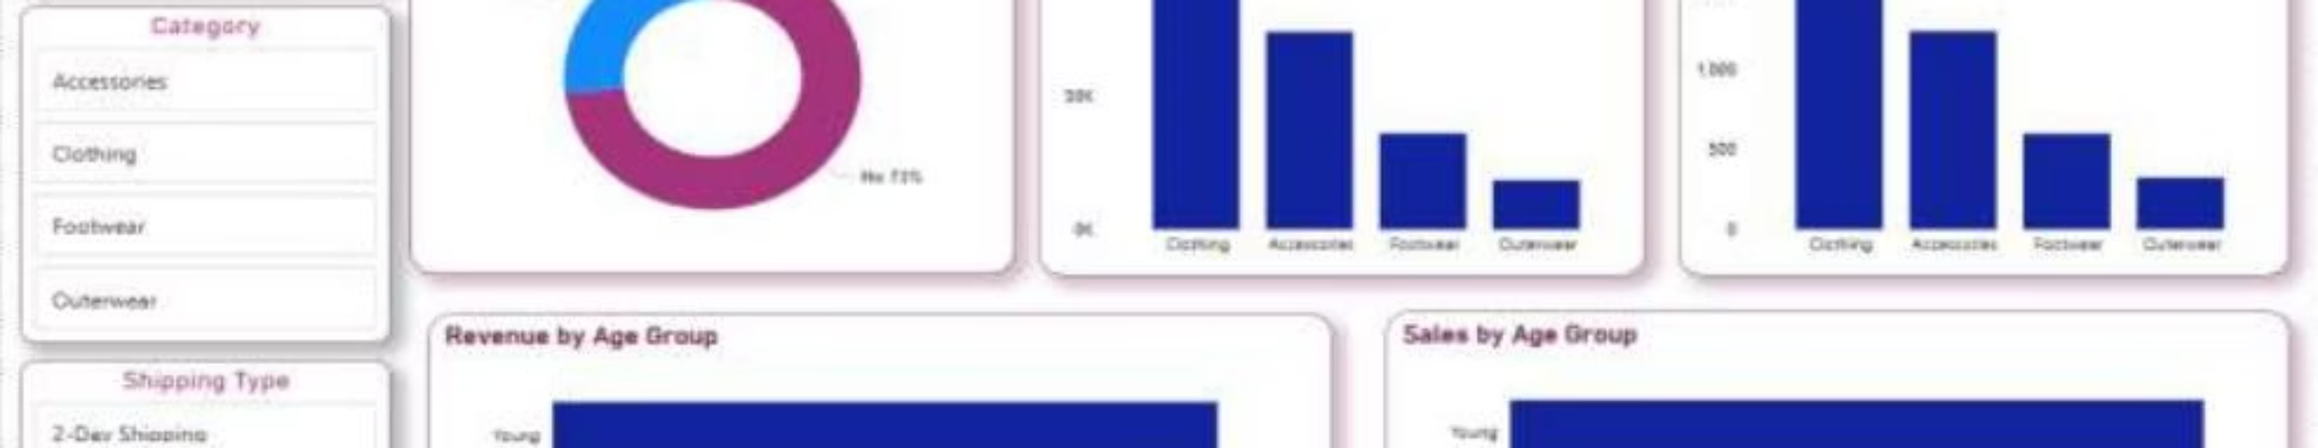
Power BI Dashboard Highlights
$59.76
3.75
27%
Average purchase amount
Average review rating
Subscription rate

Slide 10
Key Takeaways & Strategic Recommendations
Focus on Male Customer Segment
Leverage Loyal Customer Base
Male customers drive 68% of revenue—tailor marketing and product offerings to this demographic
80% customer loyalty presents opportunity for subscription growth and retention programs
Optimize Discount Strategy
Target Young Demographics
Half of Hat and Sneaker purchases use discounts—evaluate pricing strategy for these categories
Young age group leads in both revenue and sales volume across all categories

