Slide 1
Manchester United Analysis 22-23
Deepesh DWIVEDI

Slide 2
Data Sources
Football Manager Scout for players
Kaggle for 22-23 team statistics.
Computed relevant statistics referring from Opta.

Slide 3
Objective
Manchester United astonishingly lack expert scouts.
Suggesting players based on purely computed statistics.
Manchester United have a history of paying enormous amount for incompatible players.

Slide 4
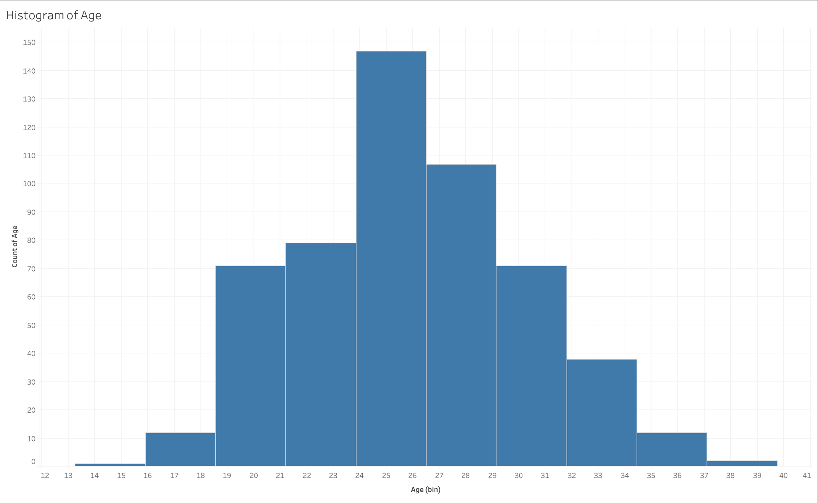
Age Distribution
Mean Age in Europe is between 24-26.
This is the age when players hit their prime.

Slide 5
Manchester United Analysis

Slide 6
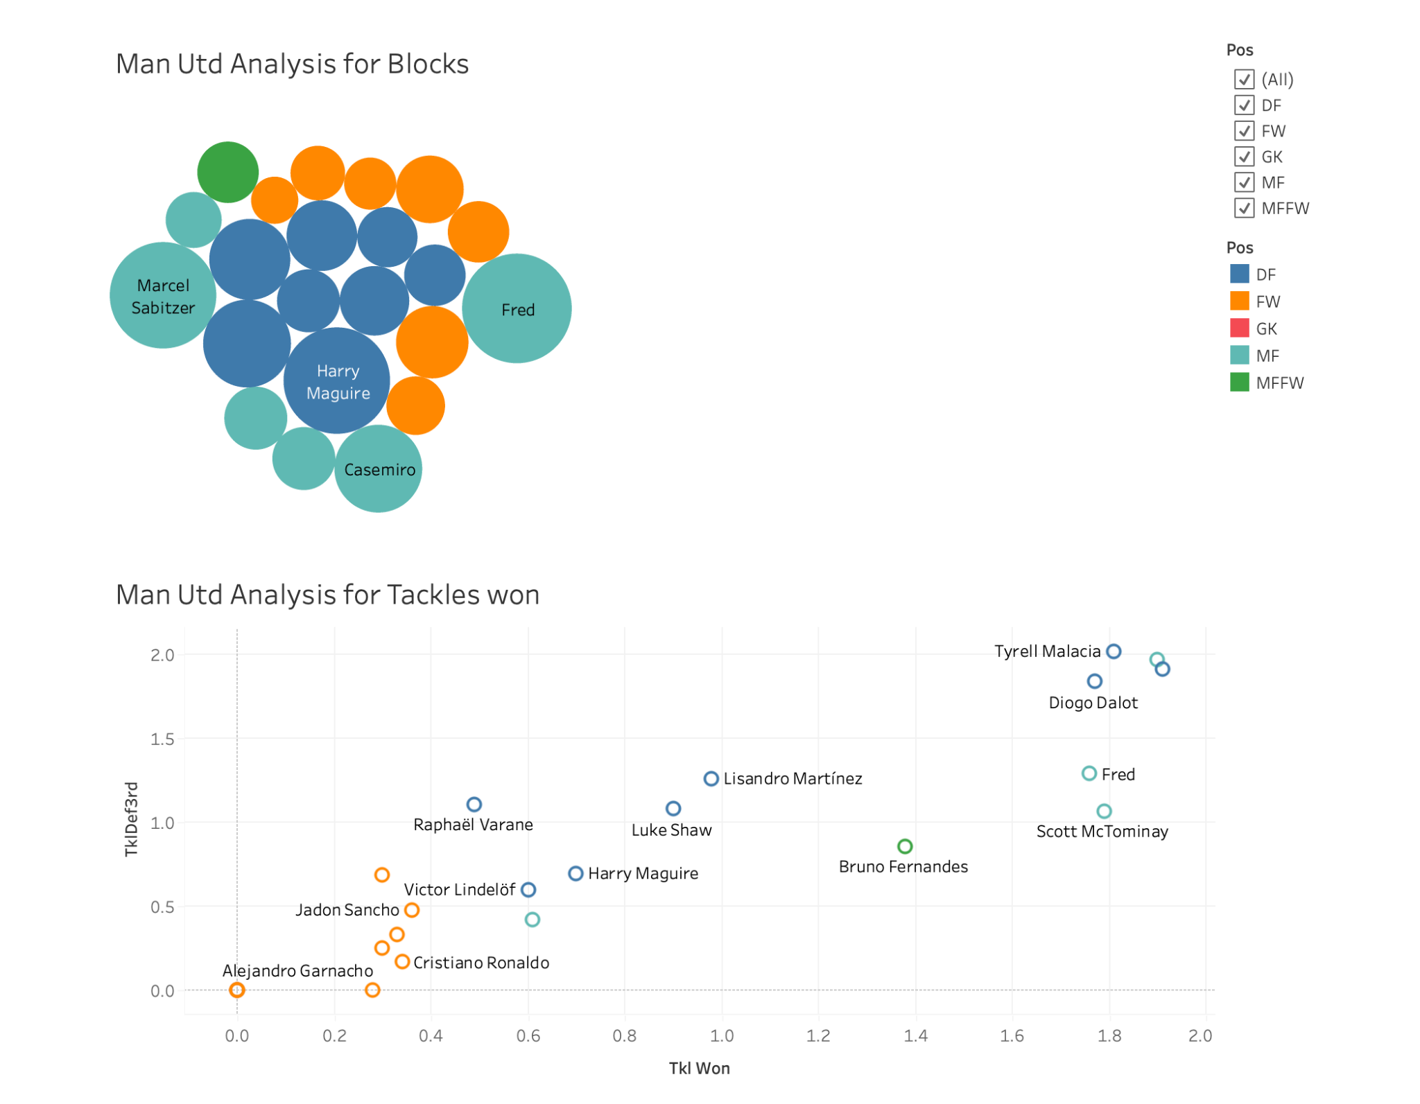
Man Utd Analysis Defense
Dashboard of all players for their defense attributes.
Only 1 defender with significant blocks.

Slide 7
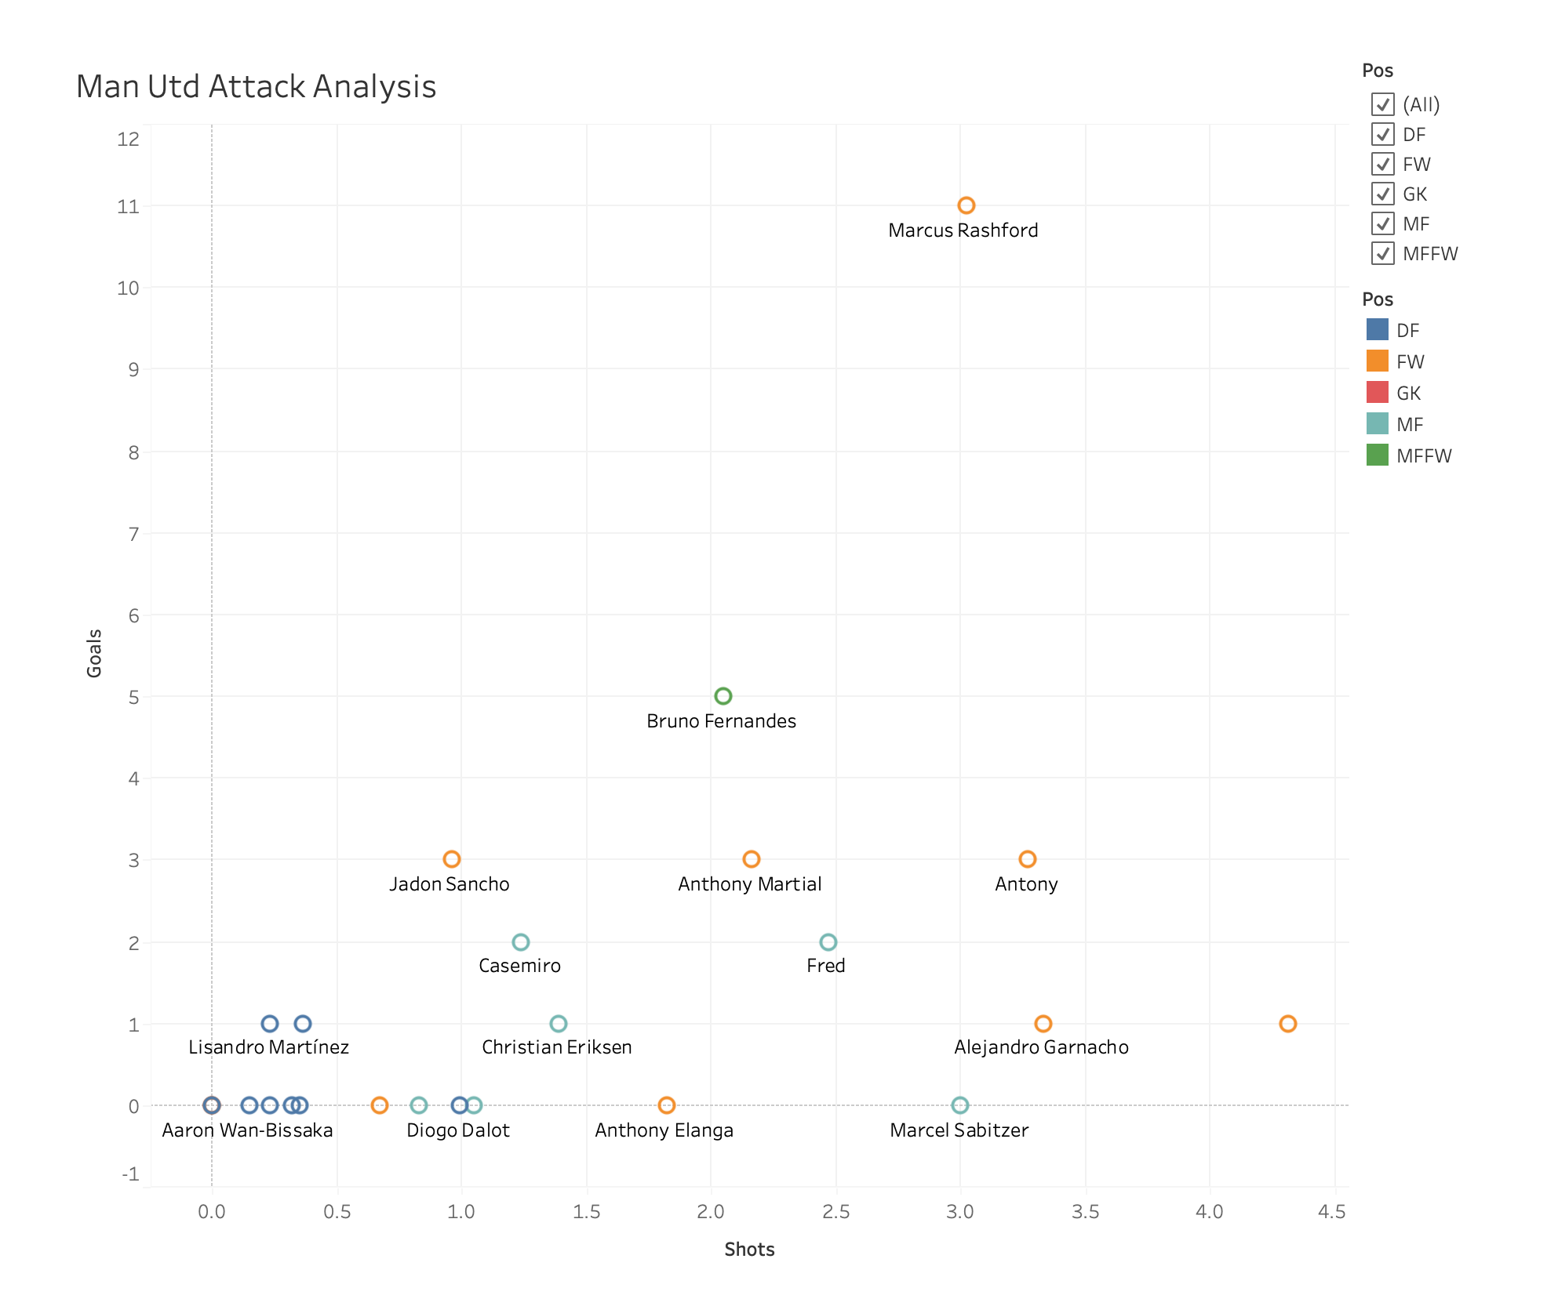
Man Utd Analysis Attack
Marcus Rashford in top notch form.
Still need more clinical goal scoring players.

Slide 8
Competitor Analysis

Slide 9
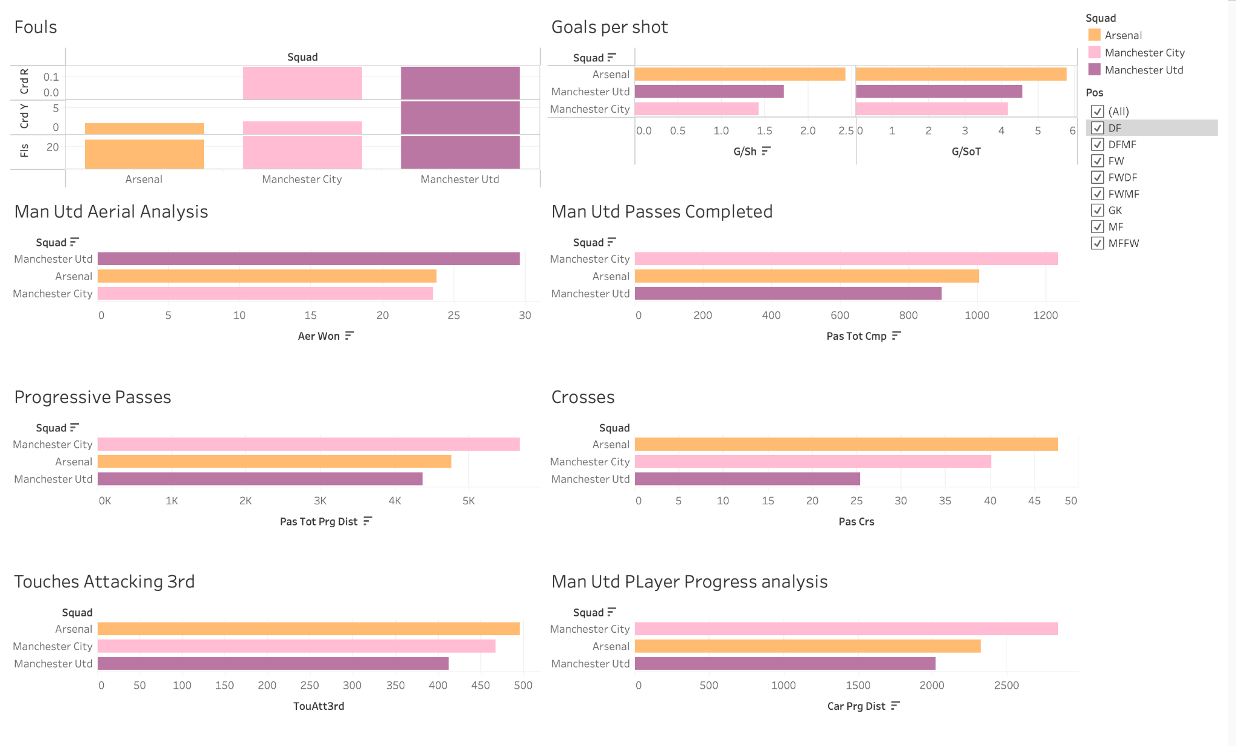
Man Utd Competitor Analysis
Key Indicators to compare important statistics
United significantly lagging behind their main rivals in important statistics.

Slide 10
My Recommendation

Slide 11
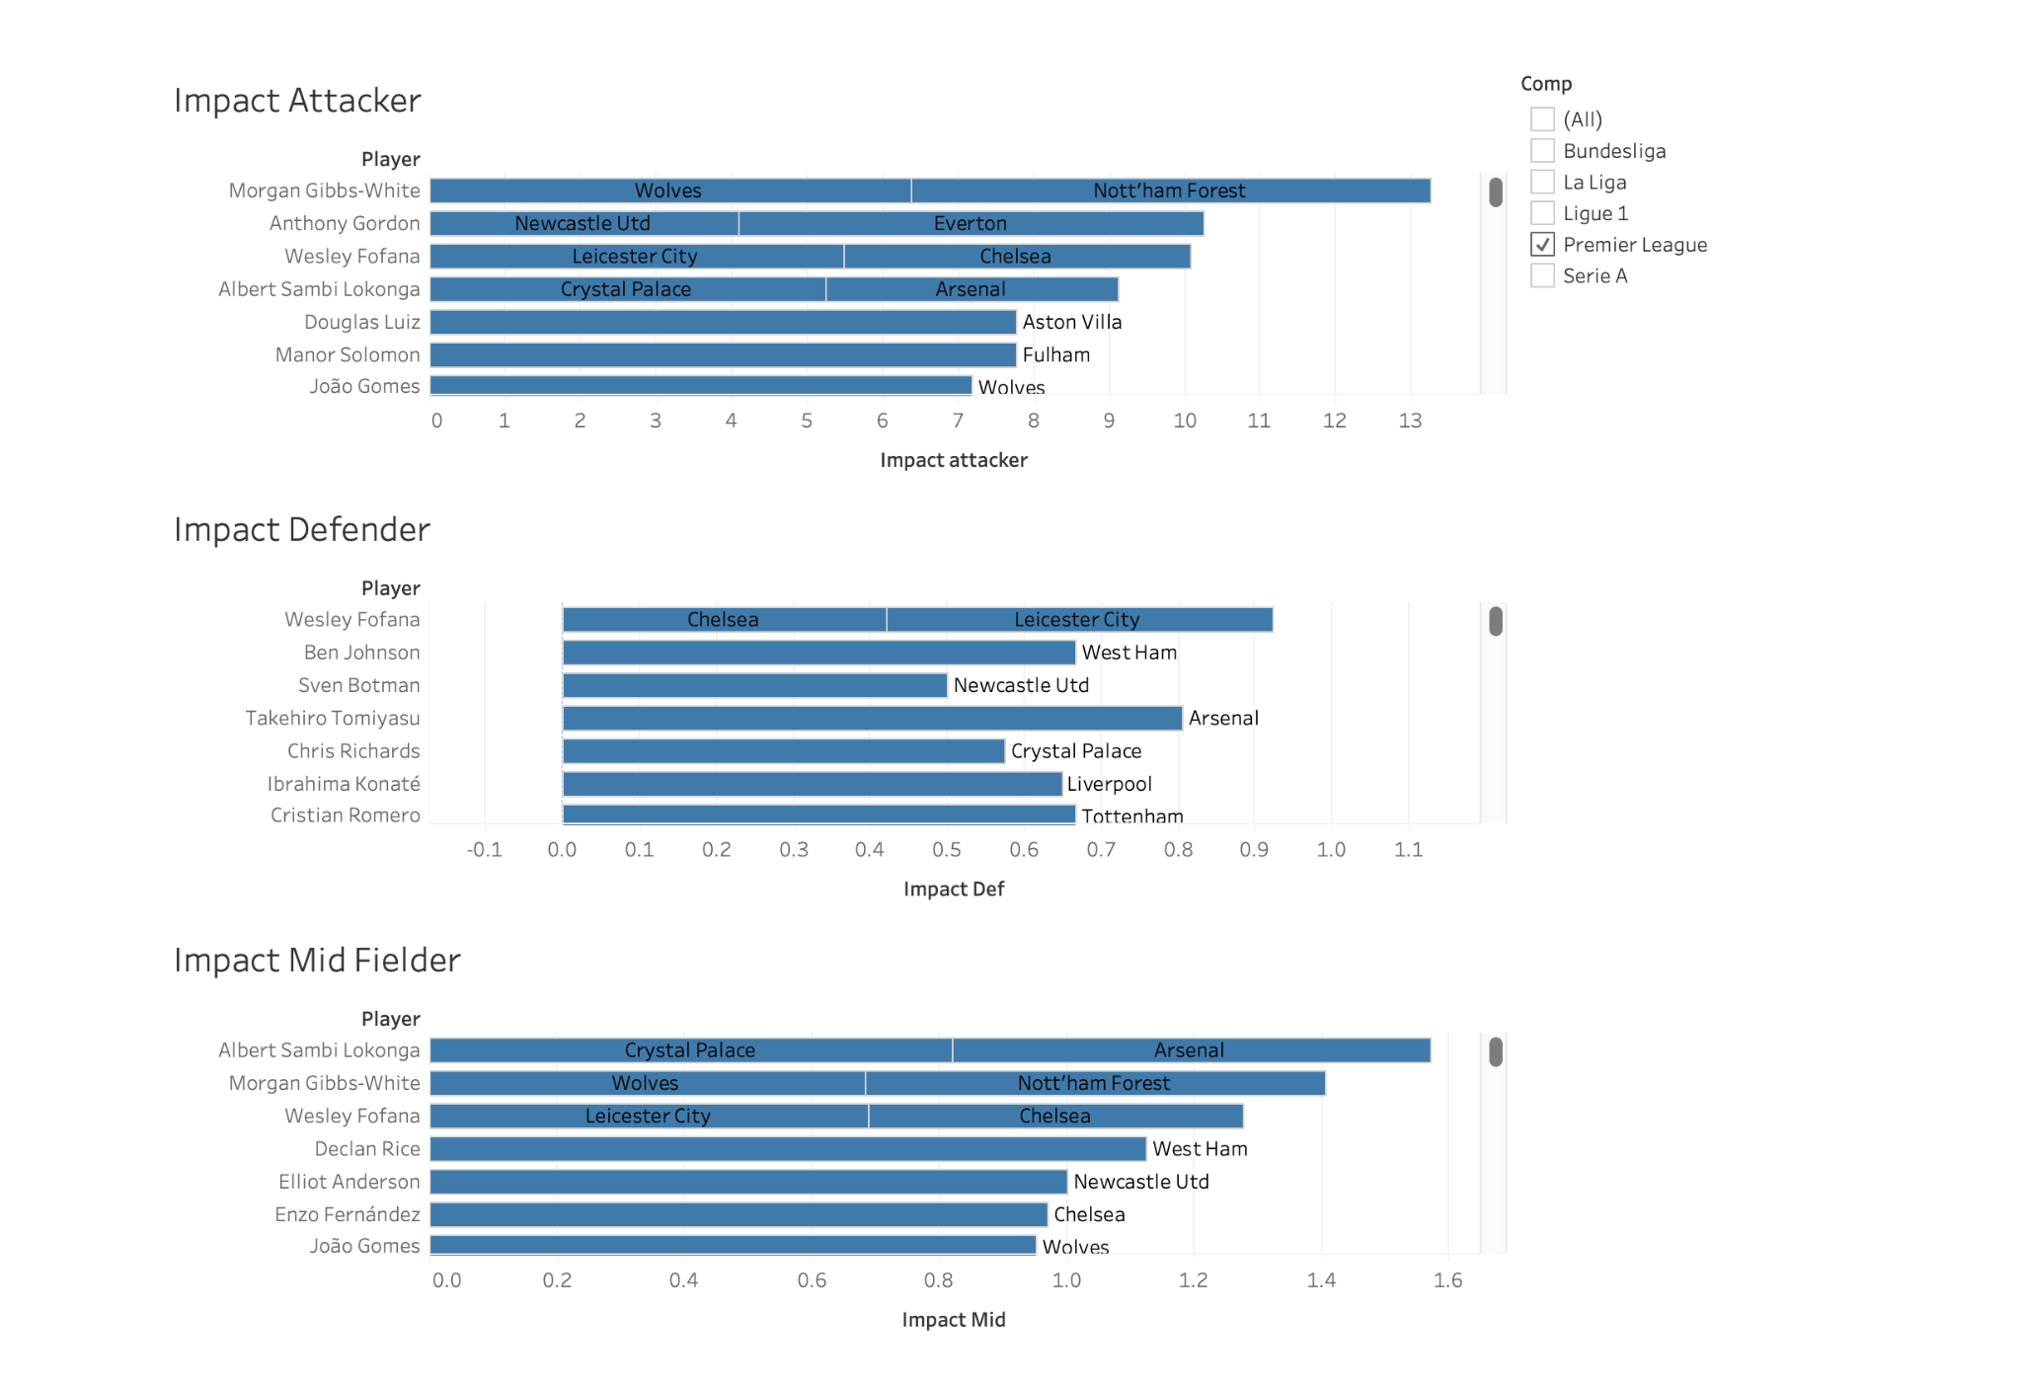
Impact Players
Young players under 23.
Impact is calculated based on relevant statistics.
Market price of these players are cheap.
Show amazing potential.

Slide 12
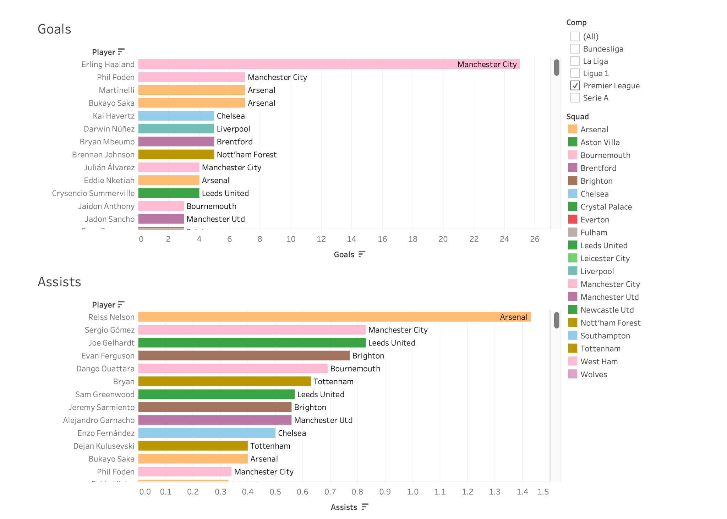
Current Young Attackers
Dashboard of young prolific strikers and Attacking mid fielders under 23.
United can enter the market this season for these targets.
Can be a cost effective option.

Slide 13
Goal Keeper Analysis

Slide 14
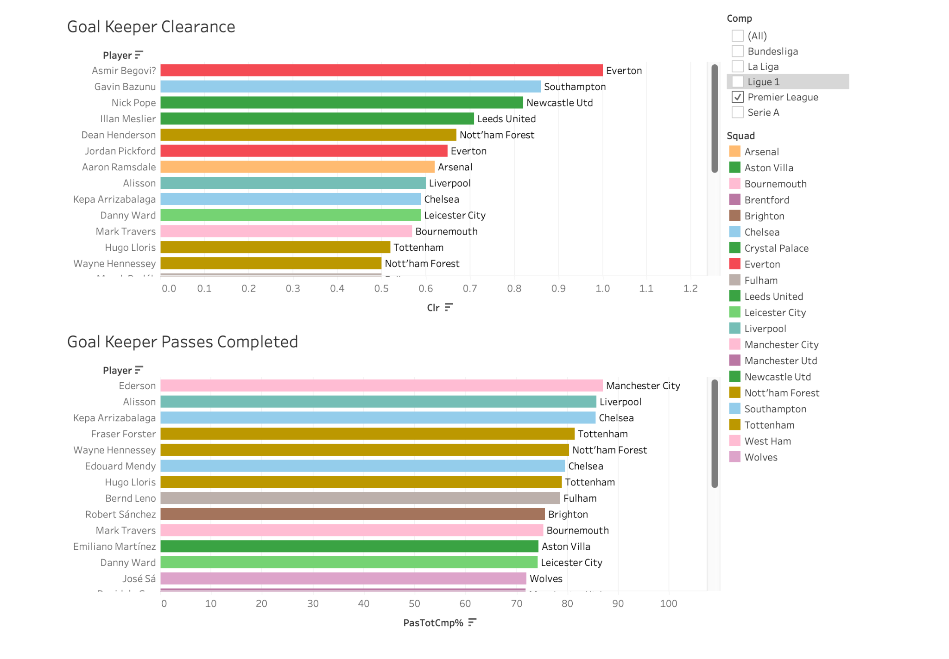
Goal Keeper Analysis
In modern football, you need GKs who can command the box and at the same time pass it properly.
These are the list of GKs which are more valuable than others.
Man Utd need to address this as well.

Slide 15
Conclusion
Most of the times going Moneyball in any sport pays well.
Deeper analysis based on relevant factors on players which can improve Manchester United for title in the upcoming season.
Results suggested by analysis is verified with FM Scout.

Slide 16
Thank You

